Slide 1
4
Boolean Algebra and Logic Simplification

Slide 2
Boolean Addition
In Boolean algebra, a variable is a symbol used to represent an action, a condition, or data. A single variable can only have a value of 1 or 0.
The complement represents the inverse of a variable and is indicated with an overbar. Thus, the complement of A is A.
A literal is a variable or its complement.
Addition is equivalent to the OR operation. The sum term is 1 if one or more if the literals are 1. The sum term is zero only if each literal is 0.
Example
Determine the values of A, B, and C that make the sum term of the expression A + B + C = 0?
Solution
Each literal must = 0; therefore A = 1, B = 0 and C = 1.

Slide 3
Boolean Multiplication
In Boolean algebra, multiplication is equivalent to the AND operation. The product of literals forms a product term. The product term will be 1 only if all of the literals are 1.
Example
What are the values of the A, B and C if the product term of A.B.C = 1?
Solution
Each literal must = 1; therefore A = 1, B = 0 and C = 0.

Slide 4
Commutative Laws
The commutative laws are applied to addition and multiplication. For addition, the commutative law states
In terms of the result, the order in which variables are ORed makes no difference.
A + B = B + A
For multiplication, the commutative law states
In terms of the result, the order in which variables are ANDed makes no difference.
AB = BA

Slide 5
Associative Laws
The associative laws are also applied to addition and multiplication. For addition, the associative law states
When ORing more than two variables, the result is the same regardless of the grouping of the variables.
A + (B +C) = (A + B) + C
For multiplication, the associative law states
When ANDing more than two variables, the result is the same regardless of the grouping of the variables.
A(BC) = (AB)C

Slide 6
Distributive Law
The distributive law is the factoring law. A common variable can be factored from an expression just as in ordinary algebra. That is
AB + AC = A(B+ C)
The distributive law can be illustrated with equivalent circuits:
A(B+ C)
AB + AC

Slide 7
Rules of Boolean Algebra
1. A + 0 = A
7. A . A = A
2. A + 1 = 1
8. A . A = 0
=
3. A . 0 = 0
9. A = A
4. A . 1 = 1
10. A + AB = A
5. A + A = A
11. A + AB = A + B
6. A + A = 1
12. (A + B)(A + C) = A + BC

Slide 8
Rules of Boolean Algebra
Rules of Boolean algebra can be illustrated with Venn diagrams. The variable A is shown as an area.
The rule A + AB = A can be illustrated easily with a diagram. Add an overlapping area to represent the variable B.
The overlap region between A and B represents AB.
=
The diagram visually shows that A + AB = A. Other rules can be illustrated with the diagrams as well.

Slide 9
Rules of Boolean Algebra
Illustrate the rule with a Venn diagram.
Example
A + AB = A + B
Solution
This time, A is represented by the blue area and B again by the red circle.
The intersection represents AB.
Notice that A + AB = A + B
A

Slide 10
Rules of Boolean Algebra
Rule 12, which states that (A + B)(A + C) = A + BC, can be proven by applying earlier rules as follows:
(A + B)(A + C) = AA + AC + AB + BC
= A + AC + AB + BC
= A(1 + C + B) + BC
= A . 1 + BC
= A + BC
This rule is a little more complicated, but it can also be shown with a Venn diagram, as given on the following slide…

Slide 11
Three areas represent the variables A, B, and C.
The area representing A + B is shown in yellow.
The area representing A + C is shown in red.
The overlap of red and yellow is shown in orange.
The overlapping area between B and C represents BC.
ORing with A gives the same area as before.
=
(A + B)(A + C)
A + BC

Slide 12
DeMorgan’s Theorem
DeMorgan’s 1st Theorem
The complement of a product of variables is equal to the sum of the complemented variables.
AB = A + B
Applying DeMorgan’s first theorem to gates:

Slide 13
DeMorgan’s Theorem
DeMorgan’s 2nd Theorem
The complement of a sum of variables is equal to the product of the complemented variables.
A + B = A . B
Applying DeMorgan’s second theorem to gates:

Slide 14
DeMorgan’s Theorem
Example
Apply DeMorgan’s theorem to remove the overbar covering both terms from the
expression X = C + D.
Solution
To apply DeMorgan’s theorem to the expression, you can break the overbar covering both terms and change the sign between the terms. This results in
X = C . D. Deleting the double bar gives X = C . D.
=

Slide 15
Boolean Analysis of Logic Circuits
Combinational logic circuits can be analyzed by writing the expression for each gate and combining the expressions according to the rules for Boolean algebra.
Example
Apply Boolean algebra to derive the expression for X.
Solution
Write the expression for each gate:
(A + B )
C (A + B )
= C (A + B )+ D
X
Applying DeMorgan’s theorem and the distribution law:
X = C (A B) + D = A B C + D

Slide 16
SOP and POS forms
Boolean expressions can be written in the sum-of-products form (SOP) or in the product-of-sums form (POS). These forms can simplify the implementation of combinational logic, particularly with PLDs. In both forms, an overbar cannot extend over more than one variable.
An expression is in SOP form when two or more product terms are summed as in the following examples:
A B C + A B A B C + C D C D + E
An expression is in POS form when two or more sum terms are multiplied as in the following examples:
(A + B)(A + C) (A + B + C)(B + D) (A + B)C

Slide 17
SOP Standard form
In SOP standard form, every variable in the domain must appear in each term. This form is useful for constructing truth tables or for implementing logic in PLDs.
You can expand a nonstandard term to standard form by multiplying the term by a term consisting of the sum of the missing variable and its complement.
Example
Convert X = A B + A B C to standard form.
Solution
The first term does not include the variable C. Therefore, multiply it by the (C + C), which = 1:
X = A B (C + C) + A B C
= A B C + A B C + A B C

Slide 18
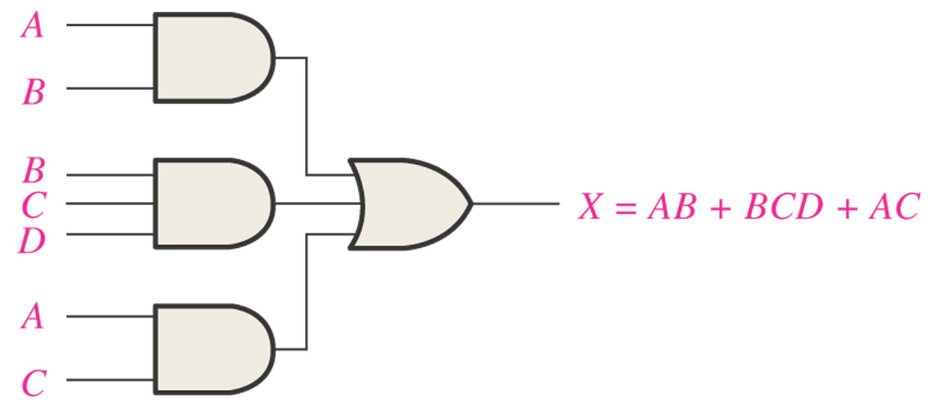
Terms
The sum-of-product (SOP) form

Slide 19
POS Standard form
In POS standard form, every variable in the domain must appear in each sum term of the expression.
You can expand a nonstandard POS expression to standard form by adding the product of the missing variable and its complement and applying rule 12, which states that
(A + B)(A + C) = A + BC.
Example
Convert X = (A + B)(A + B + C) to standard form.
Solution
The first sum term does not include the variable C. Therefore, add C C and expand the result by rule 12.
X = (A + B + C C)(A + B + C)
= (A +B + C )(A + B + C)(A + B + C)

Slide 20
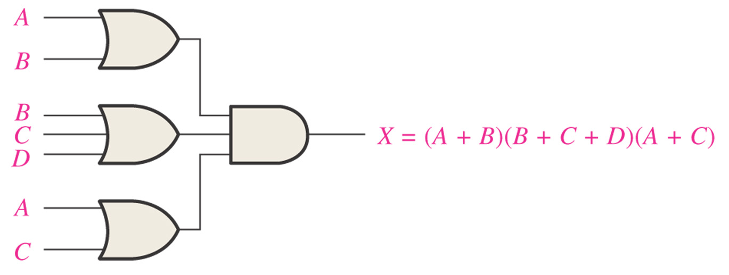
Terms
The product of sum (POS) form*

Slide 21
Terms
Minterm（最小项）
A minterm is a product term that contains all of the input variables (with each literal no more than once)
Example:
A,B,C

Slide 22
Standard Forms of Boolean Expressions
The Standard SOP form
(sum-of-product)
all the variables in the domain appear in each product term
----each product term is a minterm(最小项)
Notes:
Standard SOP expressions are important in constructing truth tables and Karnaugh map simplification.
Any nonstandard SOP expression can be converted to standard form using Boolean algebra.

Slide 23
How to converting product terms to standard SOP？
Example Convert the following Boolean expression into standard SOP form:

Slide 24
The Standard POS form
all the variables in the domain appear in each sum term
Maxterm（最大项）
A maxterm is a sum term that contains all of the input variables (each literal no more than once)

Slide 25
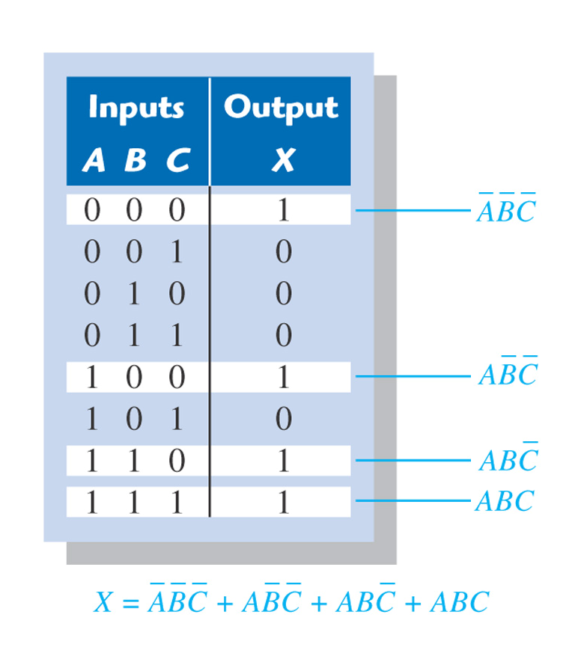
Boolean Expression
Truth Table
1:find out the 1s output,
2: Express the corresponding inputs as minterm
3:sum all the minterms that have an output one

Slide 26
Simplification Using Boolean Algebra （利用布尔代数进行逻辑化简）
Why simplification is necessary?
A simplified Boolean expression uses the fewest gates possible to implement a given expression
fewest possible term
fewest possible variables in a term
体积小,重量轻
性能可靠、稳定
成本低

Slide 27
The fewest possible terms。
Minimum expression
Fewest possible variables in a term
Ex 1：
提出AB
=1
提出A
反变量被吸收

Slide 28
Ex 2：
德·摩根
配项
被吸收
被吸收

Slide 29
The Karnaugh map is an array of cells in which each cell represents a binary value of the input variables. ——Similar to a truth table
Input variables
Truth Table
2-variable K-map
A B Y
0 0 1
0 1 1
1 0 1
1 1 0
B
0
1
A
0
1
1
1
1
0
The output for input variables
Notes:
The number of cells in a K-map is equal to the total number of possible input variable combinations as in the number of rows in a truth table.

Slide 30
Karnaugh maps
The Karnaugh map (K-map) is a tool for simplifying combinational logic with 3 or 4 variables. For 3 variables, 8 cells are required (2³).
The map shown is for three variables labeled A, B, and C. Each cell represents one possible product term.
Each cell differs from an adjacent cell by only one variable.

Slide 31
Karnaugh maps
A 4-variable map has an adjacent cell on each of its four boundaries as shown.
Each cell is different only by one variable from an adjacent cell.
Grouping follows the rules given in the text.
The following slide shows an example of reading a four variable map using binary numbers for the variables…

Slide 32
Karnaugh maps
K-maps can simplify combinational logic by grouping cells and eliminating variables that change.
Example
Group the 1’s on the map and read the minimum logic.
Solution
1. Group the 1’s into two overlapping groups as indicated.
Read each group by eliminating any variable that changes across a boundary.
B changes across this boundary
The vertical group is read AC.
C changes across this boundary
The horizontal group is read AB.
X = AC +AB

Slide 33
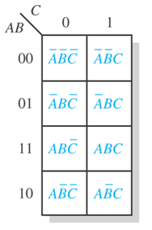
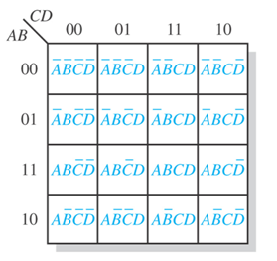
The cells in a K-map are arranged so that there is only a single-variable change between adjacent cells.
Notice the sequence！
3-variable K-map
4-variable K-map
保证逻辑相邻与几何相邻一致!

Slide 34

逻辑相邻和几何相邻一致?
逻辑相邻
逻辑相邻项可以合并
卡诺图中逻辑相邻与几何相邻一致,
因而卡诺图中的几何相邻项可以合并!

Slide 35
3-variable K-map
卡诺图中逻辑相邻与几何相邻一致,
因而卡诺图中的几何相邻项可以合并!
(20-1)

Slide 36
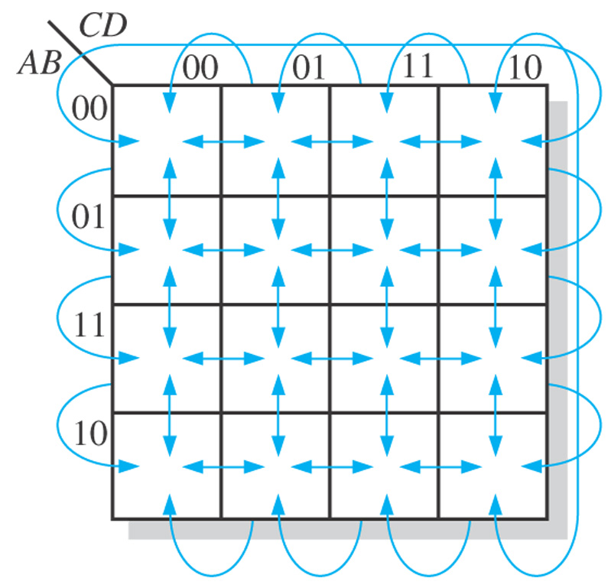
“wrap-around” adjacency
环绕相邻

Slide 37
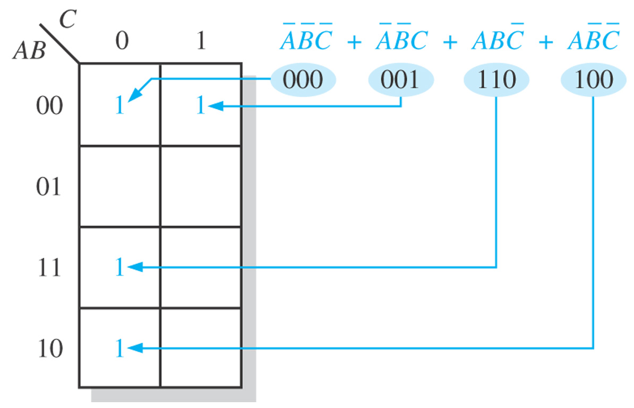
Mapping a Standard SOP Expression
由已知逻辑关系画出相应的卡诺图

Slide 38
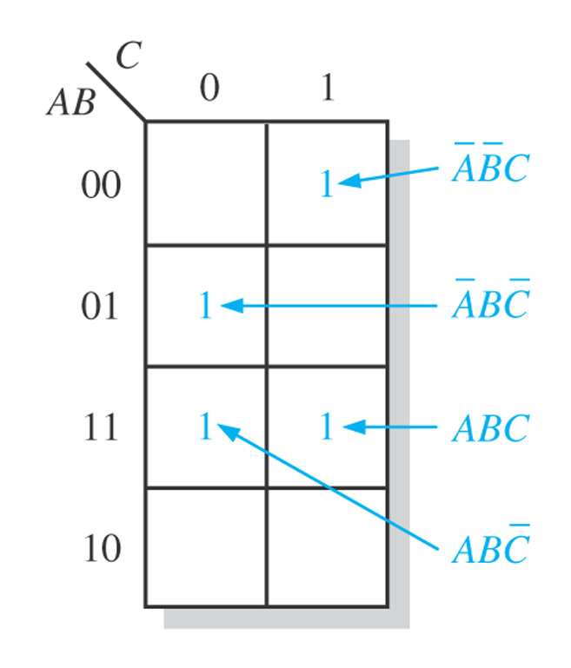
Example 1
Map the following standard SOP expression on a K-map:

Slide 39
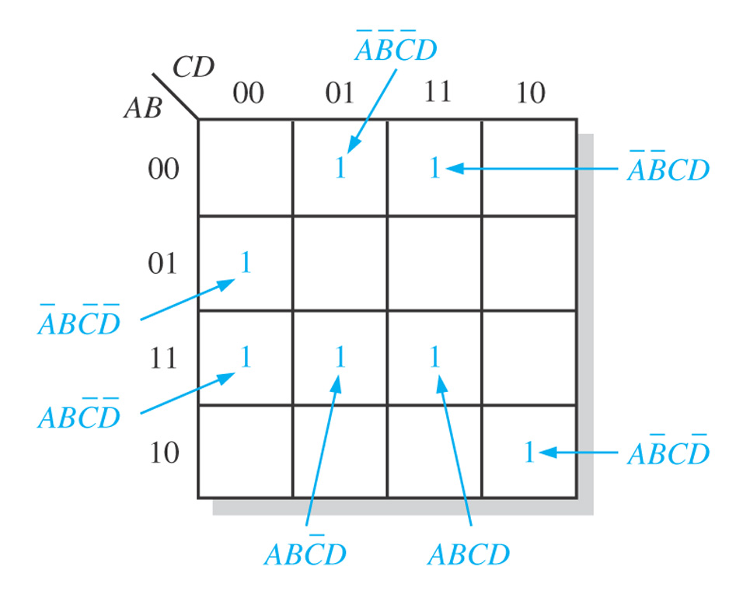
Example 2
Map the following standard SOP expression on a K-map:

Slide 40
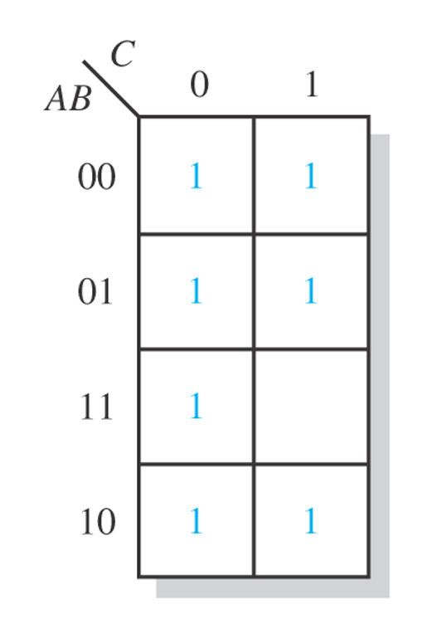
Mapping a Nonstandard SOP Expression
Map the following SOP expression on a K-map:
000
001
010
011
100
101
110

Slide 41
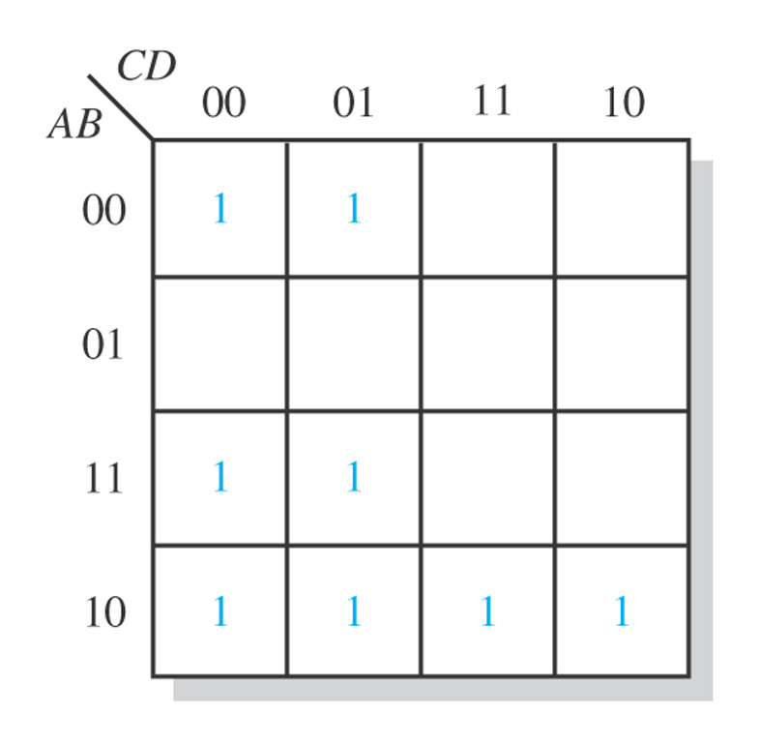
Exercise：
Map the following SOP expression on a K-map:

Slide 42
利用卡诺图化简 K-Map Simplification
Principle： Adjacent cells could be grouped, so that some variables will be cancelled
卡诺图的几何相邻与逻辑相邻一致，可以直观的找出具有相邻性的最小项并将其合并。
Step of minimization:
Group the cells that have 1s.
Determine the minimum product term for each group.
Sum all the minimum product term to form the minimum SOP expression.

Slide 43
The GOAL of Grouping the 1s
Grouping the 1s
Maximize the size of the groups （圈要大）
Minimize the number of groups （圈要少）

Slide 44
Grouping the 1s
A group must contain either 1, 2,4,8 or 16 cells, which are all powers of two.
Each cell in a group must be adjacent to one or more cells in that same group, but all cells in the group do not have to be adjacent to each other.
Always include the largest possible number of 1s in a group in accordance with rule 1.
Each 1 on the map must be included in at least one group. The 1s already in a group can be included in another group as long as the overlapping groups include noncommon 1s.

Slide 45
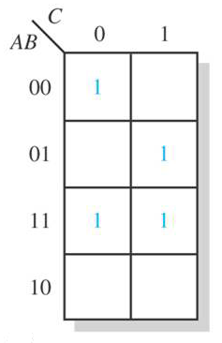
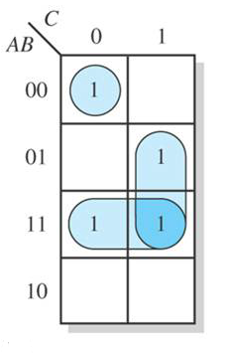
Examples of Grouping the 1s

Slide 46
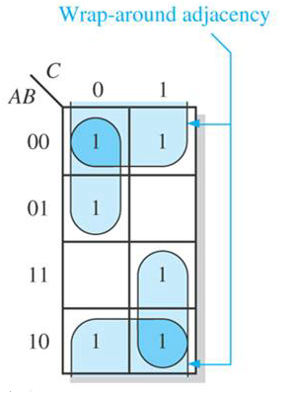
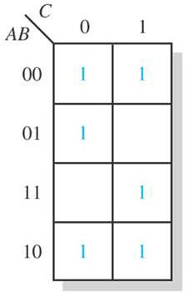
Examples of Grouping the 1s

Slide 47
Examples of Grouping the 1s
CD
CD
00
01
11
10
00
01
11
10
AB
AB
00
00
01
01
11
11
10
10

Slide 48
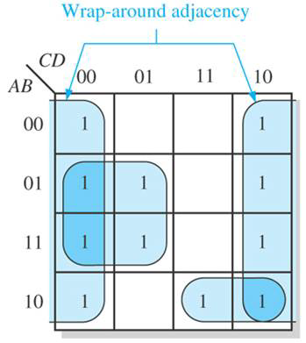
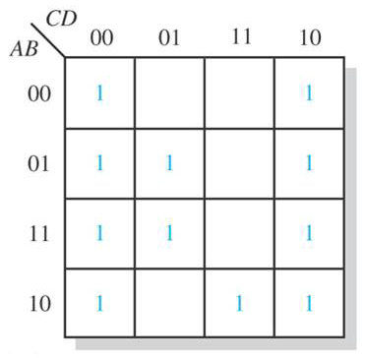
Examples of Grouping the 1s

Slide 49
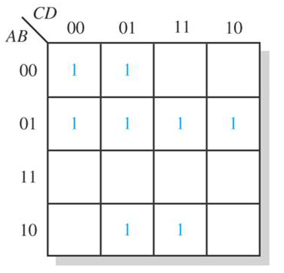
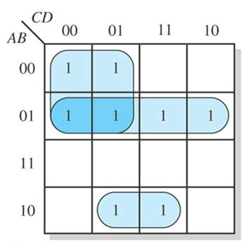
Examples of Grouping the 1s

Slide 50
Determining the Minimum SOP expression from KMap
BC
00
01
11
10
A
0
1
Variables that occur both uncomplemented and complemented within the group are eliminated.

Slide 51
Example:
BC
BC
00
01
11
10
A
0
AB
1
F=AB+BC

Slide 52
Example ：
AB
AB
C
00
01
11
10
0
1
0
1
1
1
0
0
1
0

Slide 53
Example ：
Number of 3-variable
A B C 编号
0 0 0 0
0 0 1 1
0 1 0 2
0 1 1 3
1 0 0 4
1 0 1 5
1 1 0 6
1 1 1 7
BC
00
01
11
10
A
0
m₀
m₁
m₃
m₂
1
m₄
m₅
m₇
m₆
F( A , B , C )=Σ( m1,m2,m4,m7 )
Cell 1,2,4,7 are 1s and others are 0.

Slide 54
Number of 4-variable Karnaugh map:
CD
00
01
11
10
AB
m₀
m₁
m₃
m₂
00
01
m₄
m₅
m₇
m₆
11
m₁₂
m₁₃
m₁₅
m₁₄
10
m₈
m₉
m₁₁
m₁₀

Slide 55
Example
F(A,B,C,D)=Σ(0,2,3,5,6,8,9,10,11, 12,13,14,15)
CD
00
01
11
10
AB
00
01
11
A
10

Slide 56
Other Tips
Tip 1：Check redundancy at the end of grouping
CD
00
01
11
10
AB
1
00
01
1
1
1
1
11
1
1
10
1

Slide 57
Tip 2：the simplification result is not exclusive
BC
A
00 01 11 10
0
1
1 1
1
1 1
1
BC
A
00 01 11 10
0
1
1 1
1
1 1
1

Slide 58
Tip 3：sometimes we can group the 0s to obtain
CD
00
01
11
10
AB
00
01
ABD
11
10

Slide 59
Tip 4：the results can be simplified by using “don’t care”
101 is not given, this is the “Don’t Care” condition (无关项)

Slide 60
The “don’t care ”item can be used as either 1 or 0，the aim is to obtain the simplest result
BC
Y=A
00
01
11
10
A
0
0
0
0
0
1
1
A
1
X
1
Used a 1

Slide 61
Ex:
无关项， 可0可1
CD
AB
00
01
11
10
00
1
0
0
1
01
0
1
×
×
化简得
11
×
×
1
0
10
×
1
0
×

Slide 62
End of Chapter 4
How many means could be used to represent the logic function?
Truth table
Logic expression(Boolean expression)
Logic circuit(symbol)
Karnaugh map
Pulsed waveform

Slide 63
Selected Key Terms
Variable
Complement
Sum term
Product term
A symbol used to represent a logical quantity that can have a value of 1 or 0, usually designated by an italic letter.
The inverse or opposite of a number. In Boolean algebra, the inverse function, expressed with a bar over the variable.
The Boolean sum of two or more literals equivalent to an OR operation.
The Boolean product of two or more literals equivalent to an AND operation.

Slide 64
Selected Key Terms
Sum-of-products (SOP)
Product of sums (POS)
Karnaugh map
A form of Boolean expression that is basically the ORing of ANDed terms.
A form of Boolean expression that is basically the ANDing of ORed terms.
An arrangement of cells representing combinations of literals in a Boolean expression and used for systematic simplification of the expression.

