Slide 1
5
Combinational
Logic Analysis

Slide 2
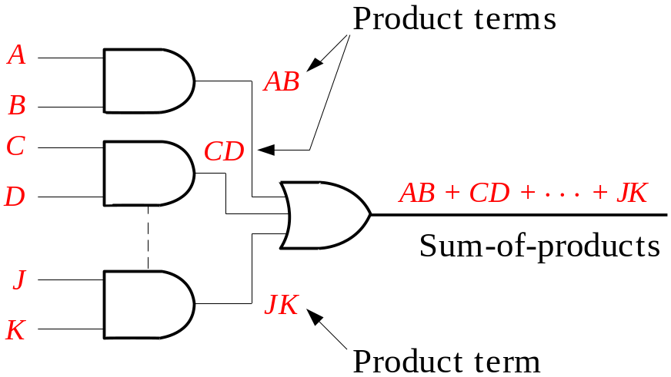
Combinational Logic Circuits
In Sum-of-Products (SOP) form, basic combinational circuits can be directly implemented with AND-OR combinations if the necessary complement terms are available.

Slide 3
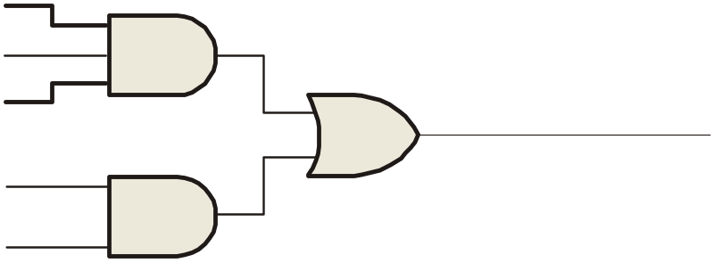
Combinational Logic Circuits
An example of an SOP implementation is shown. The SOP expression is an AND-OR combination of the input variables and the appropriate complements.
A
B
ABC
C
X = ABC
+ DE
SOP
D
E
DE

Slide 4
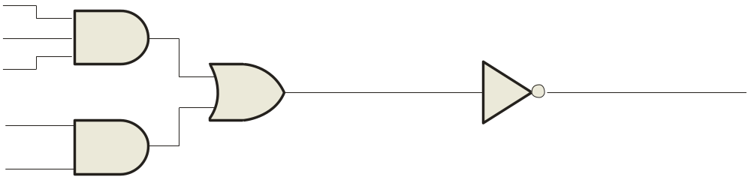
Combinational Logic Circuits
When the output of a SOP form is inverted, the circuit is called an AND-OR-Invert circuit. The AOI configuration lends itself to product-of-sums (POS) implementation.
An example of an AOI implementation is shown. The output expression can be changed to a POS expression by applying DeMorgan’s theorem twice.
A
B
ABC
C
X = ABC
+ DE
X = ABC
+ DE
AOI
D
X = (ABC)(DE)
DeMorgan
E
DE
X = (A + B + C)(D + E)
POS

Slide 5
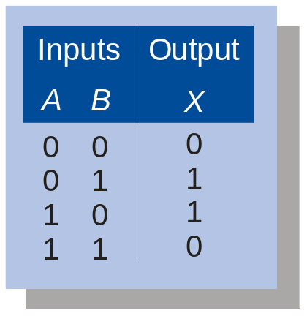
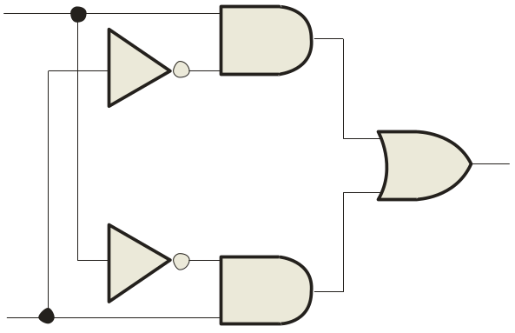
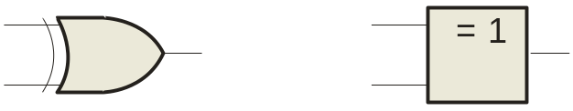
Exclusive-OR Logic
The truth table for an exclusive-OR gate is
Notice that the output is HIGH whenever A and B disagree.
The Boolean expression is
X = AB + AB
The circuit can be drawn as
A
Symbols:
X
Distinctive shape Rectangular outline
B

Slide 6
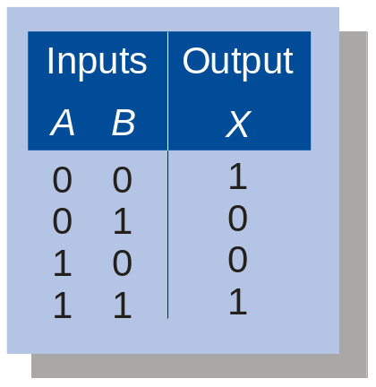
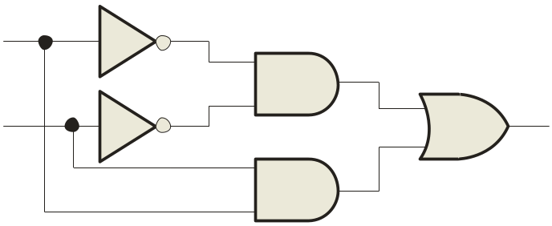
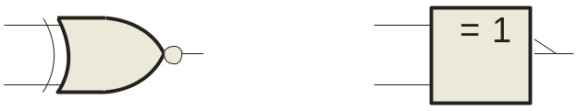
Exclusive-NOR Logic
The truth table for an exclusive-NOR gate is
Notice that the output is HIGH whenever A and B agree.
The Boolean expression is
X = AB + AB
The circuit can be drawn as
A
Symbols:
X
B
Distinctive shape Rectangular outline

Slide 7
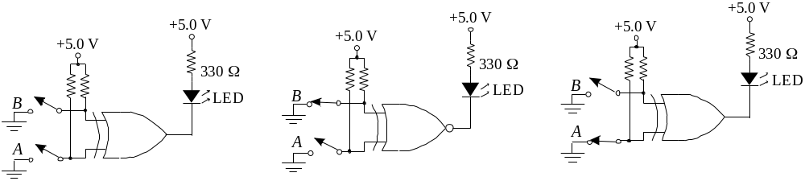

Example
For each circuit, determine if the LED should be on or off.
(a) (b) (c)
Solution
Circuit (a): XOR, inputs agree, output is LOW, LED is ON.
Circuit (b): XNOR, inputs disagree, output is LOW, LED is ON.
Circuit (c): XOR, inputs disagree, output is HIGH, LED is OFF.

Slide 8
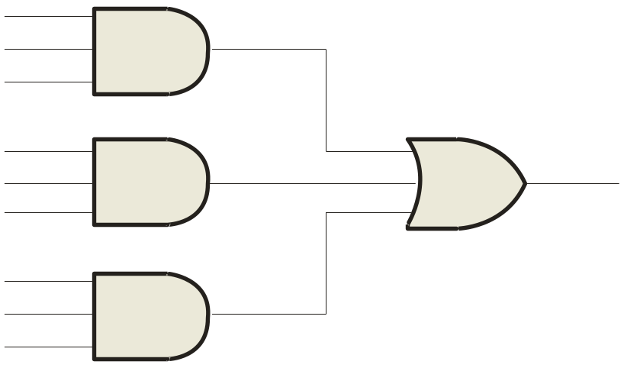
Implementing Combinational Logic
Implementing a SOP expression is done by first forming the AND terms; then the terms are ORed together.
Example
Show the circuit that will implement the Boolean expression X = ABC + ABD + BDE. (Assume that the variables and their complements are available.)
Solution
Start by forming the terms using three 3-input AND gates.
Then combine the three terms using a 3-input OR gate.
A
B
C
A
X = ABC + ABD + BDE
B
D
B
D
E

Slide 9
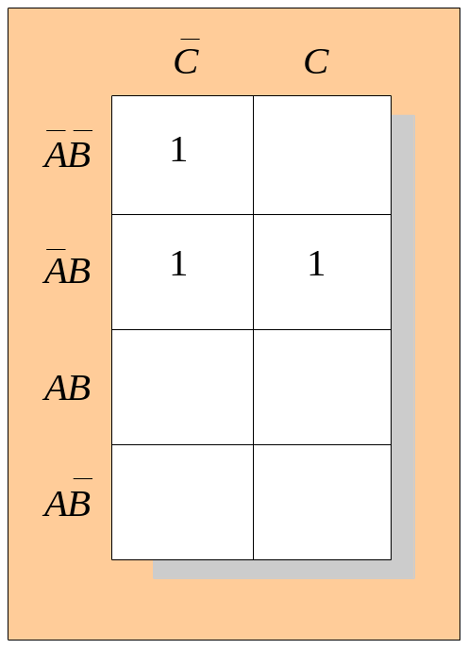
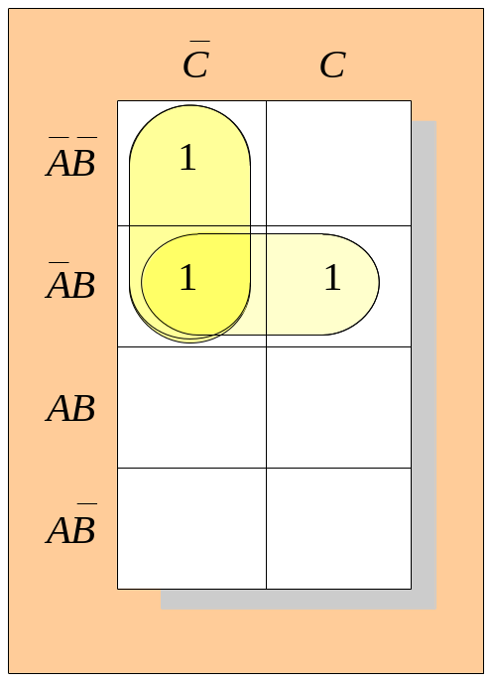
Karnaugh Map Implementation
For basic combinational logic circuits, the Karnaugh map can be read and the circuit drawn as a minimum SOP.
Example
A Karnaugh map is drawn from a truth table. Read the minimum SOP expression and draw the circuit.
Solution
1. Group the 1’s into two overlapping groups as indicated.
Read each group by eliminating any variable that changes across a boundary.
B changes across this boundary
The vertical group is read A C.
C changes across this boundary
The horizontal group is read AB.
The circuit is on the next slide:

Slide 10
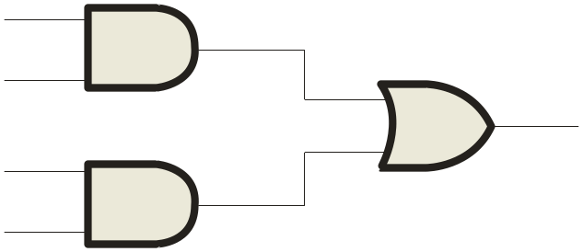
Solution
continued…
Circuit:
A
C
X =
A
C
+
A
B
A
B
The result is shown as a sum of products.
It is a simple matter to implement this form using only NAND gates as shown in the text and following example.

Slide 11
NAND Logic
Example
Convert the circuit in the previous example to one that uses only NAND gates.
Solution
Recall from Boolean algebra that double inversion cancels. By adding inverting bubbles to above circuit, it is easily converted to NAND gates:
A
C
X =
C
+
A
B
A
A
B

Slide 12
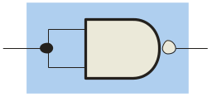
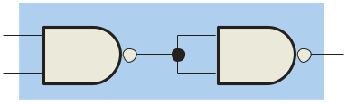
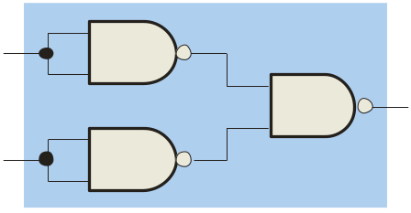
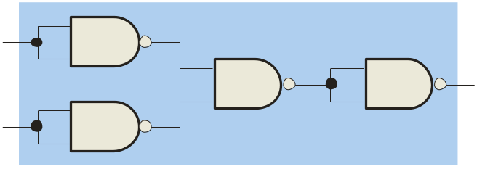
Universal Gates
NAND gates are sometimes called universal gates because they can be used to produce the other basic Boolean functions.
A
A
A
AB
B
Inverter
AND gate
A
A
A + B
A + B
B
B
OR gate
NOR gate

Slide 13
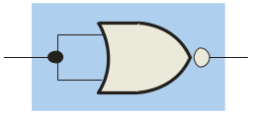
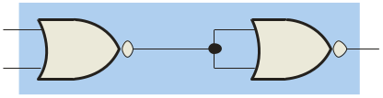
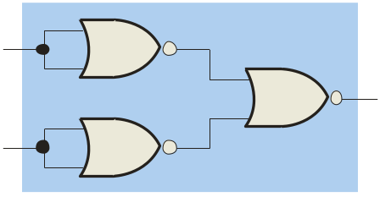
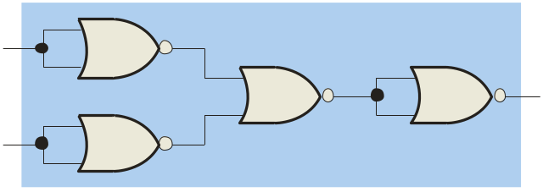
Universal Gates
NOR gates are also universal gates and can form all of the basic gates.
A
A
A
A + B
B
Inverter
OR gate
A
A
AB
AB
B
B
AND gate
NAND gate

Slide 14
NAND Logic
Recall from DeMorgan’s theorem that AB = A + B. By using equivalent symbols, it is simpler to read the logic of SOP forms. The earlier example shows the idea:
A
C
X =
A
C
+
A
B
A
B
The logic is easy to read if you (mentally) cancel the two connected bubbles on a line.

Slide 15
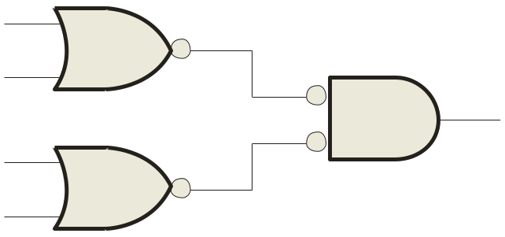
NOR Logic
Alternatively, DeMorgan’s theorem can be written as A + B = A B. By using equivalent symbols, it is simpler to read the logic of POS forms. For example,
A
B
X =
(A + B)(A + C)
A
C
Again, the logic is easy to read if you cancel the two connected bubbles on a line.

Slide 16

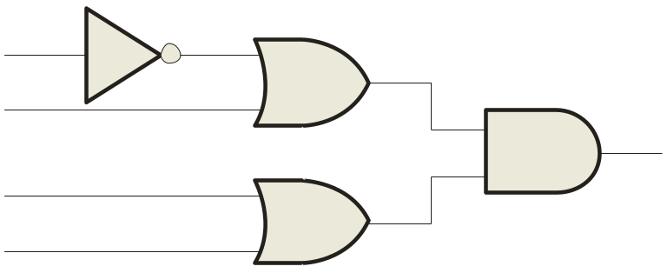
Pulsed Waveforms
For combinational circuits with pulsed inputs, the output can be predicted by developing intermediate outputs and combining the result. For example, the circuit shown can be analyzed at the outputs of the OR gates:
A
A
G₁
B
B
G₃
C
C
D
G₂
D
G₁
G₂
G₃

Slide 17
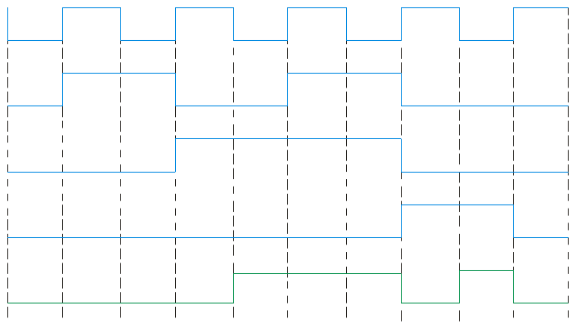
Pulsed Waveforms
Alternatively, you can develop the truth table for the circuit and enter 0’s and 1’s on the waveforms. Then read the output from the table.
Inputs
Output
A B C D
X
0 0 0 0
0
0 0 0 1
1
0 0 1 0
1
A
G₁
0 0 1 1
1
B
0 1 0 0
0
G₃
0 1 0 1
1
C
0 1 1 0
1
G₂
0 1 1 1
1
D
1 0 0 0
0
A
0 1 0 1 0 1 0 1 0 1
1 0 0 1
0
1 0 1 0
0
B
0 1 1 0 0 1 1 0 0 0
1 0 1 1
0
0 0 0 1 1 1 1 0 0 0
1 1 0 0
0
C
1 1 0 1
1
D
0 0 0 0 0 0 0 1 1 0
1 1 1 0
1
1 1 1 1
1
G₃
0 0 0 0 1 1 1 0 1 0

Slide 18
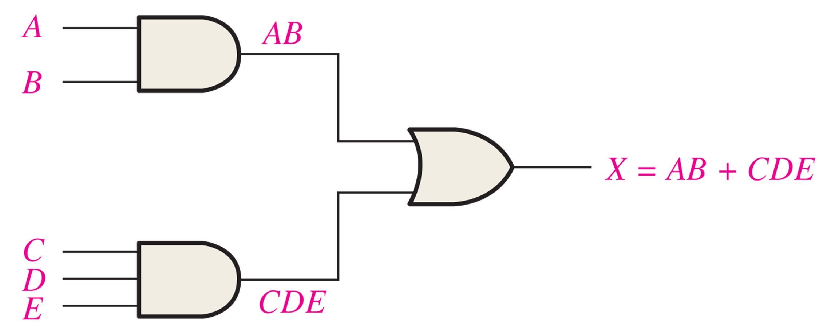
Example
Logic circuit for X = AB + CDE.
Solution

Slide 19
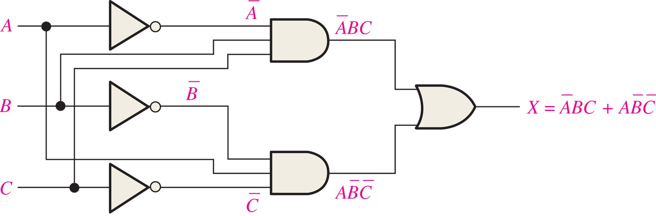
Example
Logic circuit for X = ĀBC + ABC.
Solution

Slide 20
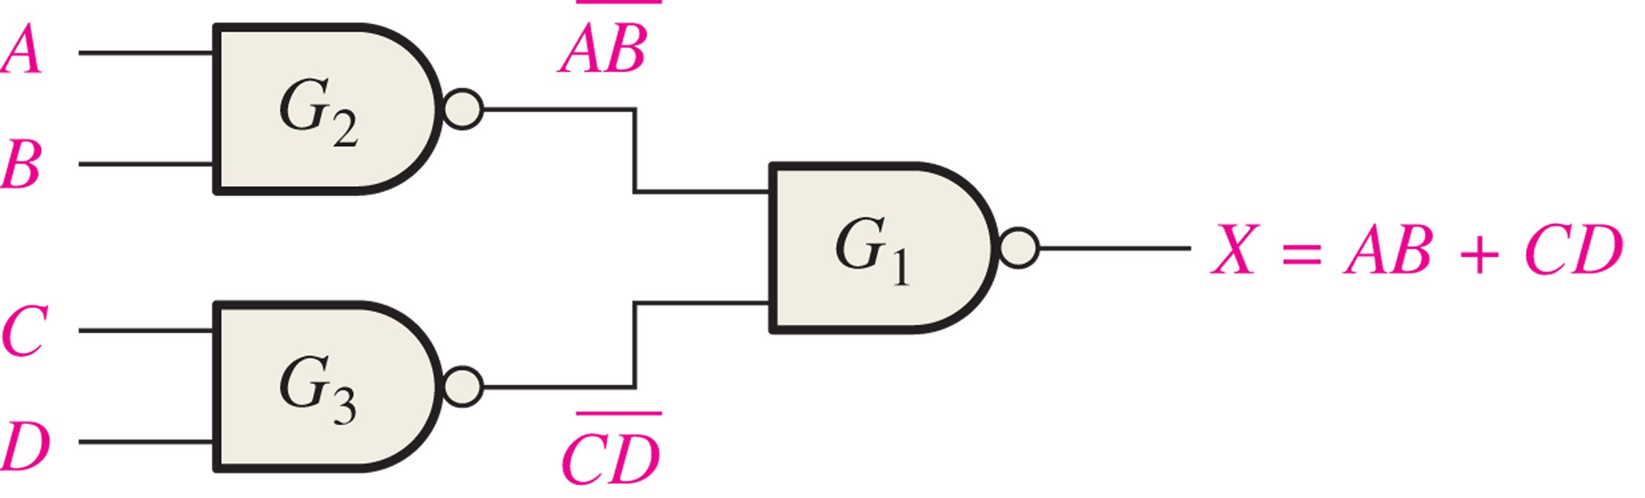
Example
NAND logic for X = AB + CD.
Solution

Slide 21
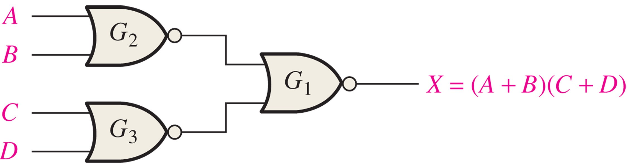
Example
NOR logic for X = (A + B)(C + D).
Solution

Slide 22
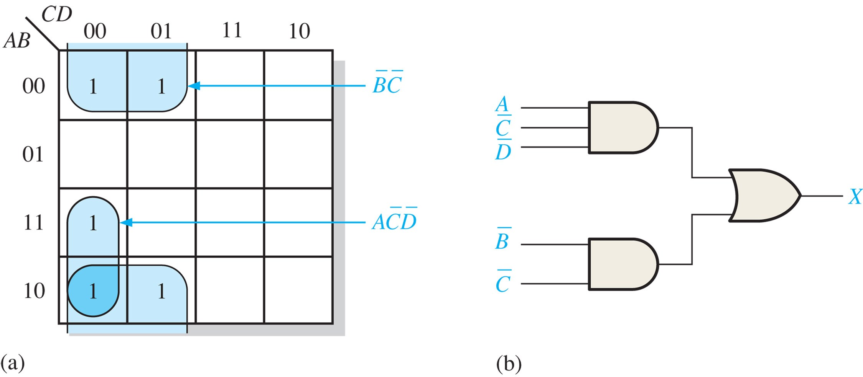
Example
Draw the logic’s Karnaugh map.
Solution

Slide 23
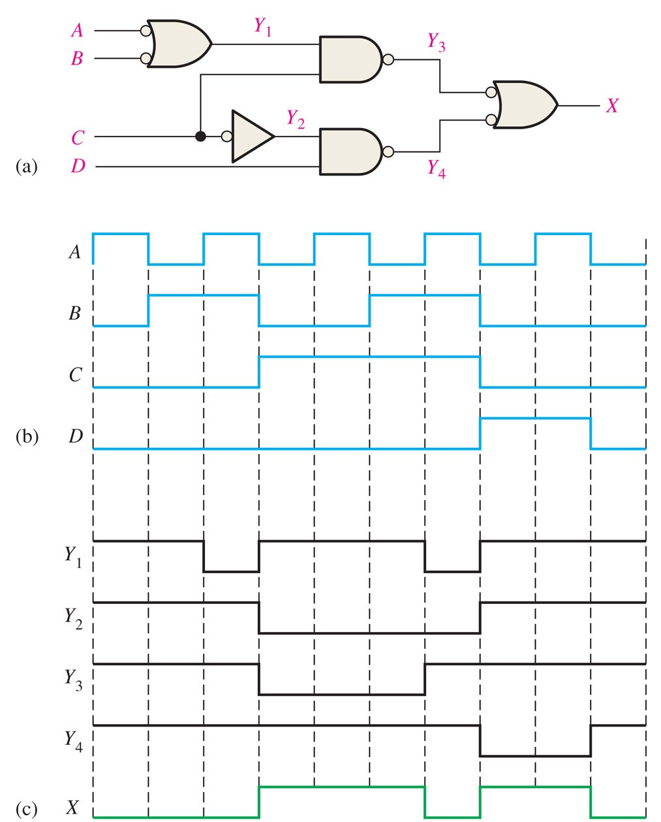
Example
Draw the logic’s wavefrom graph.
Solution

Slide 24
Selected Key Terms
Universal gate
Negative-OR
Negative-AND
Either a NAND or a NOR gate. The term universal refers to a property of a gate that permits any logic function to be implemented by that gate or by a combination of gates of that kind.
The dual operation of a NAND gate when the inputs are active-LOW.
The dual operation of a NOR gate when the inputs are active-LOW.

