Slide 1
Chapter 1:
Semiconductor Diodes

Slide 2

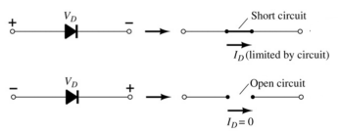
Diodes
二极管
A diode is a 2-terminal device.
A diode ideally conducts current in only one direction.

Slide 3
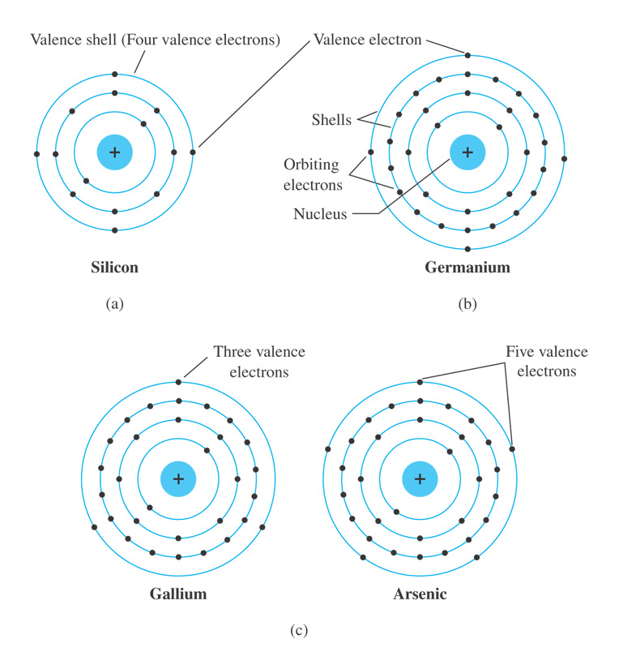
1.2 Semiconductor Materials
Common materials used in the development of semiconductor devices:
硅
Silicon (Si)
Germanium (Ge)
GaAs
锗
砷化镓
Fig. 1.3 Atomic structure of (a) silicon; (b) germanium; and (c) gallium and arsenic.

Slide 4
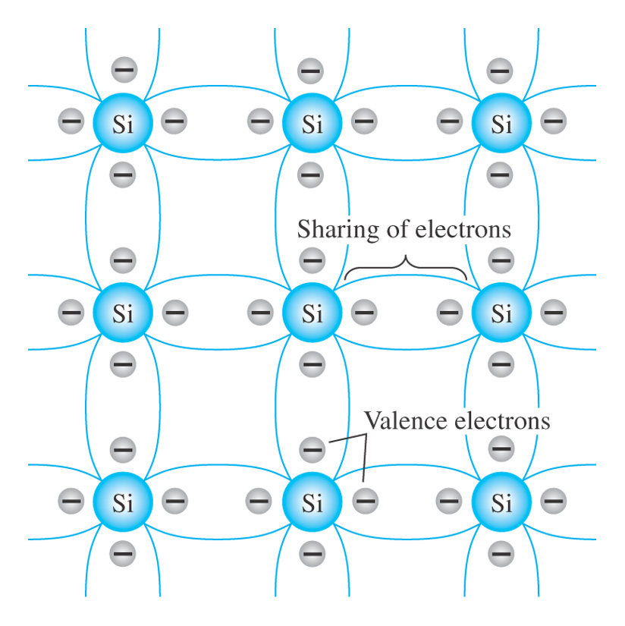
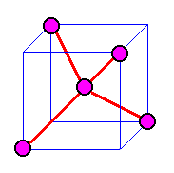
Fig. 1.4 Covalent bonding of the silicon atom.
1.3 Covalent Bonding and Intrinsic Materials
共价键
The single-crystal formed by pure semiconductor materials is called intrinsic semiconductor.

Slide 5




Intrinsic Semiconductors
空穴
Holes: Vacancies in the covalent bond
Electron-hole pairs: a free electron and a hole is generated from the covalent bond by thermal energy
Movement of Holes: by movement of covalent electrons from adjacent covalent bonds
Two types of charged particles (Intrinsic carriers) in a semiconductor
  free electrons
  holes
Electrical conductivity of intrinsic semiconductors is determined by the concentration of free electrons and holes

Slide 6
1.4 Extrinsic Materials: n-Type and p-Type Materials
The electrical characteristics of intrinsic semiconductors are improved by adding impurity materials in a process called doping.
The materials containing impurity atoms are called extrinsic semiconductors, or doped semiconductors.
掺杂
There are just two types of doped semiconductor materials:
n-type: impurities are from group V elements, e.x. Phosphorus
p-type: impurities are from group III elements, e.x. Boron

Slide 7
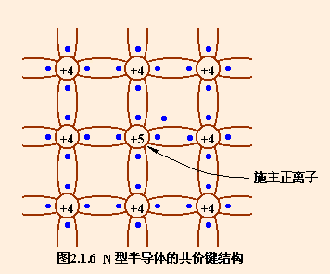
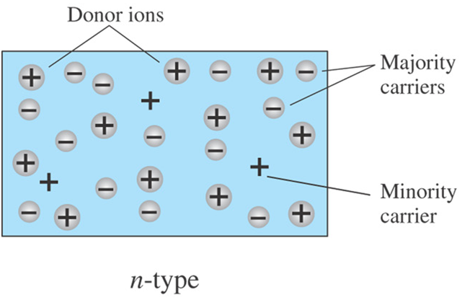
N-type Semiconductors and Carriers
A semiconductor that contains donor impurity atoms is called a N-type semiconductor.
Impurities in n-type materials act as Donor
The majority carriers in n-type materials are electrons.
The minority carriers in n-type materials are holes.
Phosphorus impurity in n-type material.

Slide 8
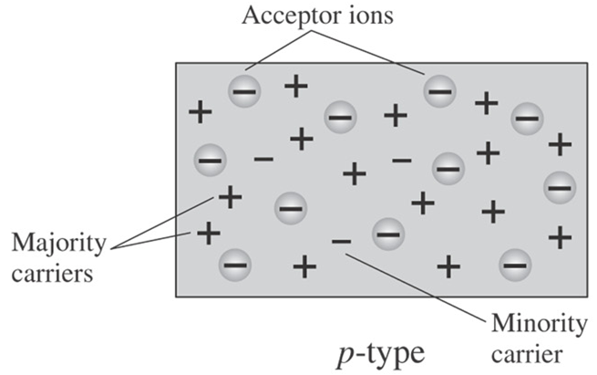
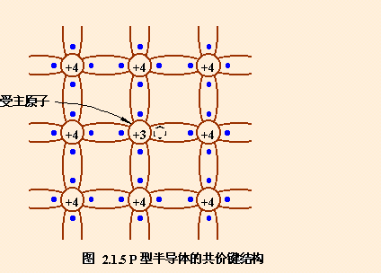
P-type Semiconductors and Carriers
A semiconductor that contains acceptor impurity atoms is called a P-type semiconductor.
Impurities in p-type materials act as Acceptor
The majority carriers in p-type materials are holes.
The minority carriers in p-type materials are electrons.
Boron impurity in p-type material.

Slide 9



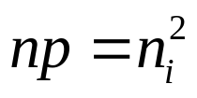
intrinsic semiconductor
doping
n-type
extrinsic semiconductor
p-type
mass-action law: or
n-type semiconductor p-type semiconductor
majority carriers: electrons holes
minority carriers: holes electrons

Slide 10
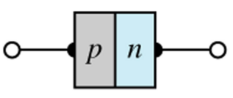
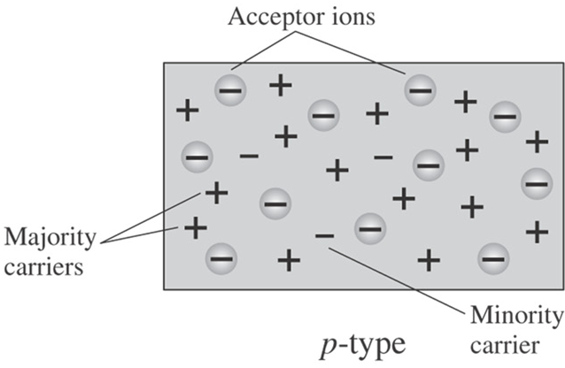
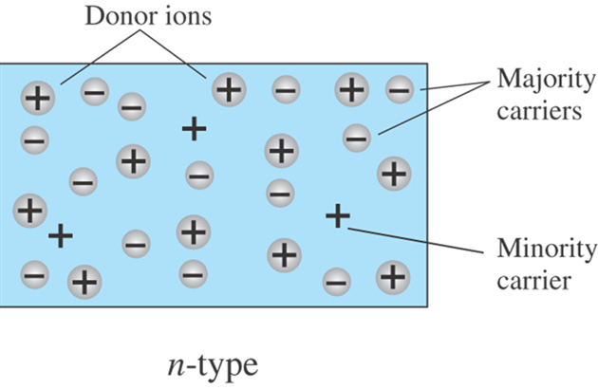
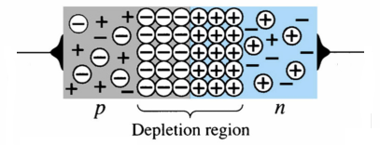
1.5 Semiconductor Diode
One end of a silicon or germanium crystal can be doped as a p-type material and the other end as an n-type material.
The result is a p-n junction.
P
N
Anode
(A)
Cathode
(K)
The result is the formation of a depletion region around the junction.
耗尽层

Slide 11
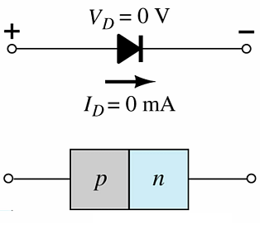
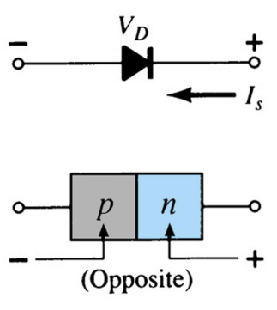
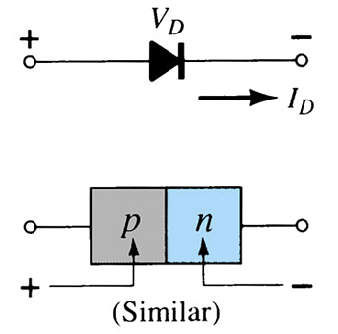
Diode Operating Conditions
A diode (or p-n junction) has three operating conditions:
反偏
正偏
No bias
Reverse bias
Forward bias

Slide 12
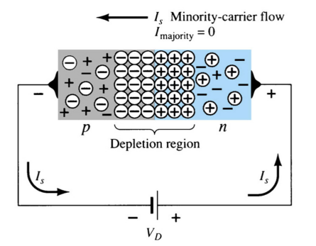
Diode Operating Conditions: Reverse Bias
Reverse Bias
External voltage is applied across the p-n junction in the opposite polarity of the p- and n-type materials.
The reverse voltage causes the depletion layer to widen.
The electrons in the n-type material are attracted toward the positive terminal.
The holes in the p-type material are attracted toward the negative terminal.

Slide 13
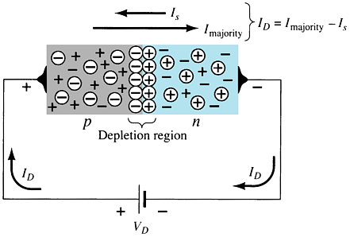
Diode Operating Conditions: Forward Bias
Forward Bias
External voltage is applied across the p-n junction in the same polarity as the p- and n-type materials.
The forward voltage causes the depletion layer to narrow.
The electrons and holes are pushed toward the p-n junction.
The electrons and holes have sufficient energy to cross the p-n junction.
The forward bias voltage required:
silicon diode ≅ 0.7V
germanium diode ≅ 0.3V

Slide 14
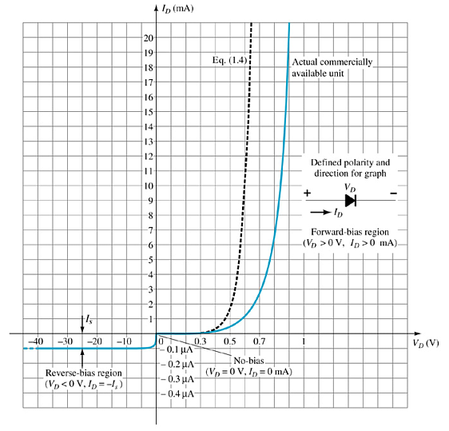
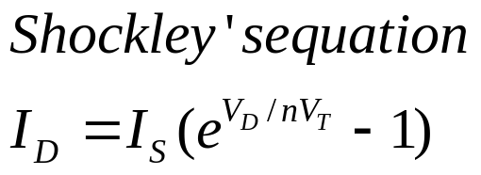
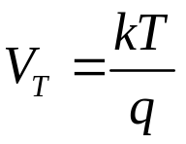
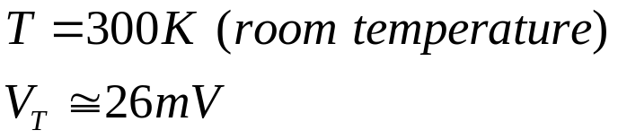
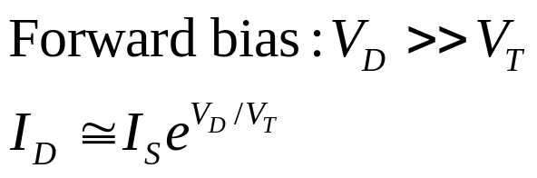
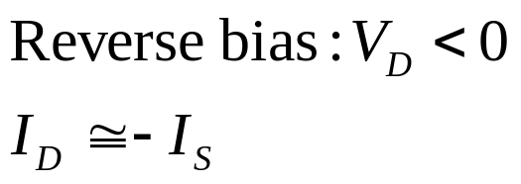
I-V Characteristics of Semiconductor Diodes

Slide 15
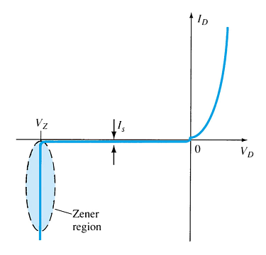
Zener Region
击穿区
The Zener region is in the diode’s reverse-bias region.
At some point the reverse bias voltage is so large the diode breaks down and the reverse current increases dramatically.
Two mechanisms of electrical breakdown
Avalanche breakdown
Zener breakdown
The maximum reverse-bias voltage that can be applied before entering the Zener region is called the Peak Inverse Voltage (PIV) or Peak Reverse Voltage (PRV)

Slide 16
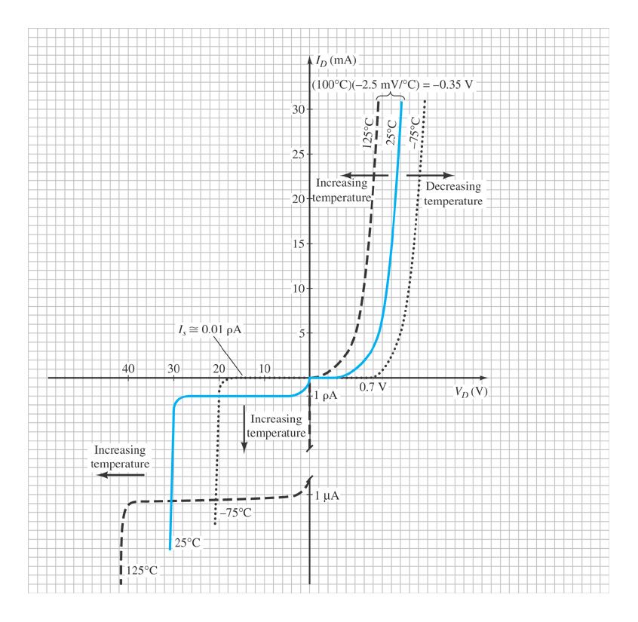
Temperature Effects
As temperature increases it adds energy to the diode.
It reduces the required forward bias voltage for forward-bias conduction.
It increases the amount of reverse current in the reverse-bias condition.
It increases maximum reverse bias avalanche voltage.
Germanium diodes are more sensitive to temperature variations than silicon diodes.

Slide 17
1.7 Resistance Levels
Semiconductor diodes (/pn junction) act differently to DC and AC currents.
There are three types of resistances:
• DC, or static, resistance
• AC, or dynamic, resistance
• Average AC resistance

Slide 18
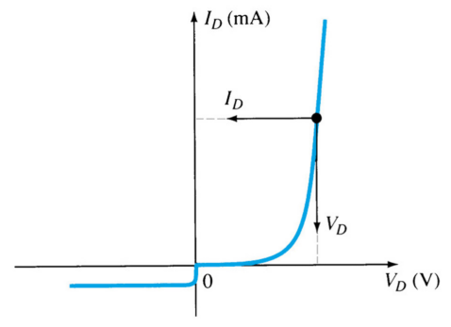
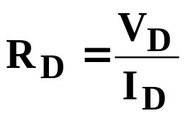
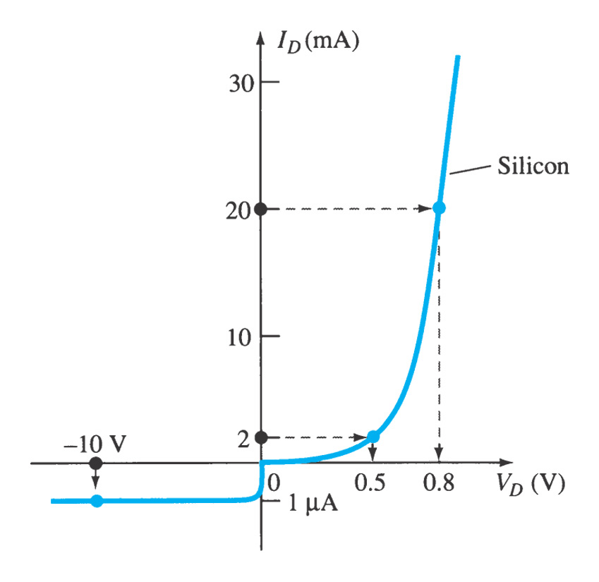
DC, or Static, Resistance
For a specific applied DC voltage V_{D}, the diode has a specific current I_{D}, and a specific resistance R_{D}.
Example 1.2

Slide 19
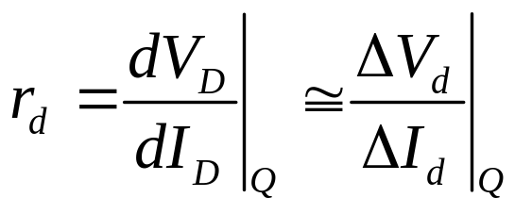
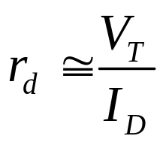
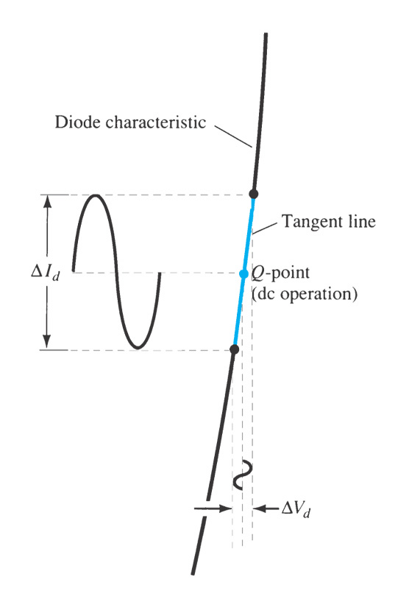

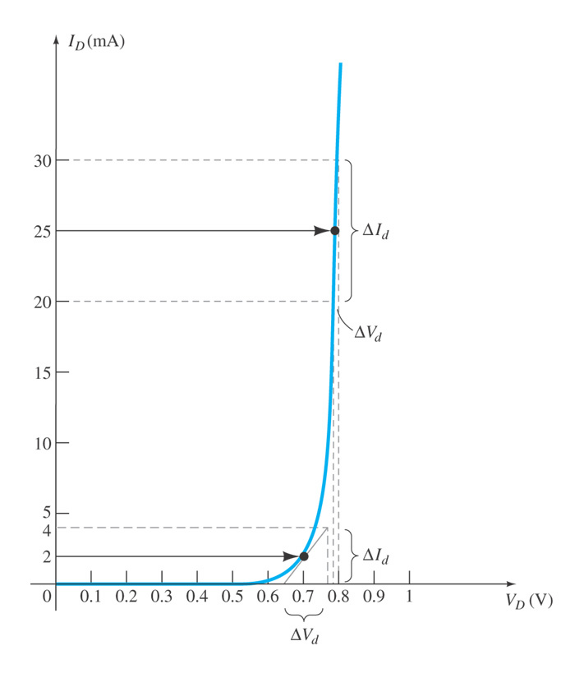
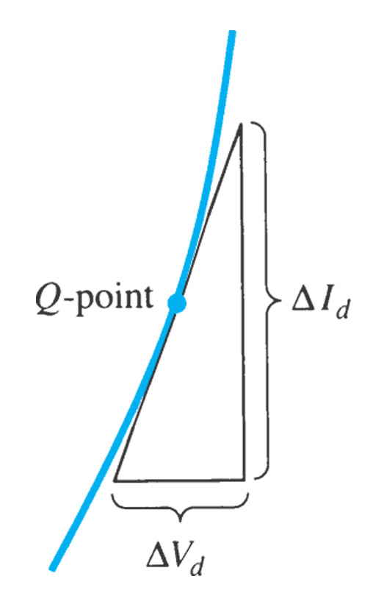
AC, or Dynamic, Resistance
Example 1.3

Slide 20
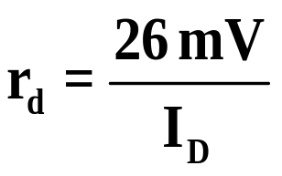
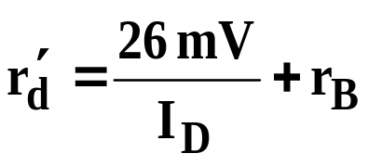

AC, or Dynamic, Resistance
In the forward bias region:
The ac resistance depends on DC operating point (I_{D}) in the diode.
r_{B} : body resistance and contact resistance. It is very small (0.1Ω ~ 2Ω). In some cases r_{B} can be ignored.
In the reverse bias region:
The resistance is essentially infinite. The diode acts like an open.

Slide 21
1.8 Diode Equivalent Circuits
There are three equivalent circuits for a diode:
Ideal Equivalent Circuit
Piecewise-Linear Equivalent Circuit
Simplified/Approximate Equivalent Circuit

Slide 22
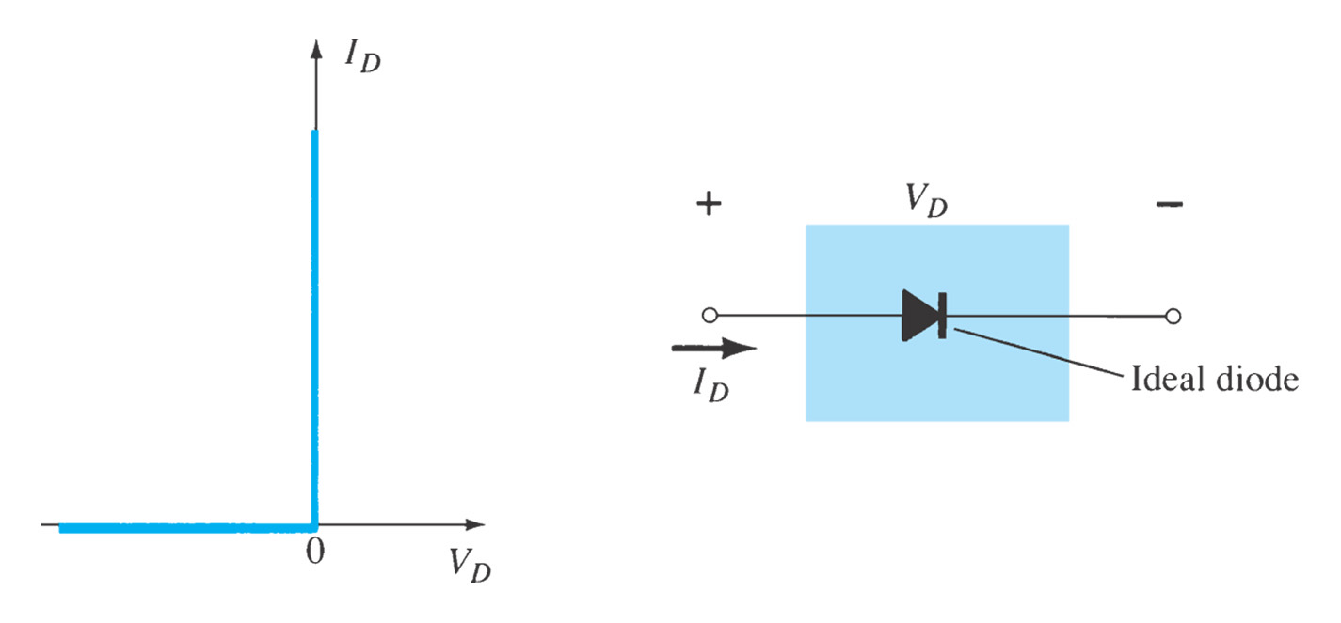
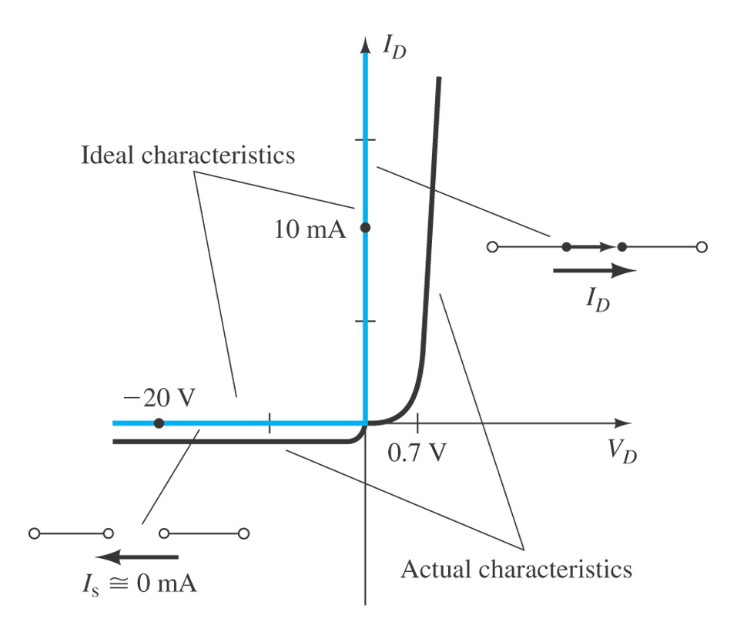
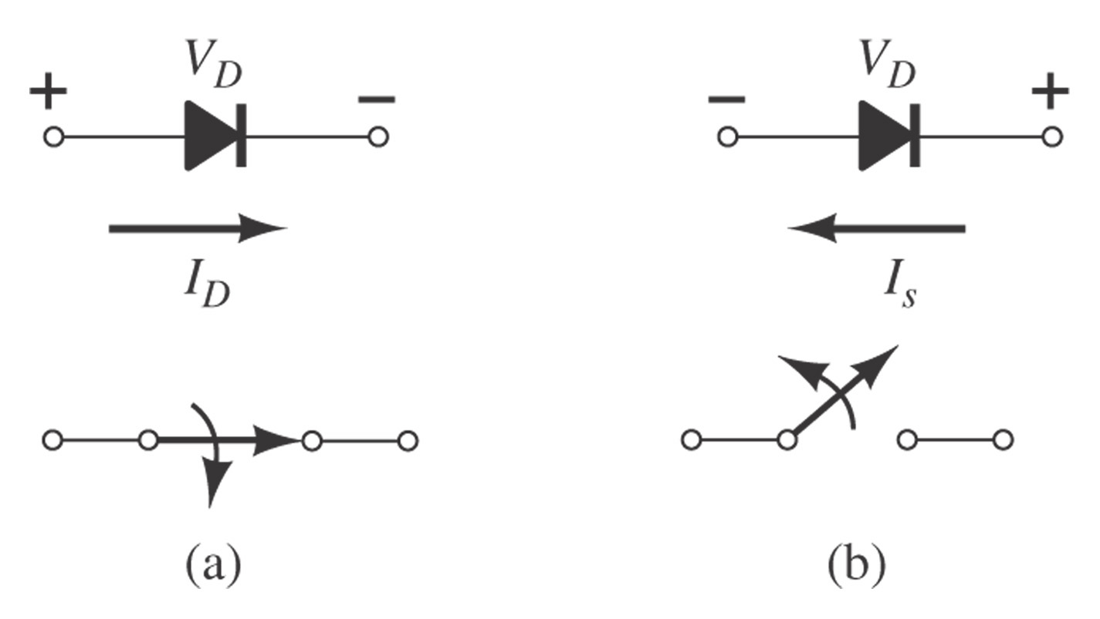
Ideal Equivalent Circuit
Conduction in one direction
On-off Switch

Slide 23
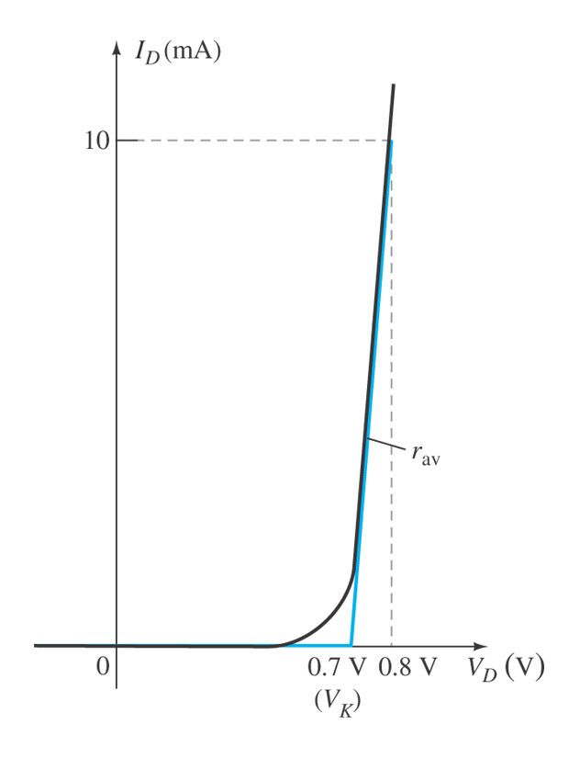
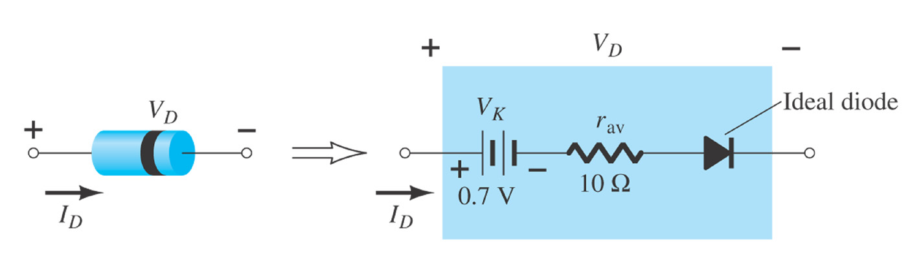
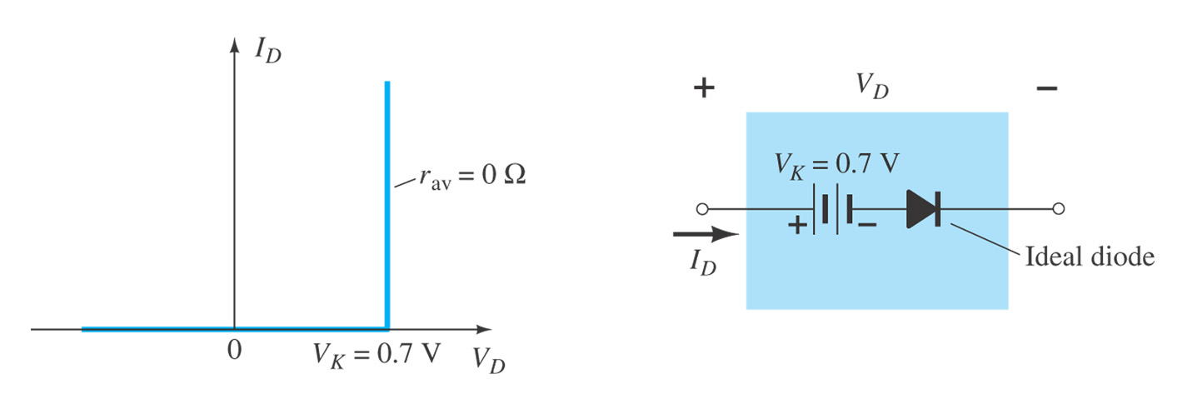
Piecewise-Linear Equivalent Circuit
Simplified Equivalent Circuit

Slide 24
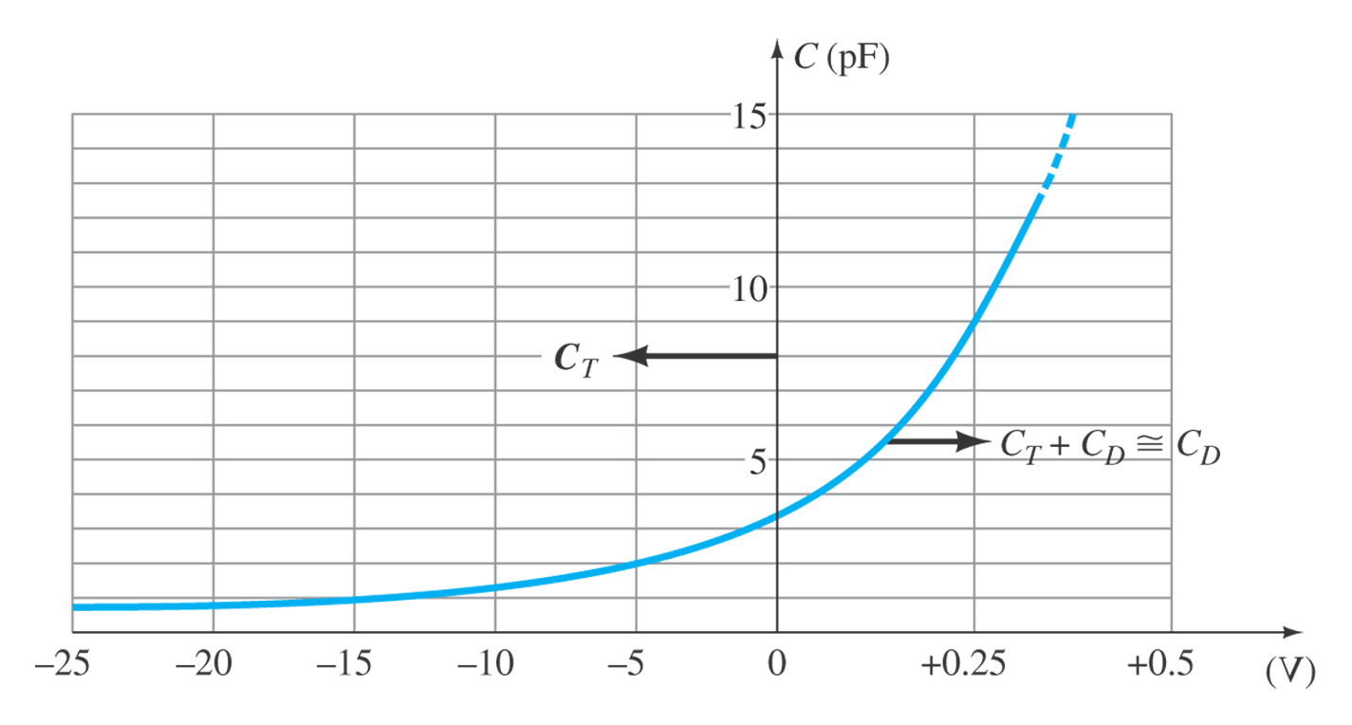
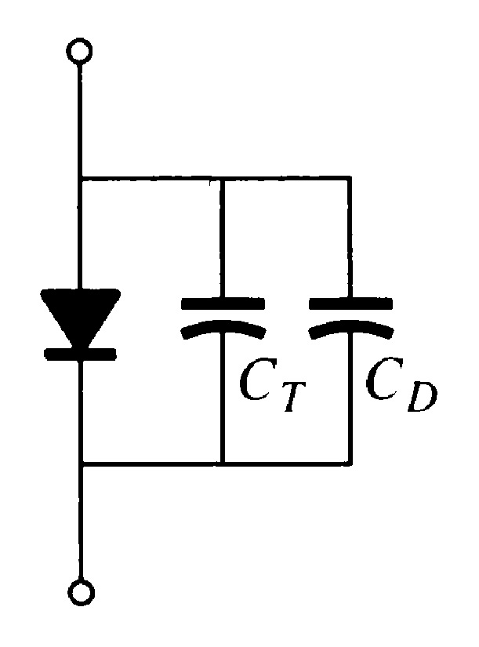
1.9 Diode Capacitance
In reverse bias, the depletion layer is very large. The diode’s strong positive and negative polarities create transition- or depletion-region capacitance, C_{T}. The amount of capacitance depends on the reverse voltage applied.
In forward bias storage capacitance or diffusion capacitance (C_{D}) exists besides barrier capacitance as the diode voltage increases.

Slide 25
1.11 Diode Specification Sheets
Data about a diode is presented uniformly for many different diodes. This makes cross-matching of diodes for replacement or design easier.
V_{F}, forward voltage at a specific current and temperature
I_{F}, maximum forward current at a specific temperature
I_{R}, maximum reverse current at a specific temperature
PIV or PRV or V(BR), maximum reverse voltage at a specific temperature
Power dissipation, maximum power dissipated at a specific temperature
C, capacitance levels in reverse bias
t_{rr}, reverse recovery time
Temperatures, operating and storage temperature ranges

Slide 26
Other Types of Diodes
Zener diode
Light-emitting diode (LED)
Photodiode
Varactor diode

Slide 27

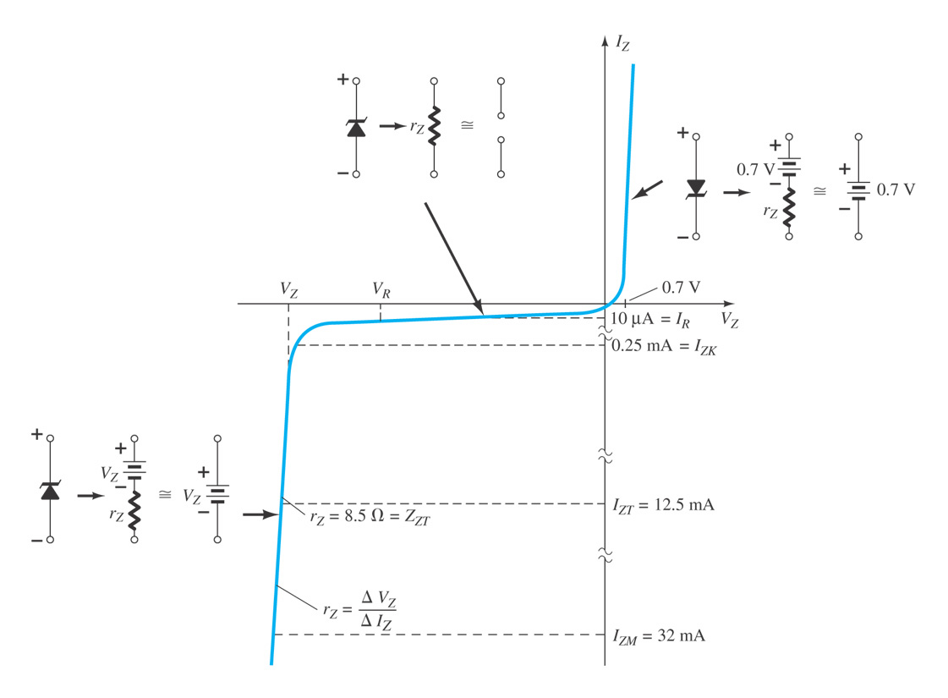



1.13 Zener Diode
A Zener is a diode operated in reverse bias at the Zener voltage (V_{Z}).
Common Zener voltages are beween 1.8 V and 200 V
Important parameters for Zener Diodes:

Slide 28
Summary of Chapter 1
Key Items
Construction of a p-n junction
Characteristics of a semiconductor diode (/p-n junction)
- Electrical conduction in only one direction
DC resistance and AC resistance
Equivalent circuits for a semiconductor diode

