Slide 1
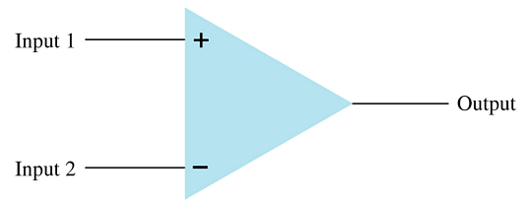
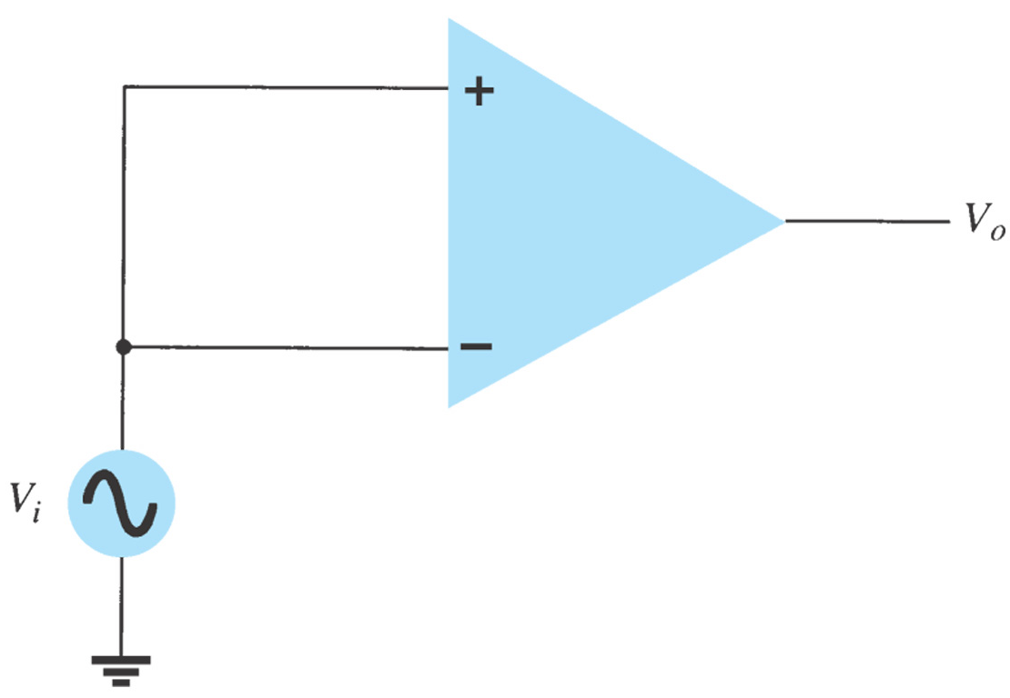
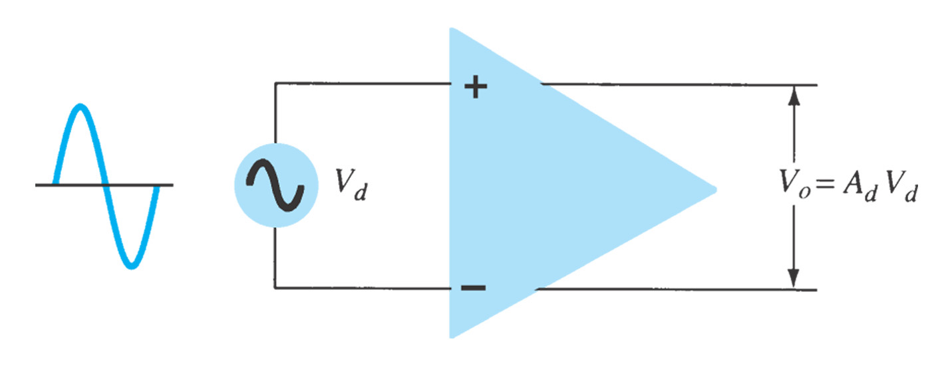
10.1 Introduction
Construction of op-amp
Note the op-amp has two inputs and one output.
Characteristics of op-amp
amplifying the differential signal while rejecting the common signal at the two inputs
very high gain differential amplifier
high input impedance (typically a few meg-Ohms)
low output impedance (less than 100 Ω).
Differential input signal: highly amplified
Common input signal: rejection/slightly amplified

Slide 2
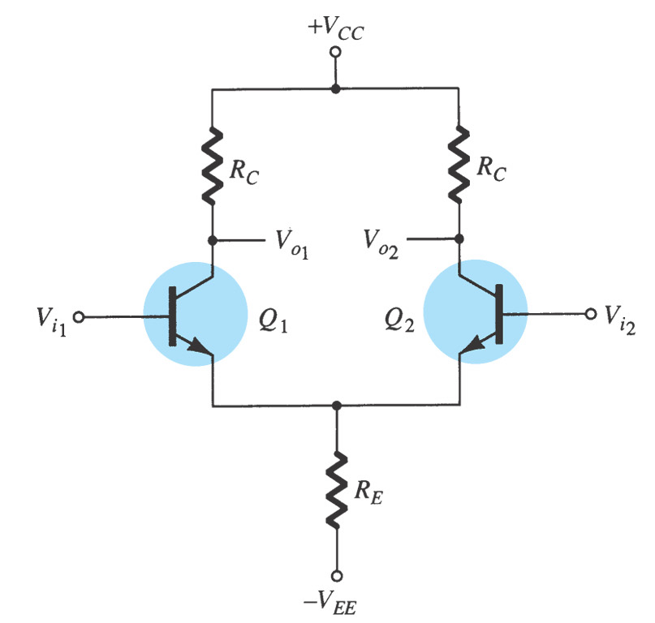
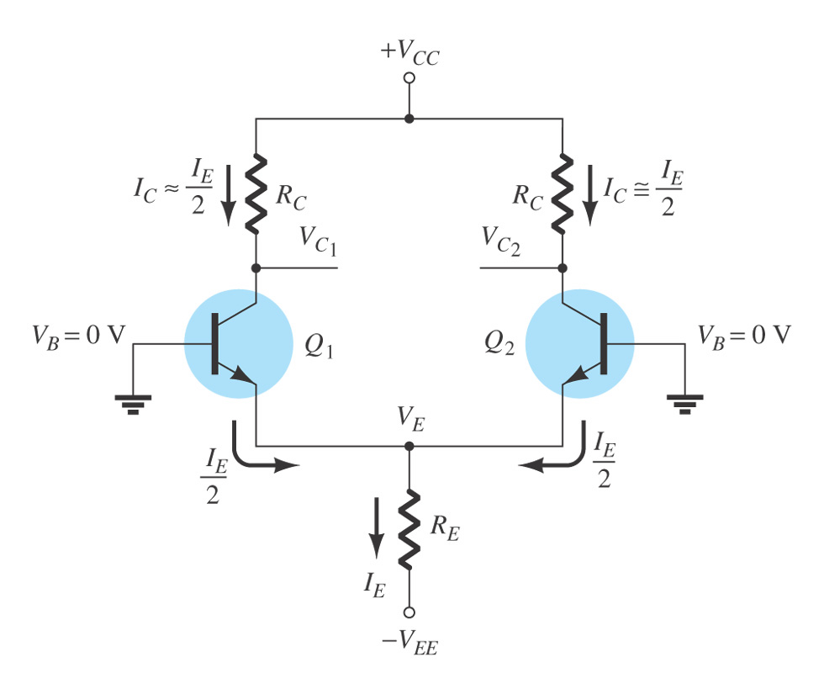
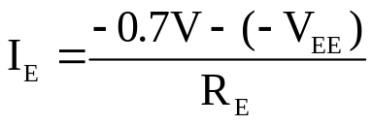

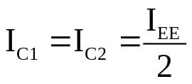
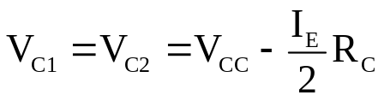
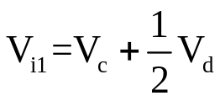
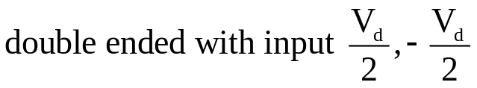

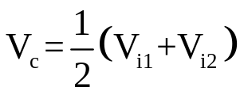
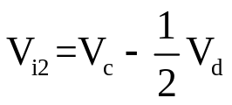

10.2 Differential Amplifier Circuit
1. DC Bias
(1) A fundemental building block of analog ICs.
(2) Two possible inputs and two possible outputs
(3) Identical transistor characteristics of the differntial-pair
(4) Amplifying differential-mode input voltage V_{d}=V_{i1}-V_{i2} ,
rejecting differential-mode input voltage V_{c}=(V_{i1}+V_{i2})/2
(5) High gain, high input impedance, and low output impedance
2. AC operation
Differential-mode operation V_{o}=A_{d}V_{d}
Common-mode operation V_{o}=A_{c}V_{c}
Differential Inputs
Common Inputs

Slide 3
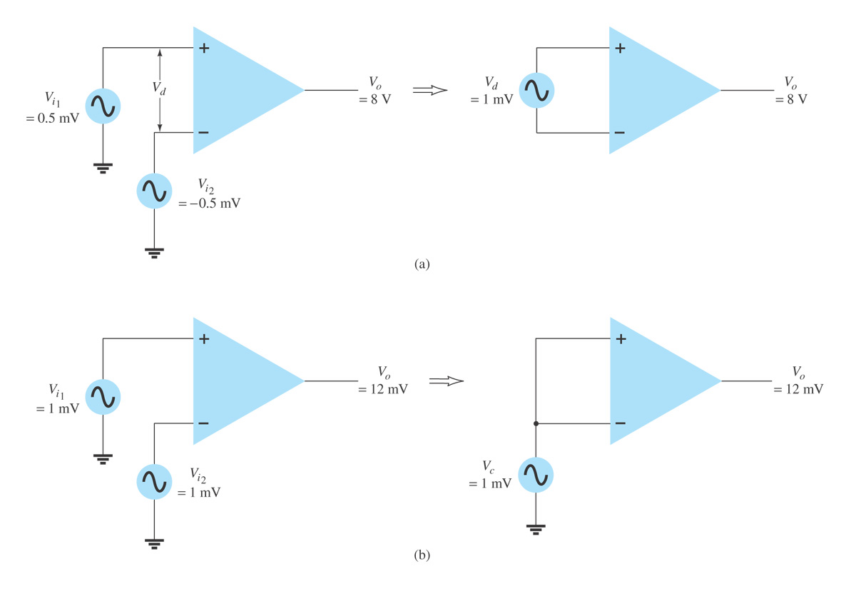


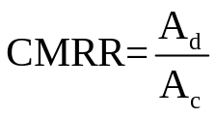
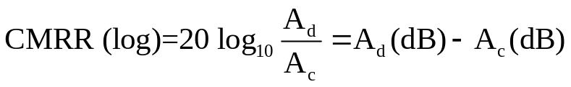
10.3 Differential And Common-mode Operation
Differential Operation
Common-mode Operation
CMRR:
Any signal that is common to both inputs will be cancelled. A measure of the ability to cancel out common signals is called CMRR (common-mode rejection ratio).

Slide 4
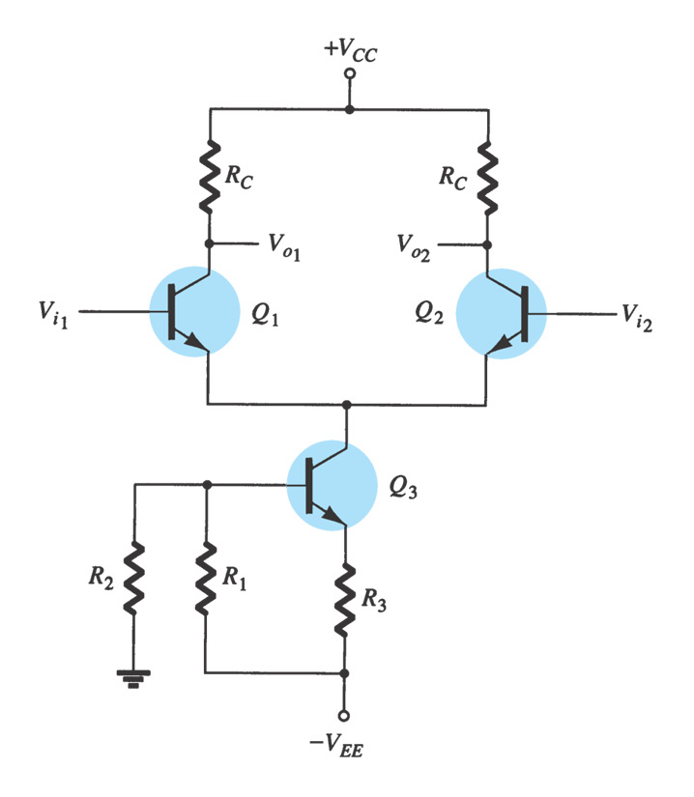
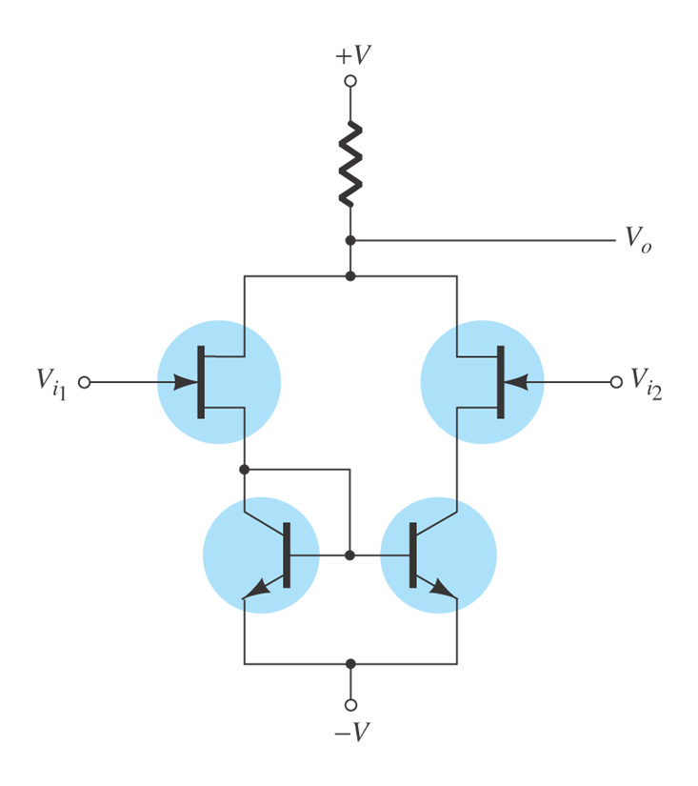
Use of Constant-Current Source
To provide operating point as well as increasing common-mode rejection ability (provide a large value of the emitter resistance to reduce A_{c}).
To be used as active load to improve the differential gain
Use of BiFET, BiMOS, and CMOS Differential Amplifier Circuits
BiFET: a differential amplifier by both BJT and JFET
BiMOS: a differential amplifier by both BJT and MOSFET
  Combine BJT and MOS transistors on the same semiconductor chip
  The advantages of the MOSFET high input impedance and the BJT high gain can be combined and utilized in the same circuit
CMOS: a differential amplifier by complementary type MOSFET
  Low power dissipation

Slide 5
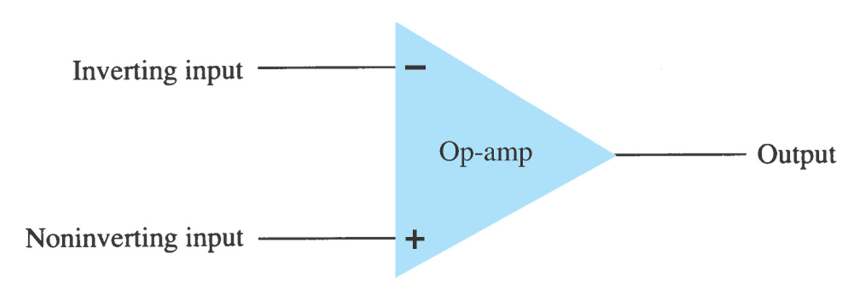
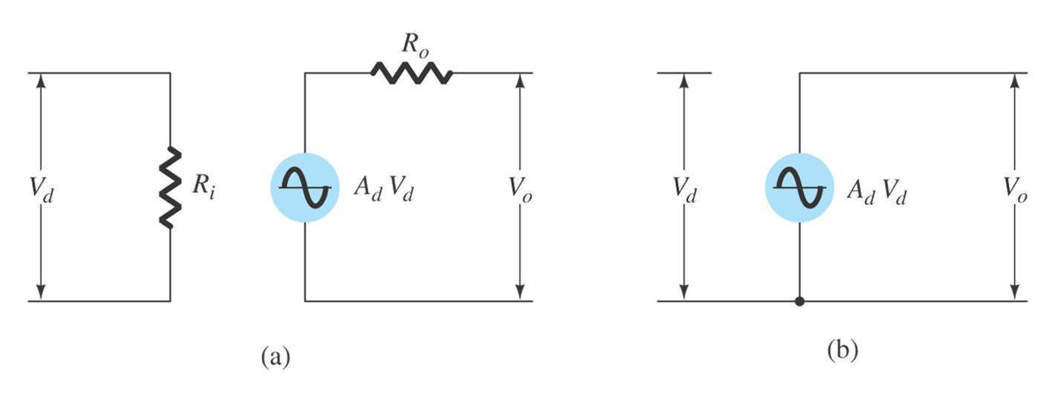
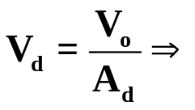
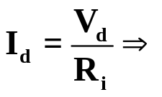
10.5 Op-Amp Basics
Ideal
Ideal features of op-amp:
A_{d} = ∞, A_{c}=0
R_{i} = ∞
R_{o} = 0
Practical
Virtual Short: V_{d}=0
Virtual Open: I_{d}=0
Practical features of op-amp:
very high gain A_{d} for differential input V_{d}
high input impedance R_{i} (typically a few meg-Ohms)
low output impedance R_{o} (less than 100 Ω).

Slide 6
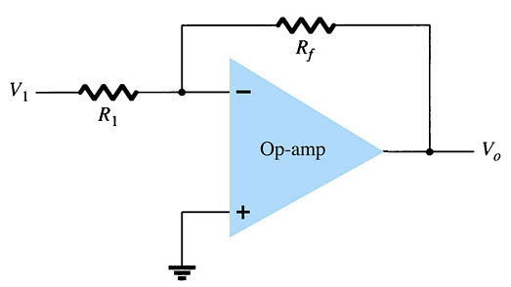
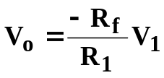
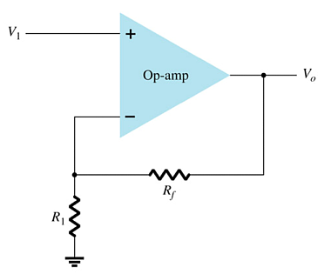
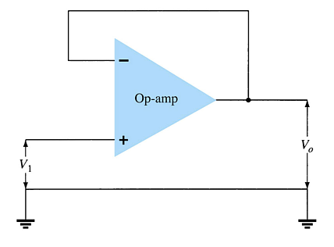

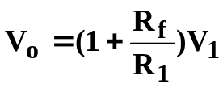
(1) Inverting constant gain amplifier
The signal input is applied to the inverting (–) input
The non-inverting input (+) is grounded
The resistor R_{f} is the feedback resistor.
The non-inverting input pin is at ground. The inverting input pin is also at 0V for an AC signal due to virtual short concept. The inverting input is at virtual ground.
(2) Noninverting constant gain amplifier
(3) Unity follower →Voltage buffer

Slide 7
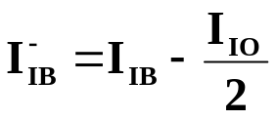
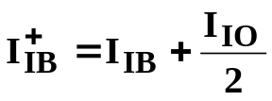
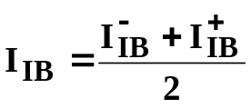
10.6 Op-Amp Specifications—DC Offset Parameters
Even when the input voltage is zero, there will be an output called offset. The following can cause this offset:
  Input offset voltage (V_{IO})
  Input offset current (I_{IO})
  Total offset voltage may due to both input offset voltage and input offset current
  Input bias current (I_{IB})
In experiments and actual applications, adjusting circuits for zero-input zero-output is employed.

Slide 8
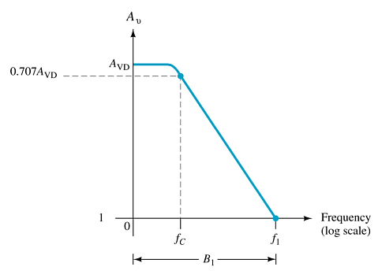



10.7 Op-Amp Specifications—Frequency Parameters
An op-amp is a wide-bandwidth amplifier. The following affect the bandwidth of the op-amp:
  Gain
  Slew rate
The plot shown is for an open loop gain (A_{OL} or A_{VD}).
The op-amp’s high frequency response is limited by internal circuitry.
In the open loop, the op-amp has a narrow bandwidth.
The bandwidth widens in closed-loop operation, but then the gain is lower.
f₁ is called the gain-bandwidth

Slide 9
Summary of Chapter 10
Characteristics of Differential Amplifier
  Differential mode operation
  Common mode operation
  CMRR
Characteristics of Op-Amp.
  Ideal assumptions (Virtual short and Virtual open)
  Practical
Linear applications of Op-Amp
  Inverting and nuninverting amplifier
  Unity follower

