Slide 1
Chapter 11
Op-Amp Applications
Notes:
Wave generator ?
Schmitt trigger ?

Slide 2
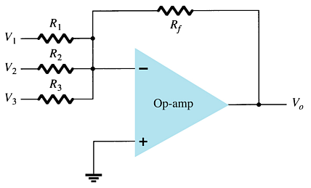
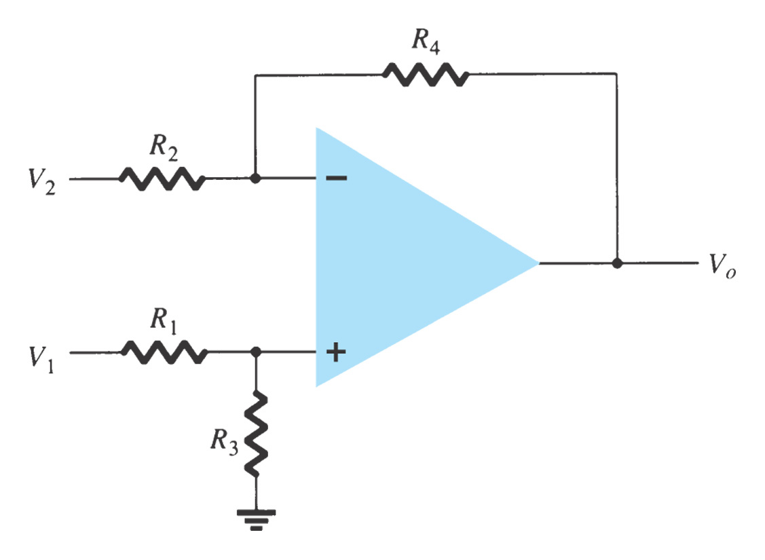
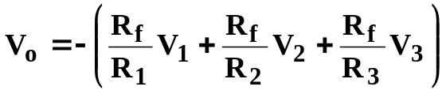
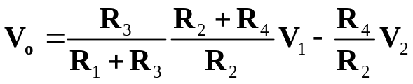
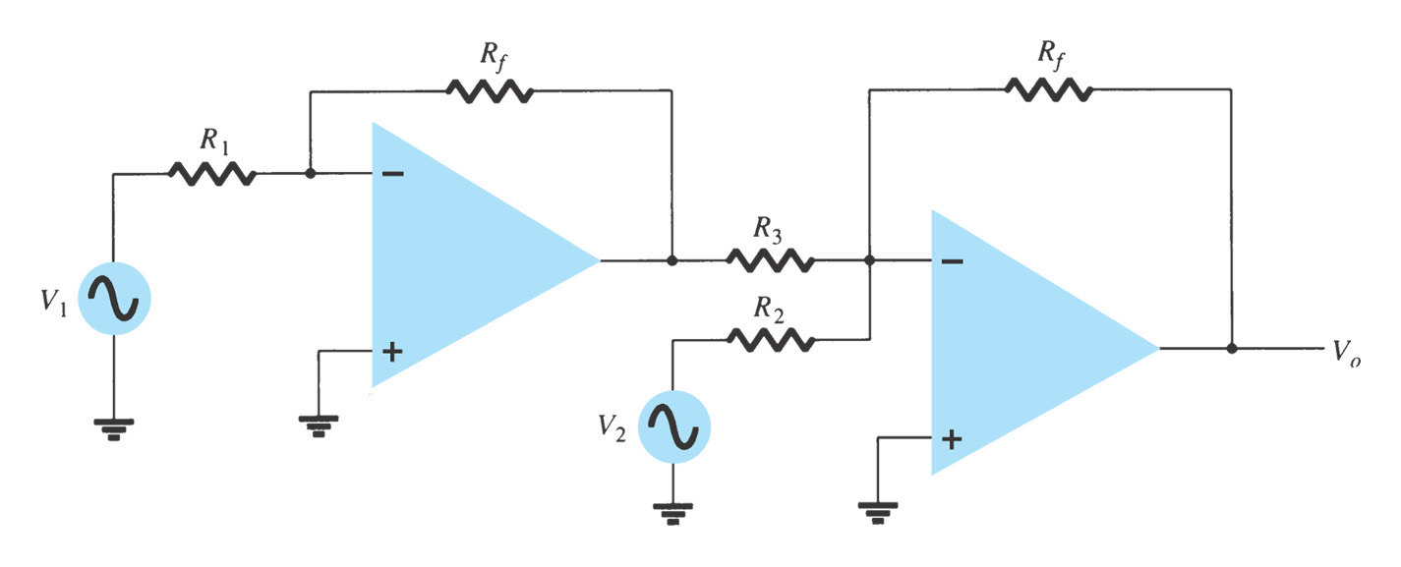
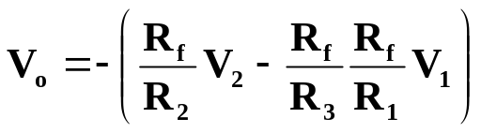
11.1 Operation Circuits
(1) Summing amplifier
(2) Voltage Subtraction

Slide 3
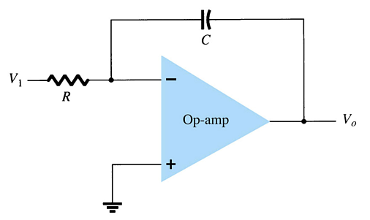
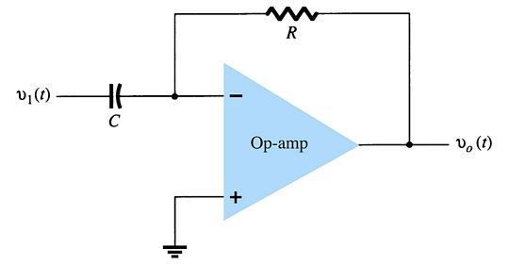
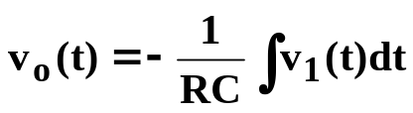
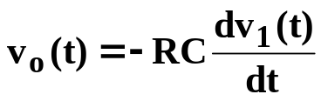
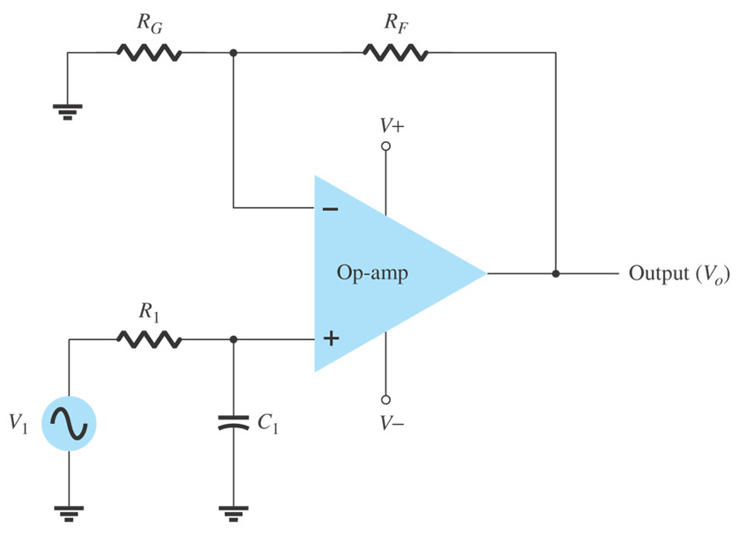
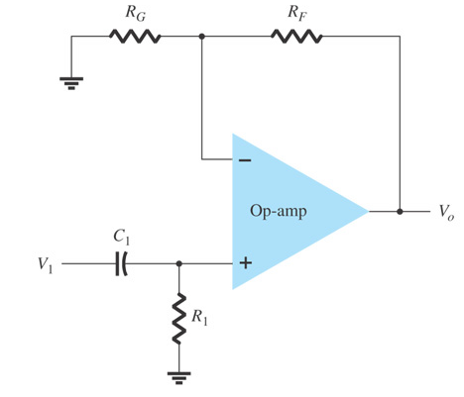
(3) Integrator
(4) Differentiator
11.2 Active Filter
(1) First-order low-pass active filter
(2) First-order high-pass active filter

Slide 4

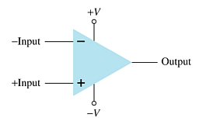




11.3 Comparator Circuit
+V_{SAT}
–V_{SAT}
Open-loop Comparators and voltage transfer characteristics
The operation is a basic comparison. The output swings between its maximum and minimum voltage, depending upon whether one input (V_{i}) is greater or less than the other (V_{ref}).
v_{O}
V_{OH}
For a noninverting op-amp comparator:
V_{o} =+V_{SAT} when V_{i} > V_{ref}.
V_{o} = – V_{SAT} when V_{i} < V_{ref}.
V_{REF}
v_{I}
V_{OL}
v_{O}
For a inverting op-amp comparator:
V_{o} = – V_{SAT} when V_{i} > V_{ref}.
V_{o} = + V_{SAT} when V_{i} < V_{ref}.
V_{OH}
V_{REF}
v_{I}
V_{OL}

Slide 5
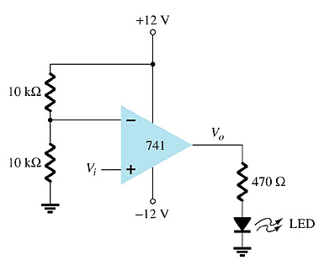
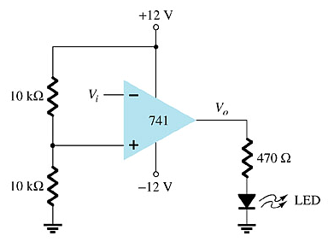
Use of Op-Amp as Comparator
Example:
V_{ref} in this circuit is +6V (from voltage divider)
+V_{SAT} = +V, or +12V
-V_{SAT} = -V or –12V
When V_{i} > +6V the output swings to +12V and the LED goes on.
When V_{i} < +6V the output is at –12V and the LED goes off.
When V_{i} < +6V the output swings to +12V and the LED goes on.
When V_{i} > +6V the output is at –12V and the LED goes off.

Slide 6
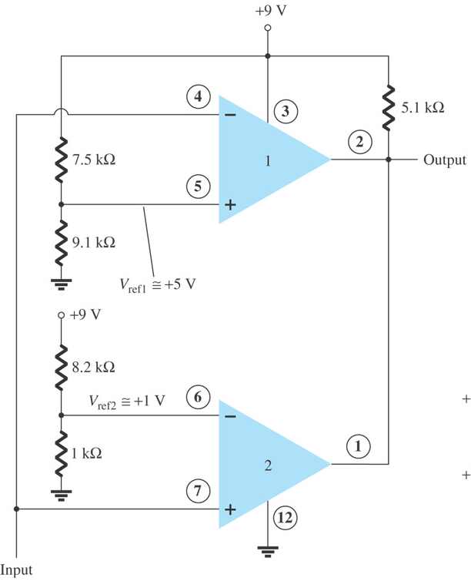

Comparator ICs
Advantages:
  Faster switching
  Built-in noise immunity
  Outputs capable of directly driving loads
Example of Comparator ICs
  311
  339
Voltage transfer characteristic
V_{ref2}=1V
V_{ref1}=5V

Slide 7
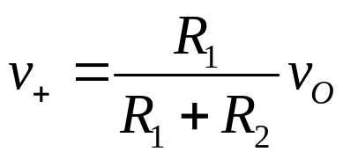

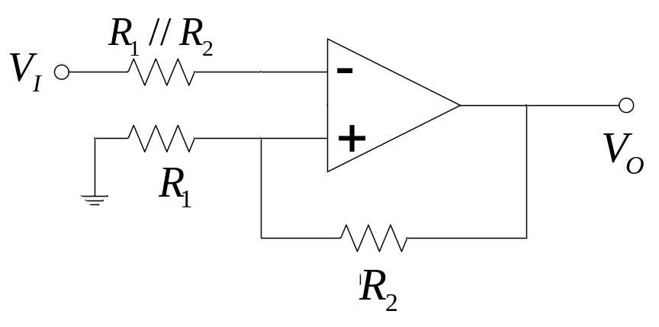

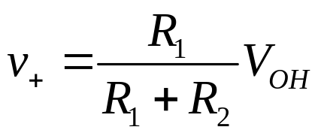
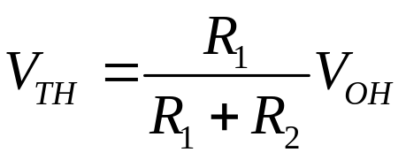


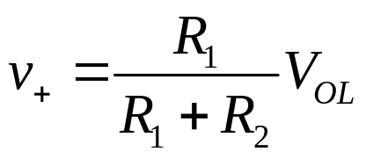
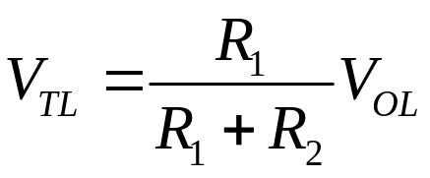
11.4 Schmitt Trigger
Basic inverting Schmitt Trigger
crossover occurs when v_{I}=v₊
voltage transfer characteristics
V_{OH}
V_{TL}
V_{TH}
crossover occurs when v_{I}=v₊
V_{OL}

Slide 8
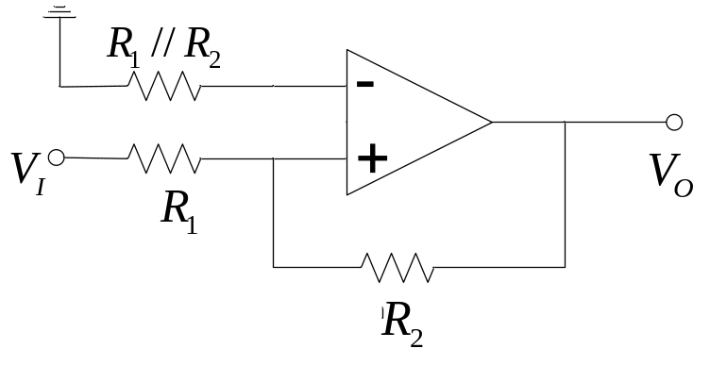
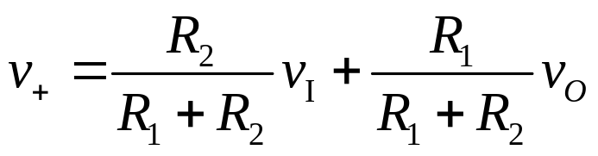

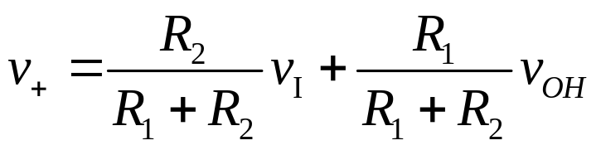
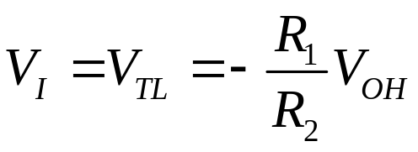
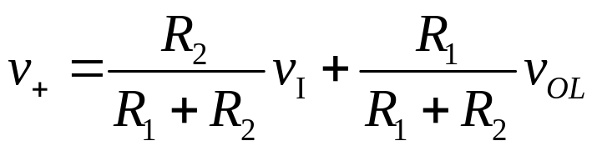
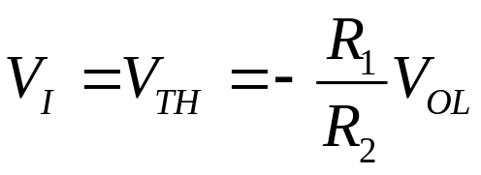
Noninverting Schmitt Trigger
voltage transfer characteristics
V_{OH}
crossover occurs when v₊=0
V_{TL}
V_{TH}
V_{OL}
crossover occurs when v₊=0
Additional Schmitt Trigger Configurations
-- With output limiters
-- With applied reference voltages

Slide 9
Summary of Chapter 11
Linear Applications
  11.1 Operational Circuits
  11.2 Active Filter
Nonlinear Applications
  11.3 Comparator
  11.4 Schmitt Trigger

