Slide 1
Chapter 12
Power Amplifiers

Slide 2
Definitions
In small-signal amplifiers the main factors are:
  Amplification
  Linearity
  Gain
Since large-signal, or power, amplifiers handle relatively large voltage signals and current levels, the main factors are:
  Efficiency
  Maximum power capability
  Impedance matching to the output device

Slide 3
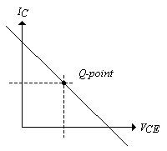
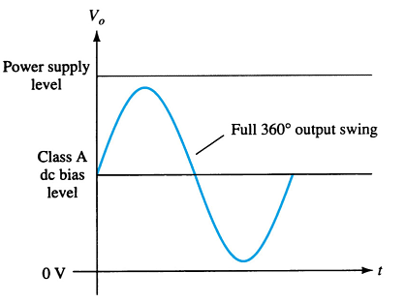
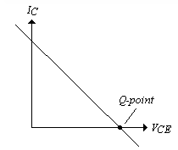
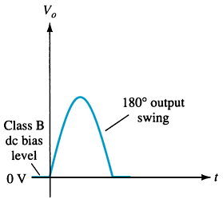
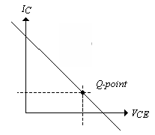
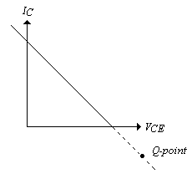
Amplifier Types
Class A
  The amplifier conducts through the full 360° of the input. The Q-point is set near the middle of the load line.
Class B
  The amplifier conducts through 180° of the input. The Q-point is set at the cutoff point.
Class AB
  This is a compromise between the class A and B amplifiers. The amplifier conducts somewhere between 180° and 360° . The Q-point is located between the mid-point and cutoff.
Class C
  The amplifier conducts less than 180 of the input. The Q-point is located below the cutoff level.
Class D
  This is an amplifier that is biased especially for digital signals.
Class A
Class B
Class AB
Class C

Slide 4
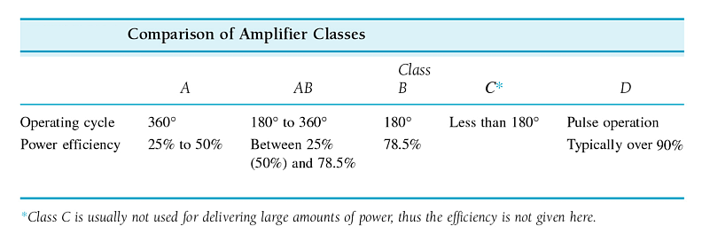
Amplifier Efficiency
Efficiency refers to the ratio of output to input power. The lower the amount of conduction of the amplifier the higher the efficiency.

Slide 5
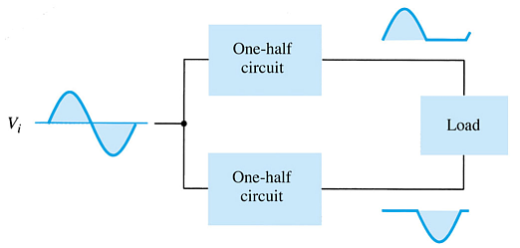
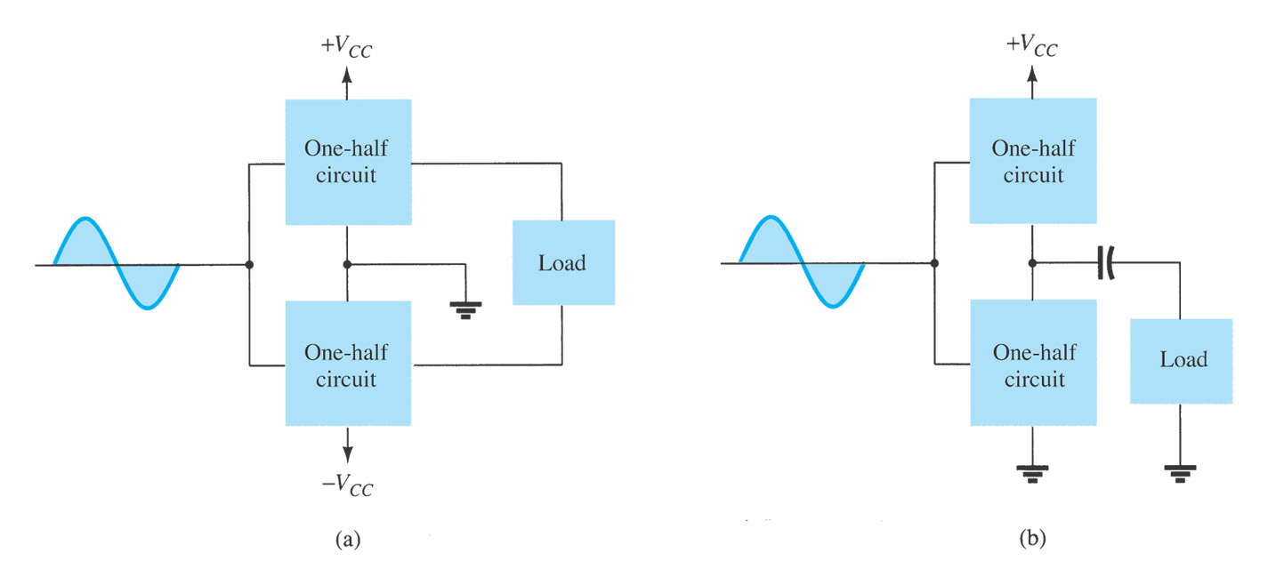
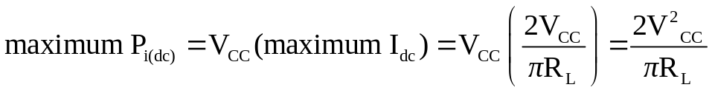
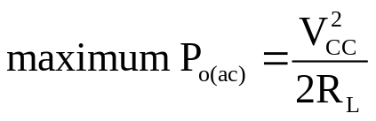
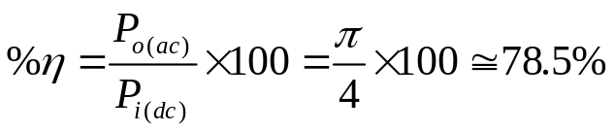
12.4 Class B Amplifier Operation
In class B, the dc bias leaves the transistor biased just off. The AC signal turns the transistor on. The transistor only conducts when it is turned on by one-half of the AC cycle.
In order to get a full AC cycle out of a class B amplifier, you need two transistors.
Block of push-pull operation
For maximum power, V_{L}=V_{cc}
The maximum efficiency of a class B amplifier is 78.5%.

Slide 6
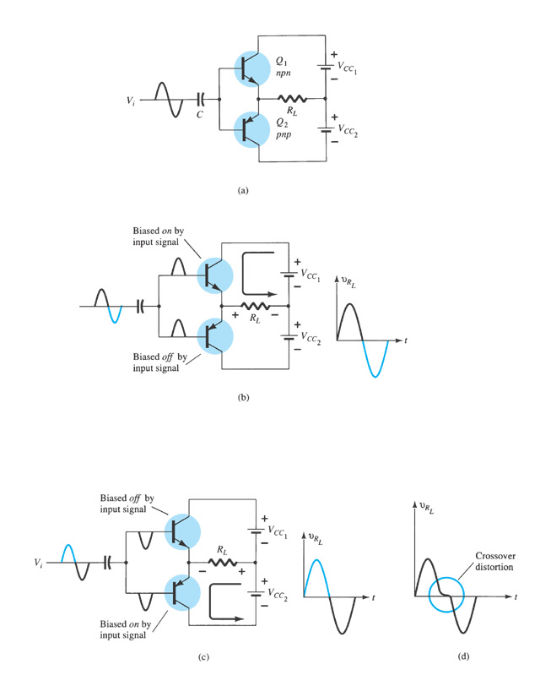
  12.5 Class B Amplifier Circuits
Complementary-symmetry Push-Pull circuit
During the positive half of the AC input cycle, transistor Q₁ (npn) is conducting and Q₂ (pnp) is off.
During the negative half of the AC input cycle, transistor Q₂ (pnp) is conducting and Q₁ (npn) is off.
Important quantities:
  input power, maximum input power
  output power, maximum output power and the input voltage at which it occurred
  power dissipation, maximum power dissipation and the input voltage at which it occurred
  power efficiency

Slide 7
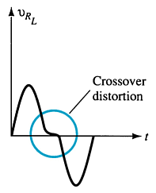
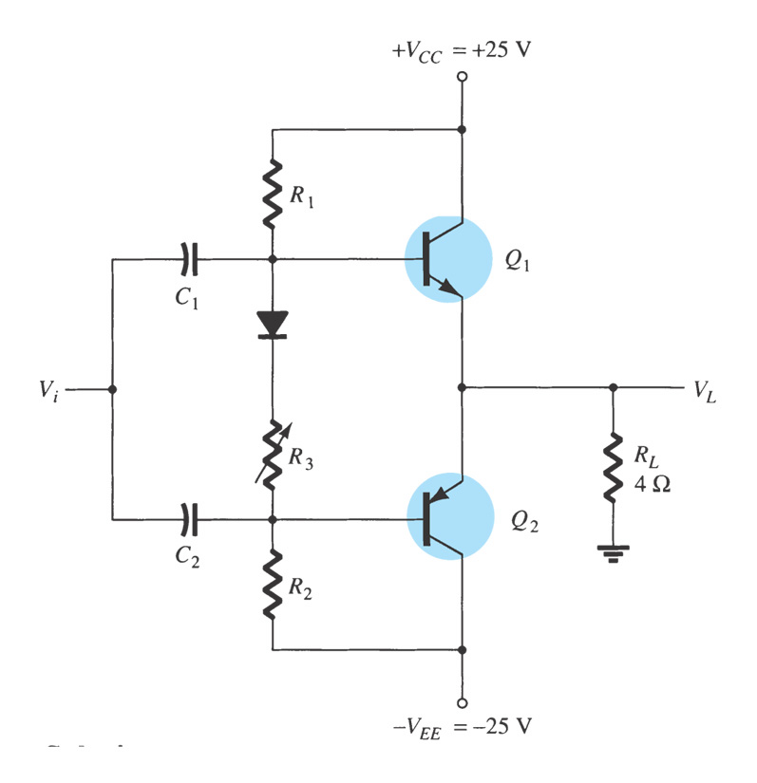
Class B Amplifier Circuits: Crossover Distortion
If the transistors Q₁ and Q₂ do not turn on and off at exactly the same time, then there is a gap in the output voltage.
Class AB, Complementary-symmetric Push-Pull Amplifier
Example 12.10
To overcome crossover distortion:
Biasing the transistors in class AB improves push-pull operation by biasing both transistors to be on for more than half a cycle.

Slide 8
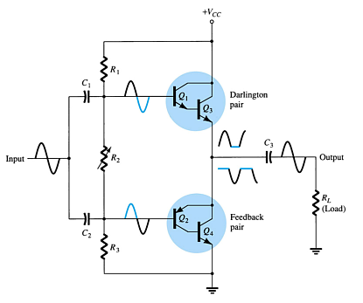
Quasi-Complementary Push-Pull Amplifier
A Darlington pair and a feedback pair combination perform the push-pull operation. This increases the output power capability.

Slide 9
Summary of Chapter 12
Concepts of power amplifiers
  Amplifier types: according to Q-point (DC biasing) and the conduction angle
  Efficiency : application related
Power amplifier circuits
  Complementary push-pull amplifier
    Class B: Crossover distortion
    Class AB: to overcome crossover distortion
  Quasi-complementary push-pull amplifier
Be able to calculate important quantities of a power amplifier
  input power, maximum input power
  output power, maximum output power and the input voltage at which it occurred
  power dissipation, maximum power dissipation and the input voltage at which it occurred
  power efficiency

