Slide 1
Chapter 13
Feedback Circuits

Slide 2
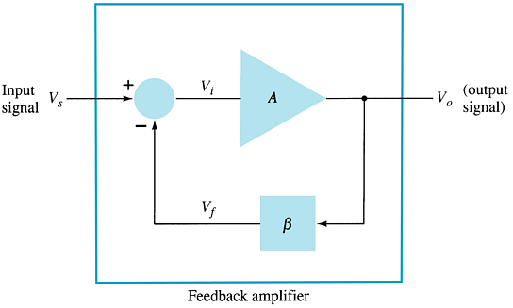
    13.1 Feedback Concepts
Feedback types:
Negative feedback
    The feedback signal is of opposite polarity to the input signal
    Typical application: to improve circuit features
  Positive feedback
    The feedback signal is of same polarity to the input signal
    Typical application: Oscillator circuit
The effects of negative feedback on an amplifier:
  Disadvantage
    Lower gain
  Advantages
    More stable gain
    Reduced noise
    More linear operation

Slide 3
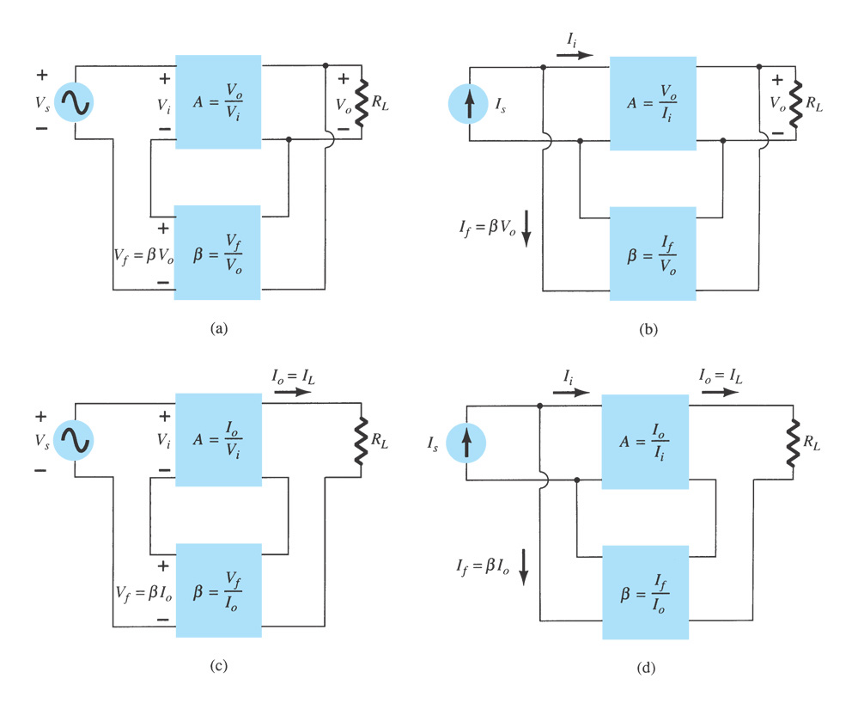
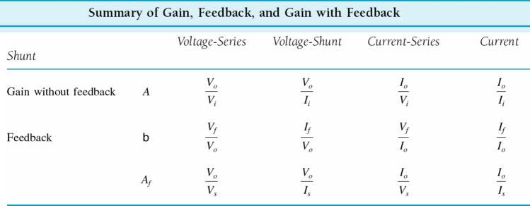
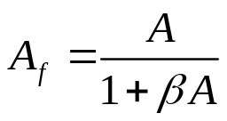
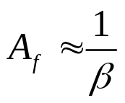

    13.2 Feedback Connection Types
Feedback amplifier types:
(a) voltage-series feedback, A_{ƒ} = V_{o} / V_{s}
(b) voltage-shunt feedback, A_{ƒ}= V_{o} / I_{s}
(c) current-series feedback, A_{ƒ} = I_{o} / V_{s}
(d) current-shunt feedback, A_{ƒ} = I_{o} / I_{s}
（1）Gain with Feedback:

Slide 4
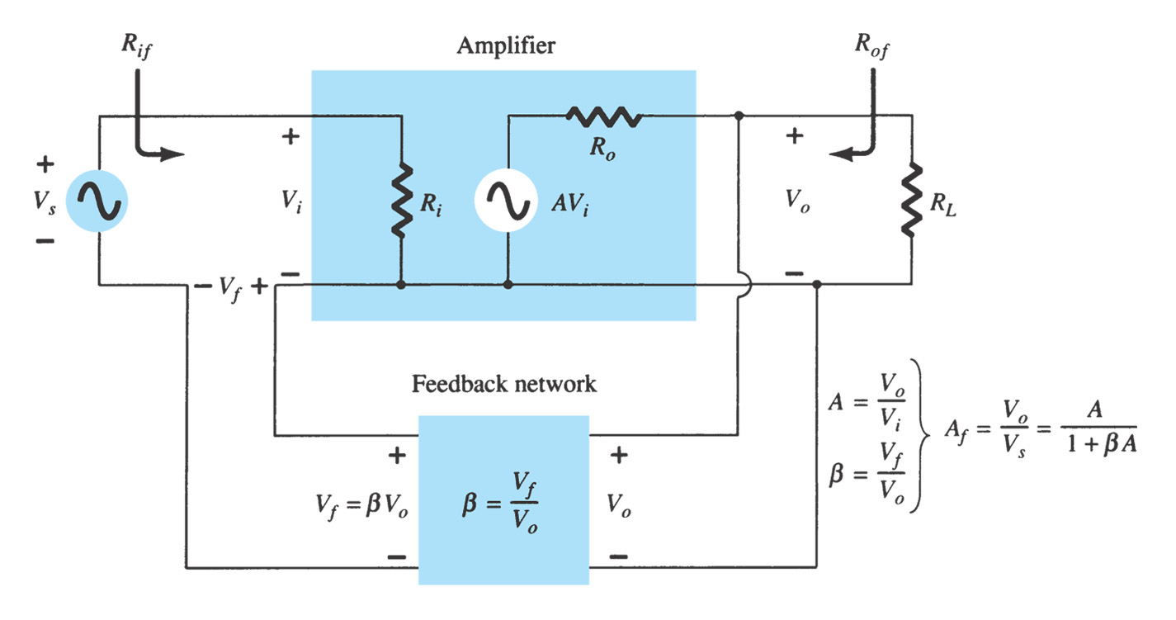
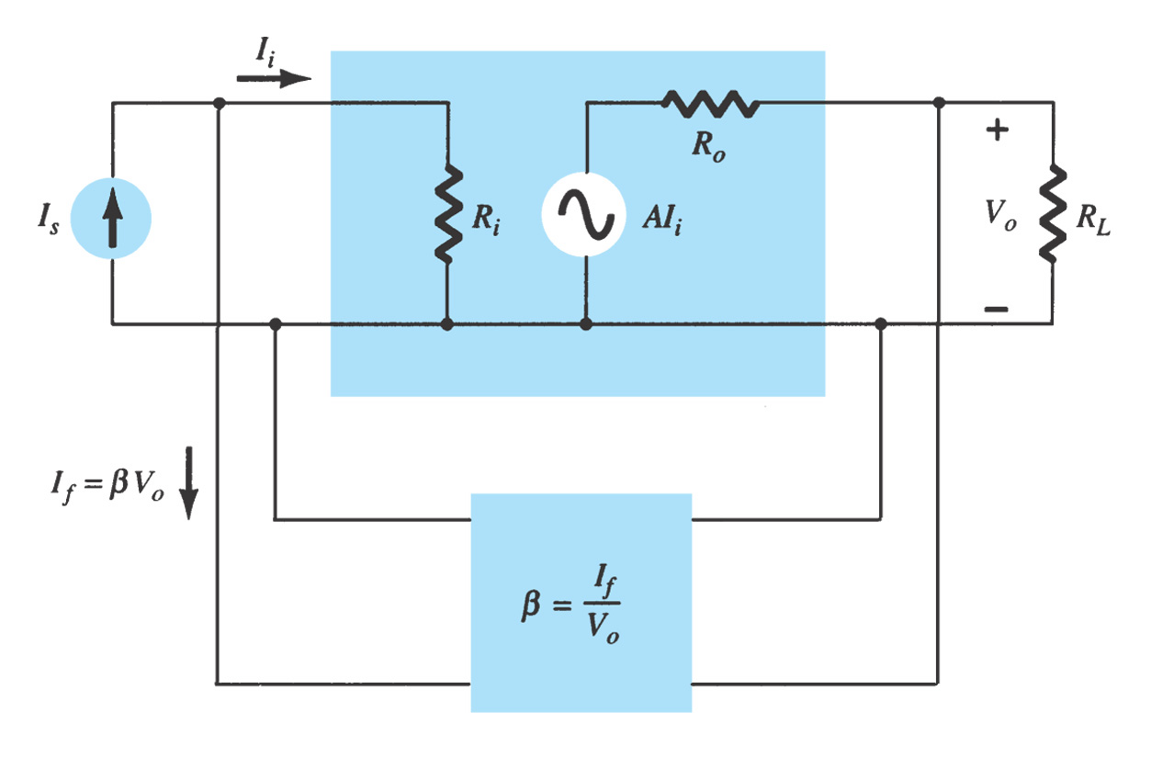
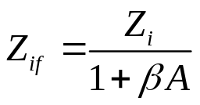

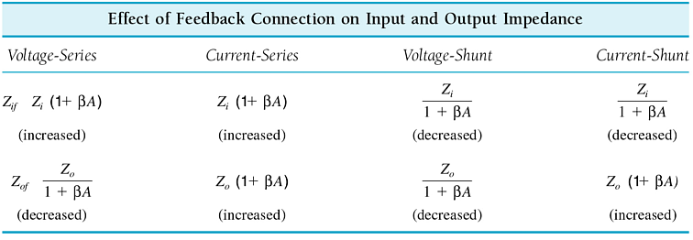
    （2）Input Impedance with Feedback

Slide 5
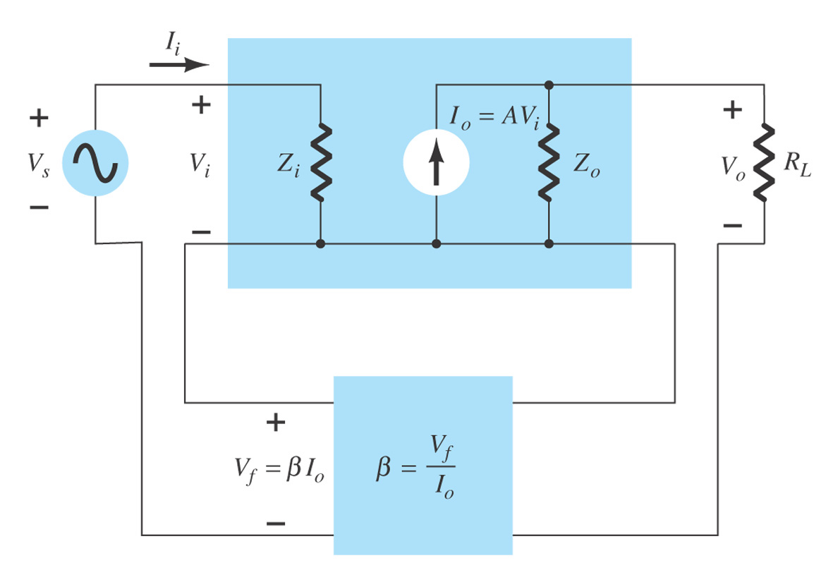
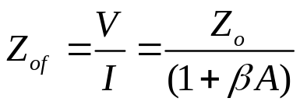
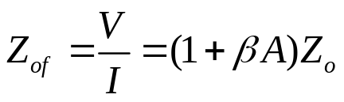
    （3）Output Impedance with Feedback

Slide 6
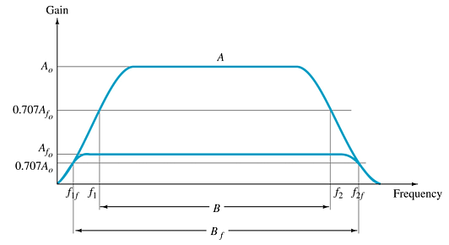
    （4）Frequency Distortion with Feedback
If the feedback network is purely resistive, then the gain with feedback will be less dependent on frequency variations.
    （5）Noise and Nonlinear Distortion with Feedback
The feedback network reduces noise by cancellation. The phase of the feedback signal is often opposite the phase of the input signal.
Nonlinear distortion is also reduced simply because the gain is reduced. The amplifier is operating in midrange and not at the extremes.
    （6）Bandwidth with Feedback
Feedback increases the bandwidth of an amplifier. The gain-bandwidth product remains the same.
（7）Gain Stability with Feedback
Gain calculations with feedback are often based on external resistive elements in the circuit. By removing gain calculations from internal variations of β and g_{m}, the gain becomes more stable.

Slide 7
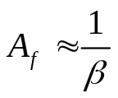


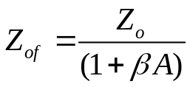







    Summary of Negative Feedback Effects
Gain
  Reduced gain, but improve gain stability
Input impedance
  **- series: increase input impedance
  **-shunt: decrease input impedance
Output impedance
  voltage-**: decrease output impedance
  current-**: increase output impedance
Reduced noise
More linear operation
Improve frequency response and increase bandwidth
Determine the
feedback type
Determine the
feedback
Determine the
feedback gain
Determine other
unknowns

Slide 8
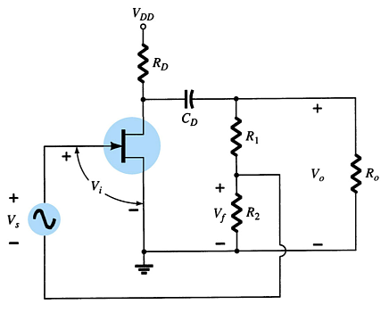

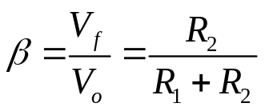
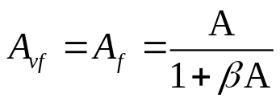

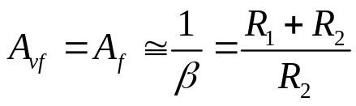
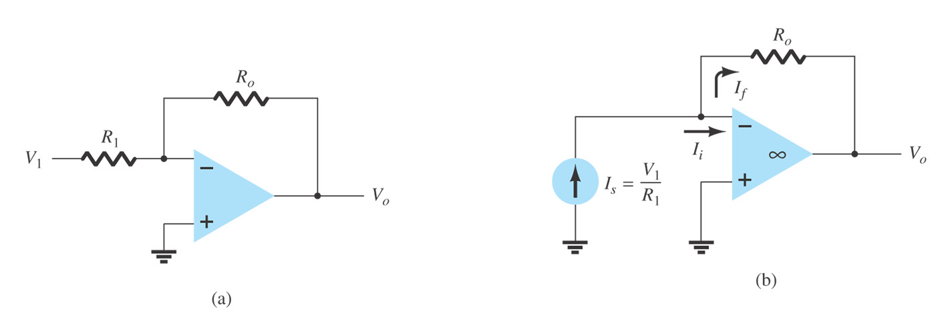

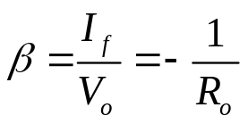
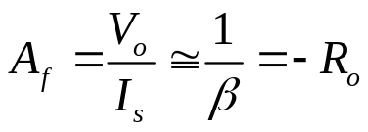
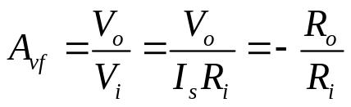
    13.3 Practical Feedback Circuits
(a) Voltage-Series Feedback
Open loop:
close loop:
(b) Voltage-Shunt Feedback
For a voltage-shunt feedback amplifier, the output voltage is fed back in parallel with the input.

Slide 9
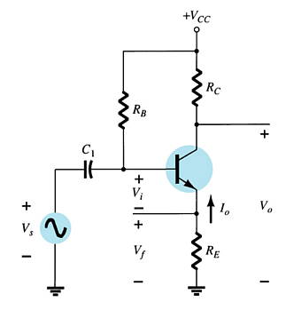
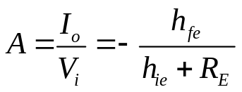

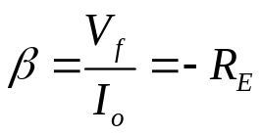

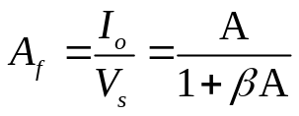
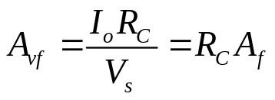


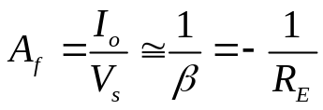
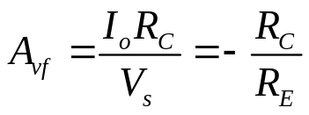
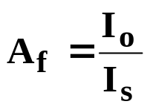
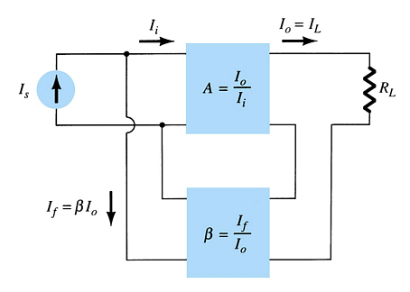
(c) Current-Series Feedback
Open loop:
close loop:
(d) Current-Shunt Feedback
The feedback gain is given by:

Slide 10
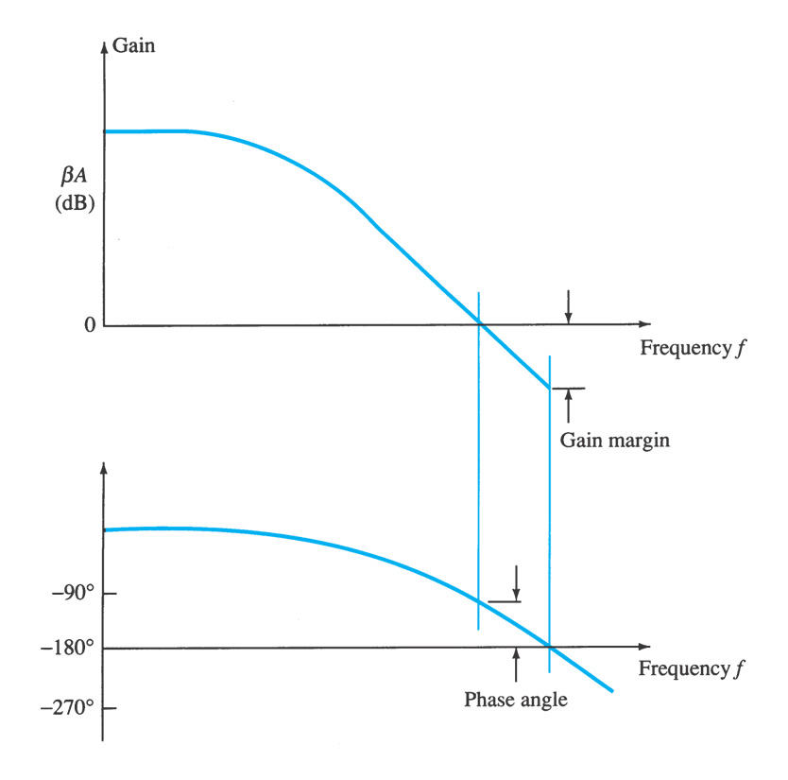

13.4 Feedback Amplifier-phase and frequency considerations
Gain and Phase Margins
Gain margin (GM)
is defined as the negative of the value of in decibels at the frequency at which the phase angle is 180º .
Phase margin (PM)
is defined as the angle of 180º minus the magnitude of the angle at which the value is unity (0dB)

Slide 11
    Summary of Chapter 13
Feedback concepts and types of negative feedback
  Find out feedback and determine the type of feedback
Effects of negative feedback
Gain and phase margin —— stable of a negative feedback amplifier
  To determine whether a negative feedback amplifier is stable.
Gain
  Reduced gain, but improve gain stability
Input impedance
  **- series: increase input impedance
  **-shunt: decrease input impedance
Output impedance
  voltage-**: decrease output impedance
  current-**: increase output impedance
Reduced noise
More linear operation
Improve frequency response and increase bandwidth

