Slide 1
Chapter 2:
Diode Applications

Slide 2

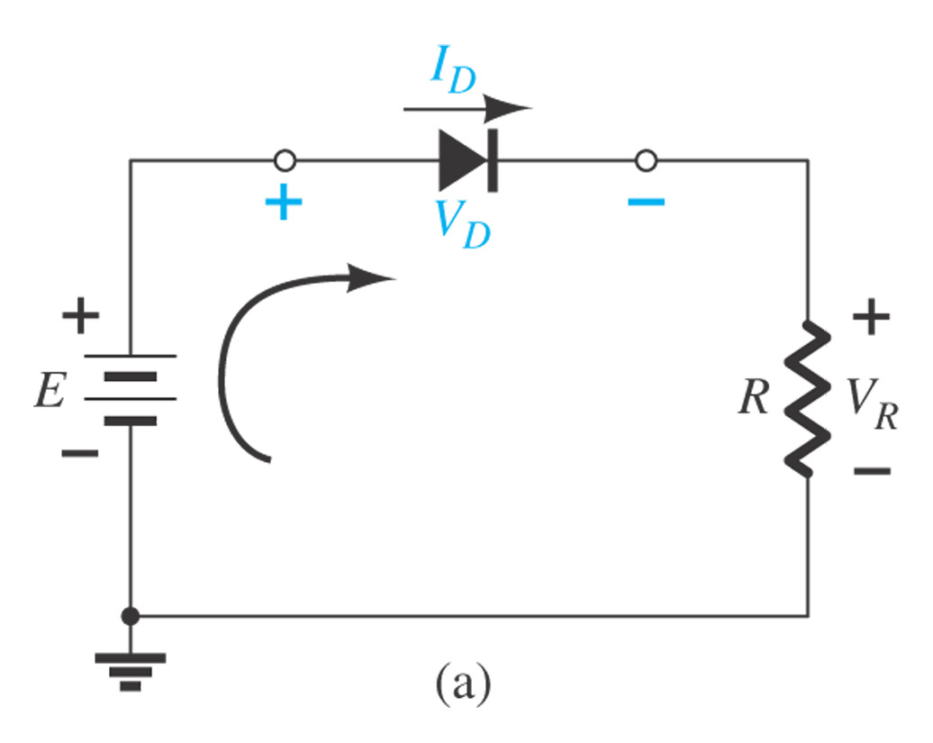
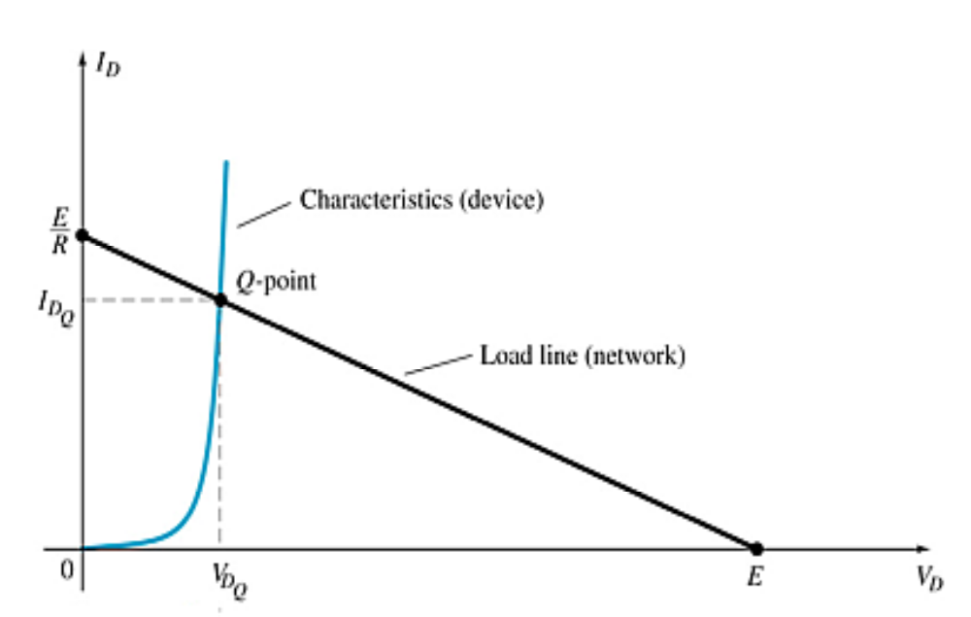
2.2 Load-Line Analysis
The load line plots all possible current (I_{D}) conditions for all voltages applied to the diode (V_{D}) in a given circuit. E / R is the maximum I_{D} and E is the maximum V_{D}.
Where the load line and the characteristic curve intersect is the Q-point, which specifies a particular I_{D} and V_{D} for a given circuit.
Characteristic curve of the solid-state device
Load-line analysis
Load line of the circuit

Slide 3
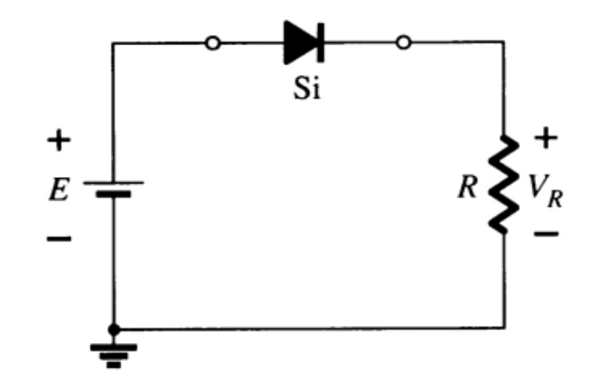
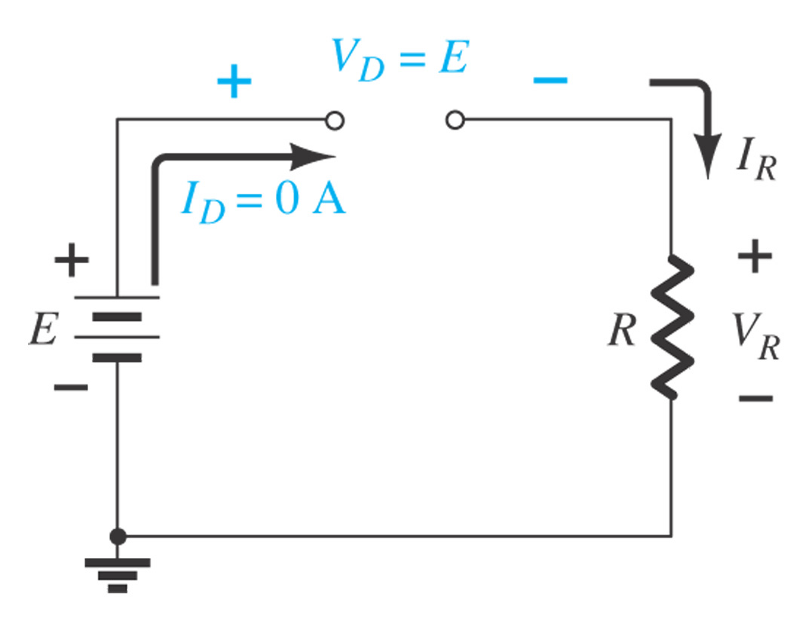
2.3 Equivalent Model Analysis
Forward Bias: E>0.7
Reverse Bias: E<0.7
Constants as known
Silicon Diode: V_{D} = 0.7V
Germanium Diode: V_{D} =0.3V
Analysis
V_{D} = 0.7V
V_{R} = E – V_{D}
I_{D} = I_{R} = I_{T} = V_{R} / R
Diodes ideally behave as open circuits
Analysis
V_{D} = E
V_{R} = 0 V
I_{D} = 0 A

Slide 4
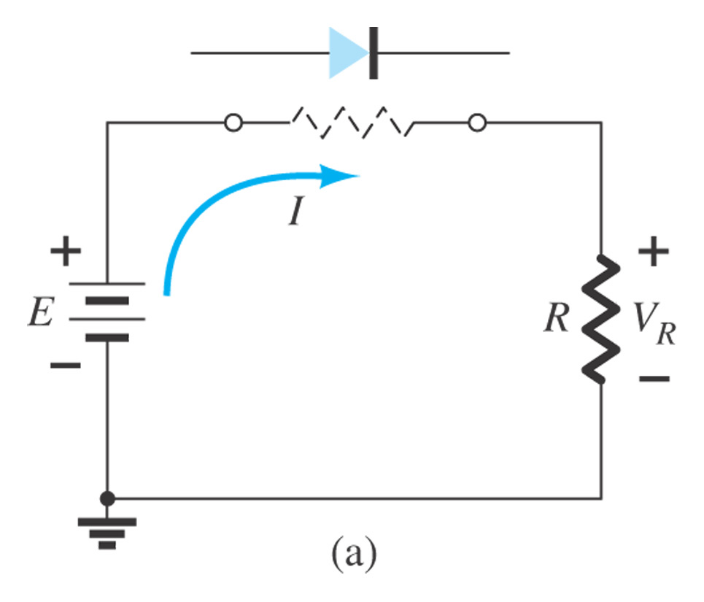
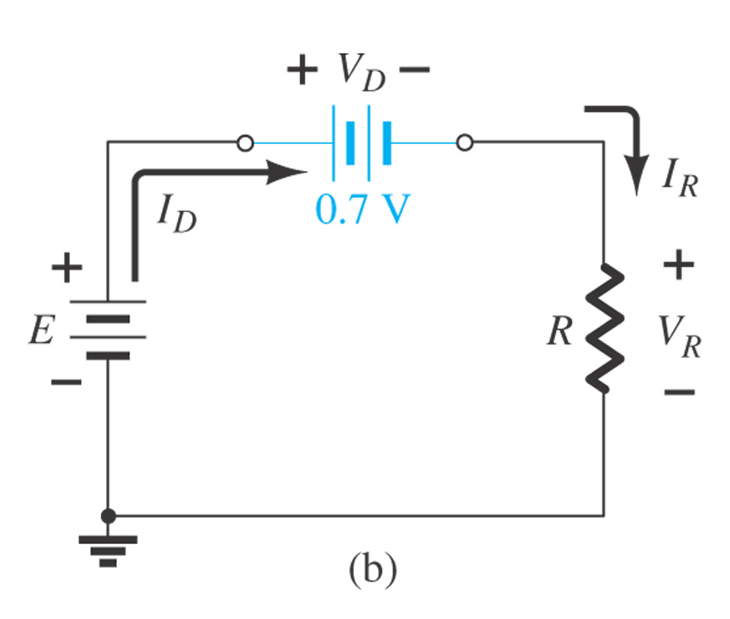
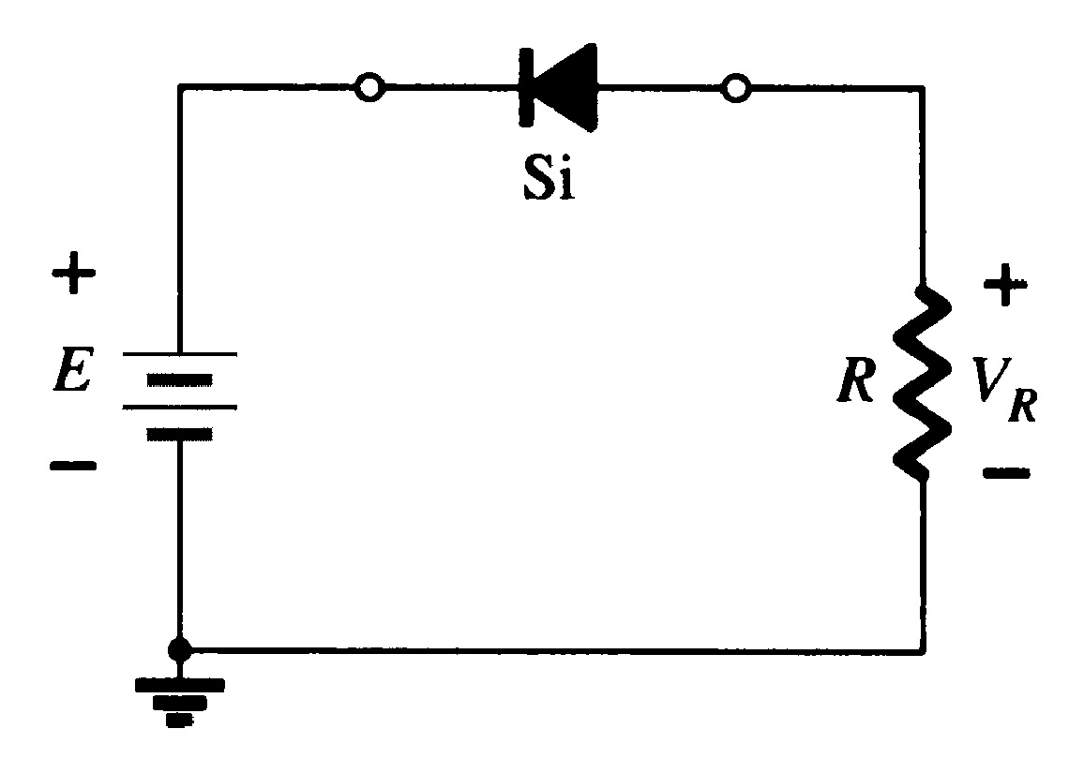
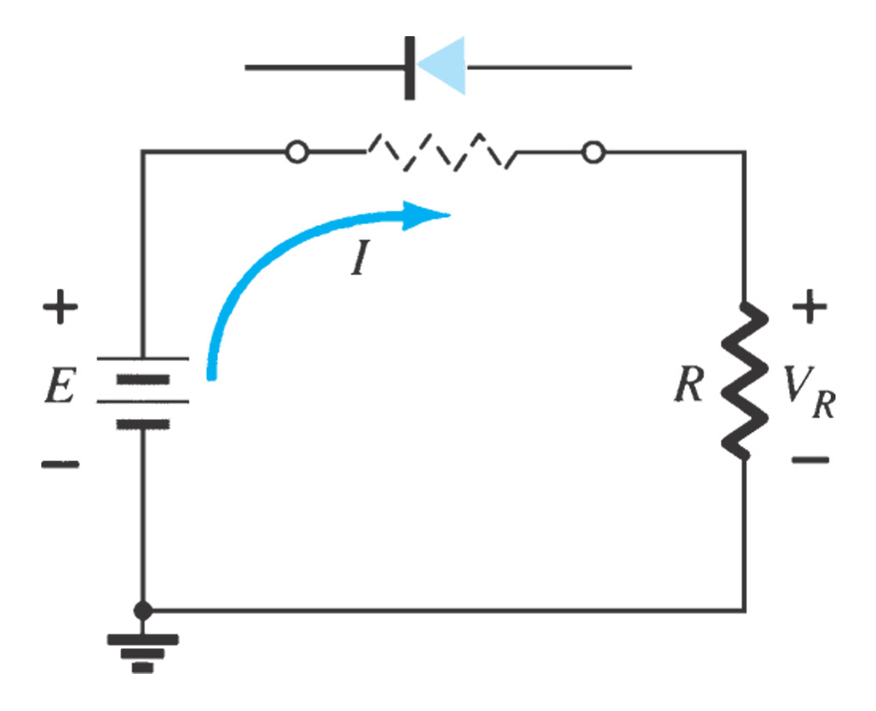
Equivalent Model Analysis
Step 1. Make assumptions (‘short/forward’ or ‘open/reverse’)
Step 2. Analysis/Check assumptions
Step 3. Make final decision

Slide 5
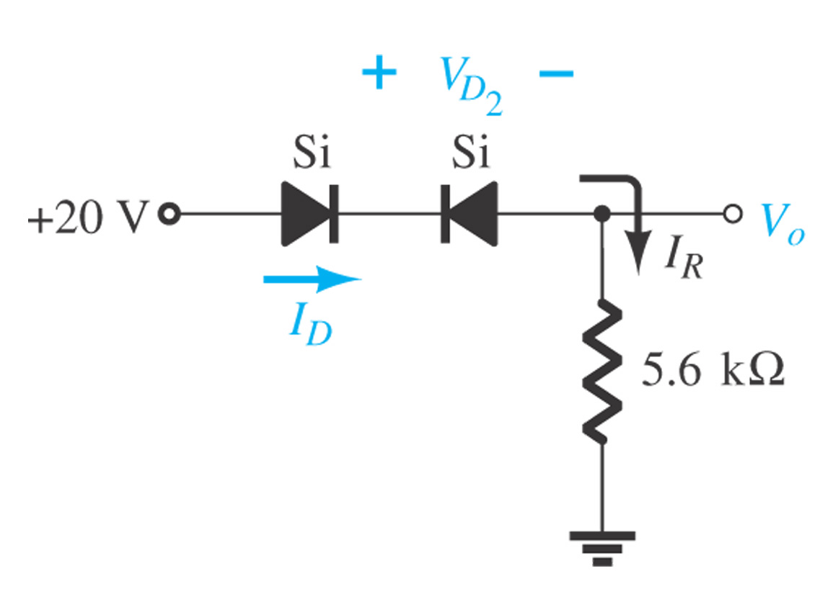
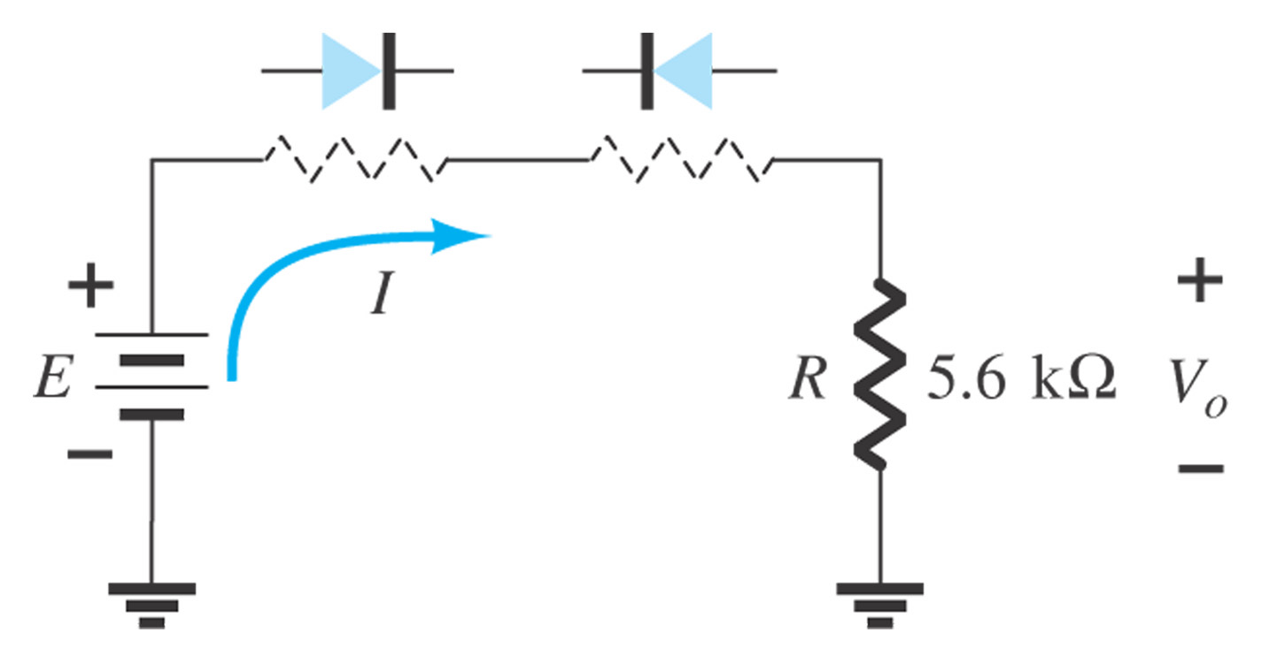
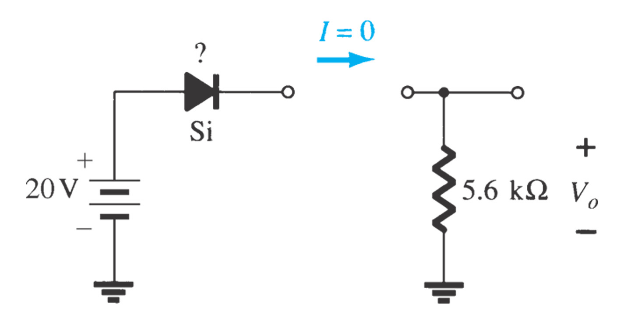
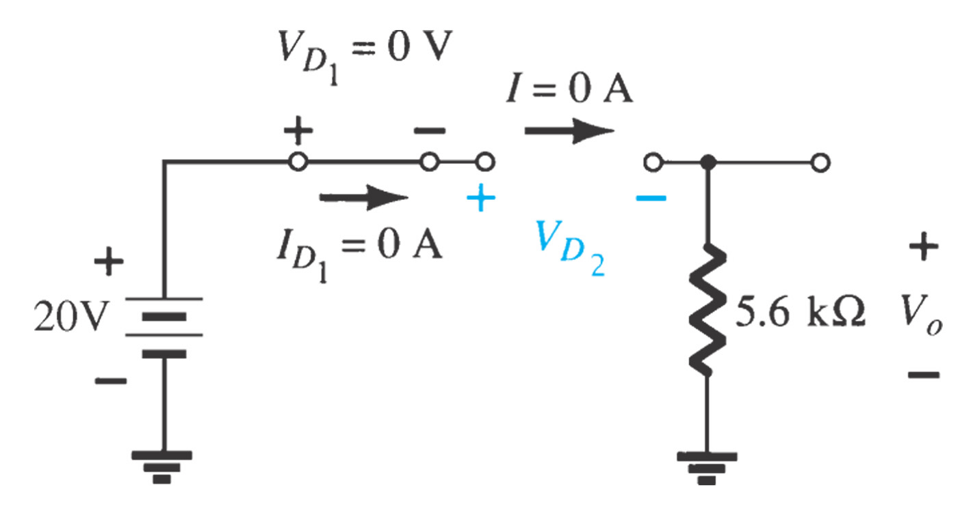
Example 2.4 Determine I_{D}, V_{D2}, and V_{o}
Step1. Make Assumptions
Step2. Analysis/Check assumptions
Step3. Make final decision

Slide 6
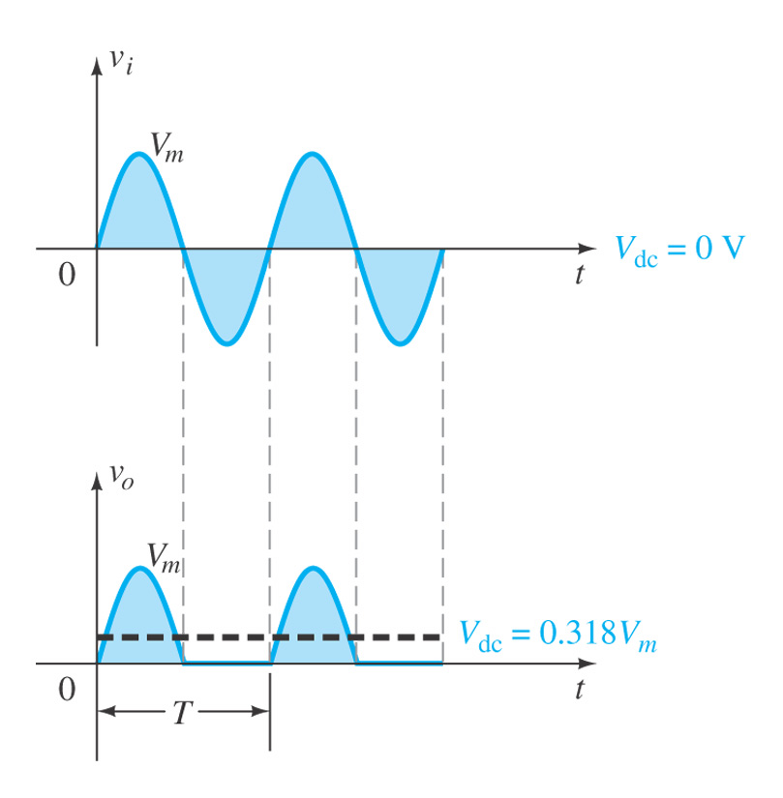
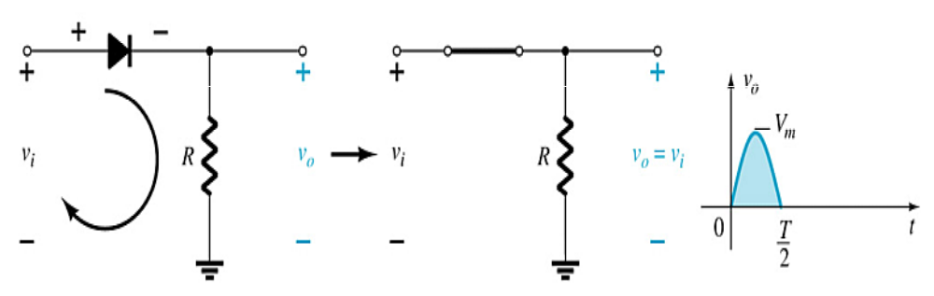
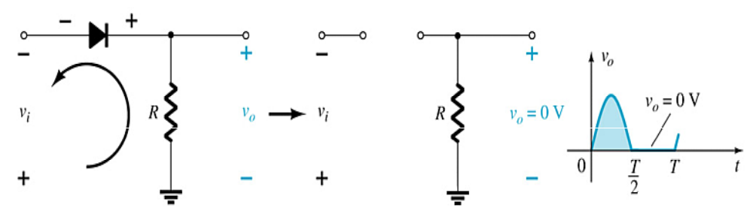
2.5 Half-Wave Rectification
The diode only conducts when it is in forward bias, therefore only half of the AC cycle passes through the diode.
The DC output voltage is 0.318V_{m}, where V_{m} = the peak AC voltage.
Note: It is important that the reverse breakdown voltage rating of the diode be high enough to withstand the peak reverse-biasing AC voltage: Vm <PIV (or PRV)

Slide 7
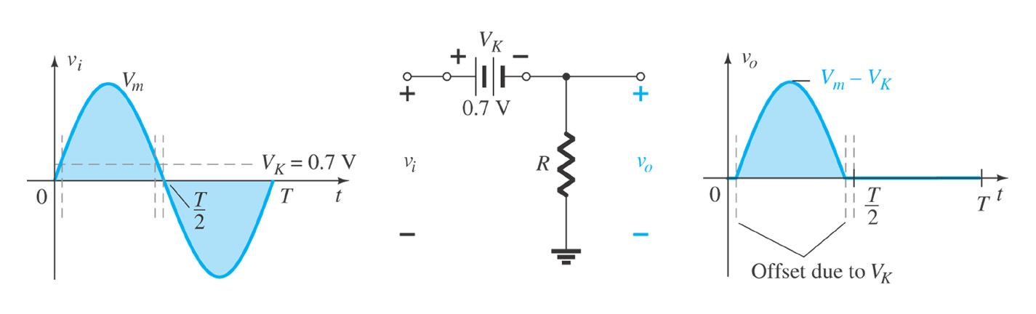
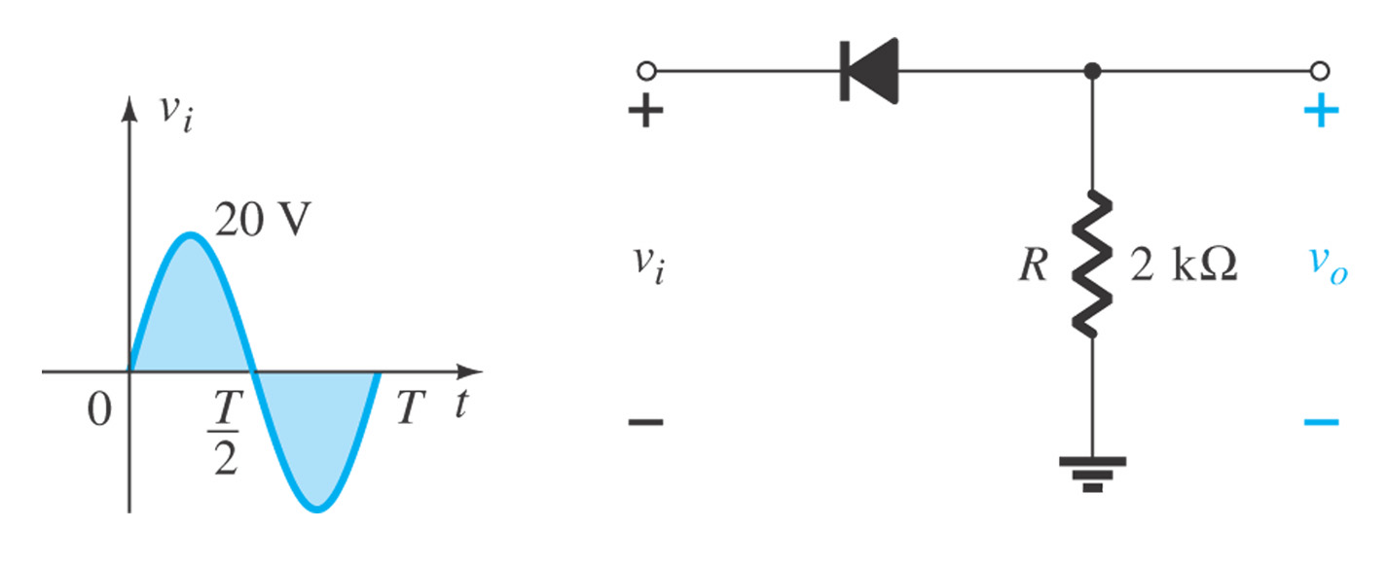
  Using an ideal diode equivalent
  Using a simplified diode equivalent
Example 2.8

Slide 8
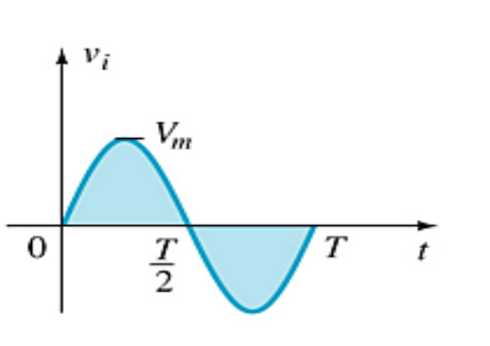
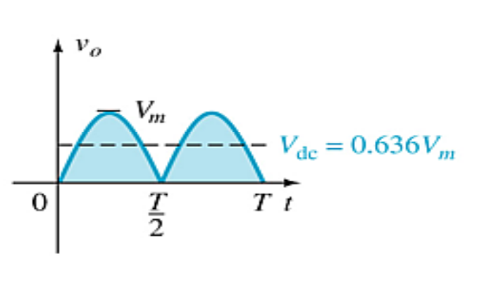
2.6 Full-Wave Rectification
The rectification process can be improved by using more diodes in a full-wave rectifier circuit.
Full-wave rectification produces a greater DC output:
  Half-wave: V_{dc} = 0.318V_{m}
  Full-wave: V_{dc} = 0.636V_{m}

Slide 9
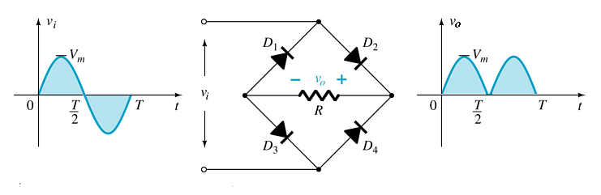
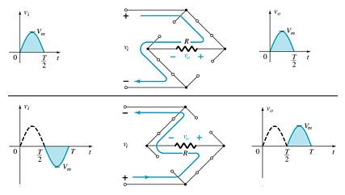
Full-Wave Rectification
Bridge Rectifier
Four diodes are required
V_{DC} = 0.636 Vm

Slide 10
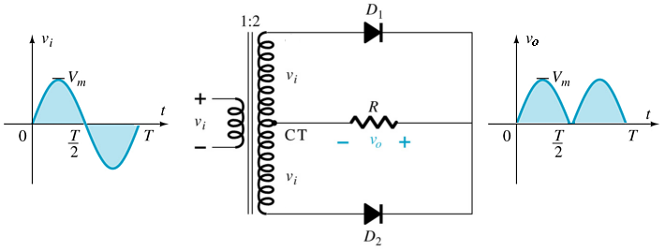
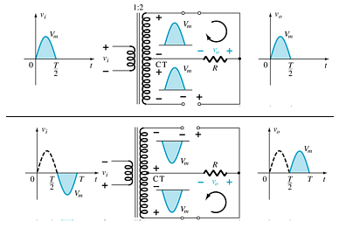
Full-Wave Rectification
Center-Tapped Transformer Rectifier
Requires
  Two diodes
  Center-tapped transformer
    V_{DC} = 0.636(V_{m})

Slide 11
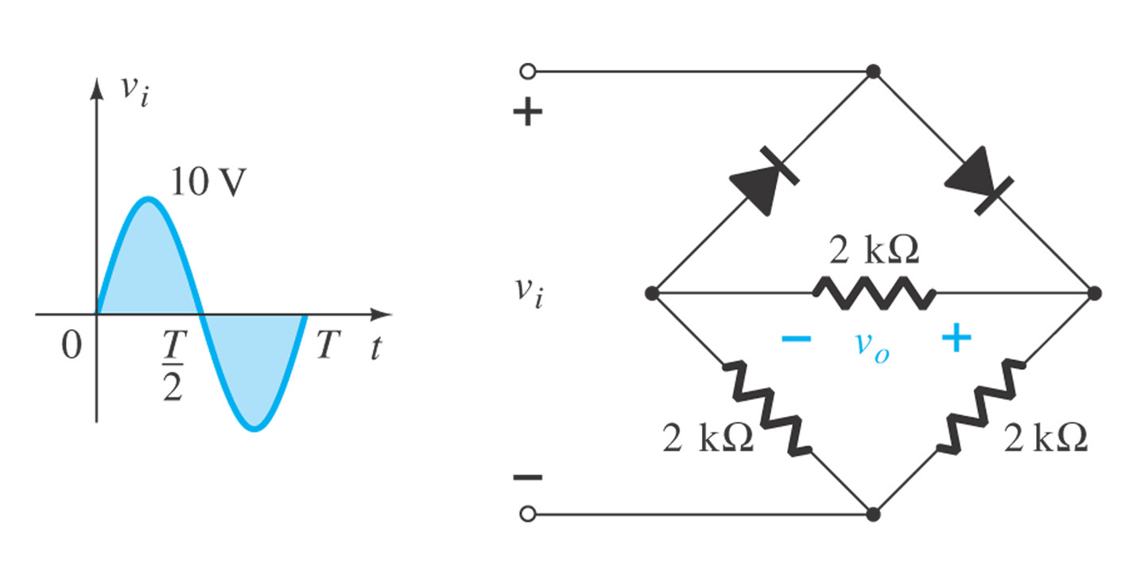
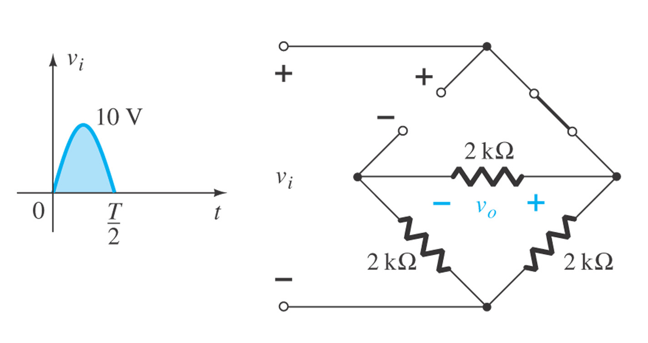
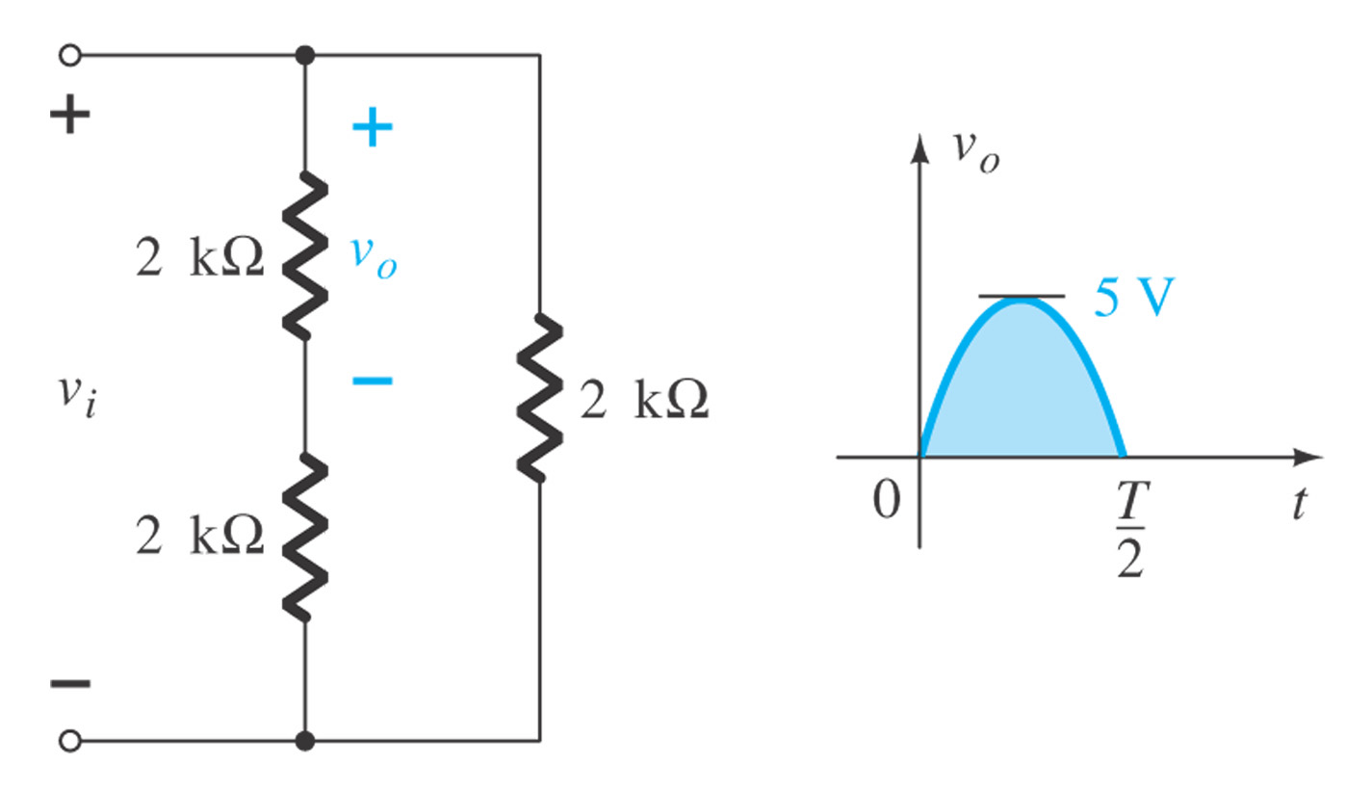
Example 2.9

Slide 12
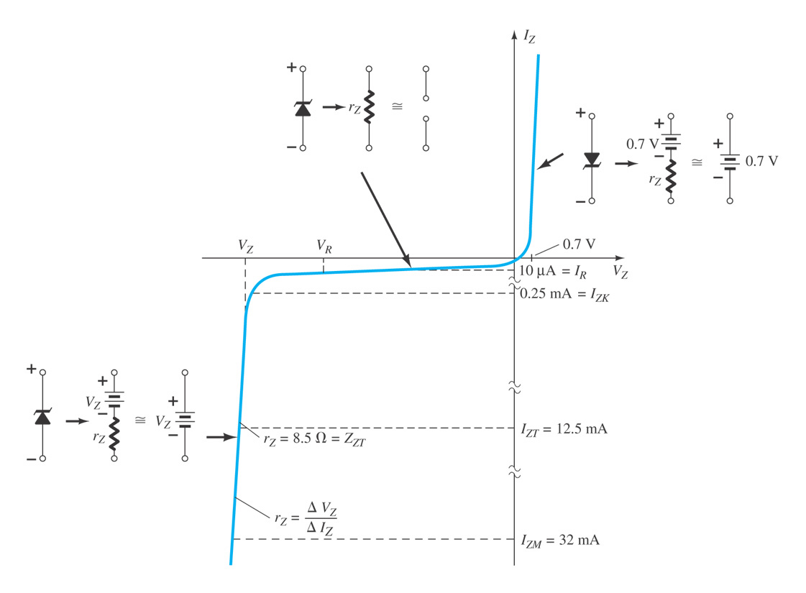
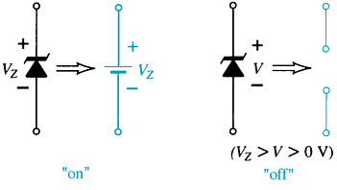
2.9 Zener Diodes
The Zener diode is operated in reverse bias at the Zener Voltage (V_{z}).
When V_{i} ≥ V_{z}
  The Zener is on
  Voltage across the Zener is V_{z}
  Zener current: I_{Z}
  The Zener Power: P_{Z} = V_{Z}I_{Z}
When V_{i} < V_{z}
  The Zener is off
  The Zener acts as an open circuit

Slide 13
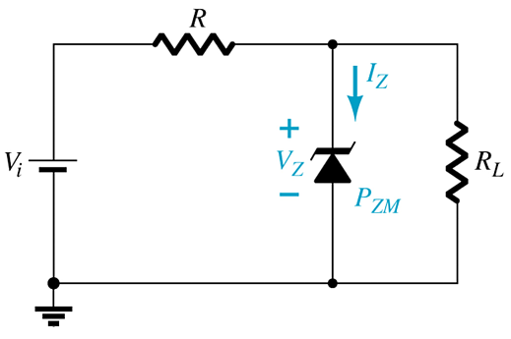
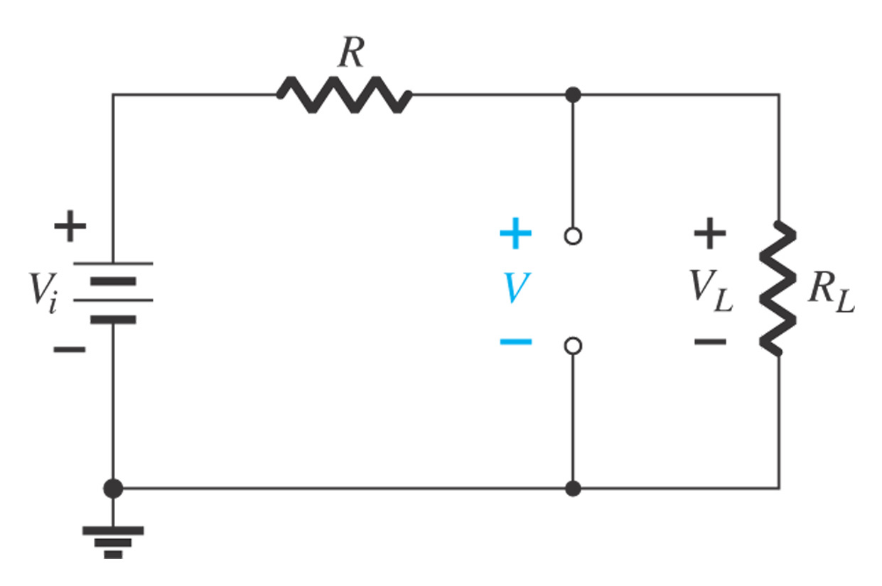
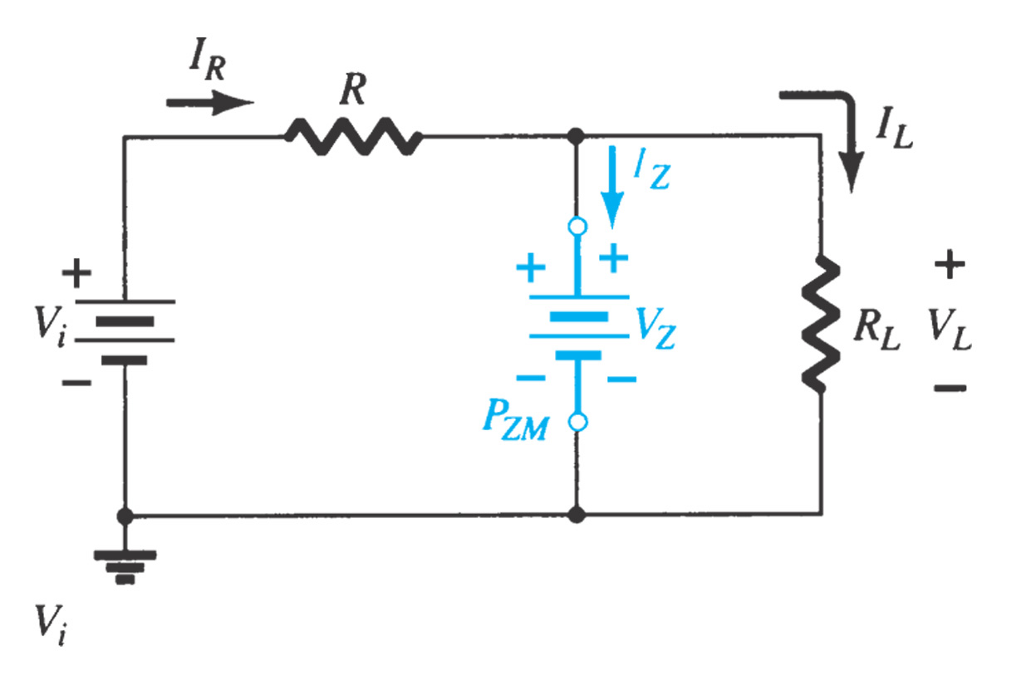
Example 2.17. Fixed V_{i}, Fixed R_{L}
Example 2.18. Fixed V_{i}, Variable R_{L}
Example 2.19. Variable V_{i}, Fixed R_{L}
Step1. Determine the state of the Zener diode by removing it from the network and calculating the voltage across the resulting open circuit.
Step2. Substitute the appropriate equivalent and solve for the desired unknowns.

Slide 14
Summary of Chapter 2
Analysis methods of diode circuits
  Equivalent Model
  Load-Line Analysis
Application of Diodes
  Rectifier
    Conversions of AC to DC for DC operated circuits
    Battery Charging Circuits
  Zener Diodes: Regulator
    Over voltage Protection
    Setting Reference Voltages
  Clipper/limiter: self study
  Clamper: self study
  …

