Slide 1
Chapter 3:
Bipolar Junction Transistors

Slide 2
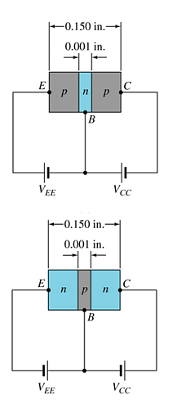
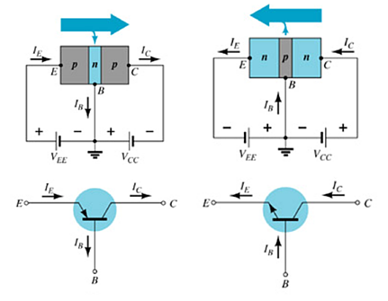
3.2 Transistor Construction
晶体管
There are two types of transistors:
pnp
npn
The terminals are labeled:
E – Emitter
B – Base
C – Collector
Features of each doped region:
E – Highly doped
B – Very narrow, lowest doped
C – lower doped, large surface
There are two pn junctions:
Base-Emitter junction
Base-Collector junction
pnp
npn

Slide 3
3.3 Transistor Operation
There four operation modes depending on the bias condition of each pn junction:
 | Emitter-Base junction | Base-Collector junction
Active operation (linear amplification) | Forward bias | Reverse bias
Saturation region | Forward bias | Forward bias
Cutoff region | Reverse bias | Reverse bias
Reverse operation | Reverse bias | Forward bias
The active operation region is normally employed for linear (undistorted) amplifiers.

Slide 4
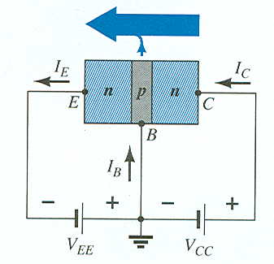
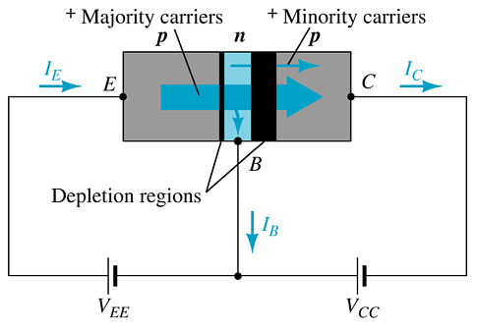
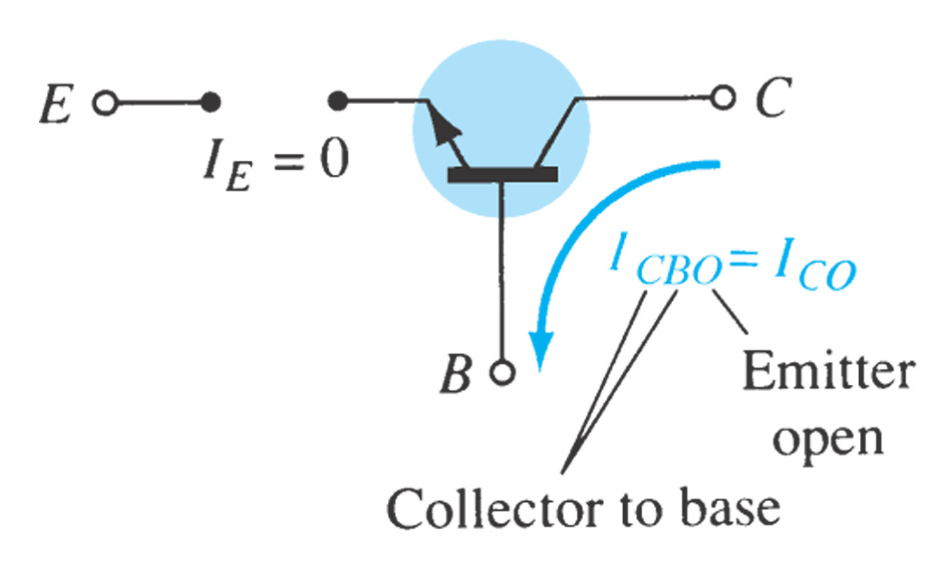



Currents in a Transistor
NPN
With the external sources, V_{EE} and V_{CC}, connected as shown below:
The emitter-base junction is forward biased
The base-collector junction is reverse biased
PNP
Emitter current is the sum of the collector and base currents:
The collector current is comprised of two currents:

Slide 5
3.4 Common-Base Configuration
Three basic configurations of a BJT according to the common terminal:
 | Input terminal | Common terminal | Output terminal
Common-Base (CB) | Emitter | Base | Collector
Common-Emitter (CE) | Base | Emitter | Collector
Common-Collector (CC) | Base | Collector | Emitter
CB: The base is common to both input (emitter–base) and output (collector–base) of the transistor.

Slide 6
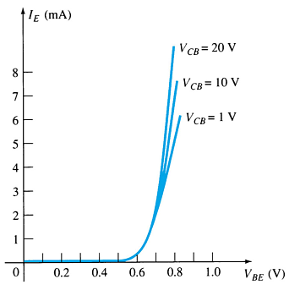
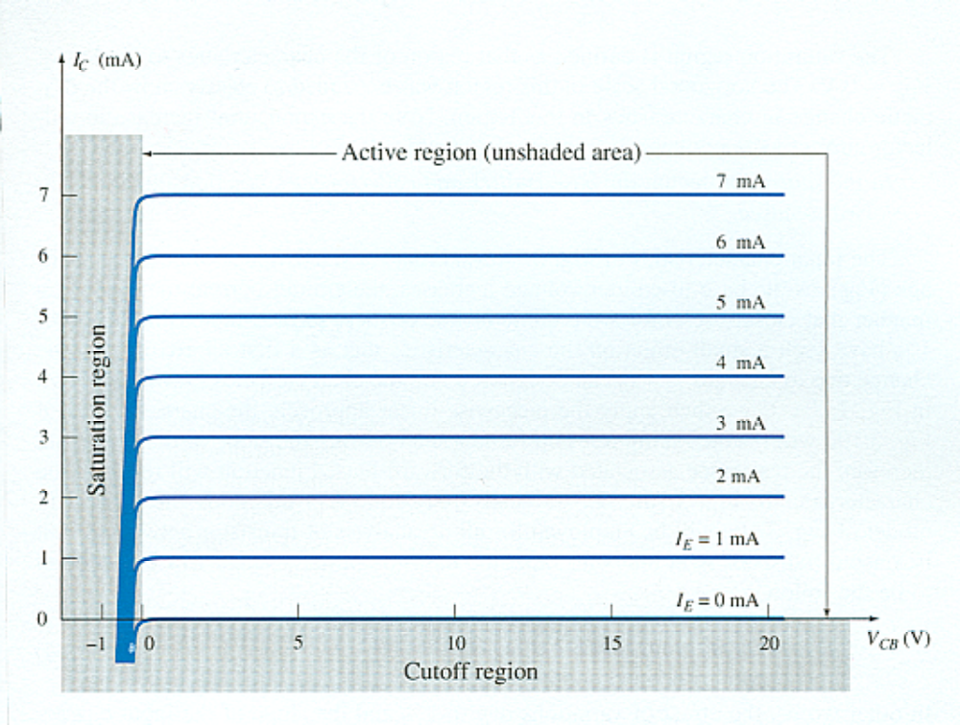
Common-Base Amplifier
Output Characteristics
This graph demonstrates the output current (I_{C}) to an output voltage (V_{CB}) for various levels of input current (I_{E}).
Input Characteristics
This curve shows the relationship between of input current (I_{E}) to input voltage (V_{BE}) for various levels of output voltage (V_{CB}).

Slide 7


Operating Regions
Cutoff region—The amplifier is basically off. There is voltage, but little current.
Saturation region—The amplifier is full on. There is current, but little voltage.
Active region—Operating range of the amplifier.
In active region:
Emitter and collector currents:
Base-emitter voltage:
I_{CBO} = minority collector current. This is usually so small that it can be ignored

Slide 8
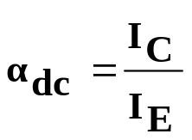
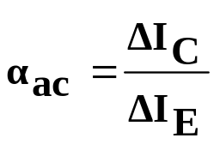
Alpha (α)
Alpha (α) relates the DC currents I_{C} and I_{E} :
    Ideally: α = 1
    In reality: α is between 0.9 and 0.998
Alpha (α) in the AC mode:

Slide 9
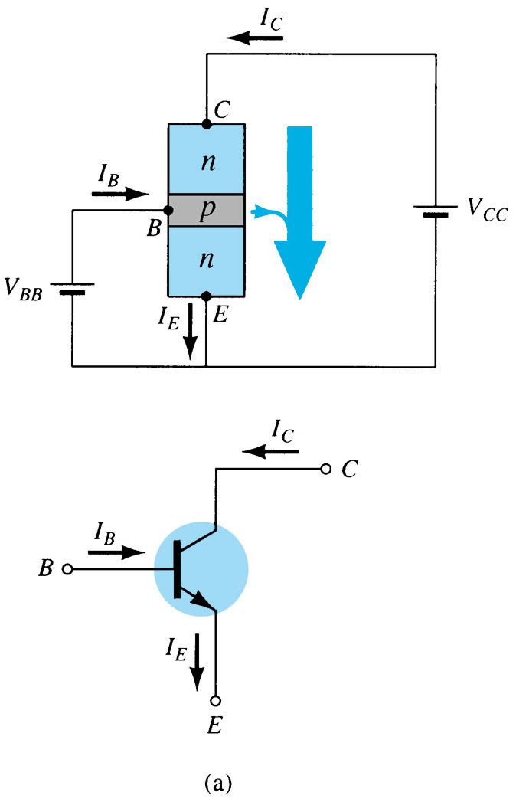
3.6 Common–Emitter Configuration
CE: The emitter is common to both input (base-emitter) and output (collector-emitter).
The input is on the base and the output is on the collector.

Slide 10
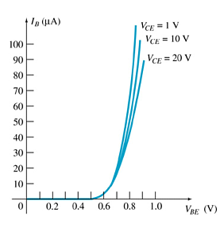
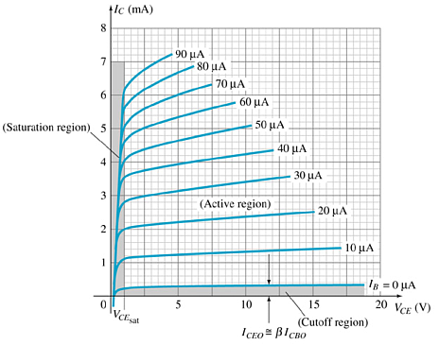
Common-Emitter Characteristics
Base Characteristics
Input Characteristics
Collector Characteristics
This curve shows the relationship between of input current (I_{B}) to input voltage (V_{BE}) for various levels of output voltage (V_{CE}).
Output Characteristics
This graph demonstrates the output current (I_{C}) to an output voltage (V_{CE}) for various levels of input current (I_{B}).

Slide 11
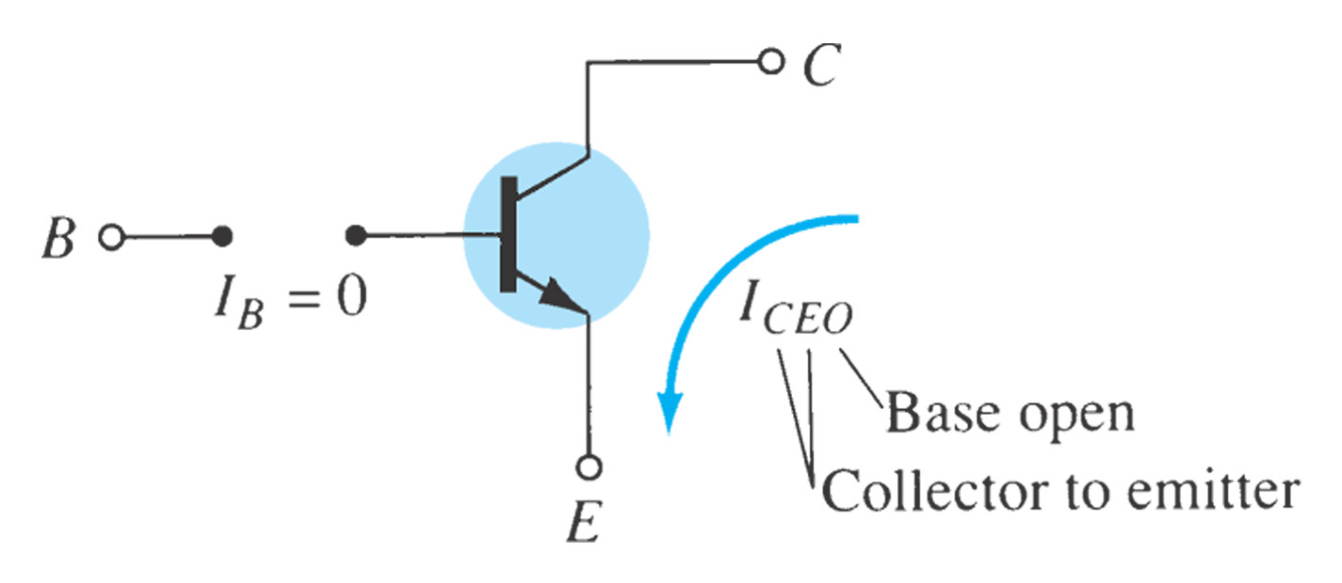
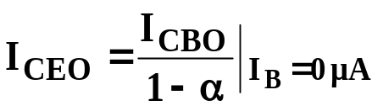
Common-Emitter Amplifier Currents
Ideal Currents
  I_{E} = I_{C} + I_{B} I_{C} = α I_{E}
where I_{CBO} = minority collector current. This is usually so small that it can be ignored, except in high power transistors and in high temperature environments.
Actual Currents
  I_{C} = α I_{E} + I_{CBO}
When I_{B} = 0 μA the transistor is in cutoff, but there is some minority current flowing called I_{CEO}.

Slide 12
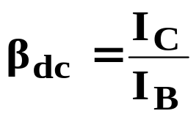
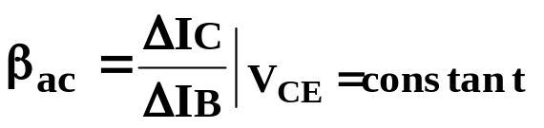
Beta (β)
β represents the amplification factor of a transistor. (β is sometimes referred to as h_{fe}, a term used in transistor modeling calculations)
In DC mode:
In AC mode:

Slide 13
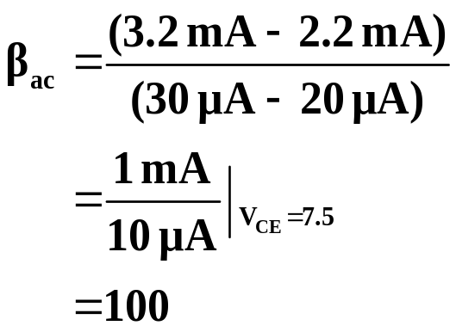
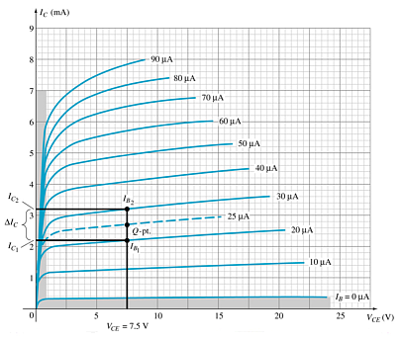
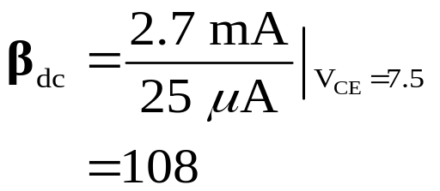
Beta (β)
Determining β from a Graph
Note: β_{AC} ≈ β_{DC}

Slide 14
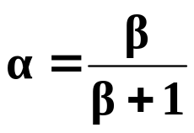
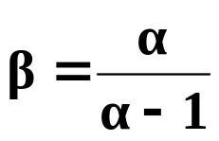


Beta (β)
Relationship between amplification factors β and α
Relationship Between Currents

Slide 15
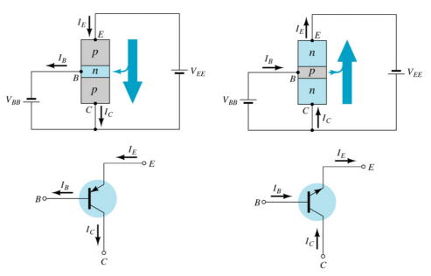
3.7 Common–Collector Configuration
CC: The collector is common to both input (base-collector) and output (emitter-collector).
The input is on the base and the output is on the emitter.
The characteristics are similar to those of the common-emitter configuration, except the vertical axis is I_{E}.

Slide 16
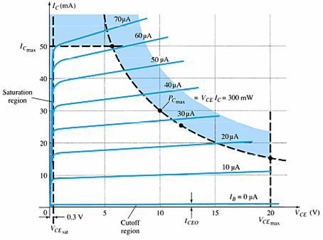

3.8 Limitations of Operation
V_{CE} is at maximum and I_{C} is at minimum (I_{Cmin}= I_{CEO}) in the cutoff region.
I_{C} is at maximum and V_{CE} is at minimum (V_{CE min} = V_{CEsat} = V_{CEO}) in the saturation region.
The transistor operates in the active region between saturation and cutoff.
CE Configuration
Common-emitter:

Slide 17
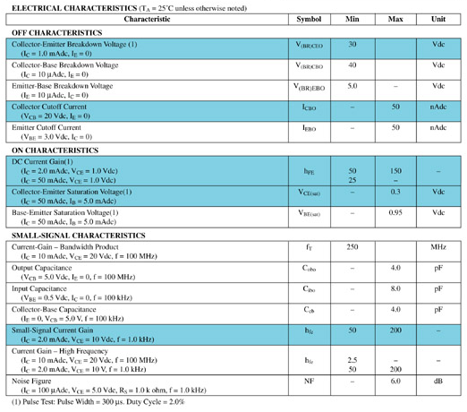
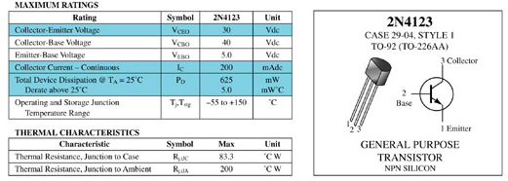
3.9 Transistor Specification Sheet
more…

Slide 18
Summary of Chapter 3
Key Information
  Transistor construction and operation
    Current relationship
  Three Basic Configurations:
    CE
    CB
    CC
  Characteristics of CE, CB and CC configuration
  Transistor Operation Regions
    Active region
    Cutoff region
    Saturation region
Application Key Notes
  Limits of Operation

