Slide 1
Chapter 4:
DC Biasing–BJTs

Slide 2
Biasing
Biasing refers to the DC voltages applied to a transistor in order to turn it on so that it can amplify the AC signal.
To provide energy for amplification
To provide a proper response to an input AC signal by determining the operating point
Nonlinear Devices
DC and AC response are different, so DC analysis can be totally separated from the ac response
The choice of parameters for DC levels will affect the AC response, and vice versa

Slide 3
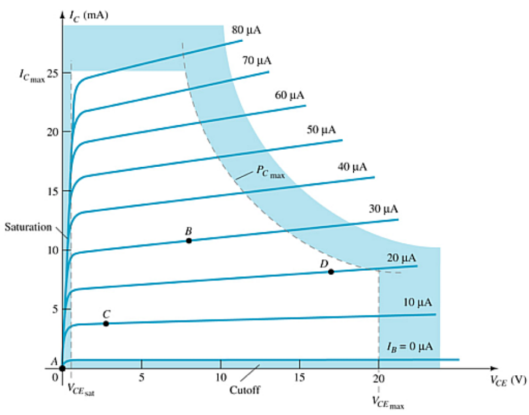
4.2 Operating Point
The DC input establishes an operating or quiescent point called the Q-point.
Biasing and Three States of Operation
Active or Linear Region Operation
  Base–Emitter junction is forward biased
  Base–Collector junction is reverse biased
Cutoff Region Operation
  Base–Emitter junction is reverse biased
Saturation Region Operation
  Base–Emitter junction is forward biased
  Base–Collector junction is forward biased
DC Biasing Circuits
Fixed-bias circuit
Emitter-stabilized bias circuit
Voltage divider bias circuit
DC bias with voltage feedback

Slide 4
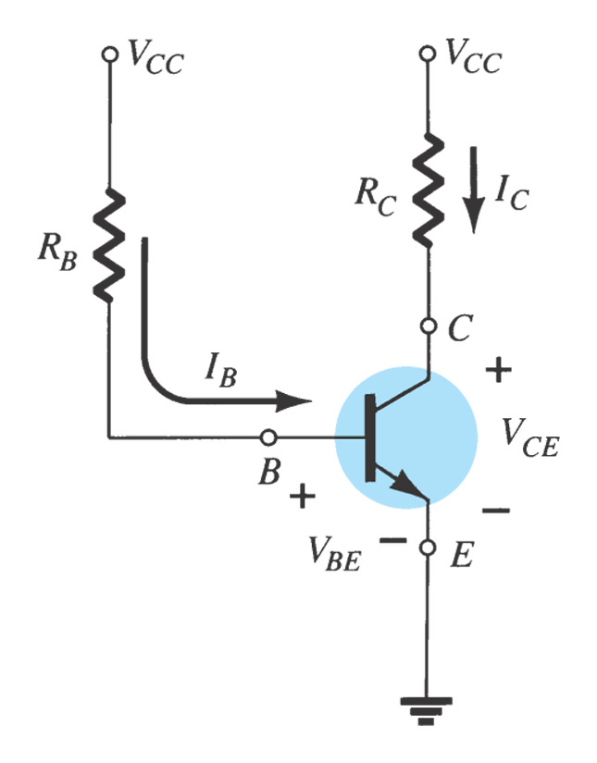
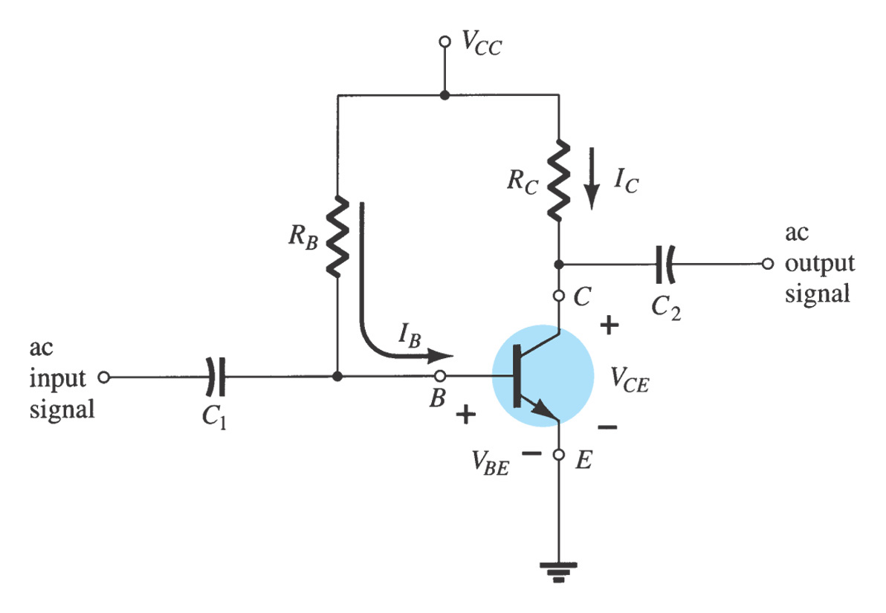
4.3 Fixed Bias Circuit
Sketching the DC equivalent is the first step for DC analysis:
Replacing the capacitor with an open-circuit equivalent.
Replacing the inductor with a short-circuit equivalent.
DC supply can be separated for analysis purpose only

Slide 5
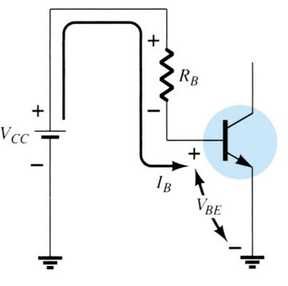
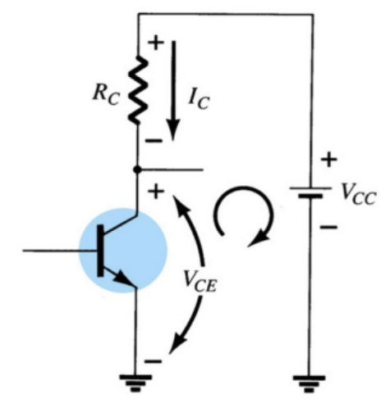

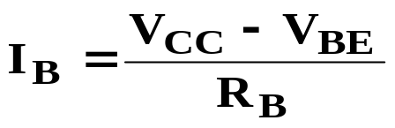

Mathematical Analysis
Base-emitter loop
Collector-emitter loop
From Kirchhoff’s voltage law:
The collector current is given by:
+V_{CC} – I_{B}R_{B} – V_{BE} = 0
Solving for the base current:
From Kirchhoff’s voltage law:

Slide 6
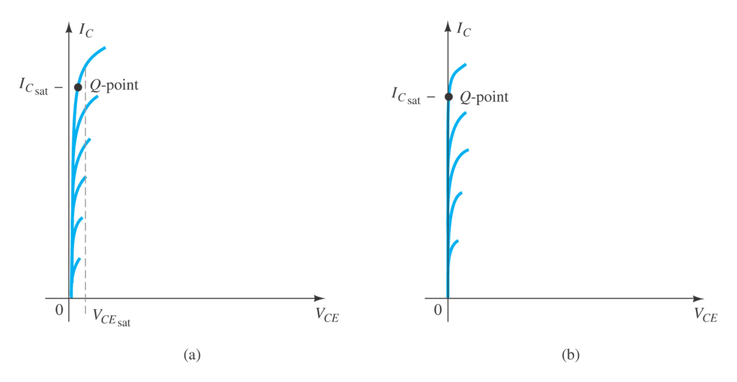
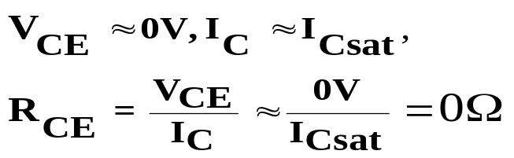


Transistor Saturation
Transistor Saturation Level
When the transistor is operating in the saturation region, it is conducting at maximum current flow through the transistor.

Slide 7
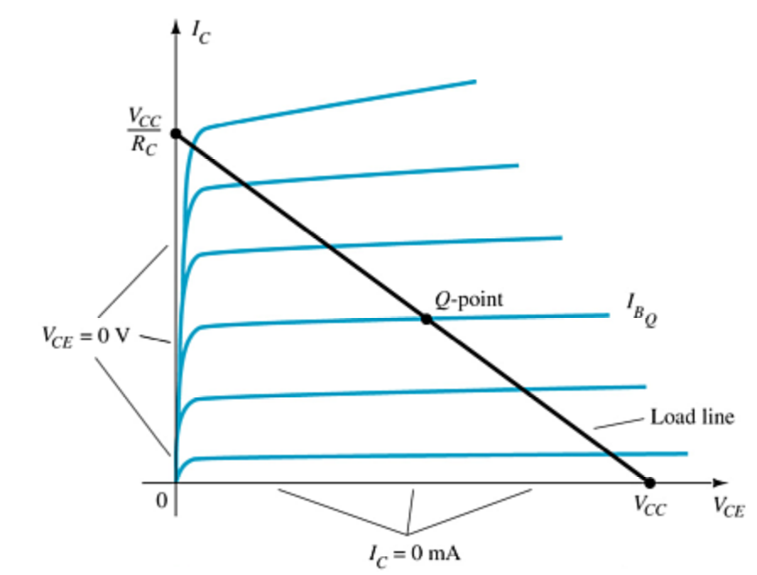
Load Line Analysis
Load equation by KVL:
The end points of the load line are:
I_{Csat}
  I_{C} = V_{CC} / R_{C}
  V_{CE} = 0 V
V_{CEcutoff}
  V_{CE} = V_{CC}
  I_{C} = 0 mA
The Q-point is the particular operating point:
where the value of R_{B} sets the value of I_{B}
where I_{B} and the load line intersect
that sets the values of V_{CE} and I_{C}

Slide 8
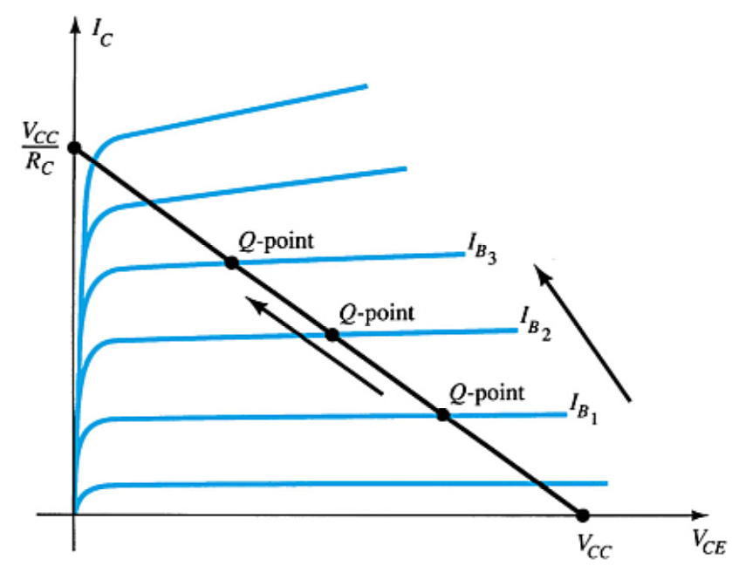
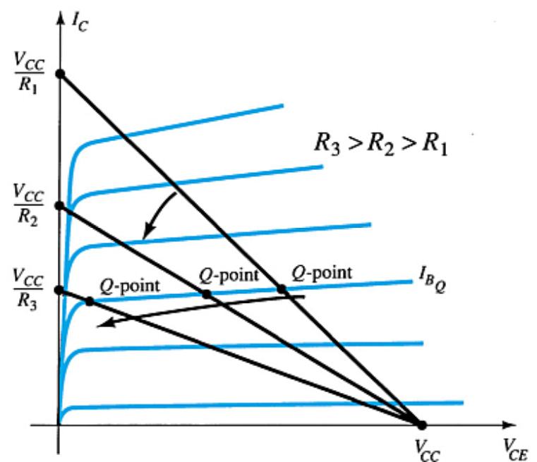
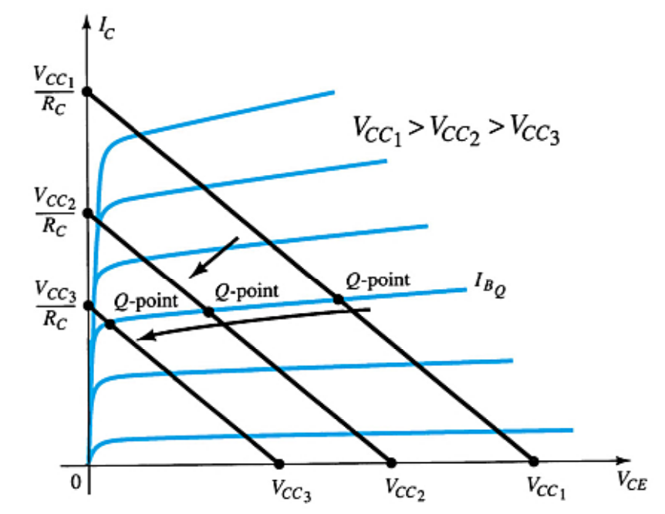
Circuit Values Affect the Q-Point
more …

Slide 9
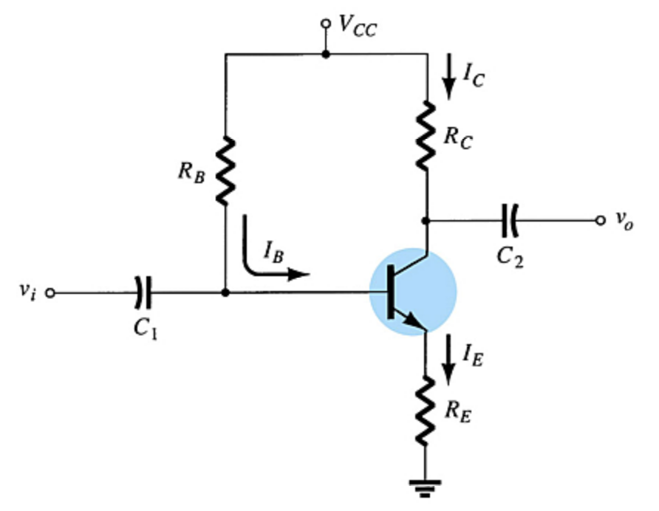
4.4 Emitter-Stabilzed Bias Circuit
Improved Biased Stability
Adding a resistor (R_{E}) to the emitter improves the stability of a transistor.
Stability refers to a bias circuit in which the currents and voltages will remain fairly constant for a wide range of temperatures and transistor Beta (β) values.

Slide 10
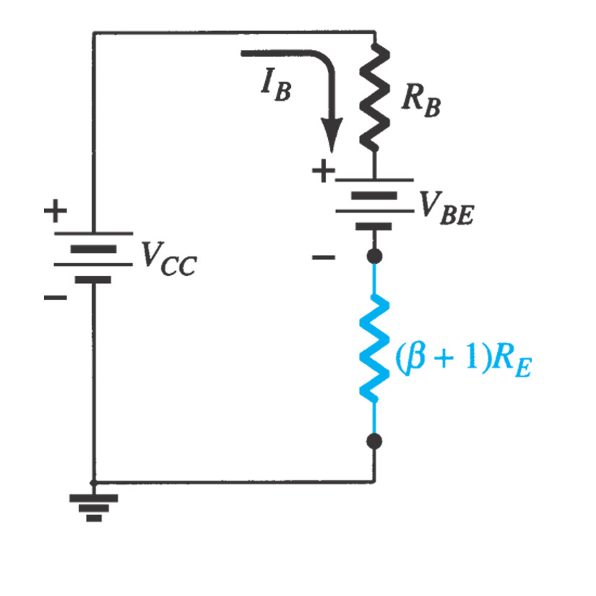
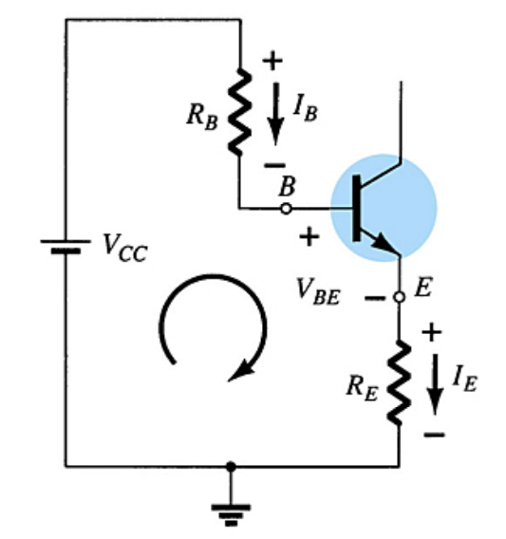


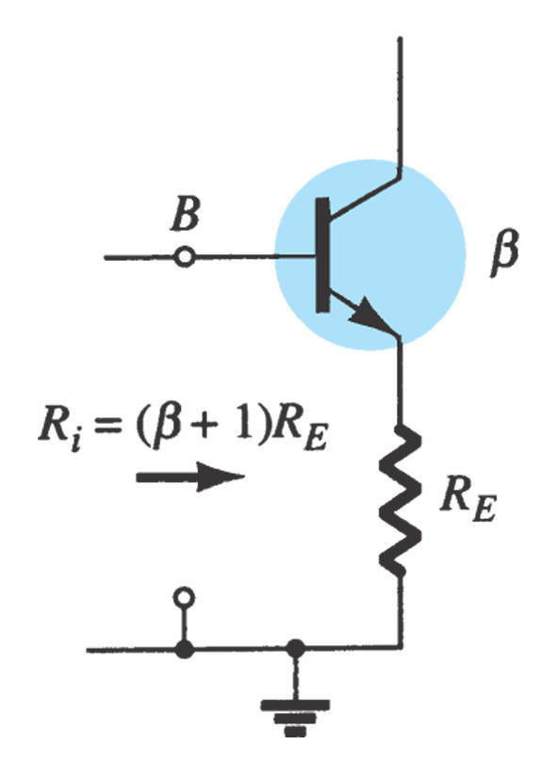
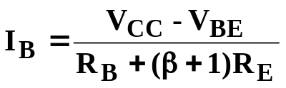
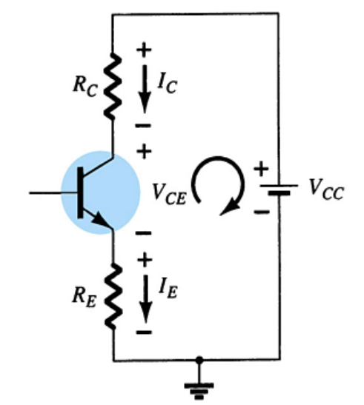


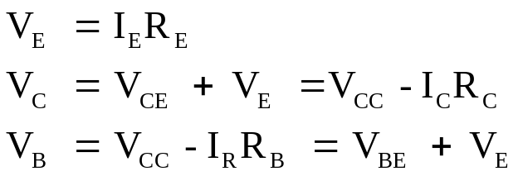
Mathematical Analysis
Base-Emitter Loop
From Kirchhoff’s voltage law :
Since I_{E} = (β + 1)I_{B}:
Solving for I_{B}:
Collector-Emitter Loop
The collector current is given by:
From Kirchhoff’s voltage law :
Since I_{E} ≅ I_{C}:
Also:
The role of R_{E}?

Slide 11
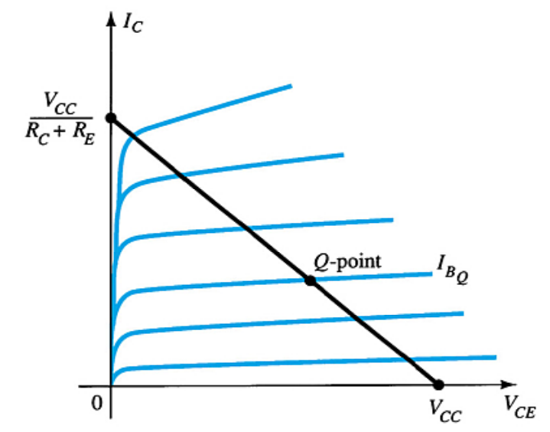
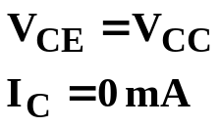
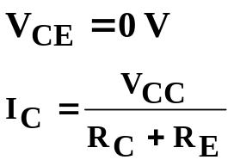
Load line Analysis
Load equation by KVL:
The endpoints can be determined from the load line.
V_{CEcutoff}:
I_{Csat}:

Slide 12
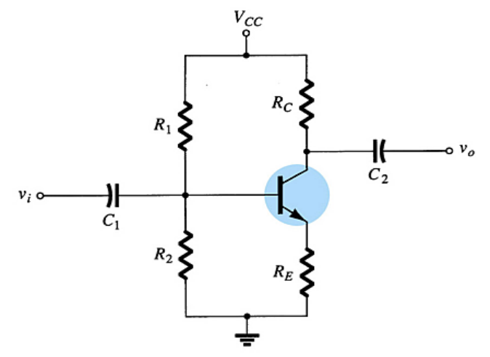
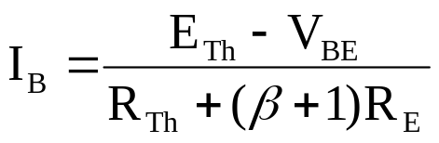
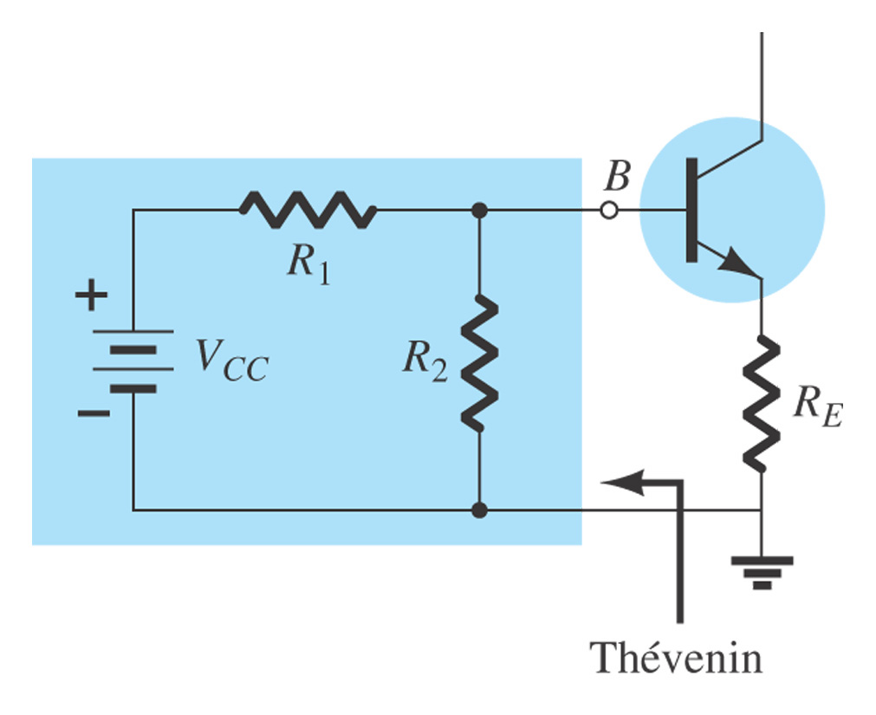
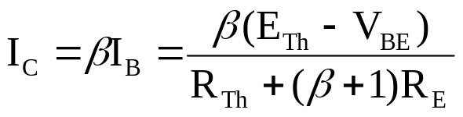

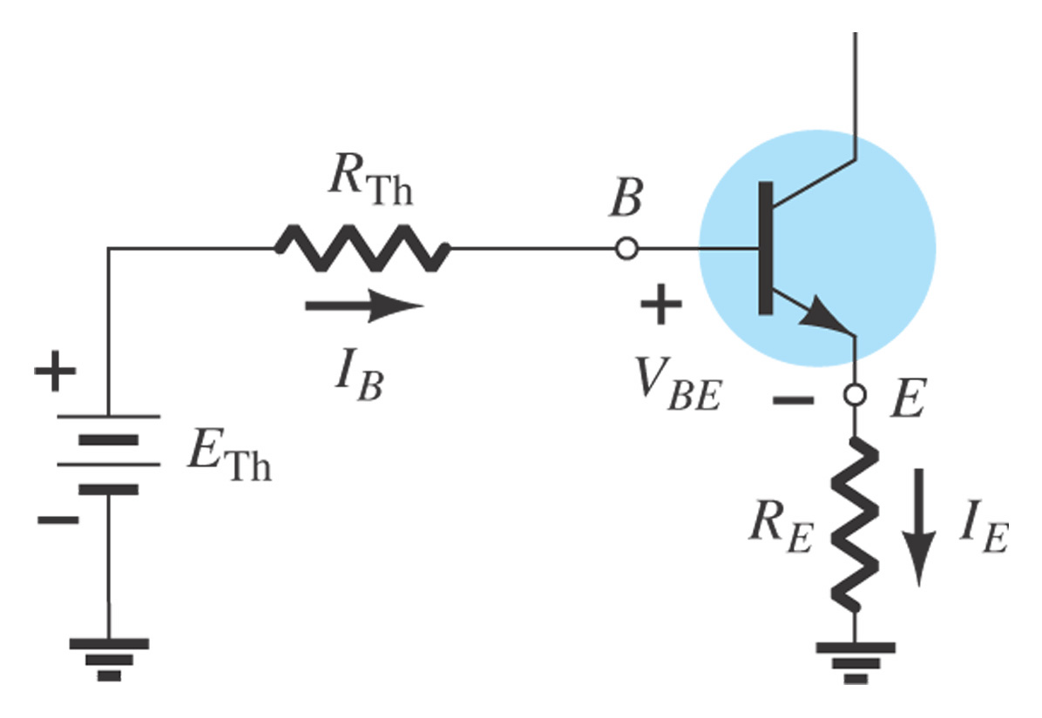
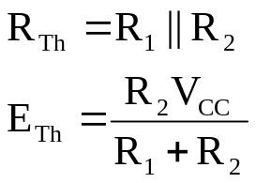
4.5 Voltage Divider Bias
This is a very stable bias circuit.
The currents and voltages are almost independent of variations in β.

Slide 13
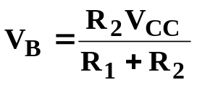
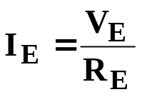

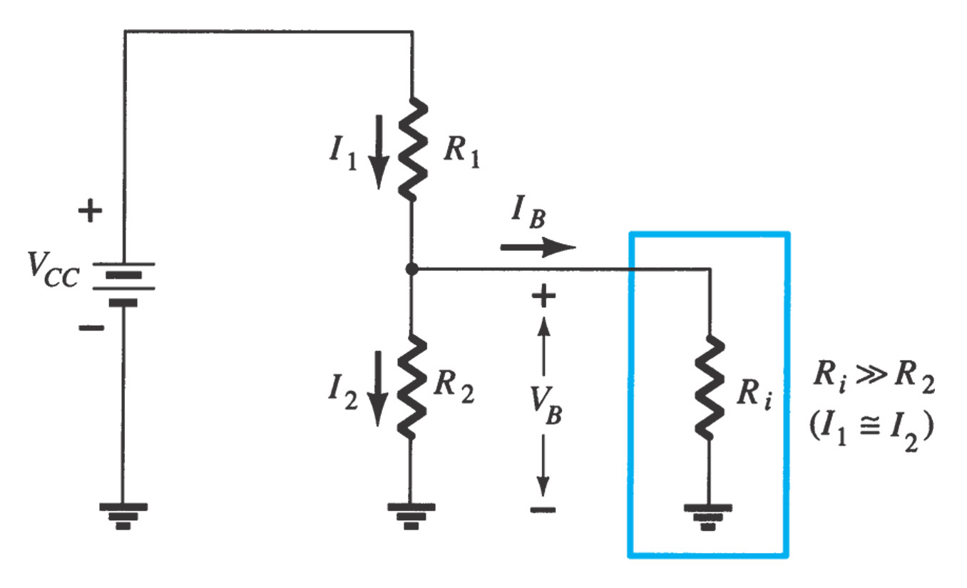

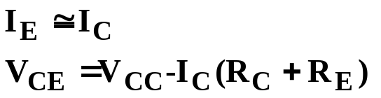
Approximate Analysis
Where I_{B} << I₁ and I₂ and I₁ ≅ I₂ :
Where βR_{E} > 10R₂:
From Kirchhoff’s voltage law:

Slide 14
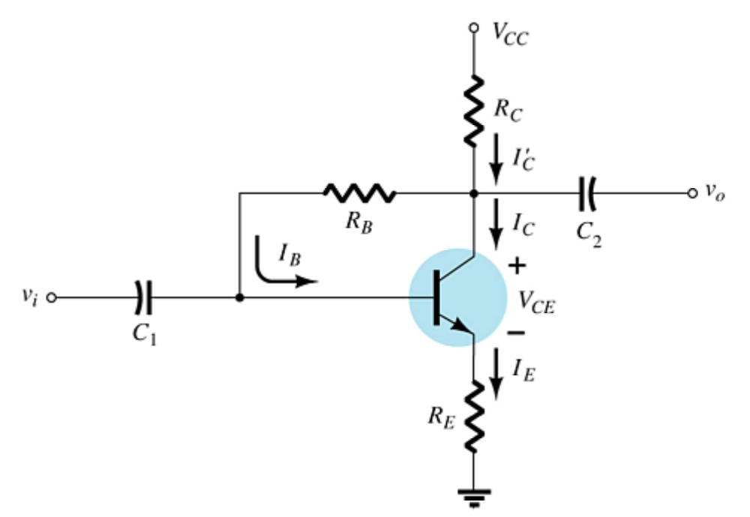
4.6 DC Bias with Voltage Feedback
Another way to improve the stability of a bias circuit is to add a feedback path from collector to base.
In this bias circuit the Q-point is only slightly dependent on the transistor beta, β.

Slide 15
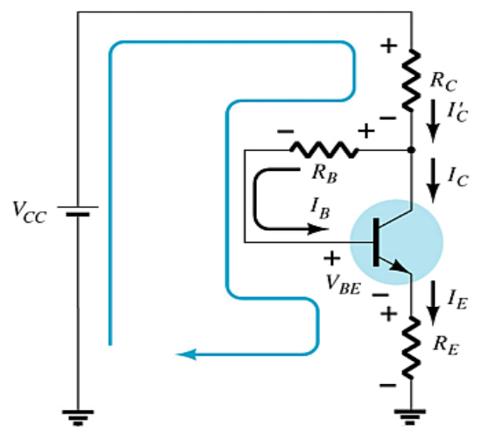


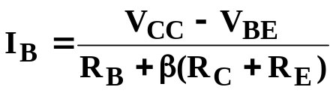
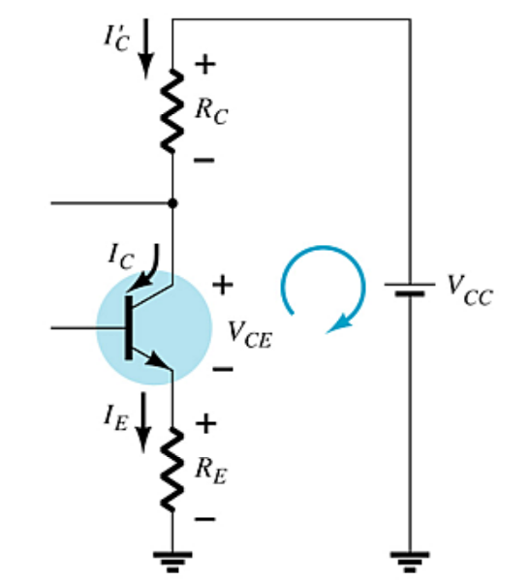
Base-Emitter Loop
Base-Emitter Loop
From Kirchhoff’s voltage law:
Where I_{B} << I_{C}:
Knowing I_{C} = βI_{B} and I_{E} ≅ I_{C}, the
loop equation becomes:
Solving for I_{B}:
Collector-Emitter Loop
Applying Kirchoff’s voltage law:
I_{E} R_{E} + V_{CE} + I_{C}′R_{C} – V_{CC} = 0
Since I_{C}′ ≅ I_{C} and I_{C} = βI_{B}:
I_{C}(R_{C} + R_{E}) + V_{CE} – V_{CC} =0
Solving for V_{CE}:
V_{CE} = V_{CC} – I_{C}(R_{C} + R_{E})

Slide 16
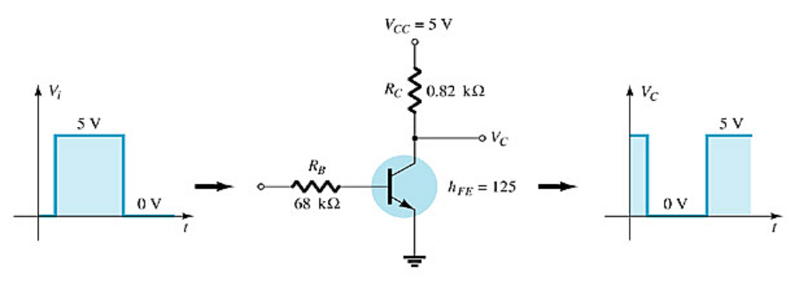
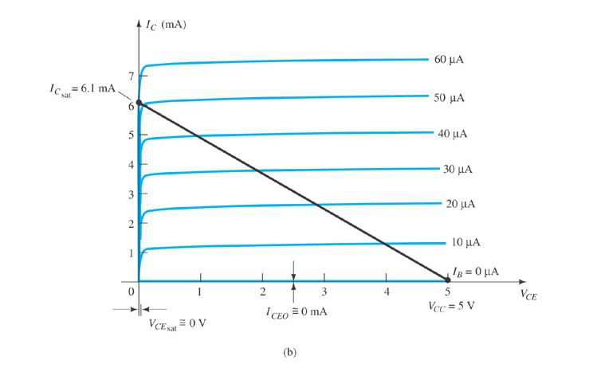
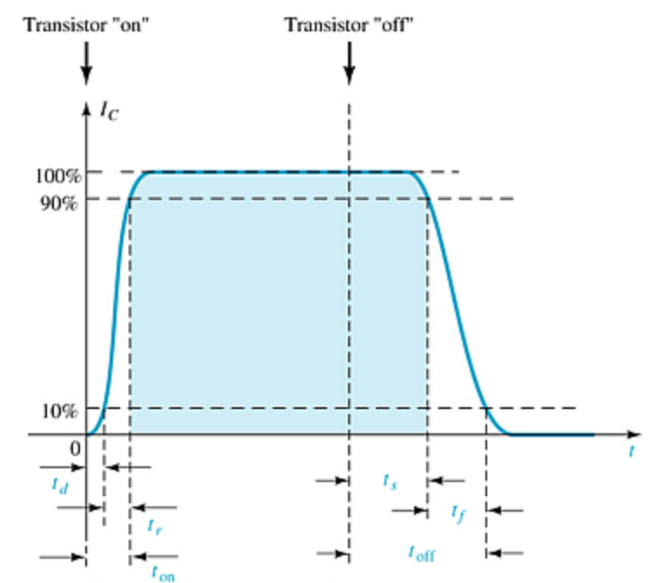
4.8 Transistor Switching Networks
Transistors with only the DC source applied can be used as electronic switches.

Slide 17

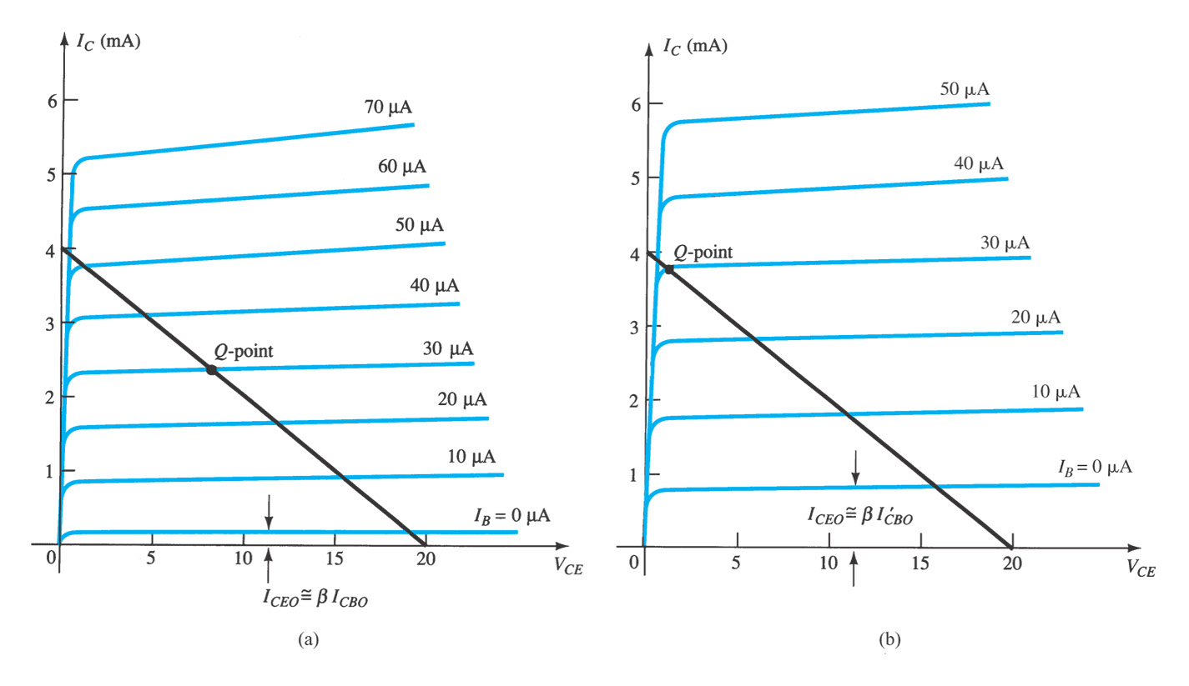


4.10 Bias Stabilization
I_{C} is sensitive to , temperature, V_{BE}, and I_{CO}

Slide 18
Summary of Chapter 4
DC analysis: DC equivalent circuit
  Mathematical analysis (V_{BE}=.7V)
  Load-line analysis
Typical DC biasing circuits
  Fixed-bias circuit
  Emitter-stabilized bias circuit
  Voltage divider bias circuit
  DC bias with voltage feedback
Factors affecting bias stability
Note: The analysis for pnp transistor biasing circuits is the same as that for npn transistor circuits. The only difference is that the currents are flowing in the opposite direction.

