Slide 1
Chapter 5:
BJT AC Analysis

Slide 2
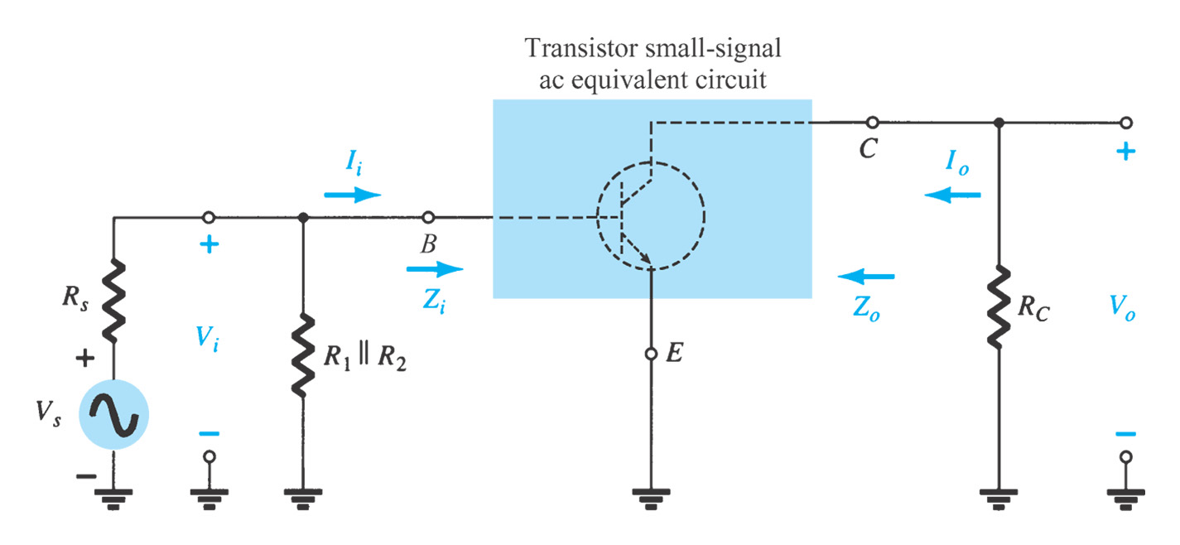
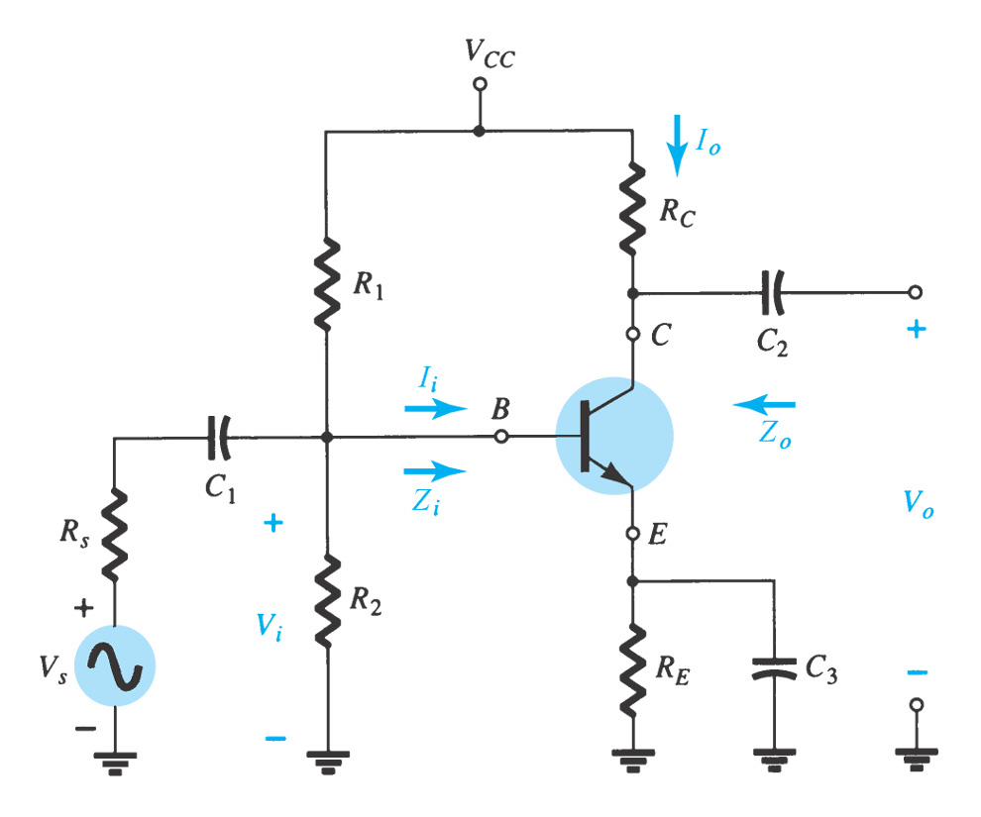
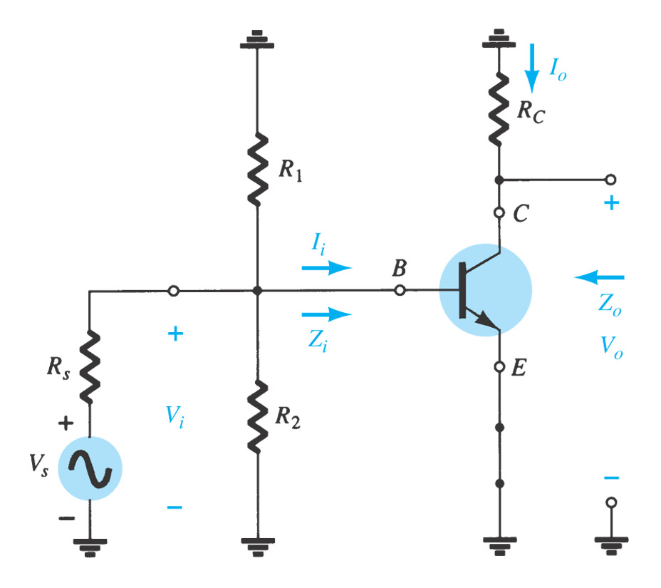
5.3 BJT Transistor Modeling
A model is an equivalent circuit that represents the AC characteristics of the transistor.
A model uses circuit elements that approximate the behavior of the transistor.
There are three models commonly used in small signal AC analysis of a transistor:
    r_{e} model
    Hybrid equivalent model
    Hybrid ∏ model
AC equivalent circuit
AC network
Sketch an AC network:
Remove DC supplies (replaced by short)
The coupling capacitor and bypass capacitor can be replaced by a short

Slide 3
5.4 The r_{e} Transistor Model
BJTs are basically current-controlled devices, therefore the r_{e} model uses a diode and a current source to duplicate the behavior of the transistor.
One disadvantage to this model is its sensitivity to the DC level. This model is designed for specific circuit conditions.

Slide 4
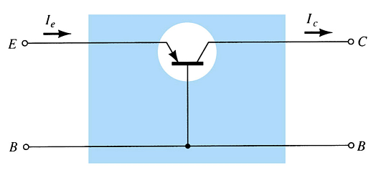
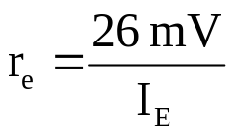

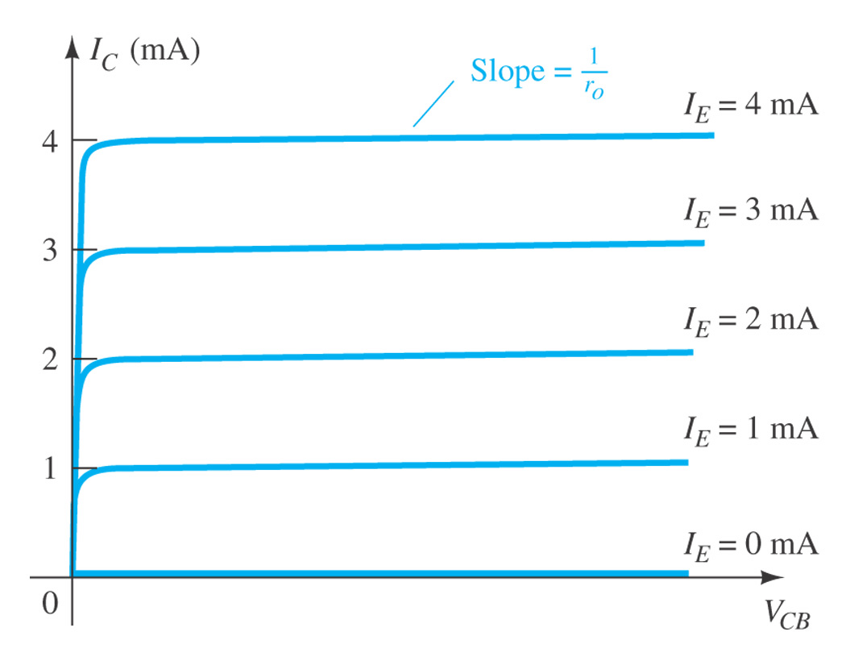

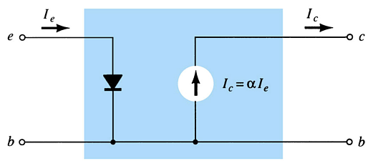

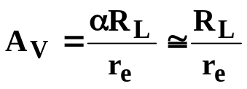
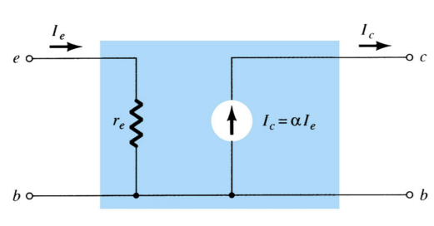

Common-Base Configuration
Input impedance: Low
Output impedance: High
Voltage gain: voltage amplification
Current gain: No current amplification
r_{e} model for CB configuration

Slide 5
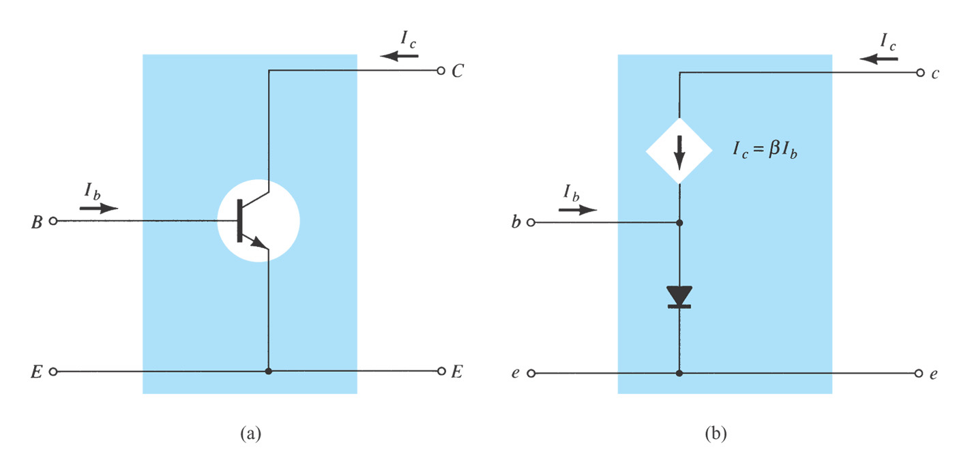
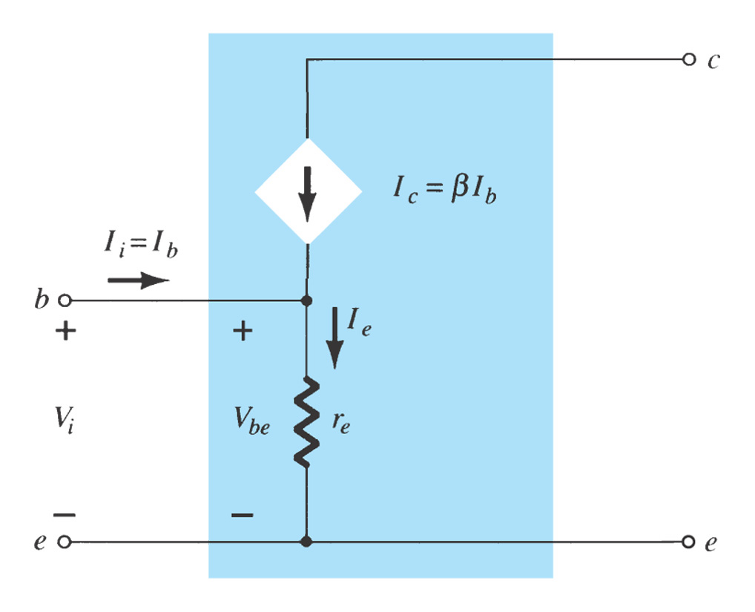


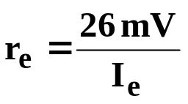

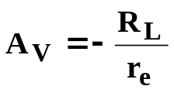
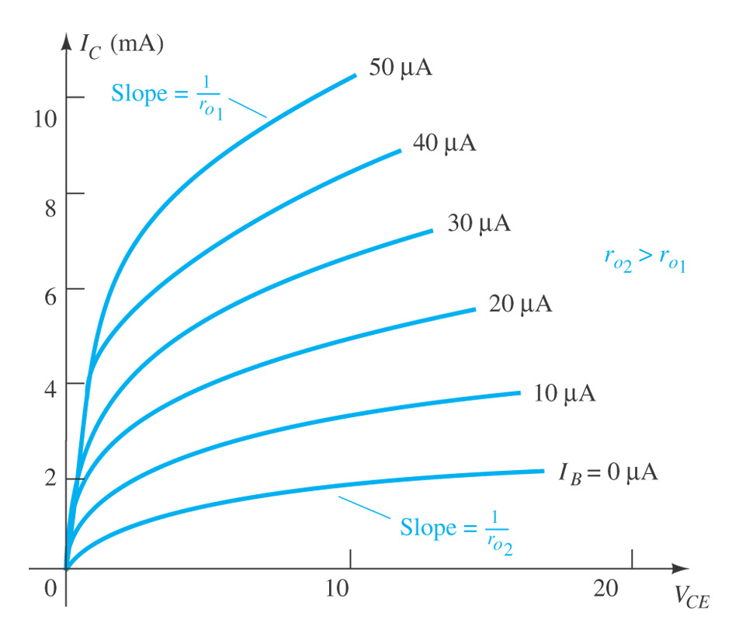
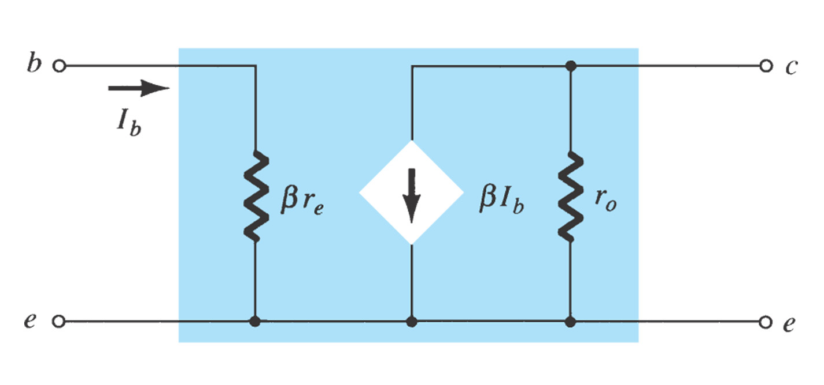

Common-Emitter Configuration
The diode r_{e} model can be replaced by the resistor r_{e}.
Input impedance: higher than CB
Output impedance: lower than CB
Voltage gain: Voltage amplification，V_{o} and V_{i} are 180° out of phase
Current gain: Current amplification
r_{e} model for CE configuration
r_{e} model requires you to determine β, r_{e}, and r_{o}.
Use the common-emitter model for the common-collector configuration.

Slide 6
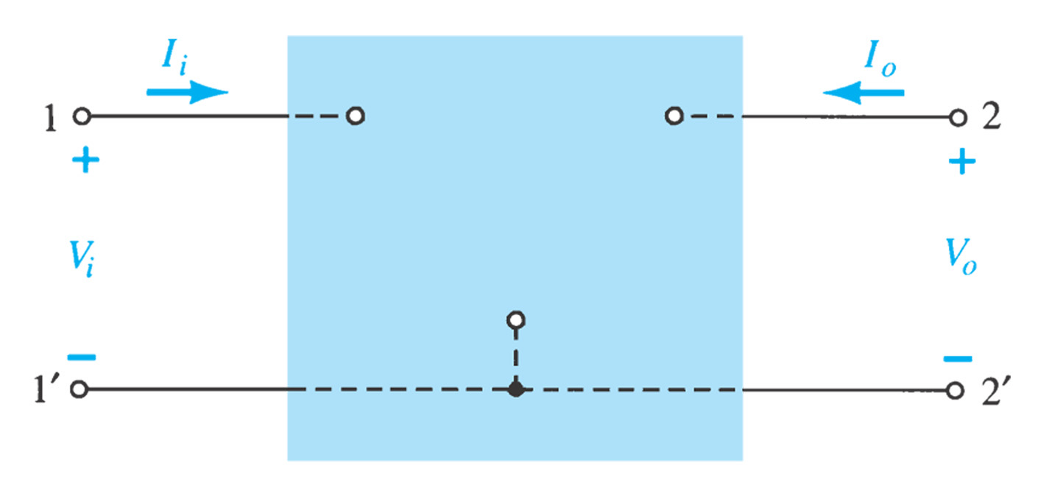
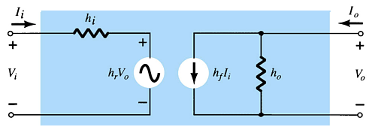
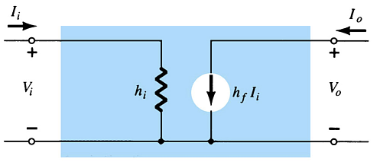
5.5 The Hybrid Equivalent Model
The following hybrid parameters are developed and used for modeling the transistor. These parameters can be found in a specification sheet for a transistor.
h_{i} = input resistance
h_{r} = reverse transfer voltage ratio (V_{i}/V_{o}) ≅ 0
h_{f} = forward transfer current ratio (I_{o}/I_{i})
h_{o} = output conductance ≅ ∞
Simplified General H-Parameter Model: Approximate hybrid equivalent model
h_{i} = input resistance
h_{r} = reverse transfer voltage ratio (V_{i}/V_{o}) ≅ 0
h_{f} = forward transfer current ratio (I_{o}/I_{i})
h_{o} = output conductance ≅ ∞

Slide 7
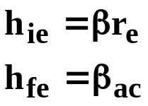
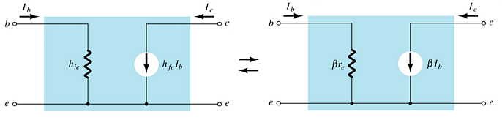
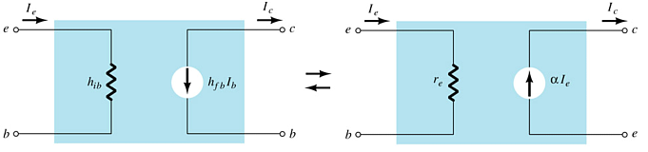
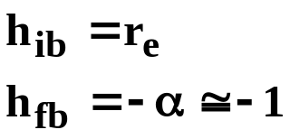
r_{e} Model vs. h-Parameter Model
Common-Emitter
Common-Base

Slide 8
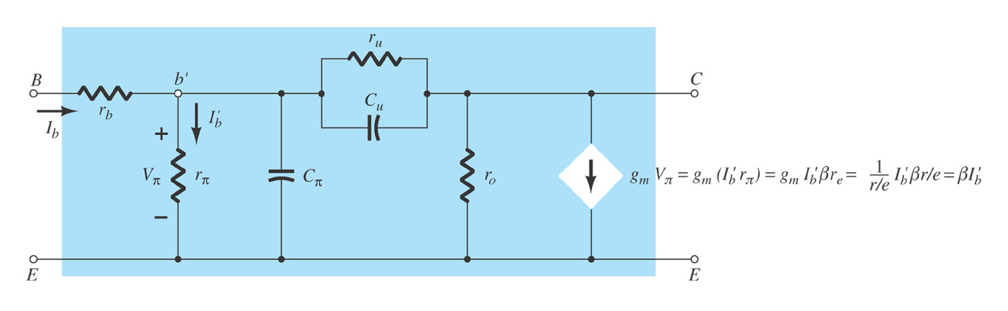
5.6 The Hybrid π Model
The hybrid π model is most useful for analysis of high-frequency transistor applications.
At lower frequencies the hybrid π model closely approximate the r_{e} parameters, and can be replaced by them.

Slide 9
AC Analysis with Equivalent models
Section 5.8 CE with fix-bias
Section 5.9 CE with voltage-divider bias
Section 5.10 CE with emitter bias
Section 5.14 CE with dc collector feedback bias
Section 5.13 CE with collector feedback
Section 5.11 CC: Emitter follower
Section 5.12 CB
CE
AC unknowns
Amplification
circuit
Calculate:
Impedance
  Input impedance
  Output impedance
Gain
  Voltage gain
  Current gain
DC analysis
to determine r_{e}
AC equivalent circuit
with r_{e} model

Slide 10
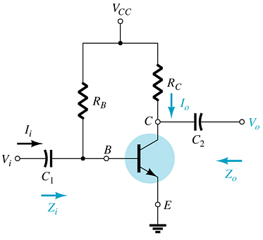
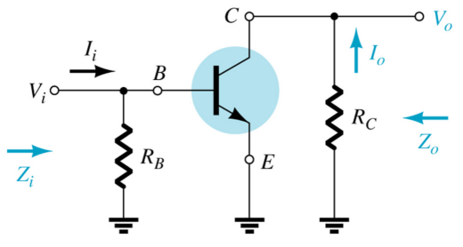
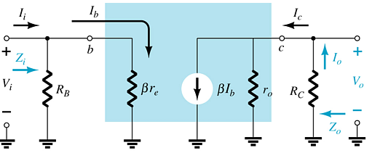
5.8 Common-Emitter Fixed-Bias Configuration
  AC network
The input is applied to the base
The output is from the collector
High input impedance
Low output impedance
High voltage and current gain
Phase shift between input and output is 180°
  AC equivalent with r_{e} model

Slide 11
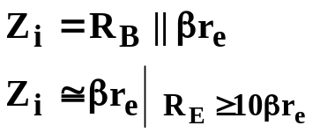
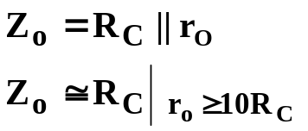
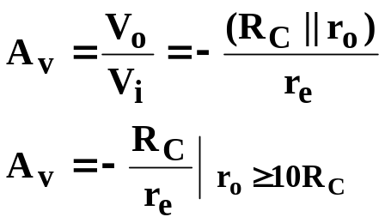
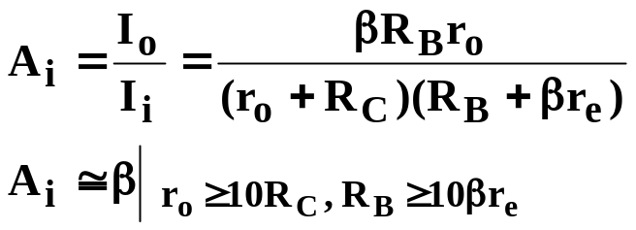
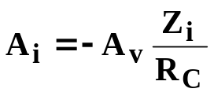
Common-Emitter Fixed-Bias Calculations
Input impedance:
Output impedance:
Voltage gain:
Current gain:
CE amplifiers:
High input impedance
Low output impedance
High voltage and current gain
Phase shift between input and output is 180°
Current gain from voltage gain:

Slide 12
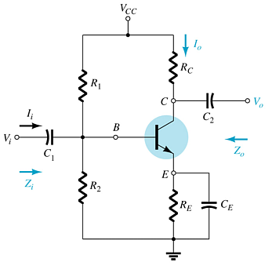
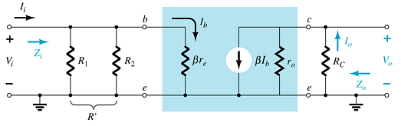
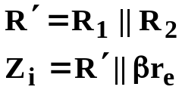
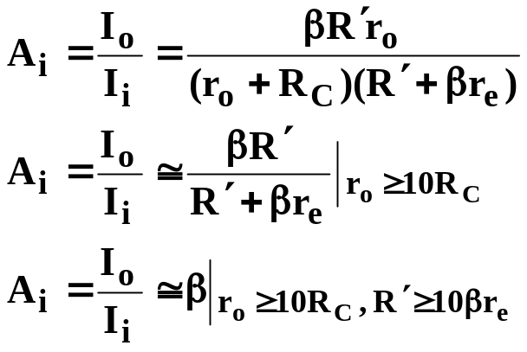
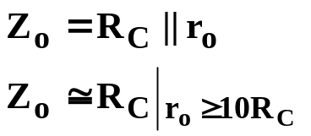
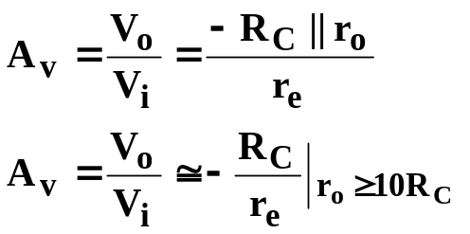
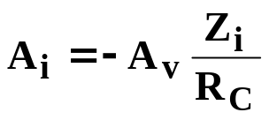
5.9 Common-Emitter Voltage-Divider Bias
r_{e} model requires you to determine β, r_{e}, and r_{o}.
Input impedance:
Current gain:
Output impedance:
Voltage gain:
Current gain from voltage gain:

Slide 13
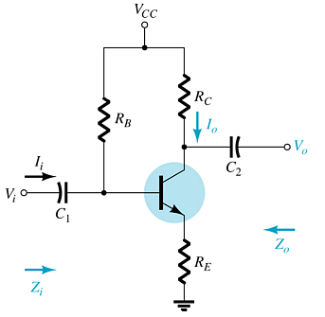



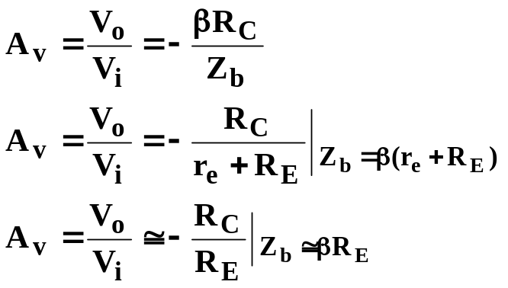
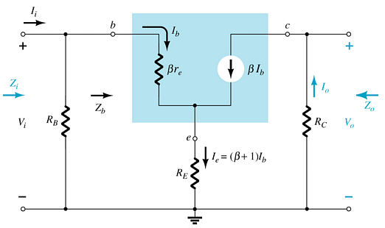
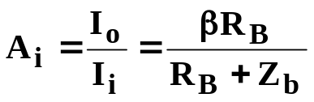
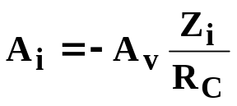
5.10 Common-Emitter Emitter-Bias Configuration
(Unbypassed R_{E})
Input impedance:
Output impedance:
Voltage gain:
Current gain:
Current gain from voltage gain:

Slide 14
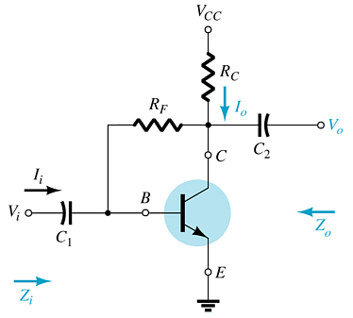
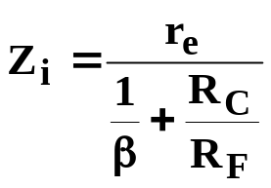

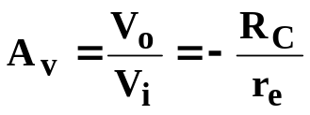
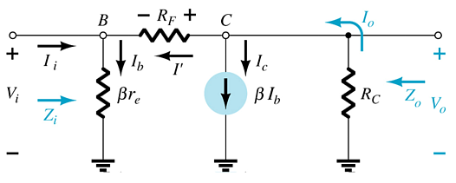
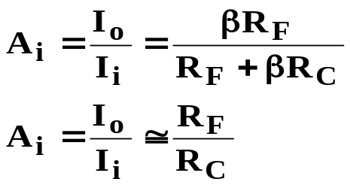
5.13 Common-Emitter Collector Feedback Configuration
Input impedance:
This is a variation of the common-emitter fixed-bias configuration
Input is applied to the base
Output is taken from the collector
There is a 180° phase shift between input and output
Output impedance:
Voltage gain:
Current gain:

Slide 15
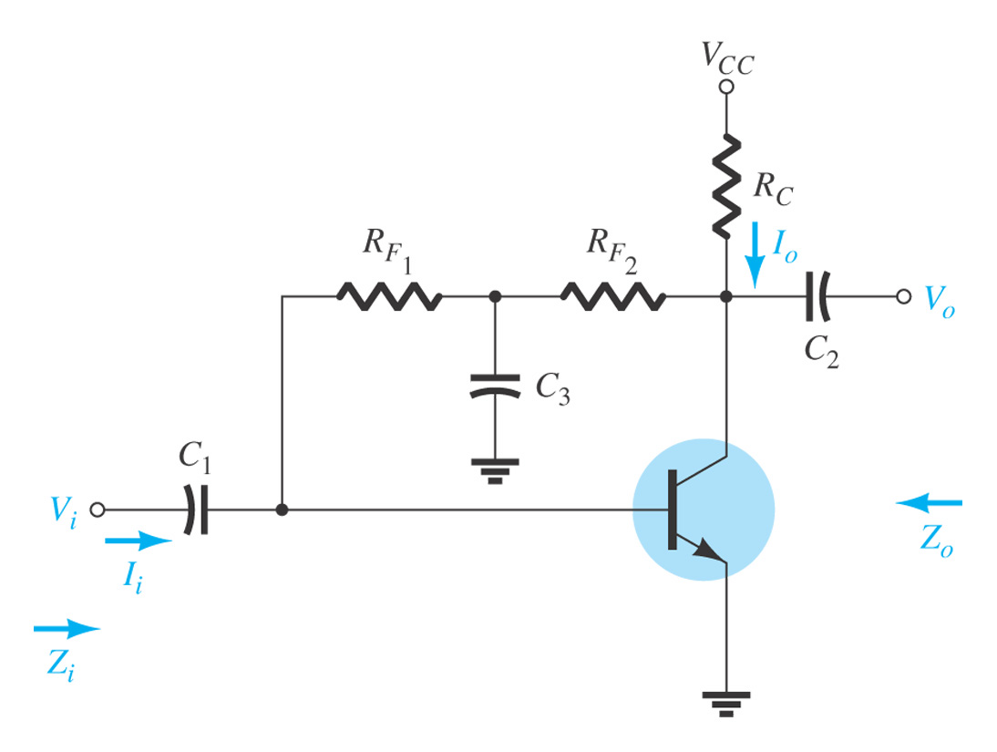
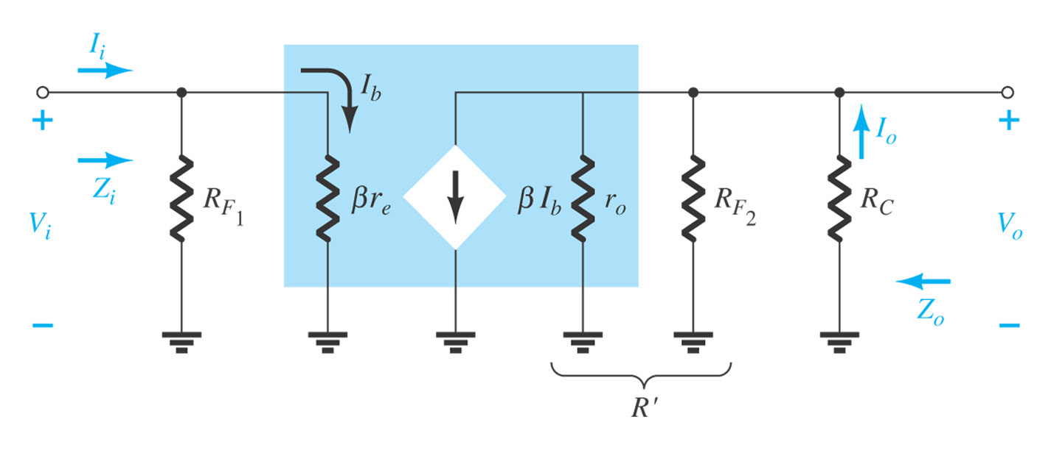
5.14 Collector DC Feedback Configuration

Slide 16








5.11 Emitter-Follower Configuration (CC)
Emitter-follower is also known as the common-collector configuration.
The input is applied to the base and the output is taken from the emitter.
There is no phase shift between input and output.
Input impedance:
Voltage gain:
Current gain:
Output impedance:
Current gain from voltage gain:

Slide 17






5.12 Common-Base Configuration
The input is applied to the emitter.
The output is taken from the collector.
Low input impedance.
High output impedance.
Current gain less than unity.
Very high voltage gain.
No phase shift between input and output.
Input impedance:
Voltage gain:
Current gain:
Output impedance:

Slide 18



5.17 Two-Port Systems Approach
This approach:
  Reduces a circuit to a two-port system
  Provides a “Thévenin look” at the output terminals
  Makes it easier to determine the effects of a changing load
With V_{i} set to 0 V:
The voltage across the open terminals is:
where A_{vNL} is the no-load voltage gain.

Slide 19




5.16 Effect of Load Impedance on Gain
This model can be applied to any current- or voltage-controlled amplifier.
Adding a load reduces the gain of the amplifier:

Slide 20




5.16 Effect of Source Impedance on Gain
The fraction of applied signal that reaches the input of the amplifier is:
The internal resistance of the signal source reduces the overall gain:

Slide 21




5.16 Combined Effects of R_{S} and R_{L} on Voltage Gain
Effects of R_{L}:
Effects of R_{L} and R_{S}:

Slide 22






5.19 Cascaded Systems
The output of one amplifier is the input to the next amplifier
The overall voltage gain is determined by the product of gains of the individual stages
The DC bias circuits are isolated from each other by the coupling capacitors
The DC calculations are independent of the cascading
The AC calculations for gain and impedance are interdependent
are loaded gains

Slide 23







R-C Coupled BJT Amplifiers
Input impedance, first stage:
Output impedance, second stage:
Voltage gain:

Slide 24


Cascode Connection: CE–CB
This example is a CE–CB combination. This arrangement provides high input impedance but a low voltage gain.
The low voltage gain of the input stage reduces the Miller input capacitance, making this combination suitable for high-frequency applications.

Slide 25


5.20 Darlington Connection
The Darlington circuit provides a very high current gain—the product of the individual current gains:
  β_{D} = β₁β₂
The practical significance is that the circuit provides a very high input impedance.
5.21 Feedback Pair
This is a two-transistor circuit that operates like a Darlington pair, but it is not a Darlington pair.
It has similar characteristics:
  High current gain
  Low Voltage gain (near unity)
  Low output impedance
  High input impedance
PNP
  β_{D} = β₁β₂
    The difference is that a Darlington uses a pair of like transistors, whereas the feedback-pair configuration uses complementary transistors.

Slide 26





5.22 Current Mirror Circuits
Current mirror circuits provide constant current in integrated circuits.
Current mirror circuit with higher output impedance.

Slide 27




5.23 Current Source Circuits
Constant-current sources can be built using FETs, BJTs, and combinations of these devices.
  I_{E} ≅ I_{C}

Slide 28
Summary of Chapter 5
AC analysis
  Load line analysis
  Mathematical analysis by small signal model
AC analysis method by small signal model
  DC analysis to determine r_{e}
  AC equivalent circuit by re model
  Calculation impedance and gain
CE amplifier
CB amplifier
CC amplifier
Cascaded amplifier system
  Effect of R_{s} and R_{L}
  CE-CB

