Slide 1
Chapter 6:
Field-Effect Transistors

Slide 2
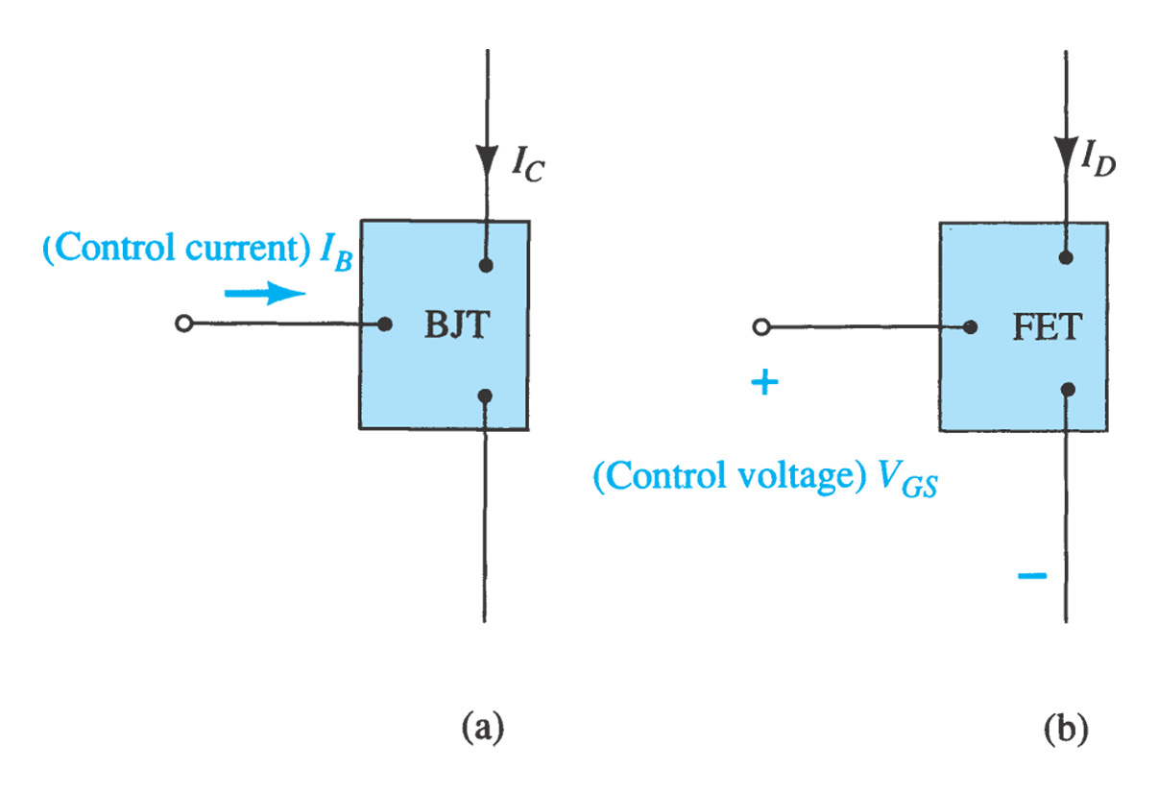
FET
FETs (Field-Effect Transistors) are much like BJTs (Bipolar Junction Transistors).
  Similarities:
    • Amplifiers
    • Switching devices
• Impedance matching circuits
  Differences:
• FETs are voltage controlled devices whereas BJTs are current controlled
devices.
• FETs also have a higher input impedance, but BJTs have higher gains.
• FETs are less sensitive to temperature variations and because of their
construction they are more easily integrated on ICs.

Slide 3
FET Types
n-channel
JFET–– Junction Field-Effect Transistor
MOSFET –– Metal-Oxide Semiconductor Field-Effect Transistor
  D-MOSFET –– Depletion MOSFET
  E-MOSFET –– Enhancement MOSFET
p-channel
n-channel
p-channel
n-channel
p-channel

Slide 4
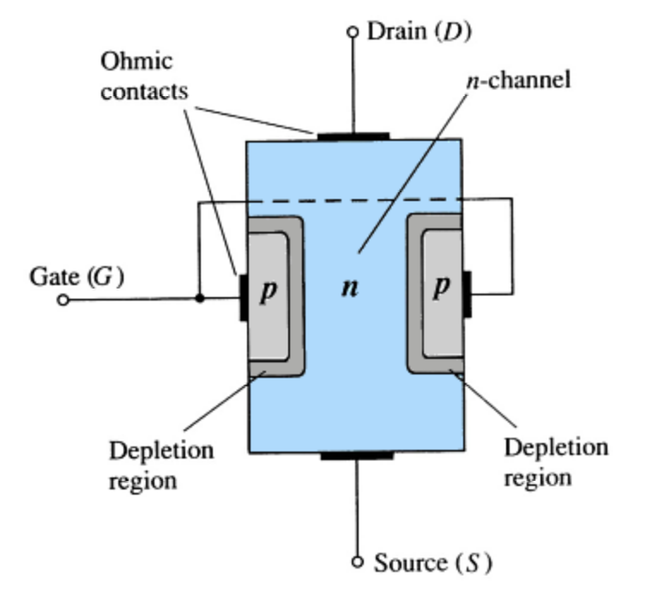
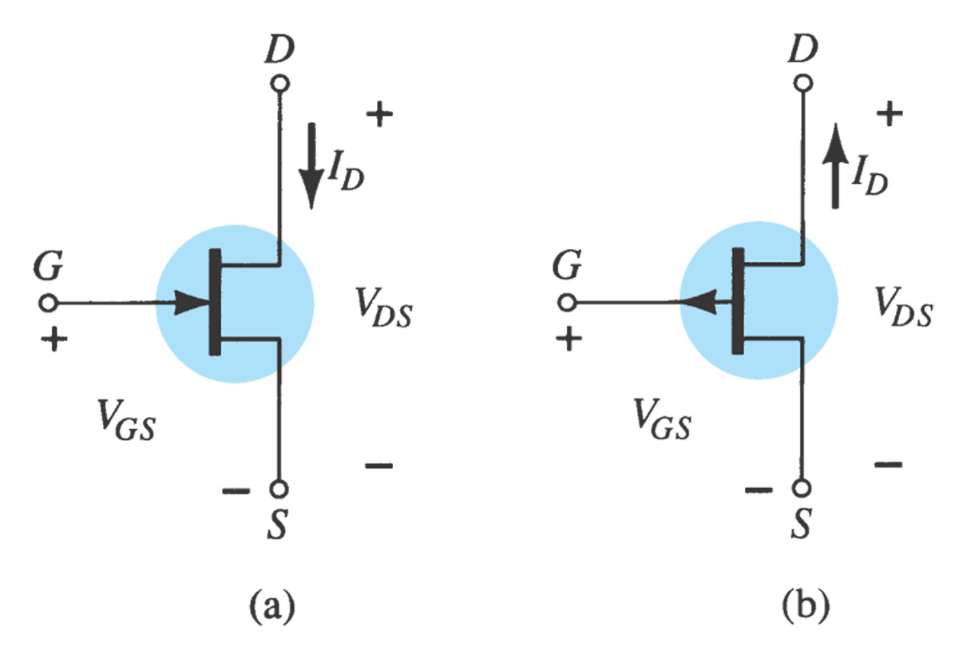
6.2 JFET Construction
There are two types of JFETs
  n-channel
  p-channel
The n-channel is more widely used.
There are three terminals.
  Drain (D) and source (S) are connected to the n-channel
  Gate (G) is connected to the p-type material
JFET symbols: (a) n-channel; (b) p-channel.

Slide 5
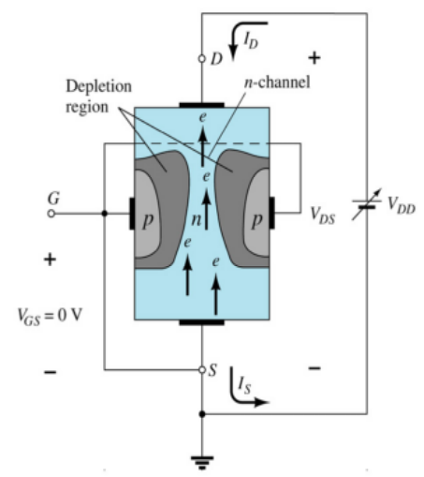
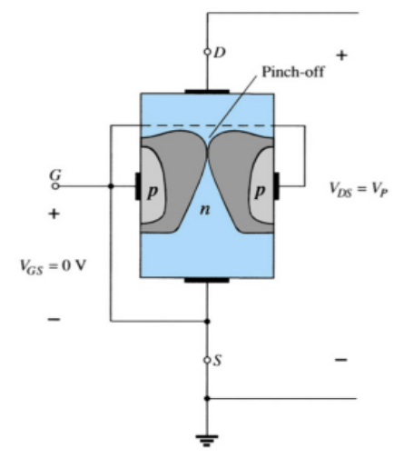
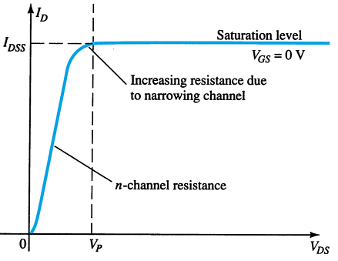
JFET Operating Characteristics
V_{GS} = 0, V_{DS} increasing to some positive value
When V_{GS} = 0 and V_{DS} is increased from 0 to a more positive voltage
  The depletion region between p-gate and n-channel increases
  Increasing the depletion region, decreases the size of the n-channel which increases the resistance of the n-channel.
  Even though the n-channel resistance is increasing, the current (I_{D}) from source to drain through the n-channel is increasing. This is because V_{DS} is increasing.
  If V_{DS} is further increased to a more positive voltage, then the depletion zone gets so large that it pinches off the n-channel.
  V_{DS} establishes the pinch-off is denoted as pinch off voltage: V_{p}.
  Any further increase in V_{DS} >V_{P} does not produce any increase in I_{D}. I_{D} is at saturation or maximum referred to as I_{DSS}.
  The ohmic value of the channel is maximum.

Slide 6
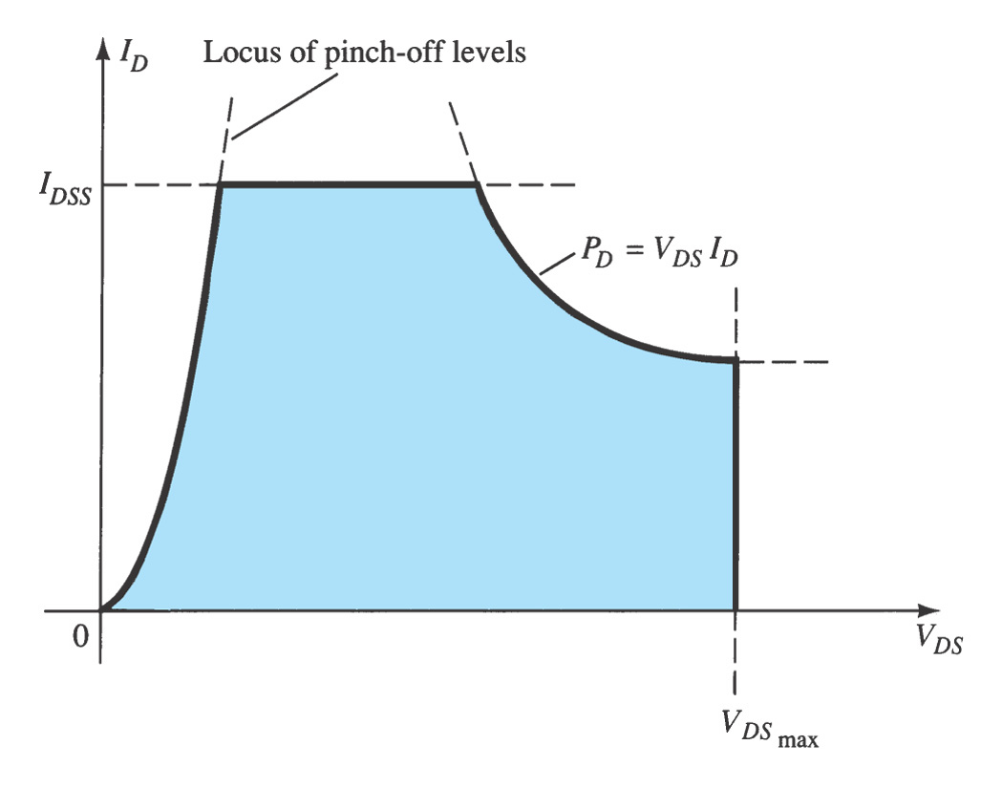
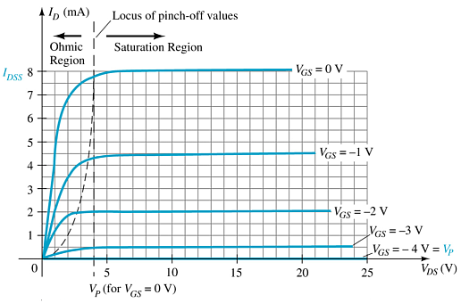
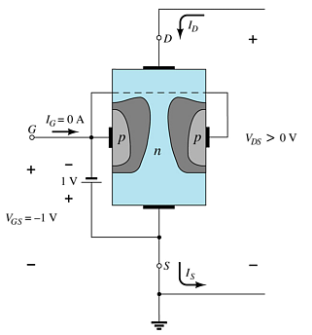
JFET Operating Characteristics
V_{GS} < 0, V_{DS} at some positive value: I_{D} < I_{DSS}
As V_{GS} becomes more negative:
the depletion region increases.
The JFET experiences pinch-off at a lower voltage (V_{p}).
I_{D} decreases (I_{D} < I_{DSS}) even though V_{DS} is increased.
Eventually I_{D} reaches 0A. V_{GS} at this point is called V_{p} or V_{GS(off)}..
For linear amplification
Also note that at high levels of V_{DS} the JFET reaches a breakdown situation. I_{D} increases uncontrollably if V_{DS} > V_{DSmax}.

Slide 7
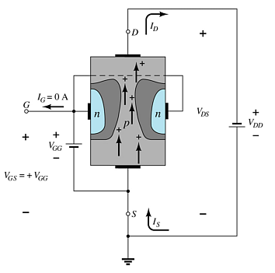
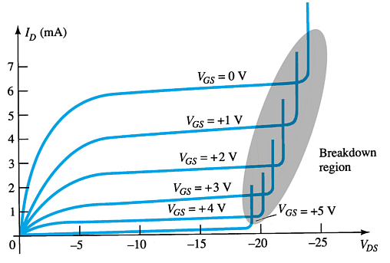
p-Channel JFETS
The p-channel JFET behaves the same as the n-channel JFET, except the polarities and currents are reversed.
Also note that at high levels of V_{DS} the JFET reaches a breakdown situation—I_{D} increases uncontrollably if V_{DS} > V_{DSmax}.

Slide 8
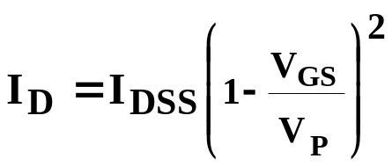
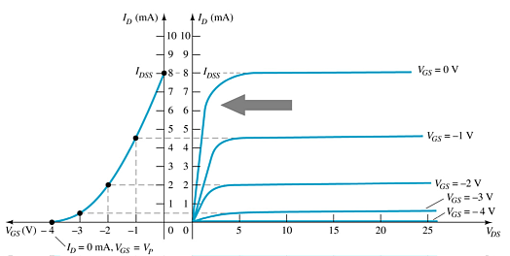
6.3 JFET Transfer Characteristics
The transfer characteristic of input-to-output is not as straightforward in a JFET as it is in a BJT.
In a BJT, β indicates the relationship between I_{B} (input) and I_{C} (output).
In a JFET, the relationship of V_{GS} (input) and I_{D} (output) is a little more complicated:
I_{DSS} and Vp (V_{GS(off)} )values can be found in a specification sheet
JFET Transfer Curve:
This graph shows the value of I_{D} for a given value of V_{GS}.
Applying Shockley’s equation (shorthand method)
from the output characteristics

Slide 9
6.6 MOSFETs
MOSFETs have characteristics similar to JFETs and additional characteristics that make then very useful.
There are two types of MOSFETs:
  Depletion-Type
  Enhancement-Type

Slide 10
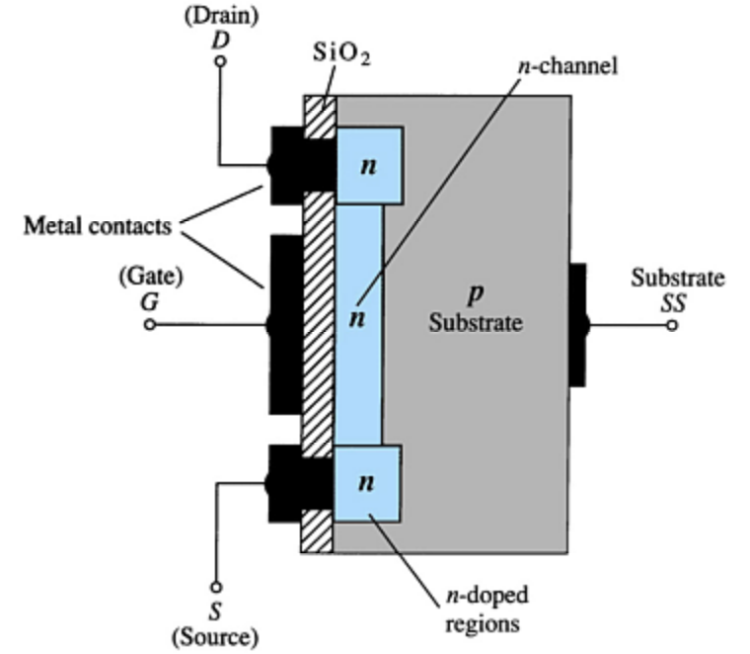
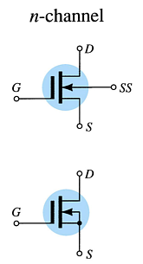
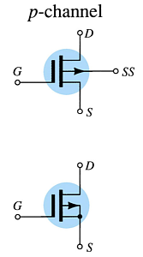
Depletion-Type MOSFET Construction
The drain (D) and source (S) connect to the to n-doped regions. These n-doped regions are connected via an n-channel. This n-channel is connected to the gate (G) via a thin insulating layer of SiO₂.
The n-doped material lies on a p-doped substrate that may have an additional terminal connection called substrate (SS).

Slide 11
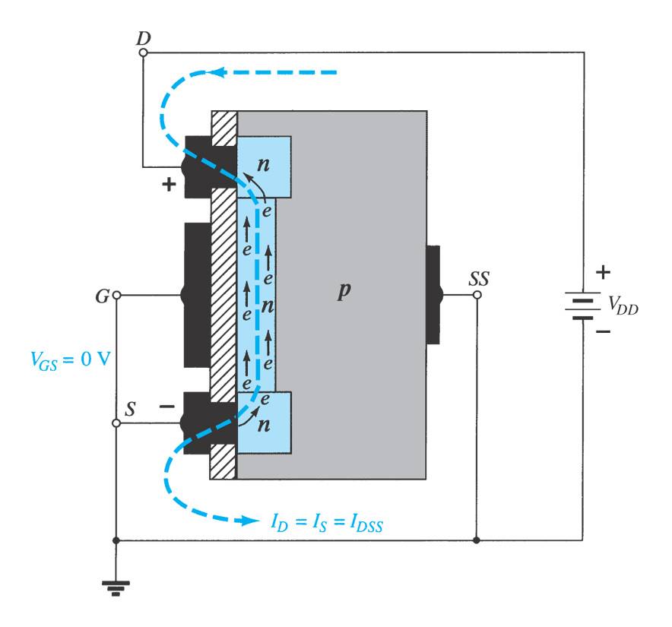
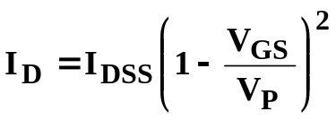
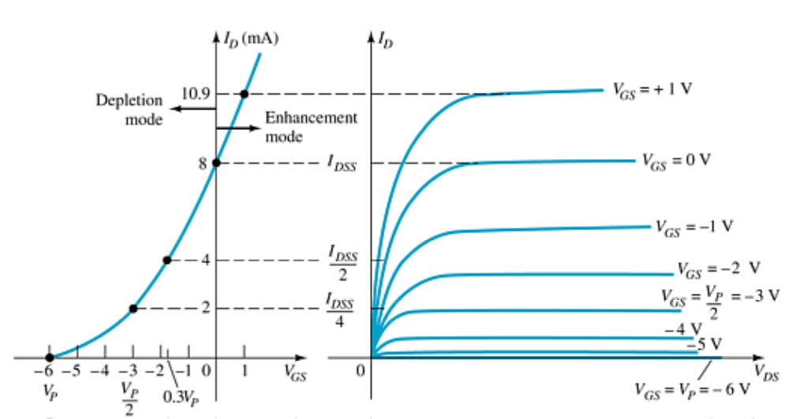

Basic Depletion-Type MOSFET Operation
A depletion-type MOSFET can operate in two modes:
  Depletion mode
  Enhancement mode
Depletion Mode
The characteristics are similar to a JFET.
  When V_{GS} = 0V, I_{D} = I_{DSS}
  When V_{GS} < 0V, I_{D} < I_{DSS}
  The formula used to plot the transfer curve still applies:
Enhancement Mode
V_{GS} > 0V
I_{D} increases above I_{DSS}
The formula used to plot the transfer curve still applies:
Note that V_{GS} is now a positive polarity

Slide 12
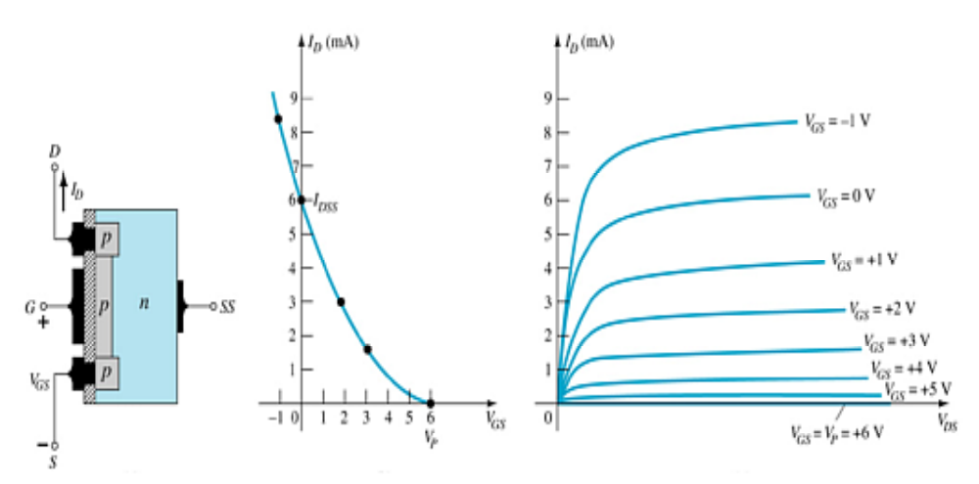
p-Channel Depletion-Type MOSFET

Slide 13
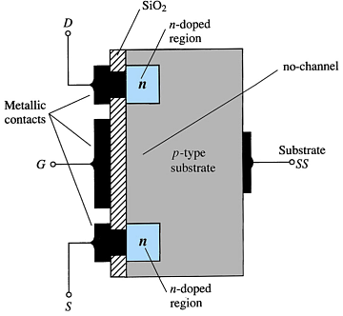
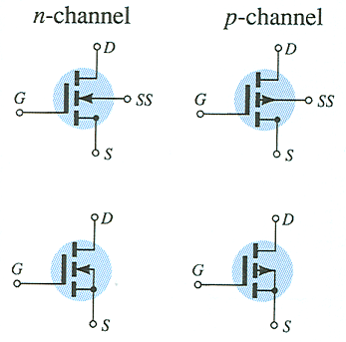
6.7 Enhancement-Type MOSFET Construction
The drain (D) and source (S) connect to the to n-doped regions. These n-doped regions are connected via an n-channel
The gate (G) connects to the p-doped substrate via a thin insulating layer of SiO₂
There is no channel
The n-doped material lies on a p-doped substrate that may have an additional terminal connection called the substrate (SS)

Slide 14


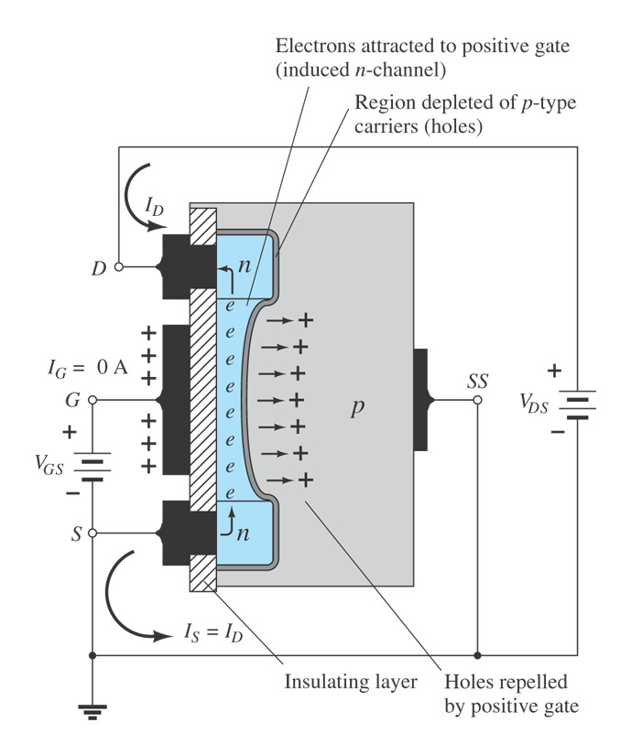
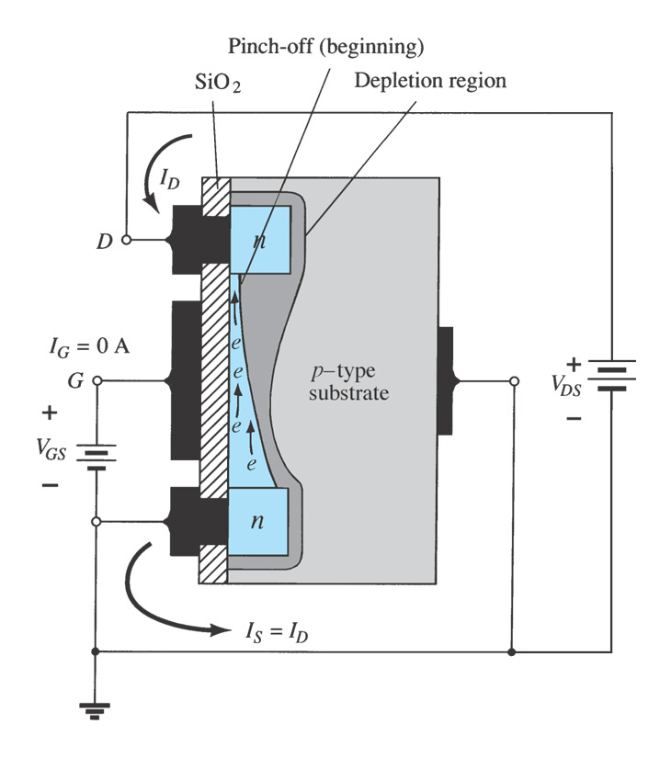
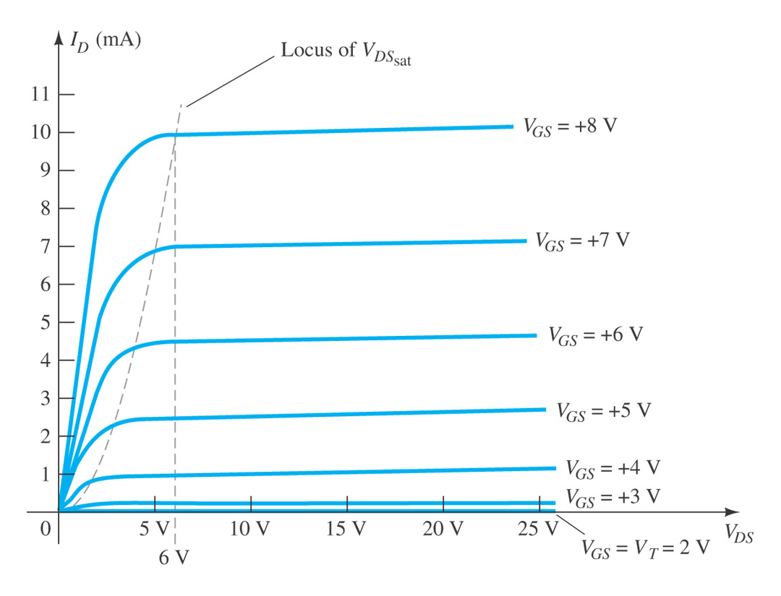
Basic Operation of the Enhancement-Type MOSFET
The enhancement-type MOSFET only operates in the enhancement mode.
V_{GS} is always positive to form an n-channel. V_{GS} resulting in the significant increase in drain current is called the threshold voltage V_{T} (or V_{GS(Th)} )
As V_{GS} increases, I_{D} increases
As V_{GS} is kept constant and V_{DS} is increased, then I_{D} saturates (I_{DSS}) due to pinch-off process. And the saturation level, V_{DSsat} is reached

Slide 15
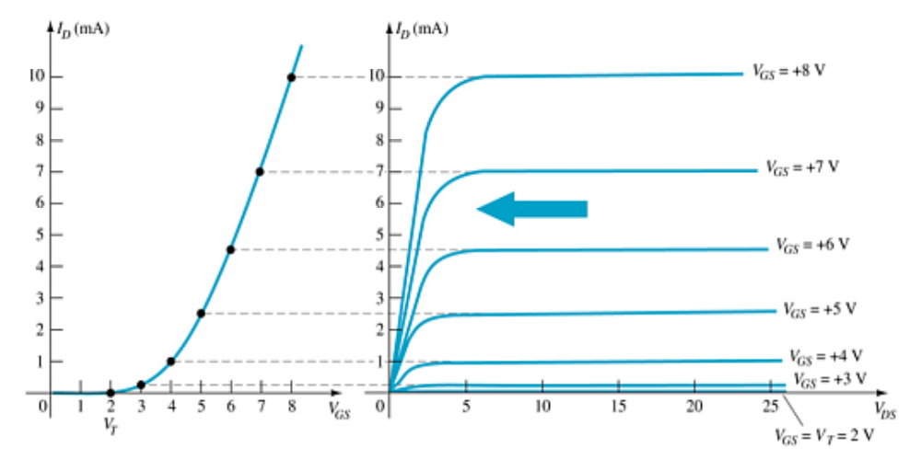

Enhancement-Type MOSFET Transfer Curve
To determine I_{D} given V_{GS}:
Where:
  V_{T} = threshold voltage or voltage at which the MOSFET turns on
  k = constant found in the specification sheet

Slide 16
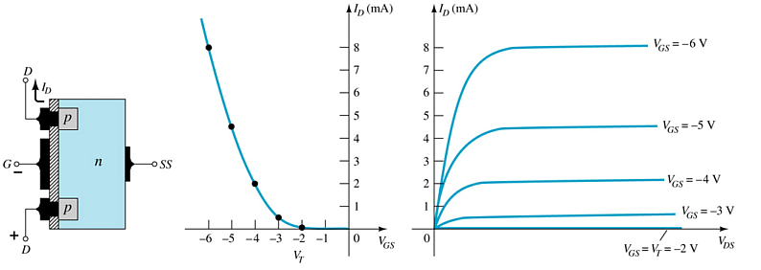
p-Channel Enhancement-Type MOSFETs
The p-channel enhancement-type MOSFET is similar to the n-channel, except that the voltage polarities and current directions are reversed.

Slide 17
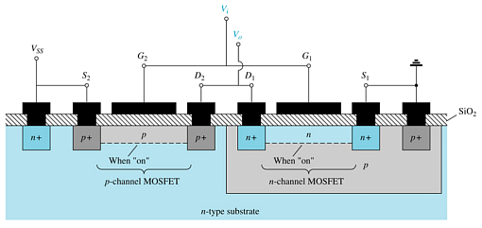
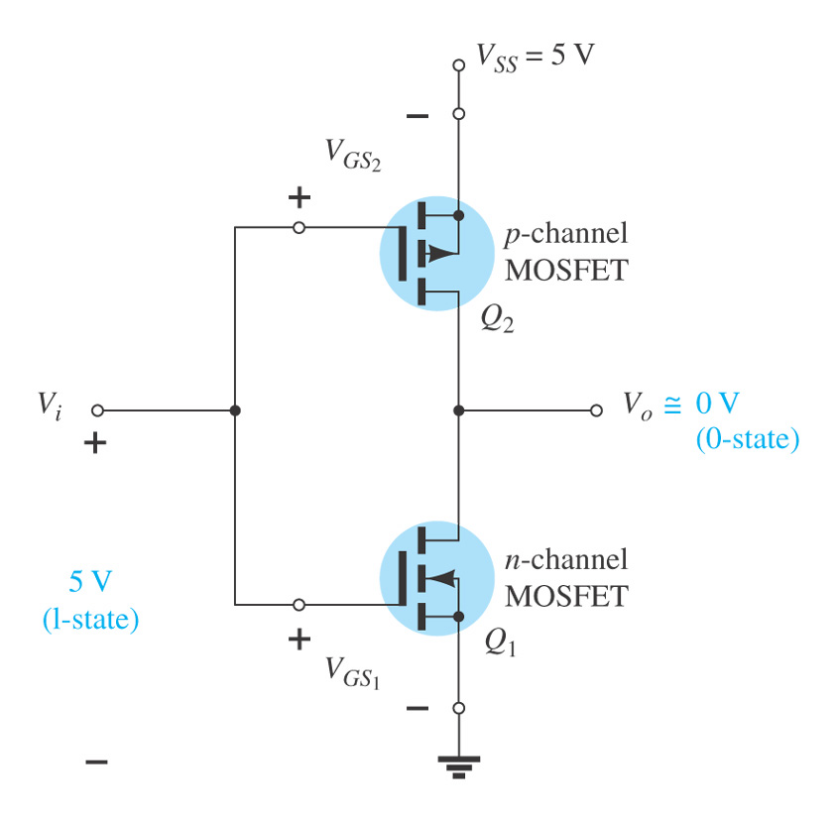
6.8 CMOS Devices
CMOS (complementary MOSFET) uses a p-channel and n-channel MOSFET on the same substrate.
Advantages
Useful in logic circuit designs
Higher input impedance
Faster switching speeds
Lower operating power levels

Slide 18
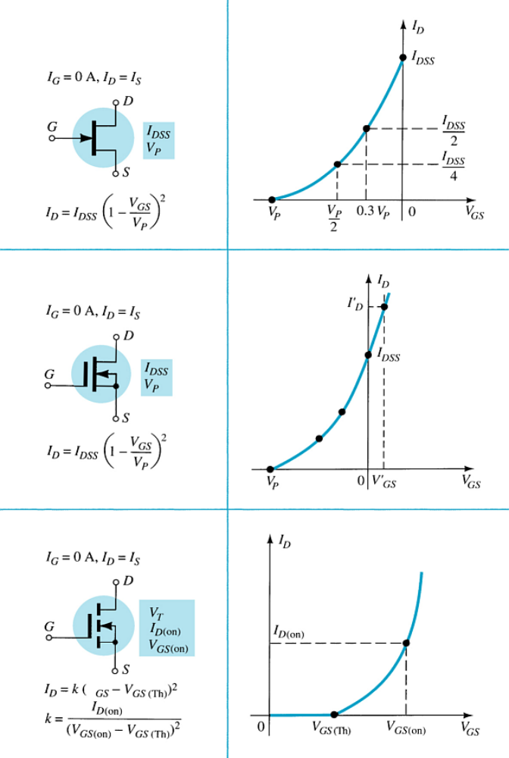


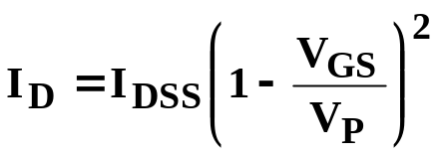
Summary
For all FETs:
For JFETs and depletion-type MOSFETs:
For enhancement-type MOSFETs:
JFETs differ from BJTs
  • Nonlinear relationship between input (V_{GS}) and output (I_{D})
  FETs are voltage controlled devices whereas BJTs are current controlled devices.
  • FETs have a higher input impedance.
  • FETs are less sensitive to temperature.

