Slide 1
FET Amplifiers
  Excellent voltage gain
  High input impedance
  Low-power consumption
  Good frequency range
Chapter 7:
FET Biasing
Chapter 8:
FET Amplifiers
Using V_{GSQ} to determine g_{m} for AC equivalent model
Step 2: AC analysis
Based on AC network and AC equivalent model:
Input impedance
Output impedance
Voltage gain
Step 1: DC analysis
Based on DC network:
V_{GSQ}
I_{DQ}
V_{DSQ}
Three basic configurations for FET amplifiers
CS: Common Source Configuration
CG: Common Gate Configuration
Source Follower: Common Drain

Slide 2


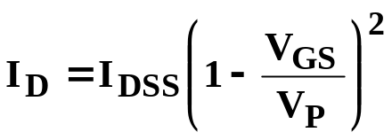

Common FET Biasing Circuits
DC analysis methods: V_{GSQ}, I_{DQ}, V_{DSQ}
Mathematical approach
Graphical approach
JFET
  Fixed-Bias
  Self-Bias
  Voltage-Divider Bias
Depletion-Type MOSFET
  Self-Bias
  Voltage-Divider Bias
Enhancement-Type MOSFET
  Feedback Configuration
  Voltage-Divider Bias
General Relationships
For all FETs:
For JFETS and depletion-type MOSFETs:
For enhancement-type MOSFETs:

Slide 3
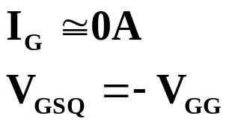
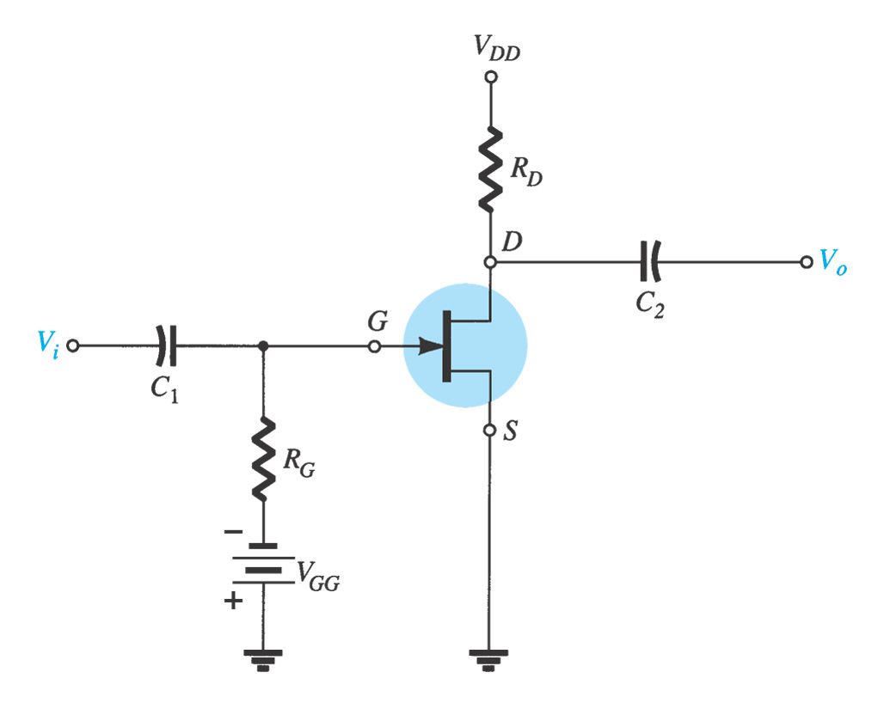
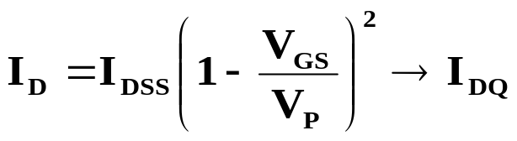

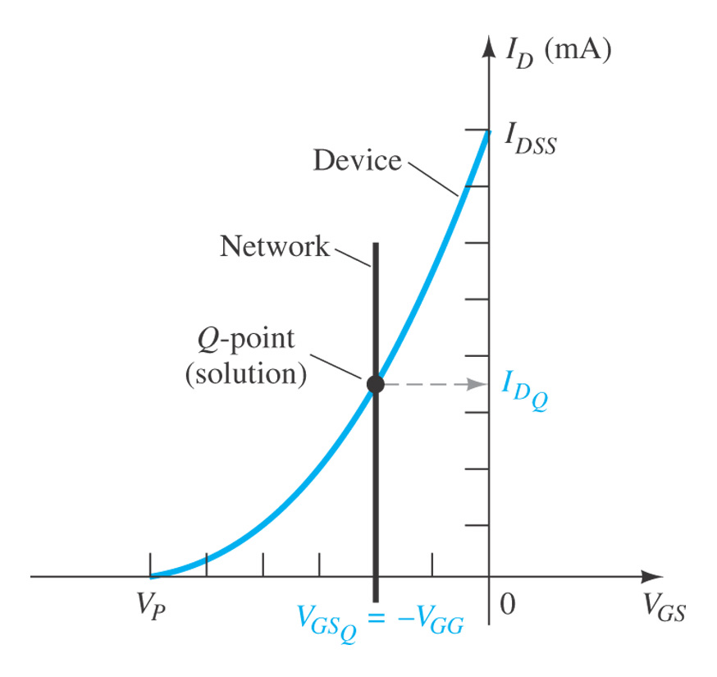
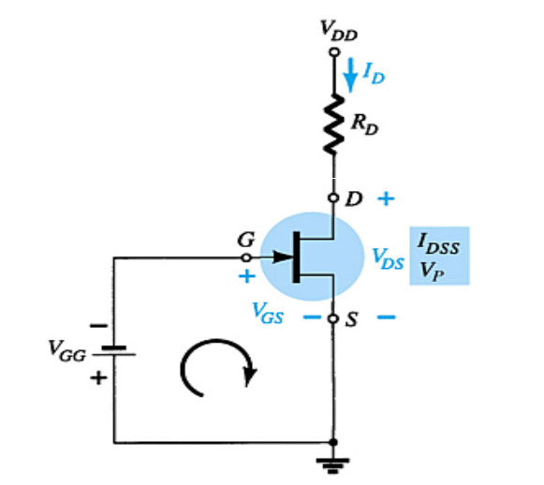
7.2 Fixed-Bias Configuration
Mathematical Approach
Graphical Approach

Slide 4
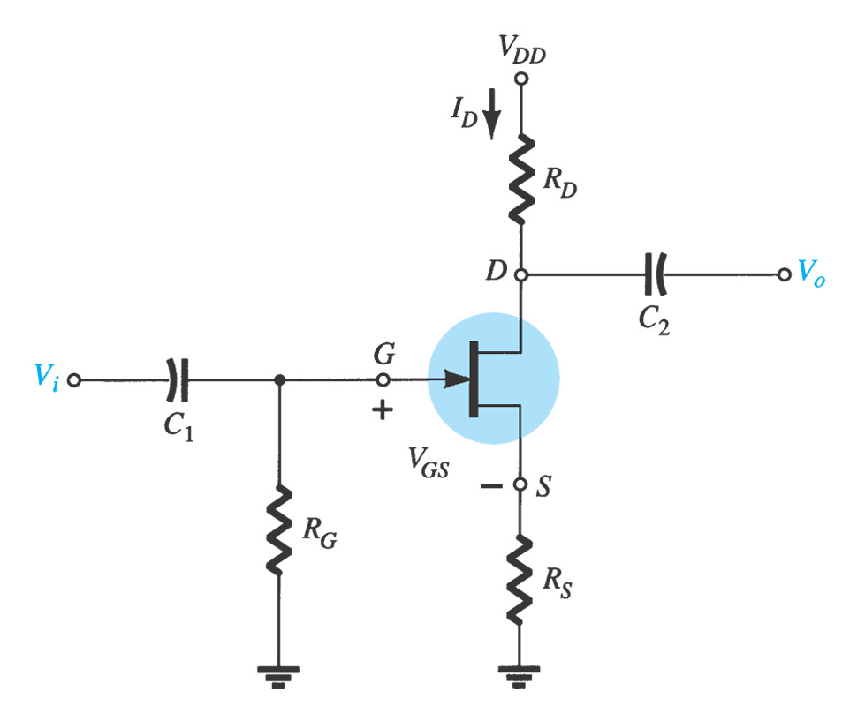
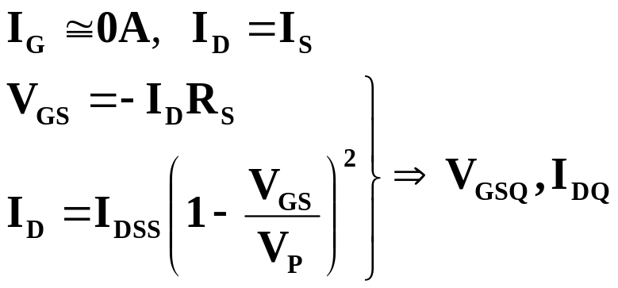

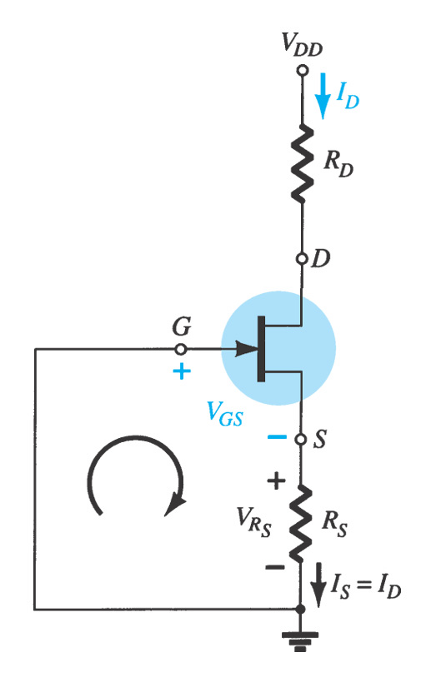
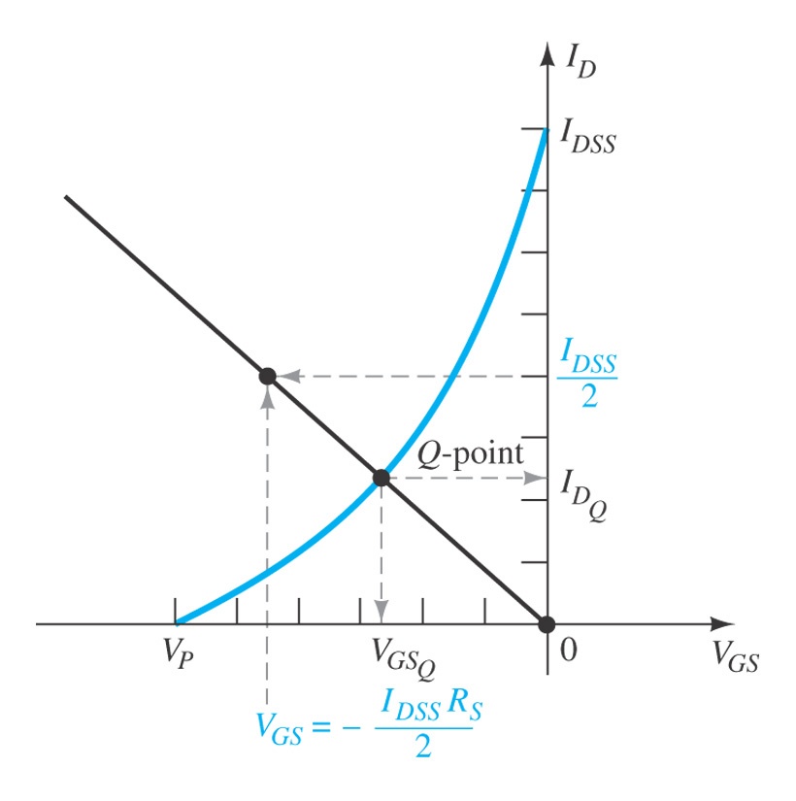
7.3 Self-Bias Configuration
Mathematical Approach
Graphical Approach

Slide 5
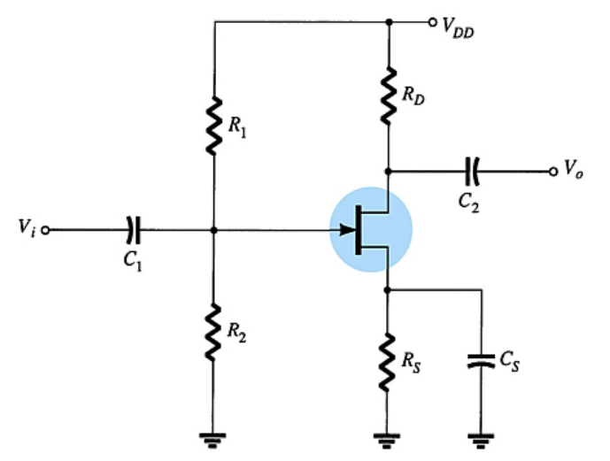
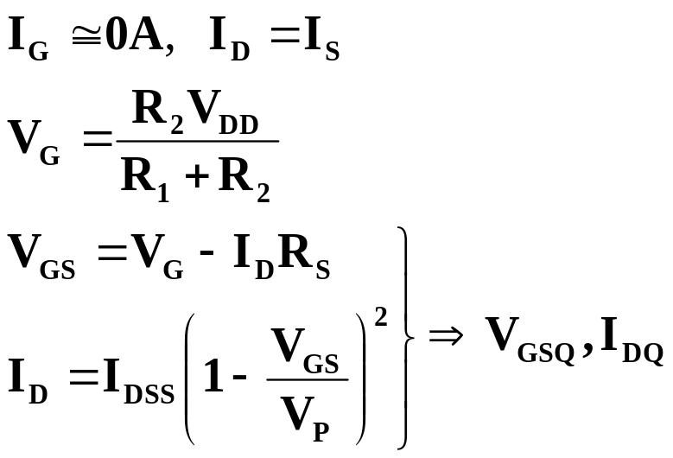
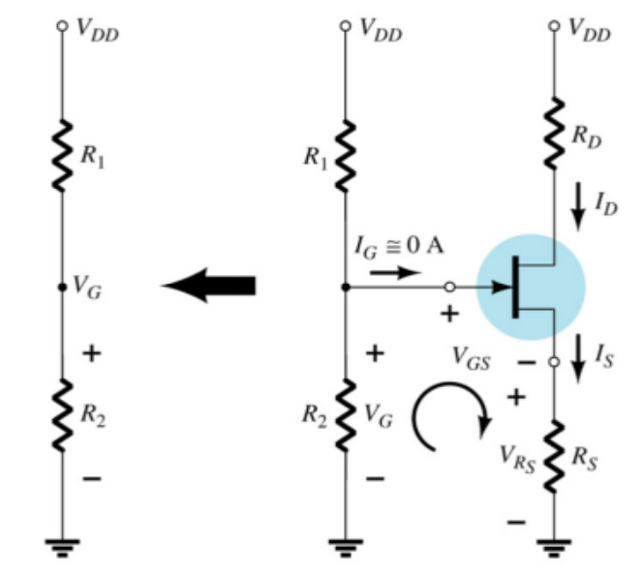
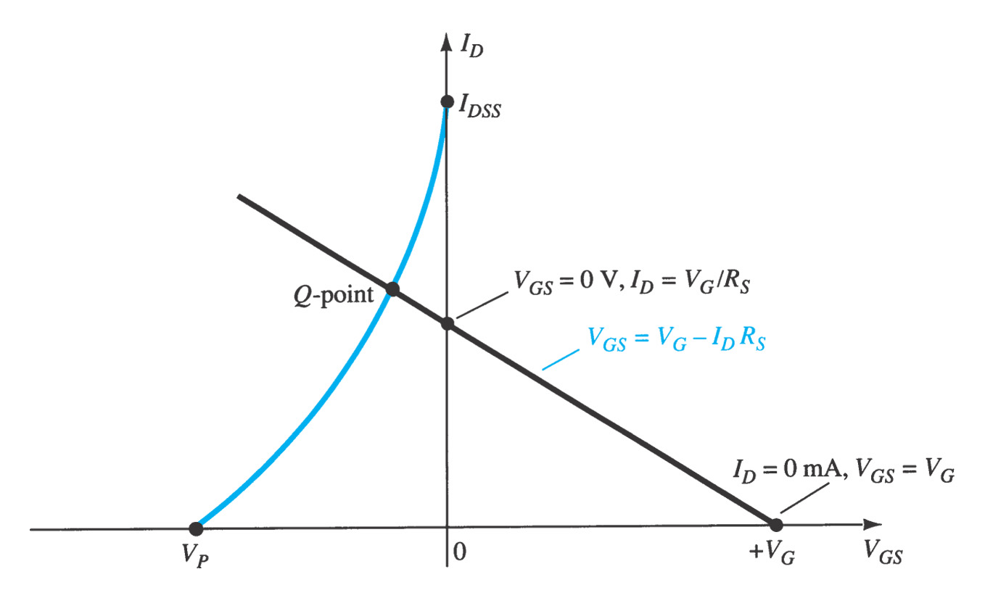
7.4 Voltage-Divider Biasing
Mathematical Approach
Graphical Approach

Slide 6
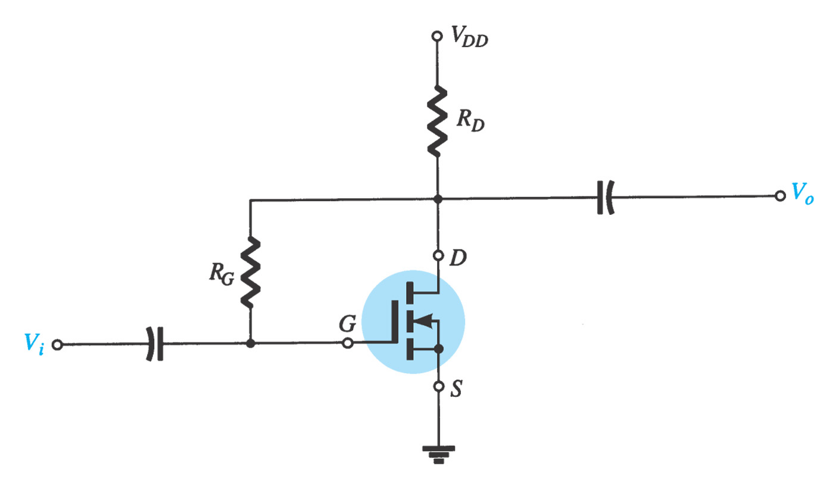
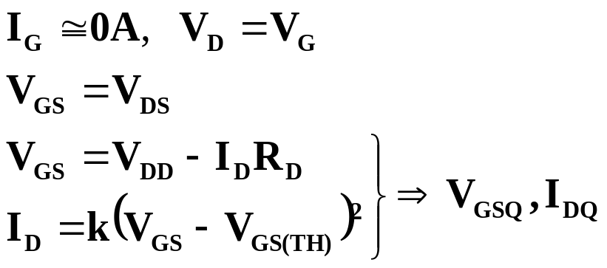
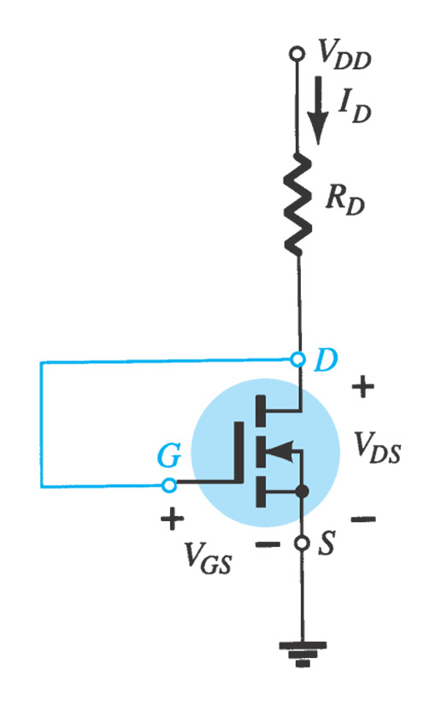
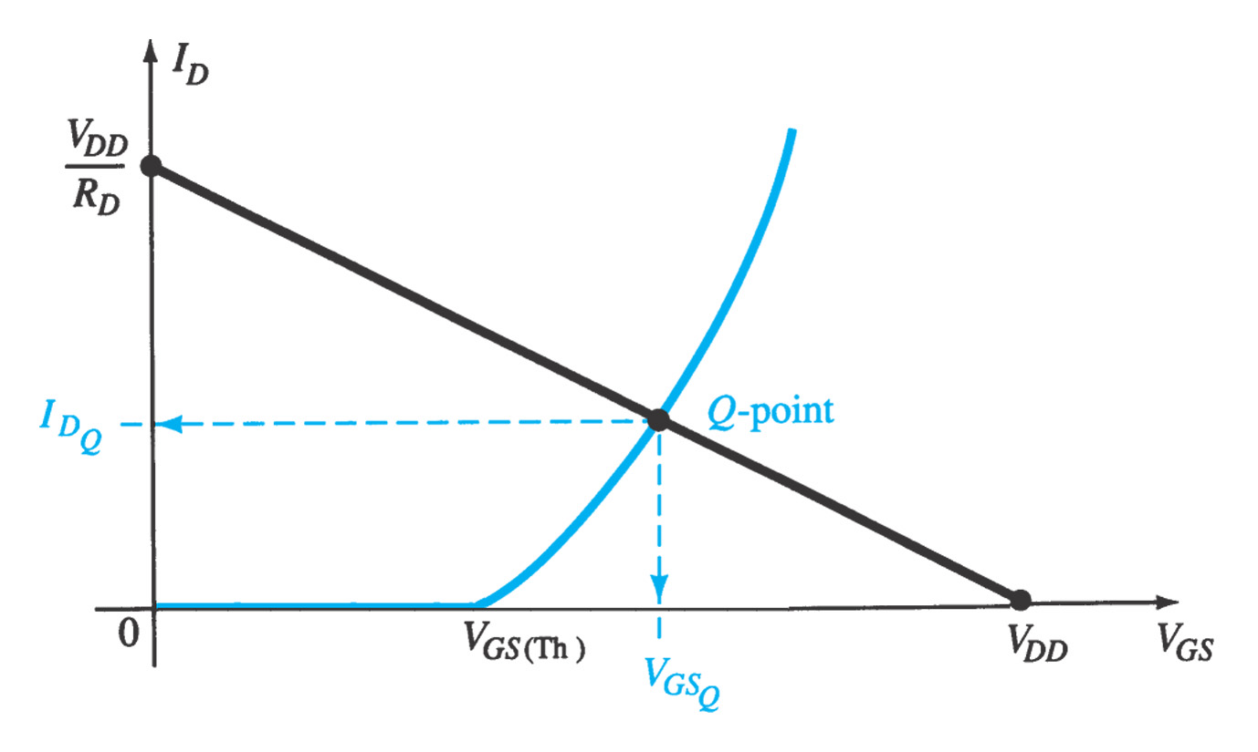
7.6 Feedback Biasing for E-MOSFETs
Mathematical Approach
Graphical Approach

Slide 7
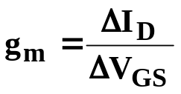
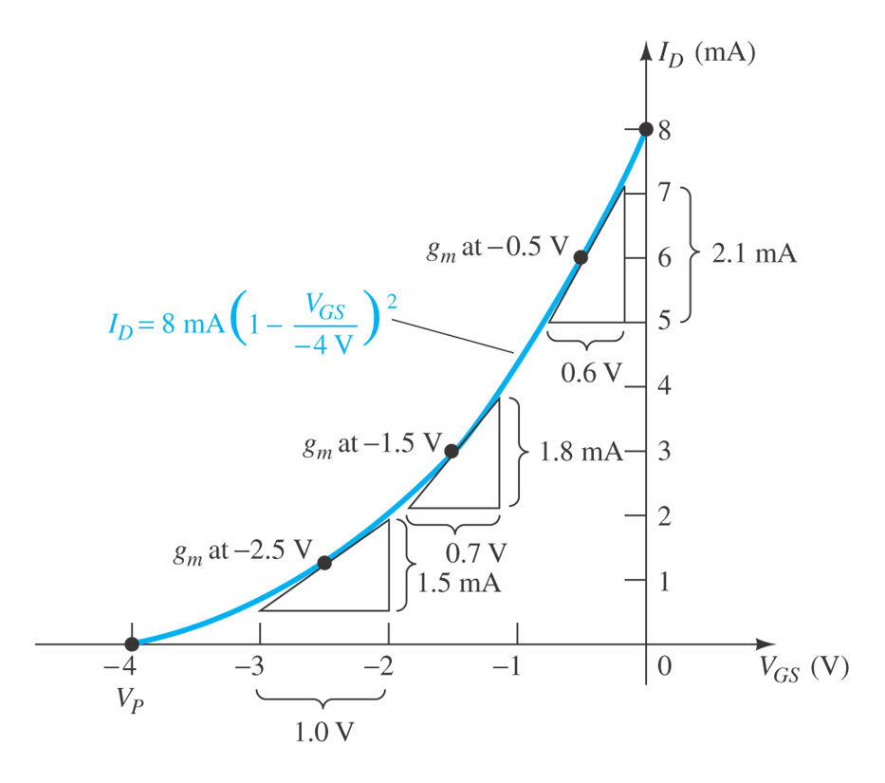
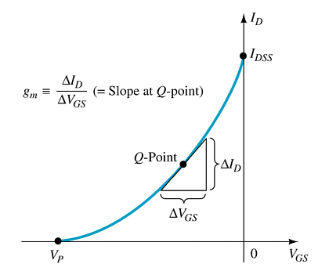
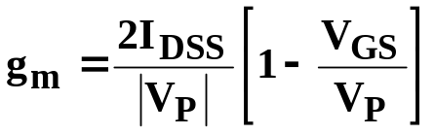
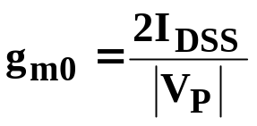
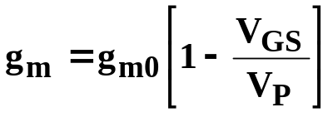
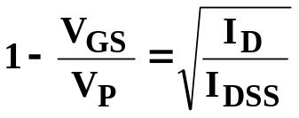
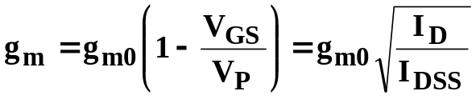

    8.2 FET Small-Signal Model
Transconductance
  The relationship of V_{GS(input)} to I_{D(output}) is called transconductance denoted by g_{m.}
Mathematical Determinations of g_{m}
Graphical Determination of g_{m}
Where V_{GS} =0V
Where
With a small signal input, FET acts as a linear device:

Slide 8
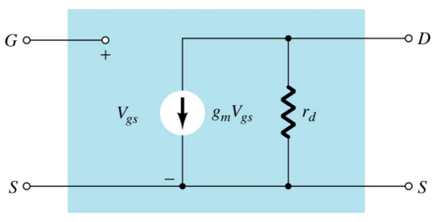

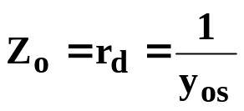
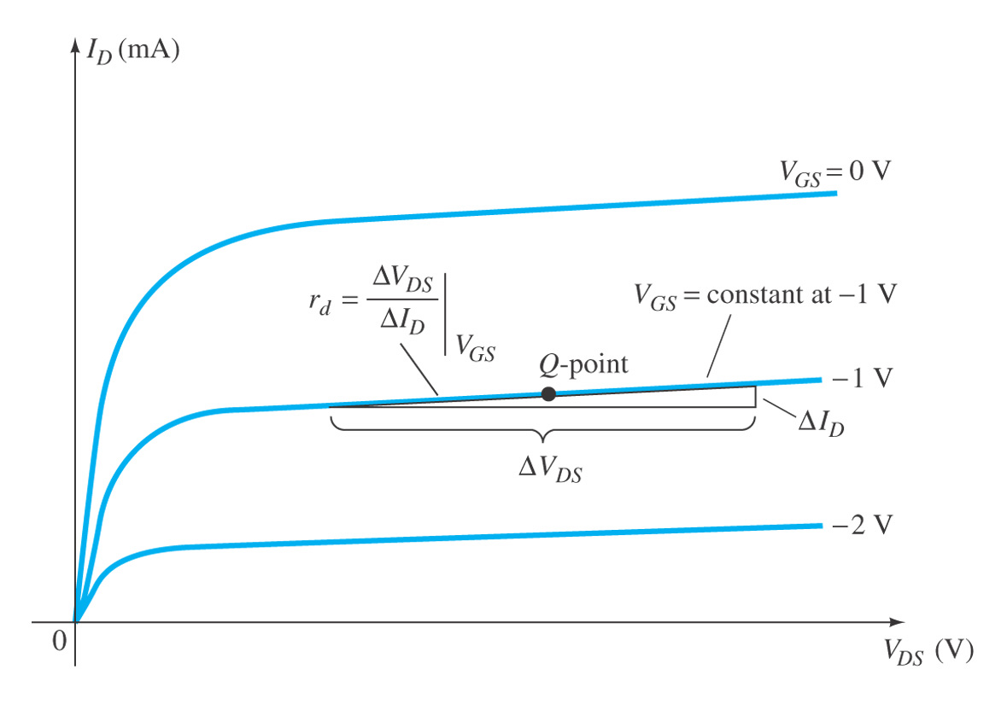
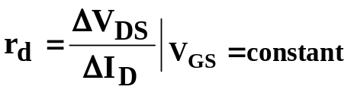
FET Impedance
FET AC Equivalent Circuit
Input impedance:
Output Impedance:
where:
y_{os}= admittance equivalent circuit parameter listed on FET specification sheets.

Slide 9
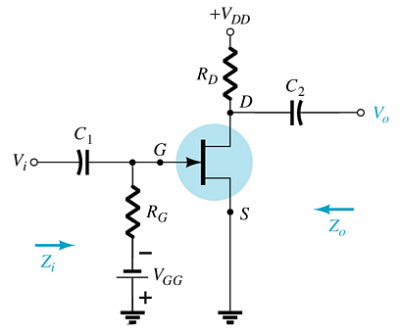


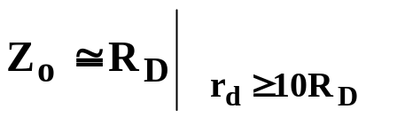
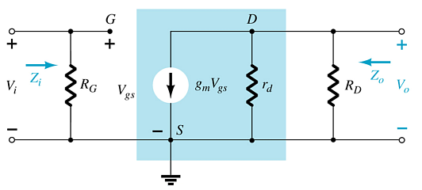
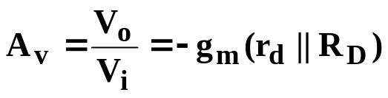
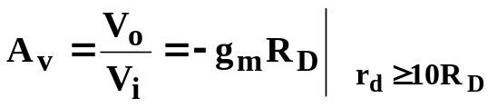
8.3 JFET Common-Source (CS) Fixed-Bias Configuration
The input is on the gate and the output is on the drain
Input impedance:
Output impedance:
Voltage gain:
CS: There is a 180° phase shift between input and output

Slide 10
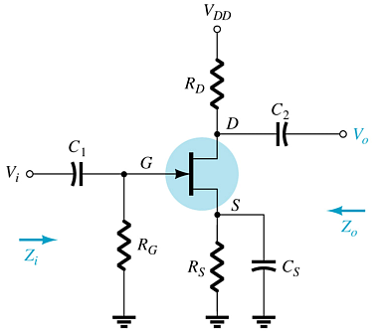

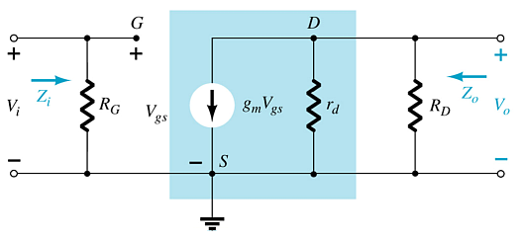

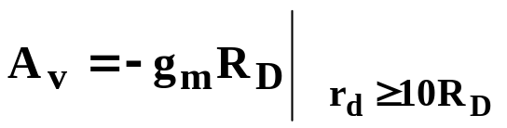
8.4 JFET Common-Source Self-Bias Configuration
The input is on the gate and the output is on the drain
Input impedance:
Output impedance:
Voltage gain:

Slide 11
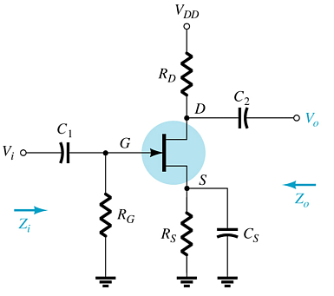
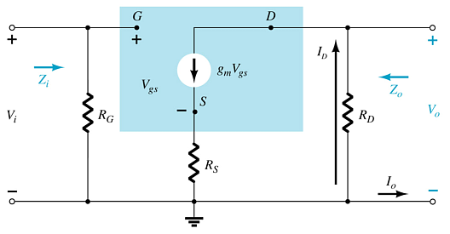
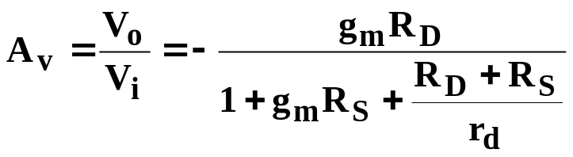
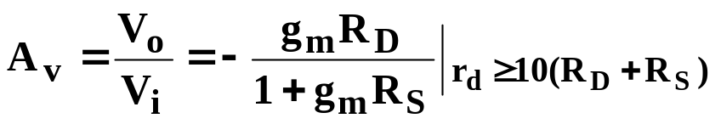
JFET Common-Source Self-Bias Configuration
Removing C_{s} affects the gain of the circuit.
Input impedance:
Output impedance:
Voltage gain:

Slide 12
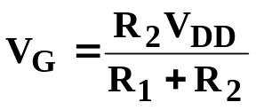
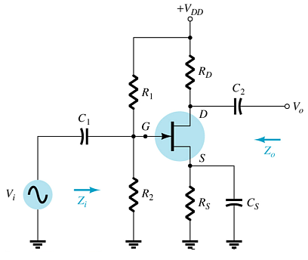


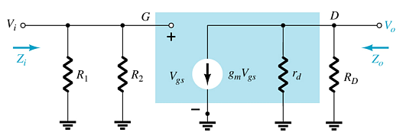

8.5 JFET CS Voltage-Divider Configuration
The input is on the gate and the output is on the drain.
Input impedance:
Output impedance:
Voltage gain:

Slide 13
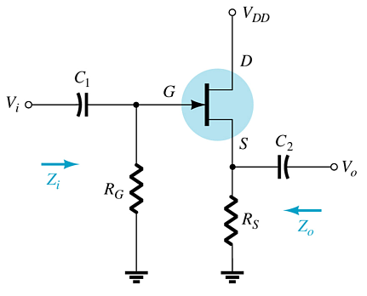

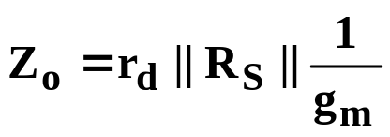
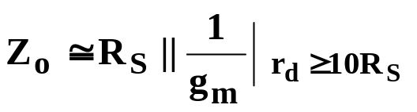
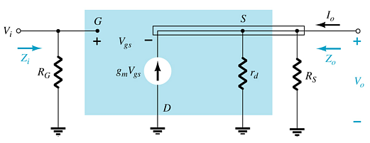
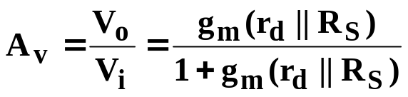

8.6 JFET Source Follower
(Common-Drain) Configuration
In a common-drain amplifier configuration, the input is on the gate, but the output is from the source.
There is no phase shift between input and output.
Input impedance:
Output impedance:
Voltage gain:

Slide 14








8.7 JFET Common-Gate Configuration
The input is on the source and the output is on the drain.
Input impedance:
Output impedance:
Voltage gain:
There is no phase shift between input and output.

Slide 15





8.8 Depletion-Type MOSFETs
D-MOSFETs have the same AC equivalent model and same equation for g_{m} with JFETs .
The only difference is that V_{GSQ} can be positive for n-channel devices and negative for p-channel devices. This means that g_{m} can be greater than g_{m0}.
8.9 Enhancement-Type MOSFETs
E-MOSFETs have the similar AC equivalent model with JFETs .
Equation for g_{m} is different.
Transfer equation for E-MOSFETs:

Slide 16








8.10 E-MOSFET CS Drain-Feedback Configuration
There is a 180° phase shift between input and output for CS amplifiers.
Input impedance:
Output impedance:
Voltage gain:

Slide 17






8.11 E-MOSFET CS Voltage-Divider Configuration
Input impedance:
Output impedance:
Voltage gain:

Slide 18

8.13 Effect of R_{L} and R_{S}
8.14 Cascade Configuration
Note: Methods and conclusions are the same with that for BJT amplifiers in 5.16, 5.19.

Slide 19
Summary of FET Amplifiers
Comparisons of FETs and BJTs
  Voltage controlled
  High input impedance
  Less sensitive to temperature
  Low power consumption
FET Amplifiers
  Analysis methods are same for FET amplifiers and BJT amplifiers except their specific characteristics and small-signal model
    DC and AC analysis
    cascaded systems
  CS, CG, CD

