Slide 1
Chapter 9:
BJT and FET
Frequency Response

Slide 2
9.2 General Frequency Considerations
  The mid-range frequency response of an amplifier refers to the frequency range in which the amplifier will operate with negligible effects from capacitors and capacitance in devices. This range of frequencies can be called the mid-range.
  At frequencies above and below the midrange, capacitance and any inductance will affect the gain of the amplifier.
  At low frequencies the coupling and bypass capacitors lower the gain.
  At high frequencies stray capacitances associated with the active device lower the gain.
  Also, cascading amplifiers limits the gain at high and low frequencies.

Slide 3
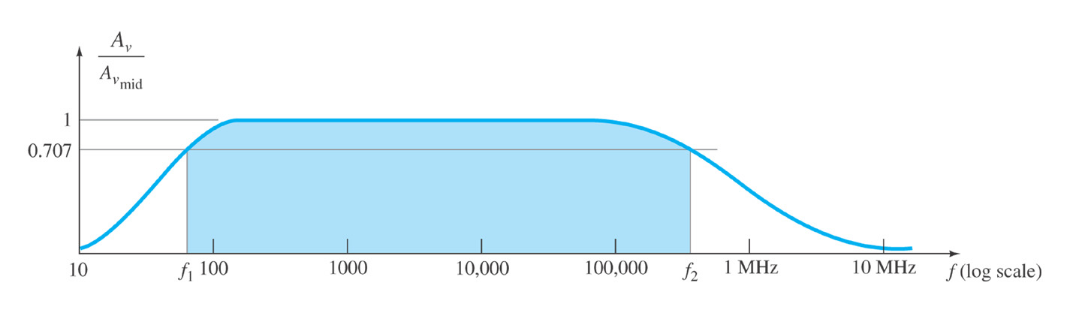
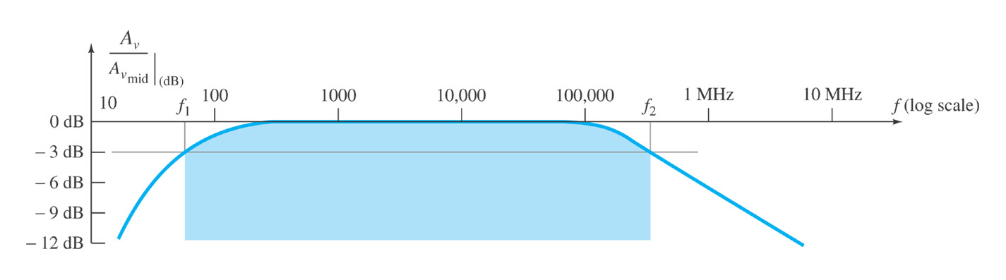
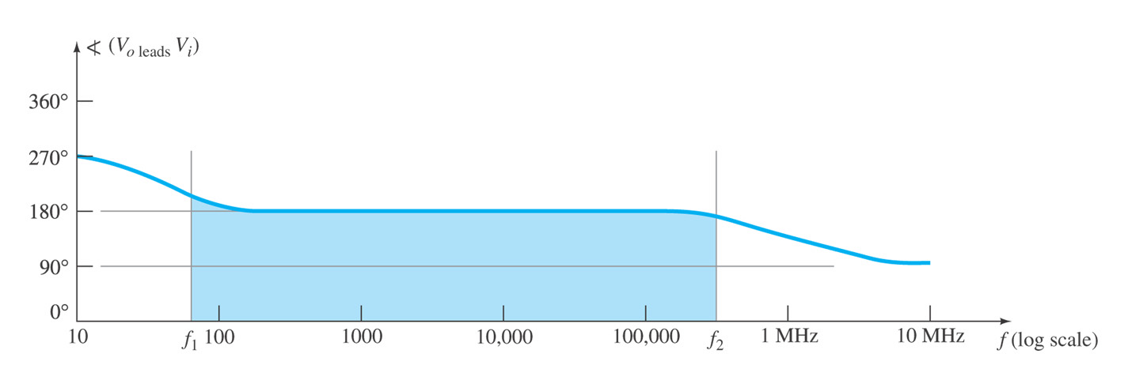
9.2 General Frequency Considerations
Bode Plot
A Bode plot indicates the frequency response of an amplifier.
The horizontal scale indicates the frequency (in Hz and log scale) and the vertical scale indicates the gain (in dB).
Normalized gain versus frequency plot.
Cutoff Frequencies
The mid-range frequency of an amplifier is called the bandwidth of the amplifier.
The bandwidth is defined by the lower and upper cutoff frequencies.
f₁: lower cutoff frequency
f₂: upper cutoff frequency
bandwidth(BW)= f₂- f₁
Cutoff frequency at which the gain has dropped by:
    0.5 power
    0.707 voltage
-3dB
Decibel plot of the normalized gain versus frequency plot.
Phase plot for an RC-coupled amplifier system

Slide 4
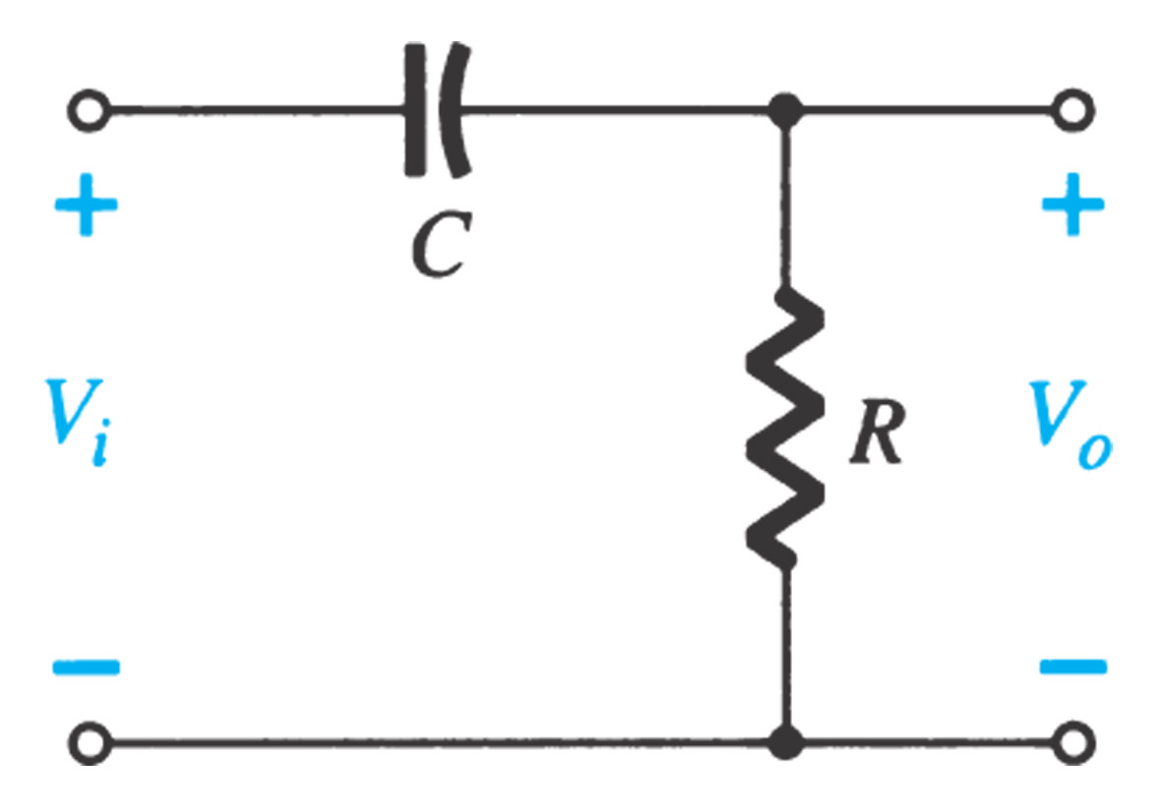
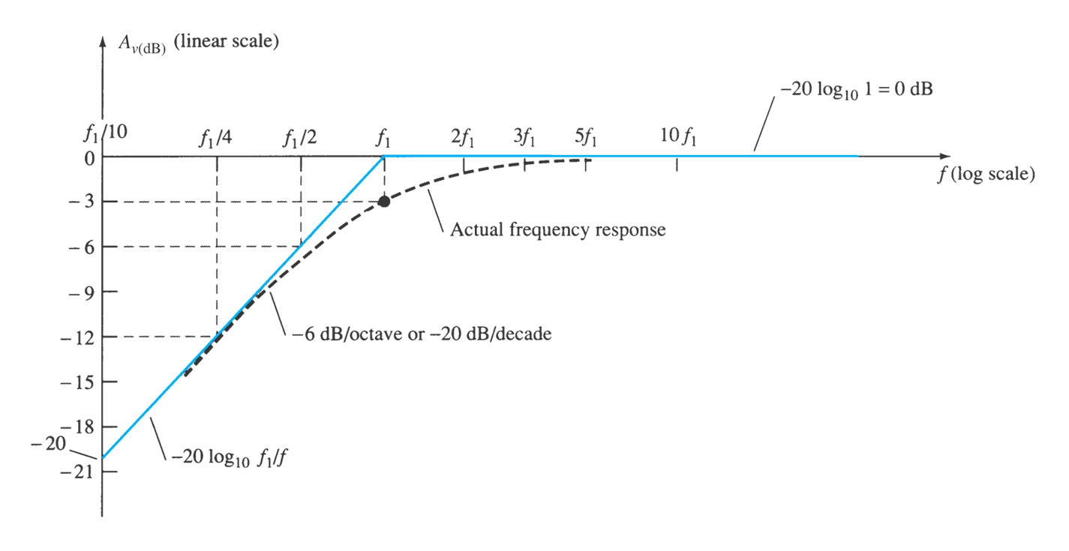
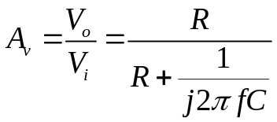
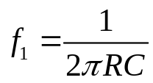
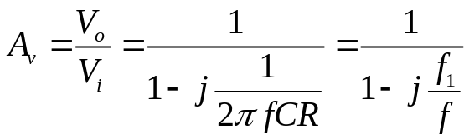
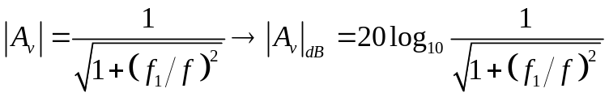
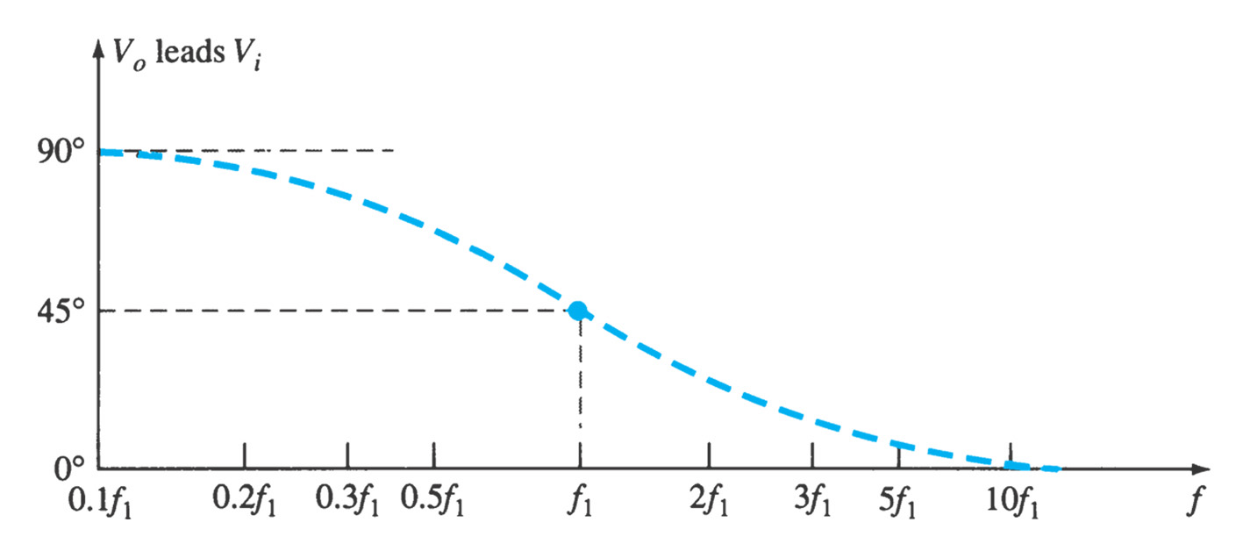

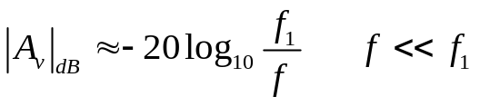




9.3 Bode Plot

Slide 5
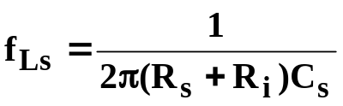

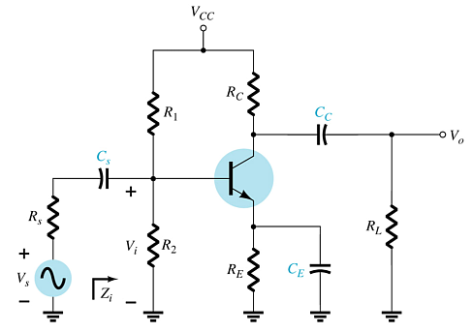
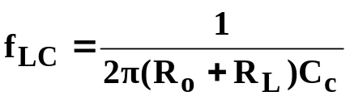

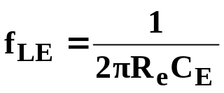
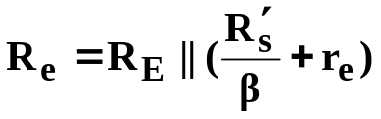

9.4 Low Frequency Response—BJT Amplifier
At low frequencies coupling capacitors (C_{S}, C_{C}) and bypass capacitors (C_{E}) will have capacitive reactances (X_{C}) that affect the circuit impedances.
Coupling Capacitor—C_{S}
The cutoff frequency due to C_{S} can be calculated by
and
Coupling Capacitor—C_{C}
The cutoff frequency due to C_{C} can be calculated with
and
Bypass Capacitor—C_{E}
The cutoff frequency due to C_{E}
can be calculated with
and
where

Slide 6
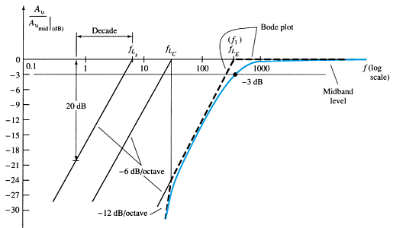
Bode Plot of Low-Frequency Response—
BJT Amplifier
The Bode plot indicates that each capacitor may have a different cutoff frequency.
It is the device that has the highest lower cutoff frequency (f_{L}) that dominates the overall frequency response of the amplifier.

Slide 7
Roll-Off of Gain in the Bode Plot
The Bode plot not only indicates the cutoff frequencies of the various capacitors it also indicates the amount of attenuation (loss in gain) at these frequencies.
The amount of attenuation is sometimes referred to as roll-off.
The roll-off is described as dB loss-per-octave or dB loss-per-decade.
-dB/decade refers to the attenuation for every 10-fold change in frequency.
-dB/octave refers to the attenuation for every 2-fold change in frequency.

Slide 8
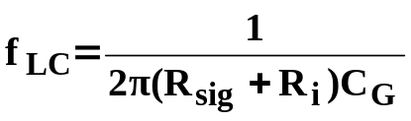

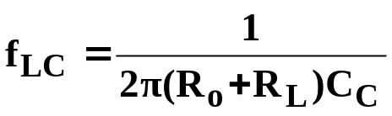
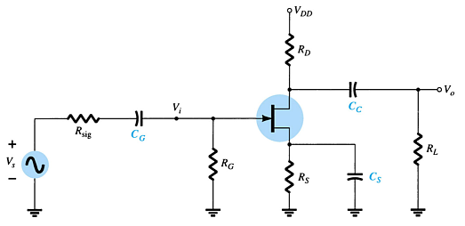

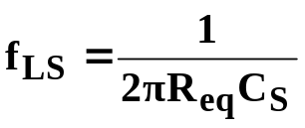
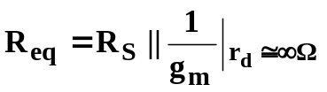
9.5 Low Frequency Response—FET Amplifier
At low frequencies coupling capacitors (C_{G}, C_{C}) and bypass capacitors (C_{S}) will have capacitive reactances (X_{C}) that affect the circuit impedances.
Coupling Capacitor—C_{G}
The cutoff frequency due to C_{G} can be calculated by
where
Coupling Capacitor—C_{C}
The cutoff frequency due to C_{C} can be calculated with
where
Bypass Capacitor—C_{S}
The cutoff frequency due to C_{S}
can be calculated with
where

Slide 9
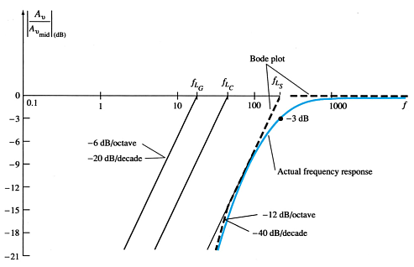
Bode Plot of Low-Frequency Response—
FET Amplifier
The Bode plot indicates that each capacitor may have a different cutoff frequency.
The capacitor that has the highest lower cutoff frequency (f_{L}) is closest to the actual cutoff frequency of the amplifier.

Slide 10
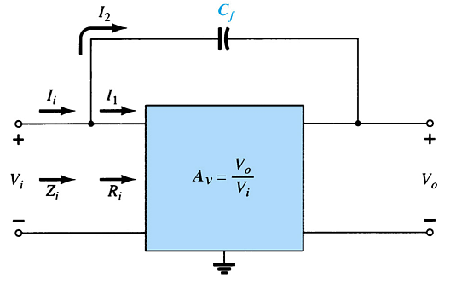

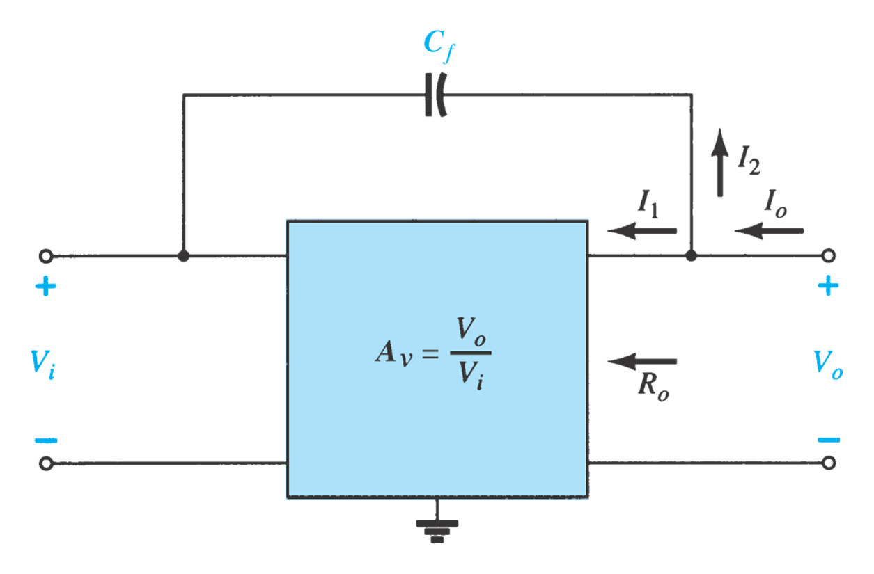
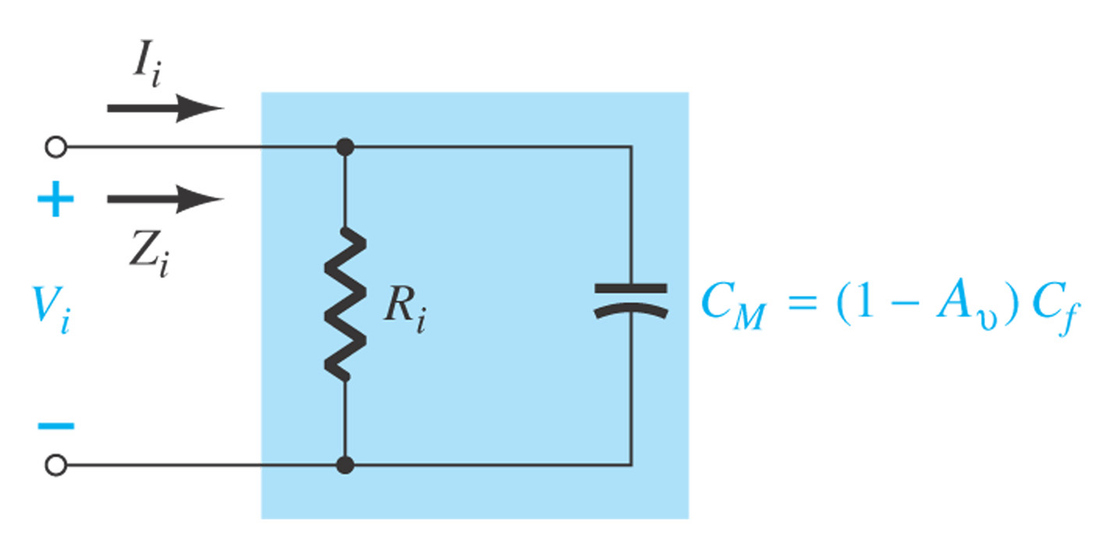

9.6 Miller Effect Capacitance
Any p-n junction can develop capacitance.
This capacitance becomes noticeable between:
  The base-collector junction at high frequencies in common-emitter BJT amplifier configurations
  The gate-drain junction at high frequencies in common-source FET amplifier configurations.
It is called the Miller Capacitance, and it affects the input and output circuits.
Miller Input Capacitance (C_{Mi})
Note that the amount of Miller capacitance is dependent on interelectrode capacitance from input to output (C_{f}) and the gain (A_{v}).
Miller Output Capacitance (C_{Mo})
If the gain (A_{v}) is considerably greater than 1, then

Slide 11
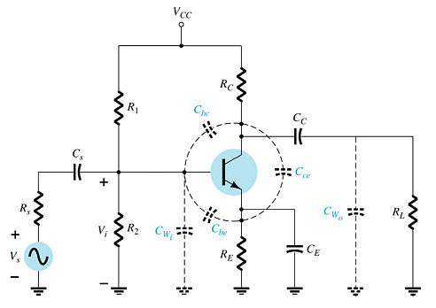
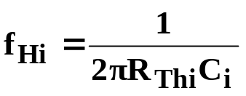

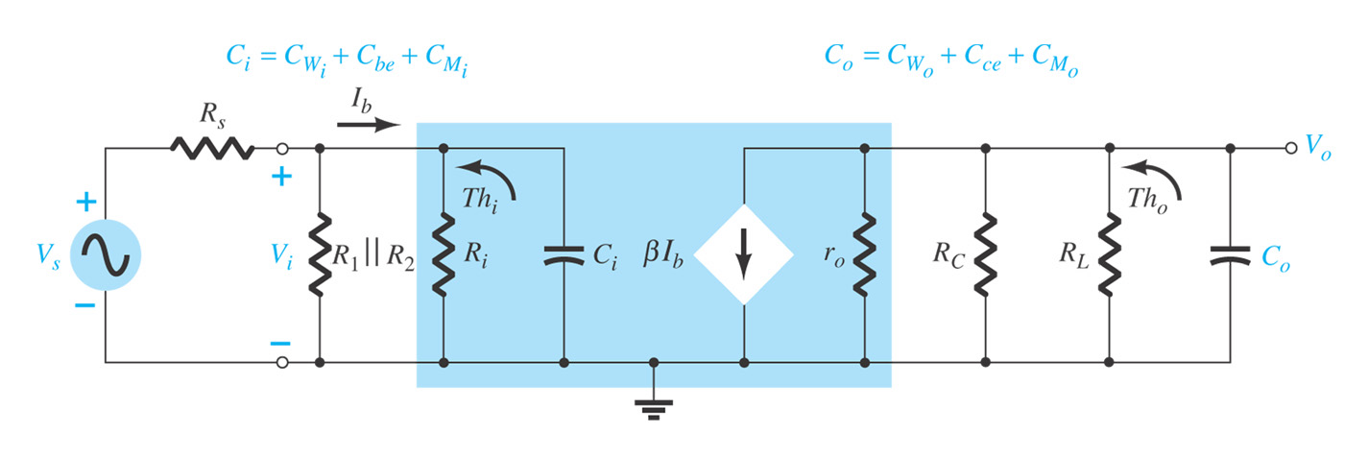
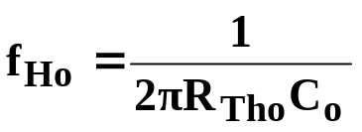


9.7 High-Frequency Response —BJT Amplifiers
Dominant capacitances that affect the high-frequency response are:
  Parasitic capacitances: C_{be}, C_{bc}, C_{ce}
  Wiring capacitances: C_{wi}, C_{wo}
High-Frequency Cutoff—Input Network (f_{Hi})
where
and
High-Frequency Cutoff —Output Network (f_{Ho})
where
and

Slide 12
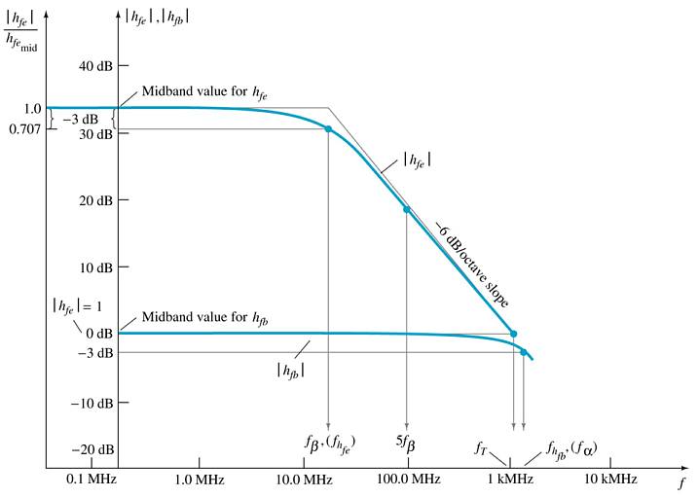
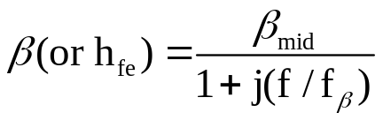
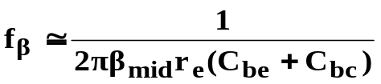



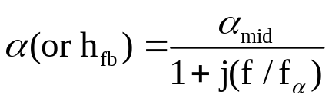
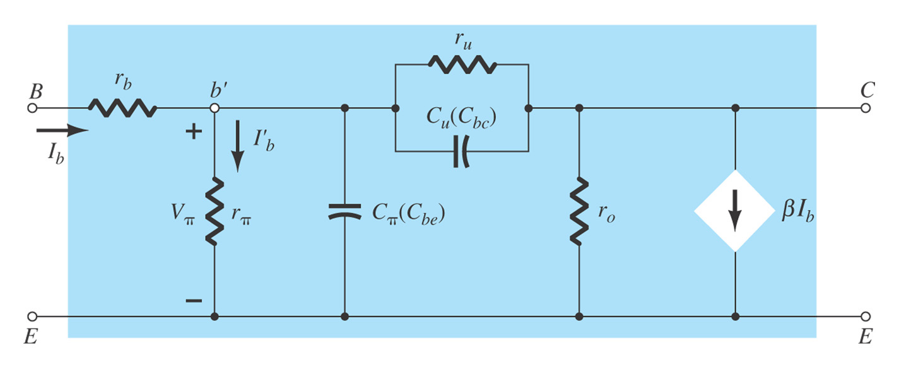
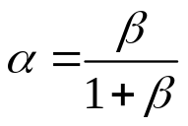

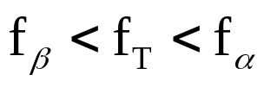
h_{fe} (or β) Variation
The h_{fe} parameter (or β) of a transistor varies with frequency

Slide 13
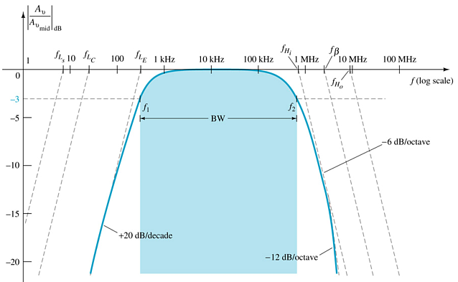
Full Frequency Response of a BJT Amplifier
Middle-frequency region: resistance features by short and open equivalents of capacitances
Low-frequency region: coupling and bypass capacitors determin lower cutoff frequency
High-frequency region: network capacitance (parasitic and introduced) and the frequency dependance of h_{fe} or h_{fb} define the upper cutoff frequency
Note the highest lower cutoff frequency (f_{L}) and the lowest upper cutoff frequency (f_{H}) are closest to the actual response of the amplifier.

Slide 14
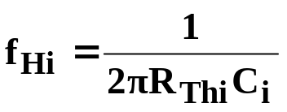



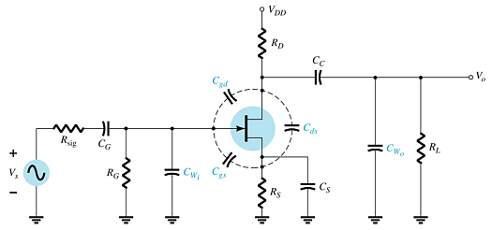
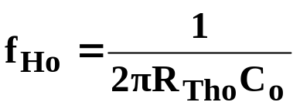

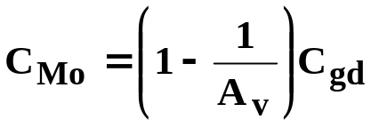

9.8 High-Frequency Response—FET Amplifier
High-Frequency Cutoff—Input Network (f_{Hi})
Dominant capacitances that affect the high-frequency response are
  Parasitic capacitances: C_{gs}, C_{gd}, C_{ds}
  Wiring capacitances: C_{wi}, C_{wo}
High-Frequency Cutoff —Output Network (f_{Ho})

Slide 15
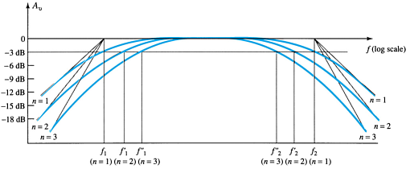
9.9 Multistage Frequency Effects
Each stage will have its own frequency response. But the output of one stage will be affected by capacitances in the subsequent stage. This is especially so when determining the high frequency response. For example, the output capacitance (C_{o}) will be affected by the input Miller Capacitance (C_{Mi}) of the next stage.
Total Frequency Response of a Multistage Amplifier
Once the cutoff frequencies have been determined for each stage (taking into account the shared capacitances), they can be plotted.
Note the highest lower cutoff frequency (f_{L}) and the lowest upper cutoff frequency (f_{H}) are closest to the actual response of the amplifier.

Slide 16
Summary of Chapter 9
Dominant capacitances that affect the high-frequency response are:
  Junction and parasitic capacitances: C_{be}, C_{bc}, C_{ce}
  Wiring capacitances: C_{wi}, C_{wo}
Dominant capacitances that affect the low-frequency response are:
  Coupling capacitances: C_{S}, C_{C}
  Bypass capacitance: C_{E}
Bode plot is required to present frequency response, and determine
  Cutoff frequencies
  Bandwidth
Miller Effect of CE (or CS) configuration
  How to increase the bandwidth of CE amplifier

