Slide 1
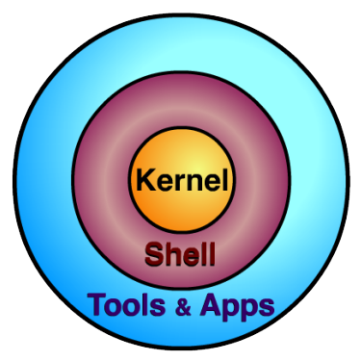
UNIX
The Basics
Source: http://cis.kutztown.edu/~kta/Projects/Unix.ppt

Slide 2
What is Unix?
Unix is just an operating system. It provides the same functionality as the operating systems we all know and love.
What makes Unix slightly more challenging, is it’s lack of the clickable graphical user interface we are all so accustomed to.
Don’t worry, it’s really not as difficult as it may seem at first! You’ll be a Unix expert in no time.

Slide 3
File System Structure
To start out, you need to have an understanding of how Unix arranges it’s files. So let’s call the file system a tree.
Think about hanging the tree upside down. All branches (directories) come from the trunk (root), or from other branches (directories).
So if the branches are file folders (directories), then the leaves must be the files contained in the directories!

Slide 4
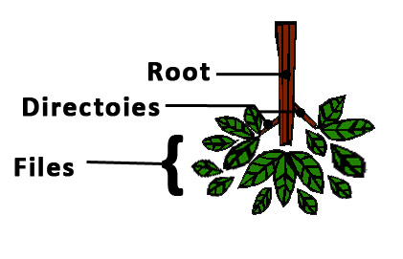
File System Structure
The trunk is the root directory.
Branches are directories.
Leaves are files.

Slide 5
File System Structure
So does the file system structure of Unix look similar to another operating system?
It should! It’s very similar to any windows, mac, or linux operating system!
  A path to a file from the root could look something like this: /dirlvl1/dirlvl2/my_file
So you should already know how things work. You just need to know the Unix commands to get around!
Note that Unix uses the forward slash! (Opposite of windows)

Slide 6


Projects—launch terminal
Ubuntu users
  Top left corner -> click “Search”-> type “terminal”
MacOS users
  Top right corner -> click “mirror”-> type “terminal”
Windows10 users
  Win +”S” -> type “cmd”
  Win +”S” -> type “Windows PowerShell”
  https://www.makeuseof.com/tag/windows-10-ssh-vs-putty/

Slide 7
Connection
On your terminal
  ssh(secure shell) yourAUaccount@gate.eng.auburn.edu
  enter yourAUpasswork
  “Please enter the name of an Engineering host <anywhere>:” click Enter
  again, enter yourAUpasswork
  a successful login info with yourAUaccount@tux#

Slide 8
Basic Unix Commands (1)
man – Displays a manual for any command
  “man pwd” will give you the manual for the pwd command.
pwd – Displays the present working directory
  “pwd” after login will show the location of your home directory.
ls – Lists the contents of your present directory
  “ls” after login will show you all the files and directories in your home directory.

Slide 9
Basic Unix Commands (2)
cd – Change the working directory (the working directory is just the one you are in)
  “cd mydir” from the home directory will take you to mydir provided it exists in the home directory.
  “cd” by itself will take you to your home directory.
  FYI: There are two symbols that mean current directory and parent directory respectively.
    ./ means current directory (“cd ./” takes you nowhere)
    ../ means parent directory (“cd ../” will take you to the directory containing the one you are in)

Slide 10
Basic Unix Commands (3)
mkdir – Make a directory
  “mkdir mydir” will make a directory named mydir inside the current working directory.
mvdir – Move a directory
  “mvdir mydir1 mydir2” will move mydir1 inside of mydir 2 provided mydir2 exists. If not, mydir1 will be renamed mydir2!
rmdir – Remove a directory
  “rmdir mydir” will remove mydir (if empty)

Slide 11
Basic Unix Commands(4)
mv – Move a file
  “mv myfile ../” will move myfile to the parent directory of the current directory.
scp -- secure copy (remote file copy program)
“scp ”
cp – Copy a file (Adding -r copies a directory)
  “cp myfile someplace” will copy myfile to the directory someplace if it exists. Otherwise, it will make a duplicate copy of myfile called someplace.

Slide 12
Unix Commands (5)
tar--tape archive.Collections of files/directories to highly compressed archive file(tar, gzip,bzip).
-c: Create an archive.
-z: The file is a “gzipped” file
-v: Display progress
-f: Allows you to specify the filename of the archive.
-x: extract compressed files
https://www.quora.com/What-is-the-difference-between-tar-gz-zip-and-tar-gz-in-Linux
https://www.interserver.net/tips/kb/use-tar-command-linux-examples/
https://www.howtogeek.com/248780/how-to-compress-and-extract-files-using-the-tar-command-on-linux/

Slide 13
Unix Commands (5)
rm – Remove a file
  “rm myfile” will delete myfile.
clear – clears the screen
  “clear” will give you a blank screen. You can still scroll up to see your text again in putty.
cat – displays a file (all at once)
  “cat myfile” will print out myfile to the screen.
exit – exits Unix
  “exit” will log you out and close putty.

Slide 14
Script and Typescript
The script command begins saving all text you type. It comes in very useful to save input and output to and from Unix.
  To begin issue the “script”command.
  Do whatever you want.
  To end, use ctrl + d.
When done, script will save all input and output to a file named typescript.

Slide 15
Caution with Script & Typescript
If you already have a file named typescript in your current directory, the script command will overwrite it without asking you!
You can use the script command with a name to choose the file the input/output from the terminal is sent to in order to avoid this.
  “script myscript” will save everything to a file named myscript instead of the regular typescript.

Slide 16
Compiling a C++ Program
To compile a c++ program, use the g++ command. “g++ myprogram.cpp”
  Provided there are no errors, this will create an executable file called a.out.
  If you want to name your executable file, use the -o flag to specify a name. “g++ myprogram.cpp -o myprogram.out”

Slide 17
Running a C++ Program
Running a c++ program is easy, just type in the name of the executable file!
  “a.out”
There could be a minor issue however. If for some reason, that doesn’t work, try preceding the name with a ./
  “./a.out”

