Slide 1



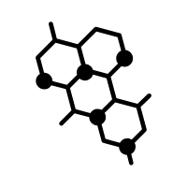







Adult Stem Cells
Lineage Origin
Multi-Omics
Functional Assays
Cell Fate Decision
Aging
Resource
Cancer Origin
Niche Regulation
Biomarker
Pre-Malignant States
Immune Evasion Onset
Epigenetic Regulation
Microenvironment Cues
Atlas Construction
Multi-Modal Models
Transformer-Based Algorithms

