Slide 1
CS677 Project Presentation
By: Ethan Timoteo Go

Slide 2
Goal
Learn the basics of Deep learning and the keras model
Apply to the MNIST datasets, datasets containing numbers
Create different models and test their accuracy

Slide 3
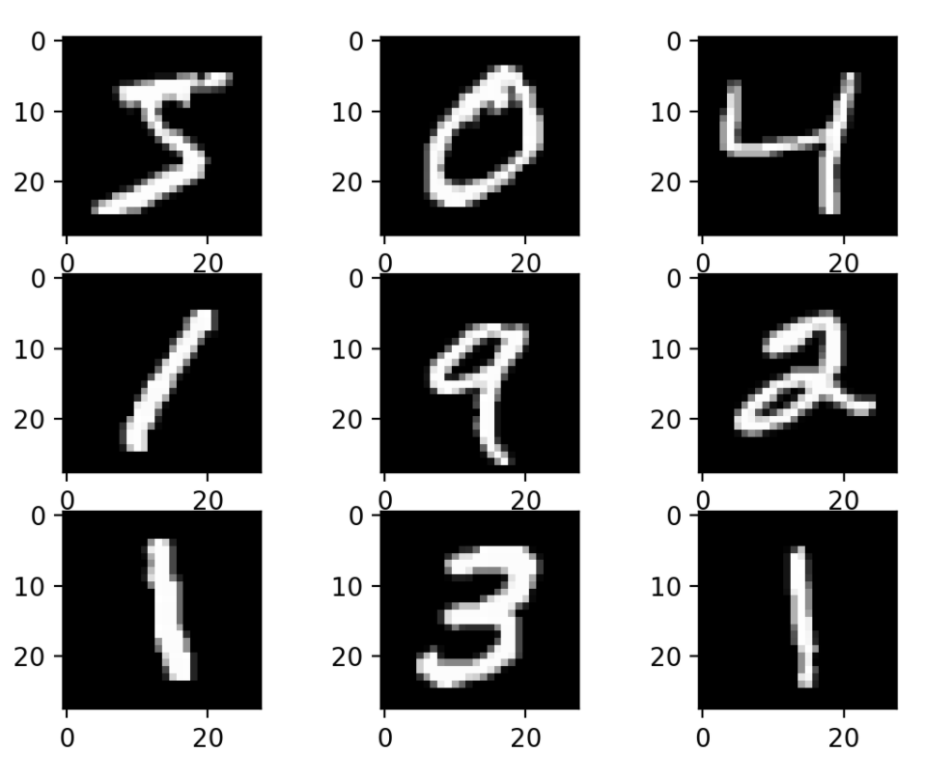
Datasets

Slide 4
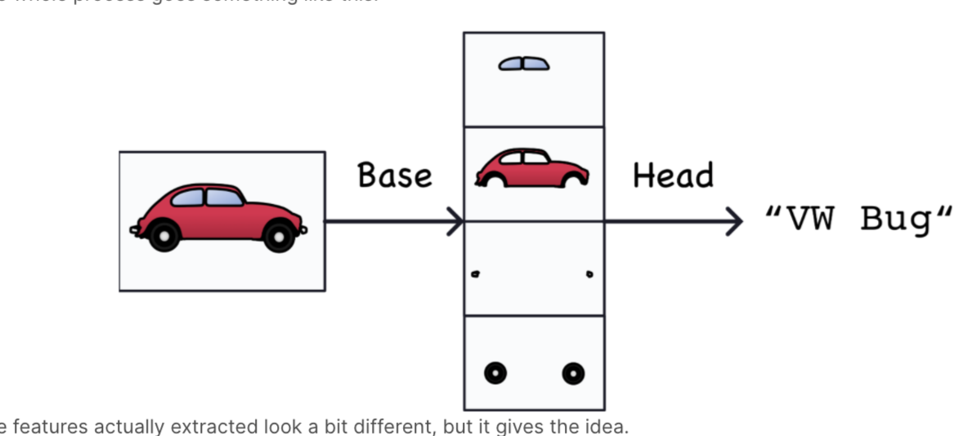
The Image detection Model

Slide 5
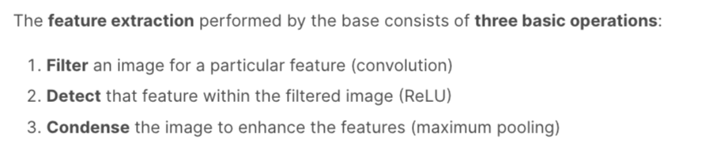
Image Detection - Base
Conv2d
Relu
MaxPooling

Slide 6
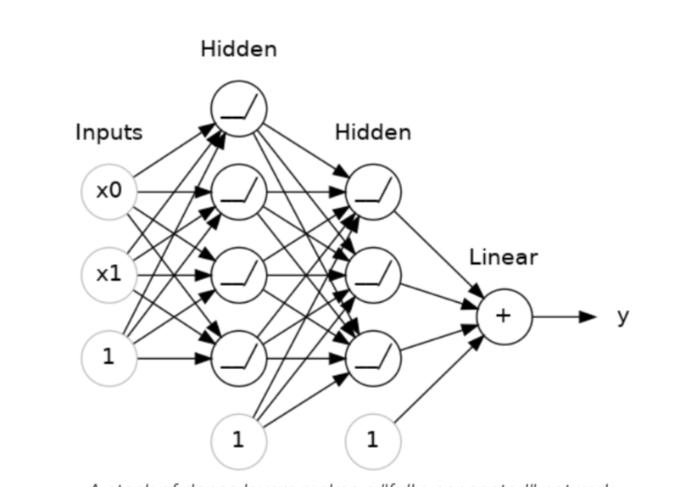
Image Detection - Head
A deep learning network with neurons

Slide 7
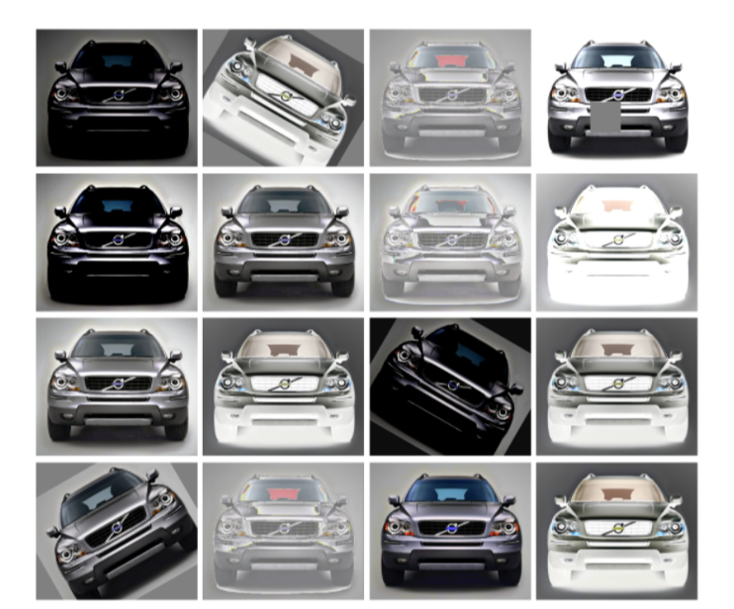
Image Augmentation

Slide 8
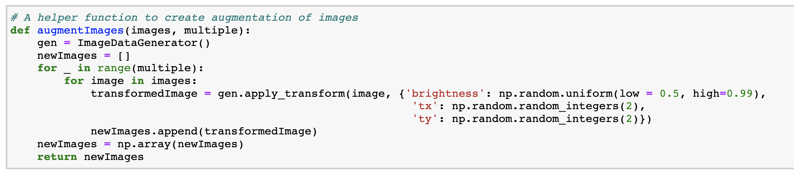

Slide 9
3 Model of Comparison
Model 1
Baseline model
Model 2
Less complex base
Model 3
Less complex head

Slide 10
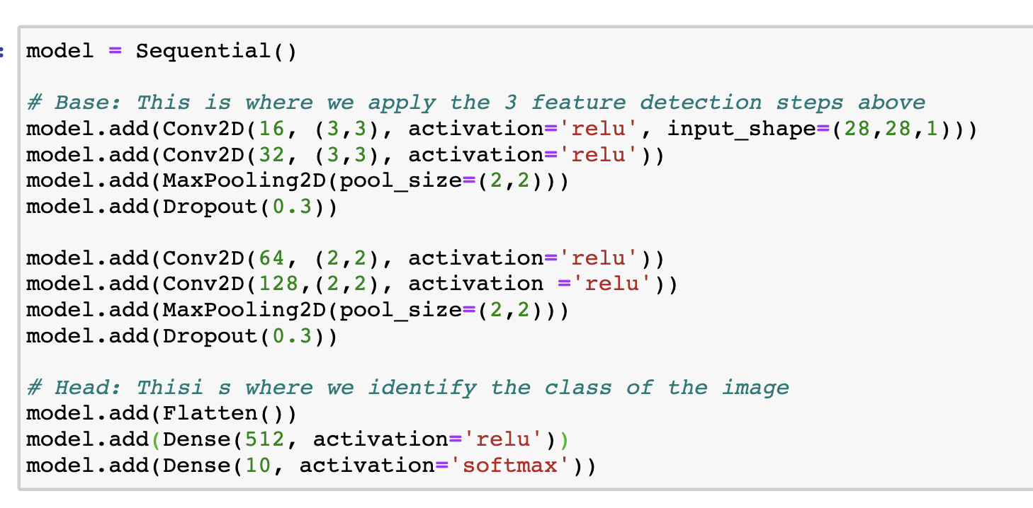

Slide 11
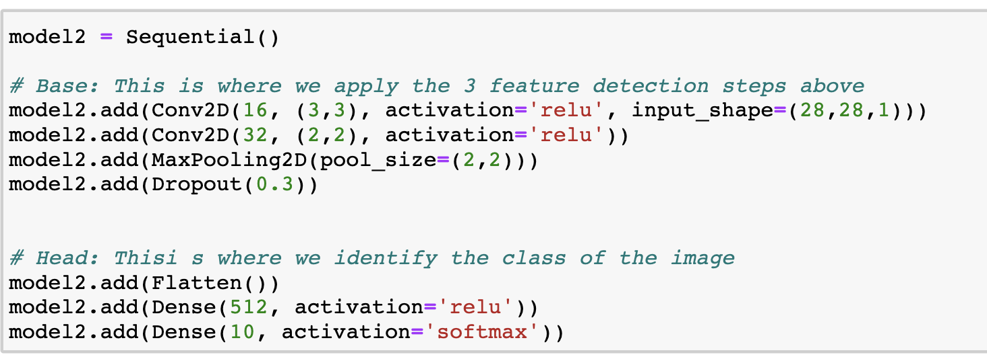

Slide 12
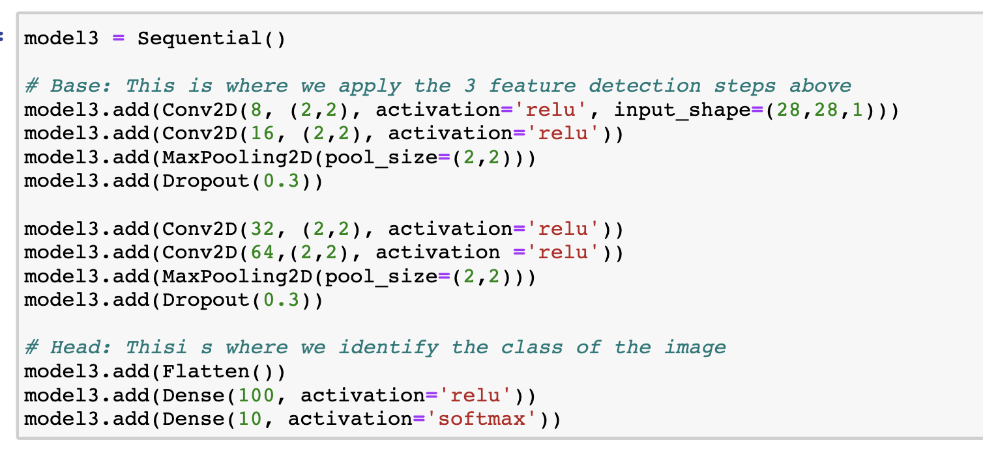

Slide 13
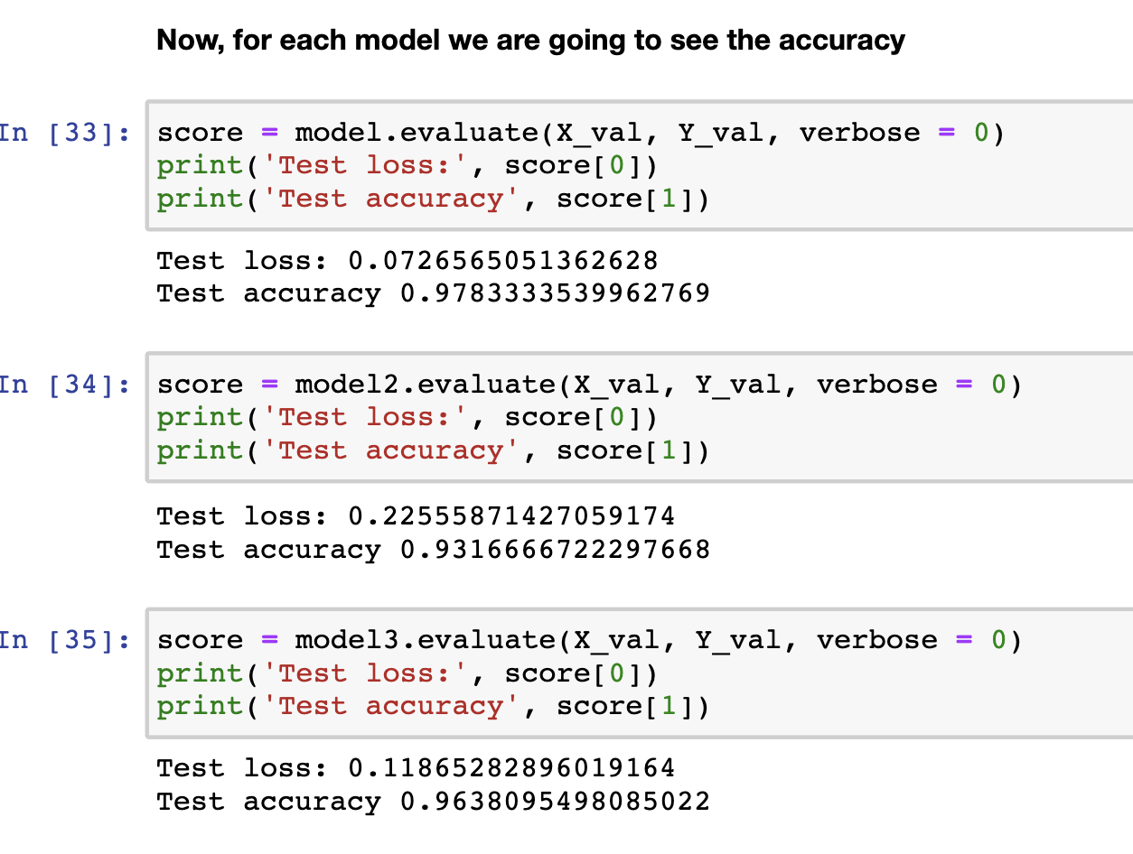
Evaluation

