Slide 1
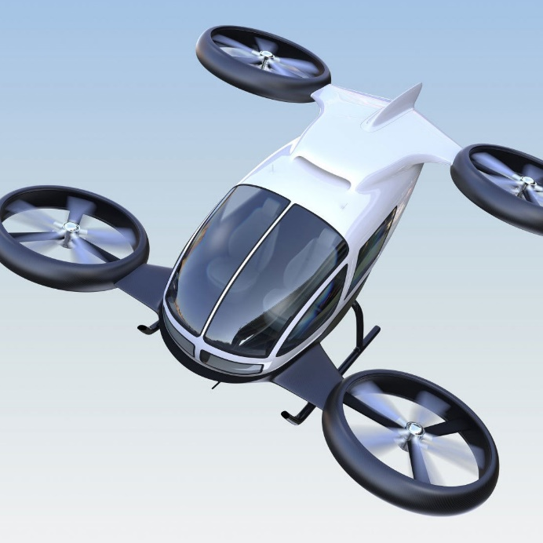
Project Plan
/04
Project phases and key tasks
Timeline
Milestones
Project plan execution and report

Slide 2
Project phases and key tasks
Phase 2:
Blue print design
Phase 3:
Manufacturing
Target decomposition.
Aims achieved.
Phase 1:
Project preparation
Phase 4:
Acceptance of delivery
Object definition.
Customer value realization.
2
0
3
5

Slide 3
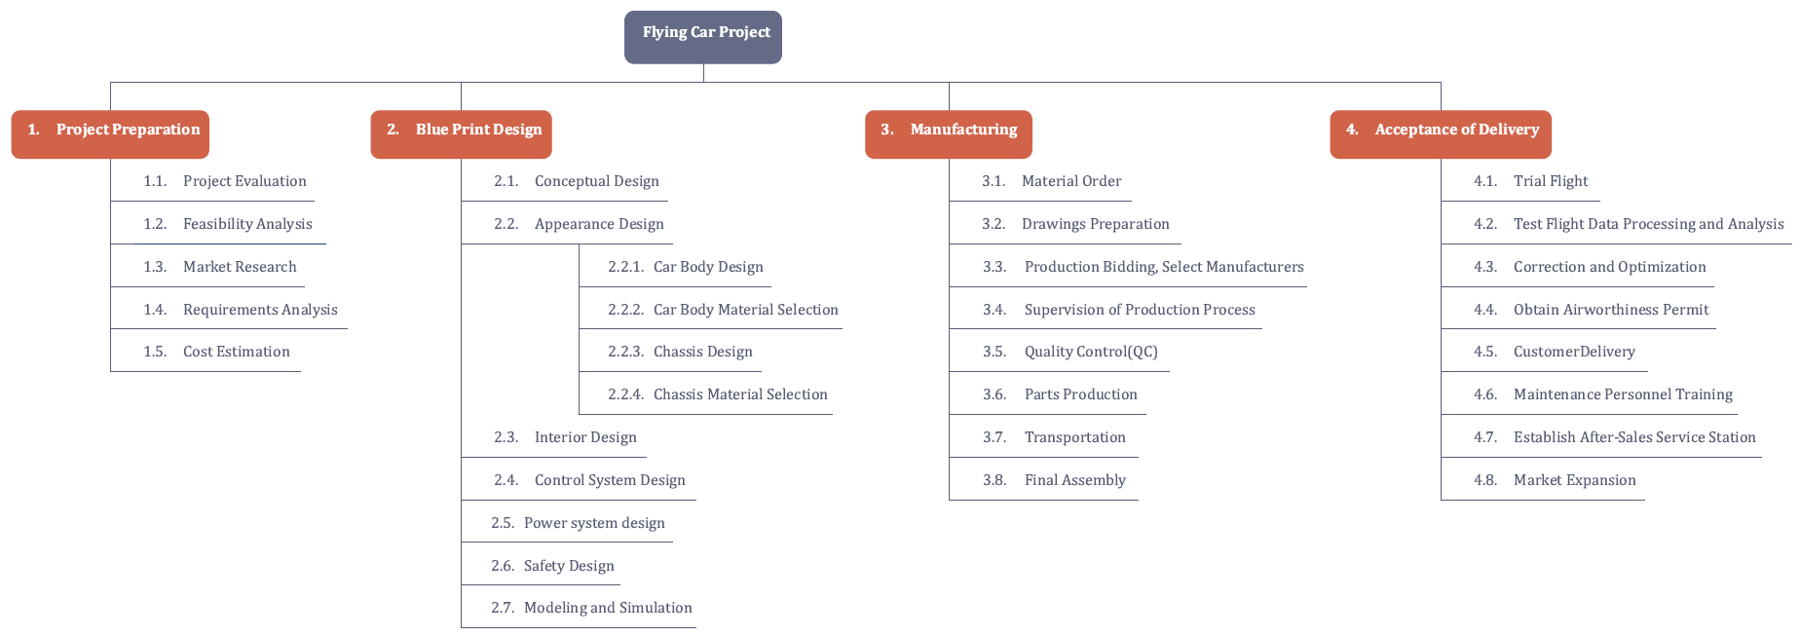
Project phases and key tasks
Work Breakdown Structure of the project

Slide 4
Timeline
32%
Life cycle is 16 years
22%
From May 19, 2019 to December 31, 2035.
31%
15%
Project preparation
Blue Print Design
Manufacturing
Acceptance of Delivery
From May 19, 2019 to August 31, 2021
……
From Oct. 1, 2021 to Dec. 31, 2025
……
From Jan. 1, 2026 to July 31, 2029
……
From August 1, 2029 to Dec. 31, 2035
……

Slide 5
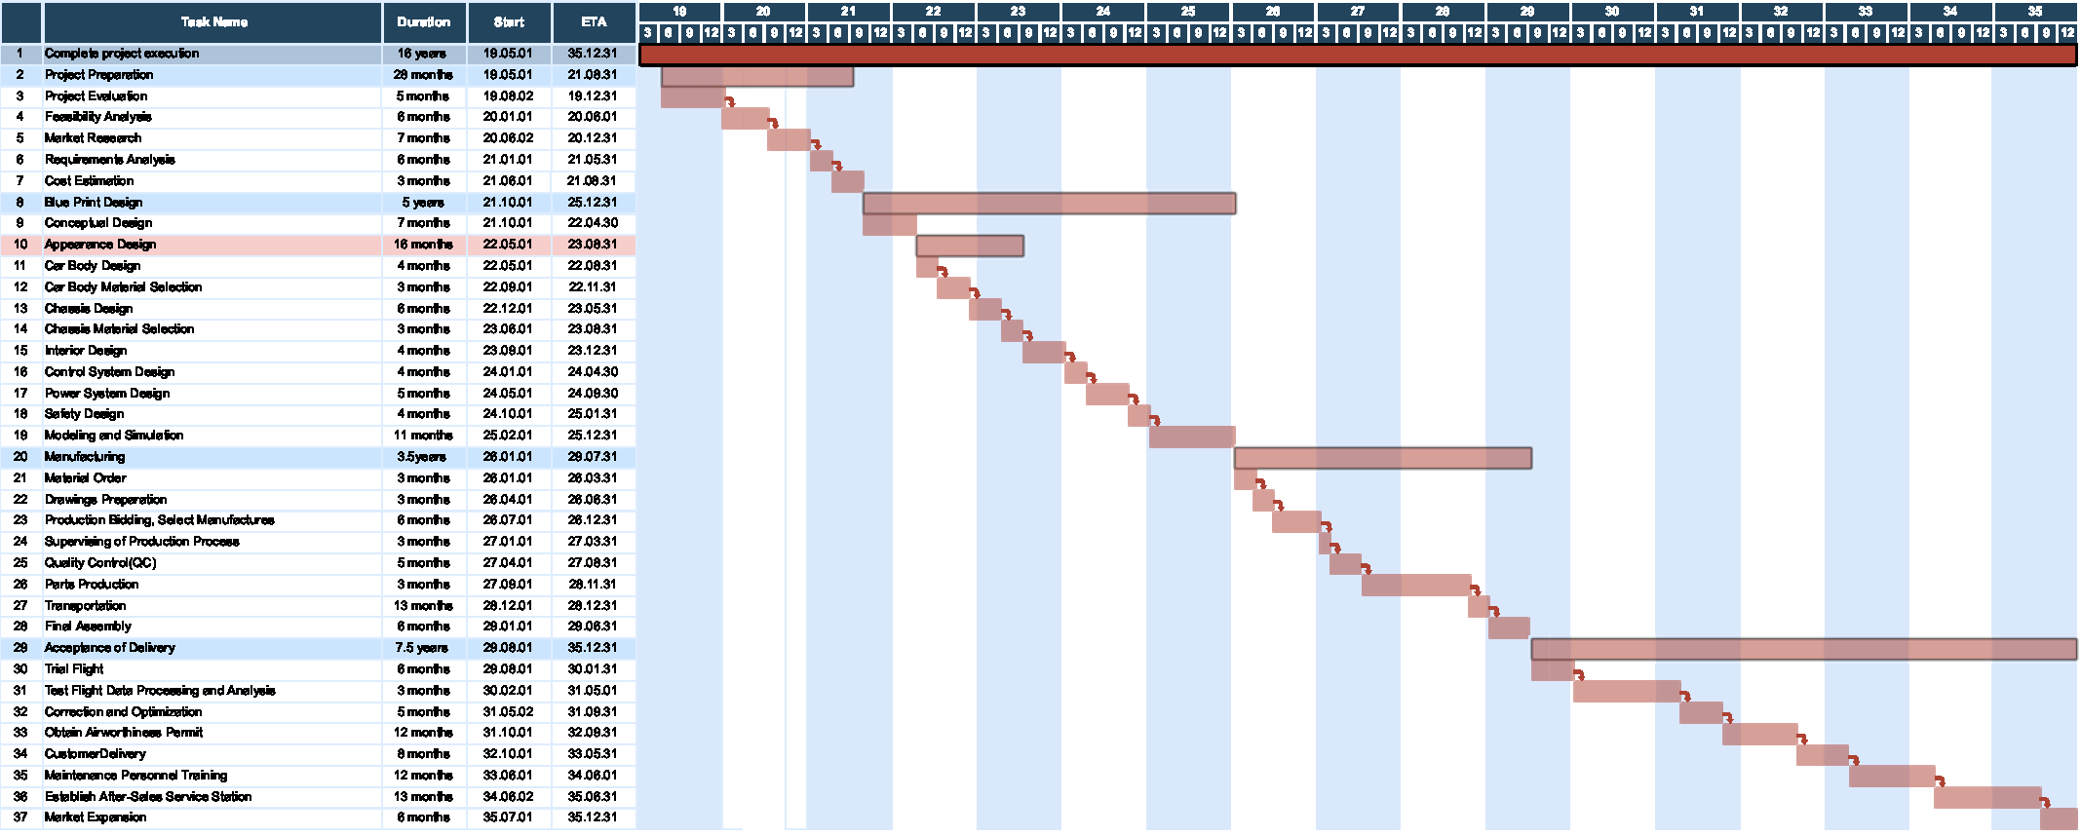
Timeline
Gantt Chart of the project

Slide 6
Milestones
Manufacturing
Production Bidding, Select Manufactures
Assembly completed, prototype offline
Project preparation
Officially approved
Reliability analysis completed
Market survey completed
Cost estimates, budget allocations
Acceptance of delivery
16
First trial flight
Obtain Airworthiness Permit
Customer Delivery
Market Expansion
Blue print design
Establish a design team
Completion of Concept selection
Completion of pneumatic design
Completion of overall design
Completion of simulation experiment
Safety verification
milestones

