Slide 1

Project Document Management
/05

Slide 2
Importance of project document management
01
02
To ensure the ultimate success of the project, it must be strict control is carried out at every stage of the purpose. The project's documentation reflects the project's work process and results and is the basis of project control. According to it, it is also a key carrier of “knowledge transfer”, so it is necessary to fully document the entire process of the project.
……
This document specifies the documents that need to be written during the project process.
this document also describes the specific requirements for documentation.
this document also describes the project team members are making these documents.
……

Slide 3
Project document system
File name | Project stage | File time | signature
Project implementation and work plan | The beginning of the project
User demand report | The beginning of the project
Evaluation report | All the stage
Design Report | The beginning of the project
Design evaluation report | After design test
Material purchase application | Middle stage
Test result report and assessment | Middle stage
User Training Program | Middle stage
User Manual | Middle stage
User training materials | Middle stage
Flying car production plan | Last stage
Maintenance Documentation | Last stage
Reconciliation Confirmation Report | Last stage
Product Quality Check Report | Last stage

Slide 4
Project Communication Management
/06

Slide 5
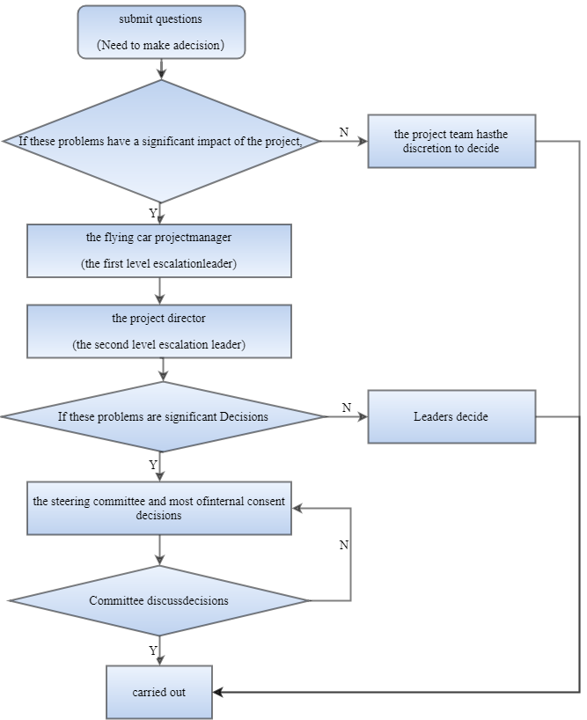
Project decision process
(1)
(2)

Slide 6
Project meeting
01
Every Thursday 14:00-15:00 All members of the project team will meet once. The meeting was hosted by the project manager and worked for the past week.
Every Friday 14:00-15:00 The project holds a management meeting, including flying car project director, project manager, and small group leader.
02

