Slide 1




iSlide® PowerPoint standard template.
Subtitle here
Speaker name and title
www.islide.cc

Slide 2

Content
01
Supporting text here.
02
Supporting text here.
03
Supporting text here.
04
Supporting text here.

Slide 3


Project organization structure
Project organization chart
Personnel responsibility
Responsibility matrix

Slide 4
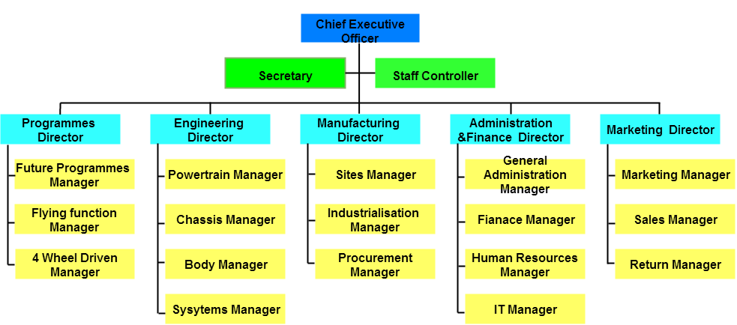
Project organization chart

Slide 5
Personnel responsibility
Project management team
Product development team
Steering Committee Member/ Project Director
Project manager
Project supervision
Development
Functional engineer
Technical engineer
Project Promotion and
Coordination Team
Other participants of project
Key user.
User test group
Training/ Process / Test Group.
Project promotion team member
Project coordination team member
www.islide.cc

Slide 6
Responsibility matrix
Project task |  | Party B
 |  | Project manager | Project supervision | Development team | business manager
Project begining | Signing the project charter
 | Project implementation plan
 | Hold a kickoff meeting
Project product planning | Product design and development
 | Product testing
product testing | Safety test
 | Performance Testing
 | User experience test
Project closing | Technical handover
 | Project Acceptance
Project management | Weekly meeting
 | Project event management
 | Demand change

