Slide 1
MP #3
Some guidelines

Slide 2
Tiny Social Network Service
Features - Same as MP-2
FOLLOW
LIST
TIMELINE
UNFOLLOW
Processes
Coordinator: Helps resolve Server and Synchronizer addresses.
Master Servers: Handles client requests.
Slave Servers: Mirrors the actions on Master server.
Follower Synchronizers: Responsible for syncing the data between the servers (following list and timelines).
Client: End User interacting with the service.

Slide 3
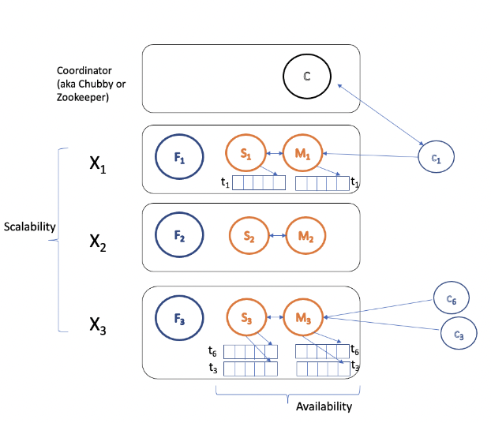
Architecture

Slide 4
TODO
Create new GRPC services to handle additional RPC calls.
Build the Coordinator.
Make changes to the client and the server code to incorporate changes like coordinator interactions.
Persist all changes to the data to disk.
Build the Follower Synchronizer.
All events must be logged using GLOG.
Submit the code via GitHub and the Design Document on Canvas.

Slide 5
GRPC Services
Create new GRPC services to handle:
RPC calls to and from the coordinator:
Client asks the coordinator for server address
Heartbeat from servers
Resolve Follower Synchronizer addresses
Resolve which cluster the client belongs to
RPC calls between the Synchronizers:
Syncing Users
Syncing Followers
Syncing Timelines

Slide 6
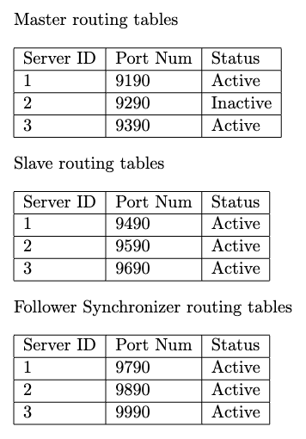
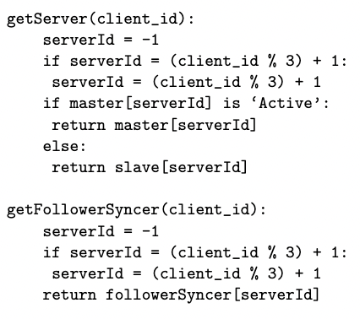
Coordinator
Build the Coordinator
Listen to heartbeats from the servers and mark the status of the servers.
On client requests, return server whose status is active.
Respond to Synchronizer requests.

Slide 7
Example: Client-Coordinator Interaction
FollowSync1
Slave1
Master1
Server IP:port?
FollowSync2
Slave2
Master2
Coordinator
Master1
Client1
FollowSync3
Slave3
Master3

Slide 8
Example: Client-Coordinator Interaction
Coordinator
FollowSync1
Slave1
Master1
FOLLOW 2
SUCCESS
FollowSync2
Slave2
Master2
Client1
FollowSync3
Slave3
Master3

Slide 9
Client
Make changes to the client and the server code: Client Side: int Client::connectTo(){ // contact Coordinator for server IP and Port. // connect to the returned master server. } // Master failure if (status.ok()) {...} else { connectTo(); displayReConnectionMessage(server_hostname, server_port); }

Slide 10
Server
Make changes to the client and the server code:
If Master, execute the client requests and also forward them to the slave server. The slave server will replicate the actions.
Heartbeat to Coordinator every 10 seconds using threading. Message can include the Server ID, IP, port and type.
Persist all changes immediately as server may go down any time.

Slide 11
Persistence
Persist all changes to the data to disk.
All the data is saved to <server_type>_<id>. Ex: All the data from master server whose ID is 1 are saved in master_1/ directory.
The format of the data within the directories is up to you.
Follower Synchronizer updates these files for both master and slave within that cluster.
Make sure to handle synchronization issues like master and sync server writing to the same file at the same time.

Slide 12
Example: Master Failure
Coordinator
getServer(Client1)
returns Slave1
FollowSync1
Slave1
Master1
FOLLOW 2
ERROR
FollowSync2
Slave2
Master2
Client1
FollowSync3
Slave3
Master3

Slide 13
Example: Master Failure
Coordinator
FollowSync1
Slave1
FOLLOW 2
SUCCESS
FollowSync2
Slave2
Master2
Client1
FollowSync3
Slave3
Master3

Slide 14
Example: Master Restart
Coordinator
FollowSync1
Slave1
Master1
FOLLOW 2
SUCCESS
FollowSync2
Slave2
Master2
Client1
FollowSync3
Slave3
Master3
Since FollowSync1 syncs data every 30 seconds, it is its responsibility to sync the data between the slave and the master once the master is back.

Slide 15
Follower Synchronizer
Build the Follower Synchronizer.
Maintain persistent information about follower-following relations. This information is synced to all clusters.
Any post from a user being followed should be updated to the timeline file using the Synchronizer every 30 secs.
Ex: u1 follows u2. u2 posts a message. F2 checks if there are any updates to u2’s timeline file using stat(). If yes, the updates are sent to F1.
F1 updates u1’s timeline file.

Slide 16
Example: Follower Synchronization
T1: User 1’s timeline file. T2: User 2’s timeline file.
User 1 follows User 2.
User 2 posts a message.
FollowSync1
Slave1
Master1
Send updates
Write to T1
T1
T1
Coordinator
every 30 seconds
getFollowerSyncer(User 1): returns FollowSync1
replicate action
FollowSync2
Slave2
Master2
post
Client2
write to timeline files
Get updates from file.
Send updates to the synchronizers of followers of User 2.
T2
T2

Slide 17
Logging
All events must be logged using GLOG library.
Prefix the name of the log files using their IDs. Ex: master1, slave1, sync1, client1, etc. Can be done using google::InitGoogleLogging(log_file_name.c_str());
To prevent buffering of logs, add the following definition to all cc files: #define log(severity, msg) LOG(severity) << msg; \ google::FlushLogFiles(google::severity);
Syntax: log(INFO, "Server starting...");

Slide 18
Executables
./coordinator -p <portNum>
./server -cip <coordinatorIP> -cp <coordinatorPort> -p <portNum> -id <idNum> -t <master/slave>
./synchronizer -cip <coordinatorIP> -cp <coordinatorPort> -p <portNum> -id <synchronizerId>
./client -cip <coordinatorIP> -cp <coordinatorPort> -id <clientId>

Slide 19
Client-Coordinator Interactions
Master1
Master1
Server IP:port?
Client1
Master2
Coordinator
Master2
Client2
Master3
Client3
Master3
Master1
Client4

