Slide 1
Ethan J. Witt
Portfolio

Slide 2
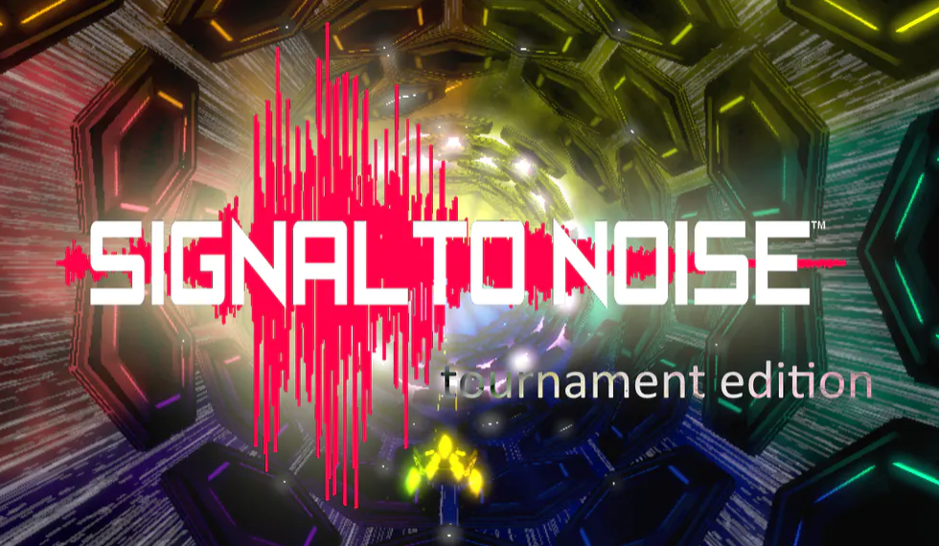
Signal to noise: tournament edition
(Unity Engine)
Solanimus Games
https://solanimus.com/
Signal to Noise: Tournament Edition is a music-driven action game. However, that does not mean it is a typical rhythm game. Taking inspiration from some of the greatest classic games ever made, it’s a high-octane hardcore rail shooter first and foremost that just so happens to build itself in front of your eyes from any music you play. Analyzing more audio components than any music-driven game before, Signal to Noise pieces together your experience based on the dynamics, pitch and tempo of your chosen track, interpreting it phrase-by-phrase and crafting your experience on the fly. Enemies, power-ups and the arenas themselves act differently each time you play a new tune.
Check it out on GameJolt at: https://gamejolt.com/games/signalte/91954

Slide 3
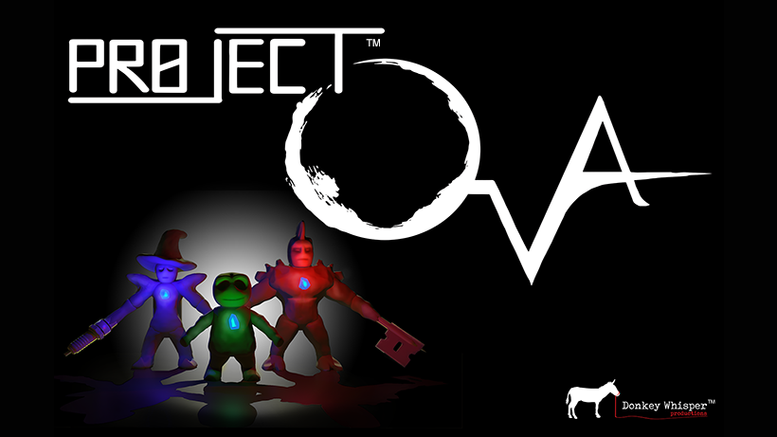
Project OVA
(Unreal Engine 4)
Currently in production by Donkey Whisper Productions
https://donkeywhisper.com/
Description:
Project OVA is an action/adventure game with heavy puzzle and combat elements, and a strong focus on story. Viewing the world over the shoulder of their avatar, players will encounter interesting personalities, fight dangerous creatures, and solve challenging puzzles. Players can run, sneak, climb, craft, and fight as they explore the interesting home of Doctor Markov Dragunov, from the perspective of a 4-inch tall clay sculpture.
Forged in the mind of Kumar Singh, the vast universe of Project OVA contains many secrets, colorful characters, and deep lore. Multiple themes of science fiction and fantasy collide to create a cyber-bio-punk wonderland for players to shape and explore.

Slide 4
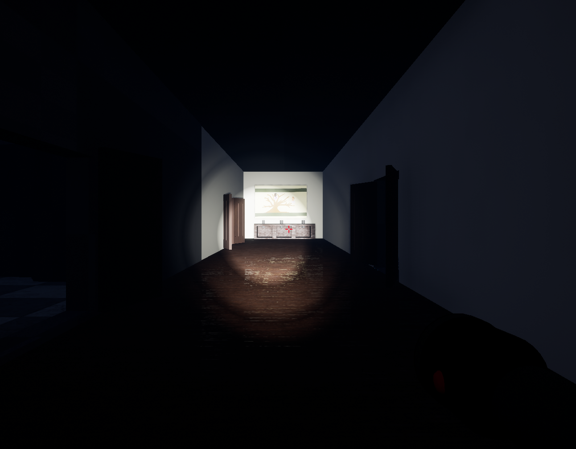
Clueless Murder Palace
(Unreal Engine 4)
Clueless Murder Palace came to be from a Global Game Jam competition (https://globalgamejam.org/2019/games/clueless-murder-palace) where participants are given 48-hours to create a game start to finish. The catch is the participants must create the game based on a theme that is unknown to the participants until the event begins. Our team created Clueless Murder Palace in 2019.
Description: “You are now the proud owner of that old Victorian house on the hill, all its contents, and its otherworldly residents. In order to make this house your home, help the ghosts that abound find peace, by placing objects of importance to them back where they belong, and removing objects that caused their demise. Based loosely on the board game Clue, use visual and audio clues to find the objects without angering the ghosts. Help the likes of General Catsup and Dr. Sauce find eternal peace.”

Slide 5
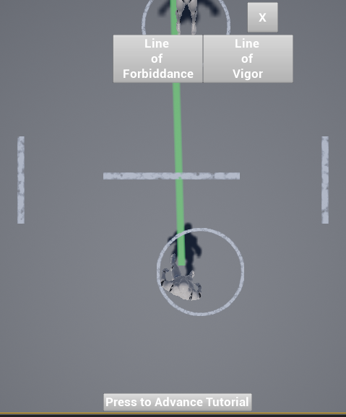
[UNNAMED] Prototype
(Unreal Engine 4)
This Prototype was developed to pitch to an Intellectual Property owner to obtain licensing rights. The certain magic system which allows the “mages” to create drawings that are able to move and interact in the real world. The story has an element of battle that we were able to implement for mobile and other touchscreen devices. The player would literally draw their “commands” and battle other players. This only went to the prototype stage and serves as a proof-of-concept and was not brought into full production.

