Slide 1
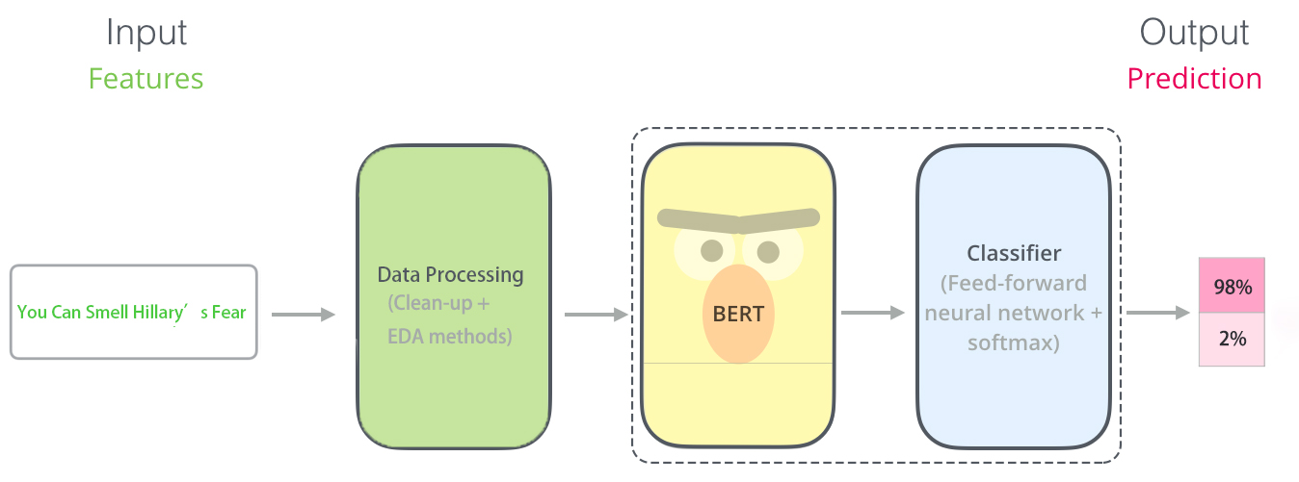
Google BERT
By Wang Yifan

Slide 2
Part 1: Data Processing
Drop non-sentence
Type1: http[s]://www.claritypress.com/LendmanIII.html
Type2: [email protected]
Type3: @EP_President #EP_President
Type4: **Want FOX News First * in your inbox every day? Sign up here.**
Type5: ☮️ 💚 🌍 etc
EDA methods
Insert word by BERT similarity (Random Insertion)
Substitute word by BERT similarity (Synonym Replacement)

Slide 3
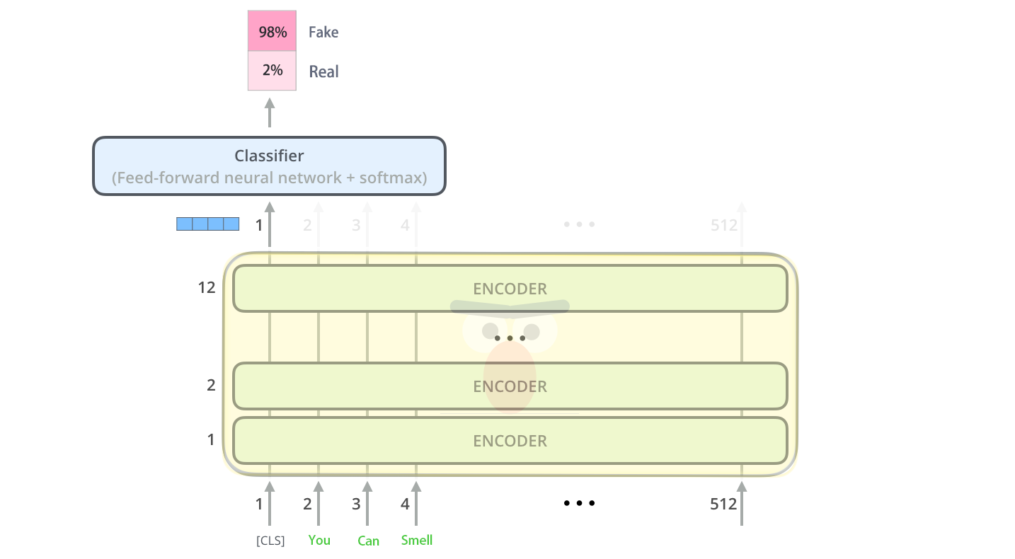
Part 2: Bert

Slide 4
Result

Slide 5
Reference
EDA:
https://towardsdatascience.com/these-are-the-easiest-data-augmentation-techniques-in-natural-language-processing-you-can-think-of-88e393fd610
Implemenation: https://github.com/makcedward/nlpaug
Can’t remove stopwords:
Deeper Text Understanding for IR with Contextual NeuralLanguage Modeling
https://arxiv.org/pdf/1905.09217
Understanding the Behaviors of BERT in Ranking
https://arxiv.org/pdf/1904.07531
Bert by Pytorch:
https://pytorch.org/hub/huggingface_pytorch-pretrained-bert_bert/

