Slide 1

第七次作业

Slide 2

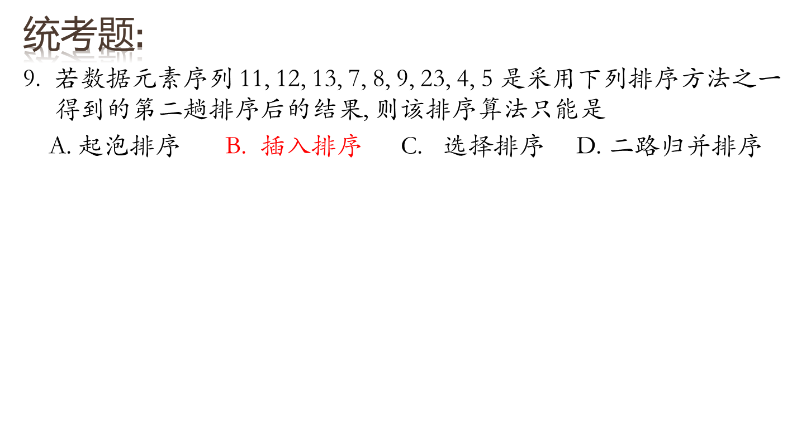

Slide 3

Sort the sequence 3, 1, 4, 1, 5, 9, 2, 6, 5 using insertion sort.
  3，1，4，1*，5，9，2，6，5*
  P=1 [1，3] ，4，1*，5，9，2，6，5*
  P=2 [1，3，4 ]，1*，5，9，2，6，5*
  P=3 [1，1*，3，4 ]，5，9，2，6，5*
  P=4 [1，1*，3，4，5] ，9，2，6，5*
  P=5 [1，1*，3，4，5，9] ，2，6，5*
  P=6 [1，1*，2，3，4，5 ，9]，6，5*
  P=7 [1，1*，2，3，4，5 ，6，9]，5*
  P=8 [1，1*，2，3，4，5 ，5*，6，9]

Slide 4






Show the result of running Shellsort on the input 9, 8, 7, 6, 5, 4, 3, 2, 1 using the increments { 1, 3, 7 }.
Increment=7 9, 8, 7, 6, 5, 4, 3, 2, 1
Increment=3 2, 1, 7, 6, 5, 4, 3, 9, 8
Increment=1 2, 1, 4, 3, 5, 7, 6, 9, 8
1, 2, 3, 4, 5, 6, 7, 8, 9

Slide 5

Show how heapsort processes the input 142, 543, 123, 65, 453, 879, 572, 434, 111, 242, 811, 102.
初始堆：
142
543
123
65
453
879
572
434
111
242
811
102

Slide 6
调整为最大堆（也可调整为最小堆）：
142
543
123
65
453
879
572
434
111
242
811
102
879
811
572
  开始调整
434
543
123
142
65
111
242
453
102

Slide 7
堆排序：
102
811
572
434
543
123
142
811
65
111
242
453
879
543
572
434
453
123
142
65
111
242
102
879

Slide 8
最终堆：
65
102
111
123
142
242
434
453
543
572
811
879

Slide 9

Rewrite heapsort so that it sorts only iterms that are in the range low to high which are passed as additional parameters.
public static void heapSort( Comparable [ ] a, int low, int high) //low,high为下标
{ for(int i=low+(high-low+1)/2; i>=low; i--)
perDown(a, i, low, high);
for(int i=high; i>low; i--)
{ swapReferences( a, low, i );
perDown(a,low,low,i-1);
}
}
public static void heapsort( Comparable [ ] a )
{ for( int i = a.length / 2; i >= 0; i-- )
percDown( a, i, a.length );
for( int i = a.length – 1; i > 0; i-- )
{ swapReferences( a, 0, i );
percDown( a, 0, i);
}
}
private static int leftChild( int i )
{ return 2 * i + 1;
}
private static int leftchild(int i, int low)
{ return (2*i+1-low); //2*(i-low)+1+low
}

Slide 10
private static void percDown( Comparable [ ] a, int i, int n )
{ int child;
Comparable tmp;
for( tmp = a[ i ]; leftChild( i ) < n ; i = child )
{ child = leftchild( i );
if( child != n – 1 && a[ child ] . compareTo( a[ child + 1 ] ) < 0 )
child ++;
if( tmp . compareTo( a[ child ] < 0 )
a[ i ] = a[ child ];
else
break;
}
a[ i ] = tmp;
}
public static void perDown(int[] a, int i, int low, int high)
{ int child;
Comparable tmp;
for(tmp=a[i]; leftchild(i,low)<high+1; i=child) {
child = leftchild(i,low);
if(child!=high && a[ child ] . compareTo( a[ child + 1 ] ) < 0 )
child++;
if(tmp . compareTo( a[ child ] < 0 )
a[i]=a[child];
else
break;
}
a[i]=tmp;
}

Slide 11

Sort 3, 1, 4, 1, 5, 9, 2, 6 using mergesort.
[3] [1] [4] [1*] [5] [9] [2] [6]
P=1：[1 3] [1* 4] [5 9] [2 6]
P=2： [1 1* 3 4] [2 5 6 9]
P=3： [1 1* 2 3 4 5 6 9]

Slide 12
谢谢

