Slide 1


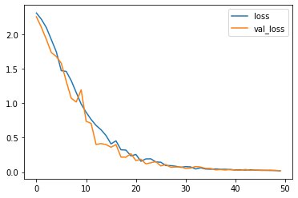
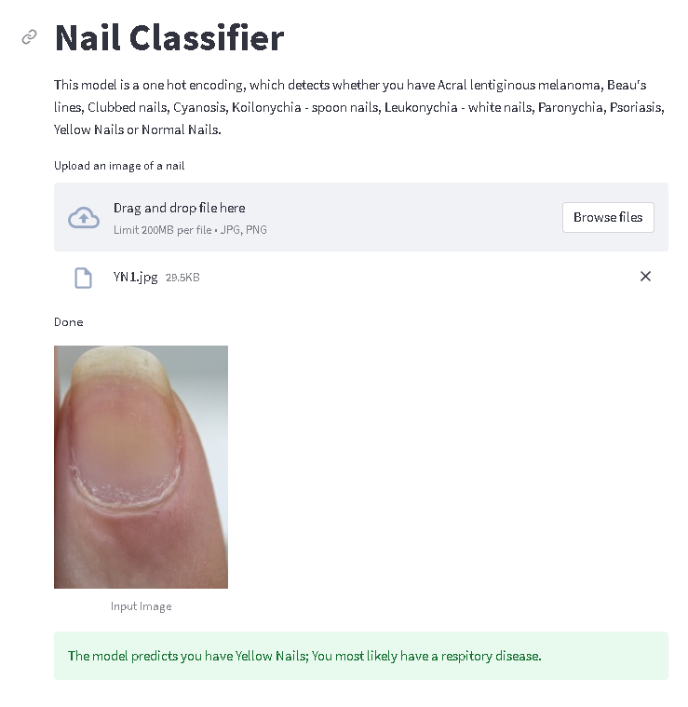
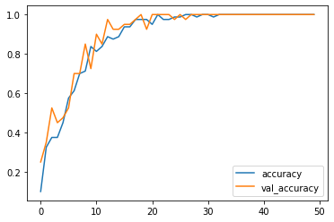
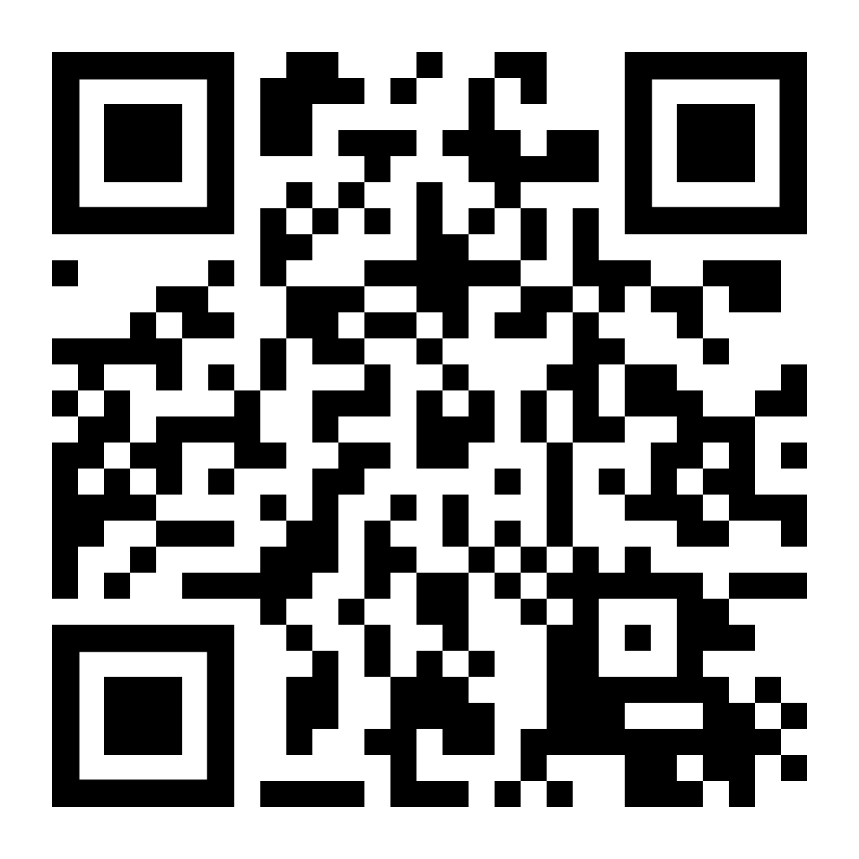
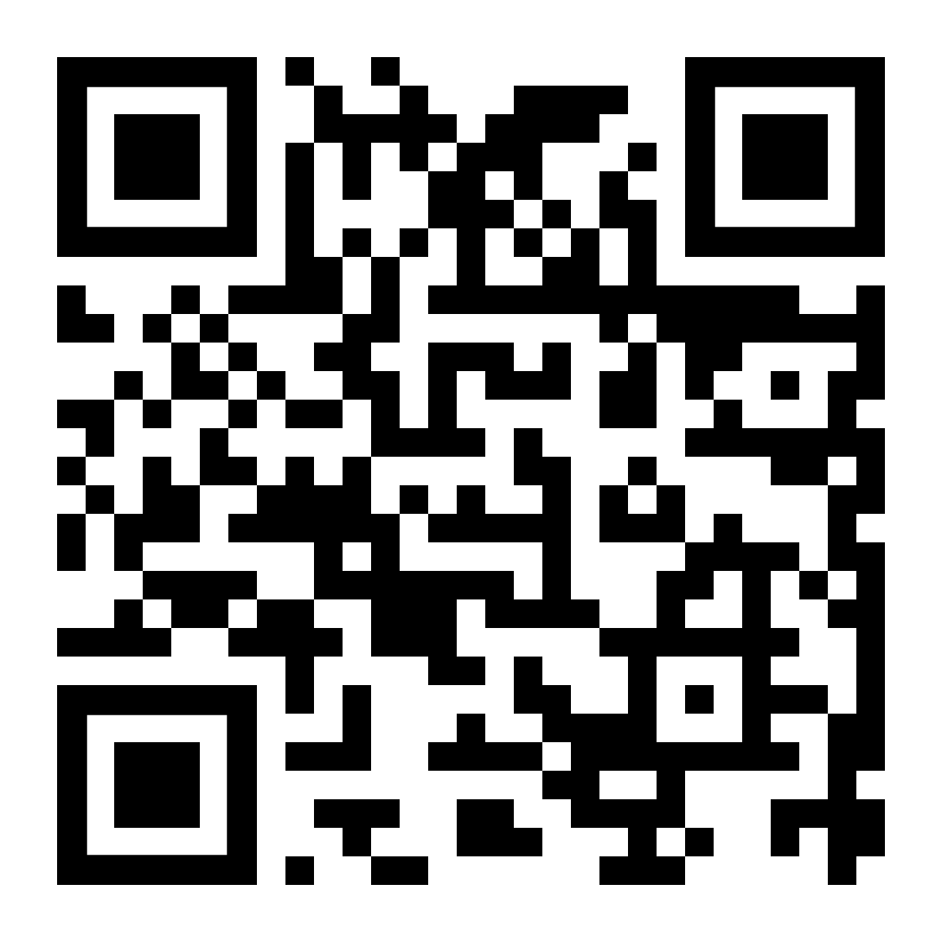
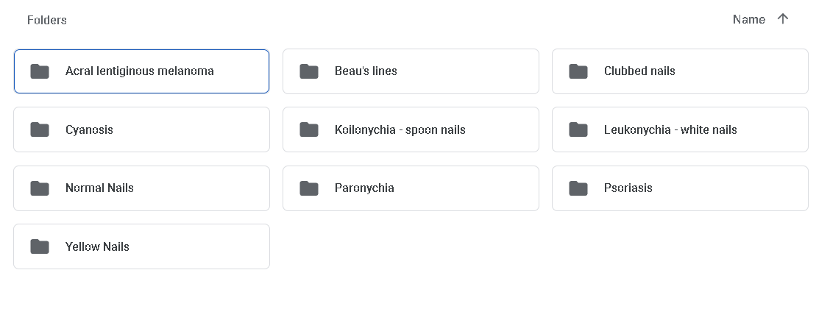
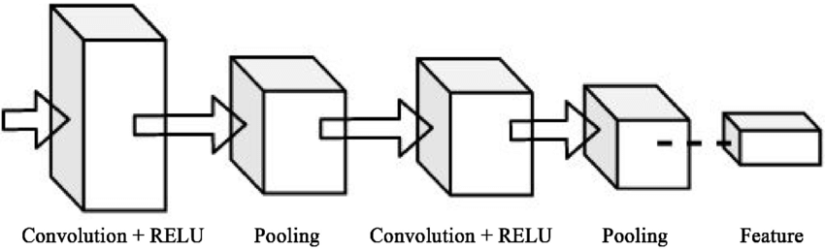
AIoT Coding, Engineering and Entrepreneurial Skills Education for Gifted Students
Project Title
Student(s): 09 Cheung, Ethan Tung Hei Project ID: P22
Abstract
Results/Application
Detecting patterns of the nails, which correlate to certain diseases, or health problems.
Objective/Background/Motivation
Project can be used for early diagnosis in developing countries.
Inspired by TensorFlow’s “Powered by TensorFlow: helping doctors detect respiratory diseases using machine learning”
Want to do something innovative.
As world develops, focuses changes to increasing the quality of life.
Heard that certain nail patterns correlates with health problems and diseases.
GitHub Link
YouTube Link
Methodology
Discussion/Conclusion
Create a dataset of nail types, using google images
Train on Cnn Model
Link inference engine to an UI
Make a UI, which detect the possible diseases you have, and gives advice accordingly.
I have learnt that the most important task in data science is the data itself. Data is the most important thing in a machine learning project.
More data needed for testing and training.(Our dataset was too small)
Also, the UI needs to be developed further.

