Slide 1

Nails for health
CityU-EE Gifted Education Fund Programme: AIoT Coding, Engineering and Entrepreneurial Skills Education for Gifted Students
Nails predict your future, now you can read them too
Team Members (09)
09 Ethan Cheung

Slide 2
Introduction
A project that uses image detection of nail types, which correlates to certain diseases and certain nutrient deficiencies.

Slide 3
Background & Motivation
Inspired by TensorFlow ‘Powered by TensorFlow: Helping doctors detect respiratory diseases using machine learning’ video
I have seen chinese doctors look at nails to predict your health.
In order for countries to become more developed, I believe there needs to be better healthcare.
I would like to able to create an application that is accessible to anyone, regardless of their social status.
It should be efficient, accessible, innovative.

Slide 4
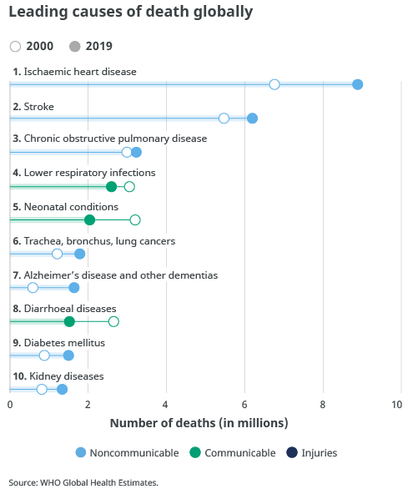
What is the target market?
As we can see, millions of people are dying globally to these problems alone.
Examples of what nails could detect would be heart diseases, respiratory infections, skin cancer and lung cancers. If they were treated, it would lead to mortality rates being lower.

Slide 5
Are there existing solutions?
Currently, there is no efficient solution to this problem. There is the traditional solution of visiting the doctor when you feel unwell.
However, it can be expensive and inefficient.
(time of response to a possible cancer may be too long.)

Slide 6
What is your solution?
I would like to create an application that uses machine learning, computer vision to detect the nail patterns. By doing so, we are able to inform the user of their possible diseases, and give them advice based on the nail classified.
Currently, I hope to keep the project simple, by having less layers of complexity that a dermatologists would analyse.

Slide 7

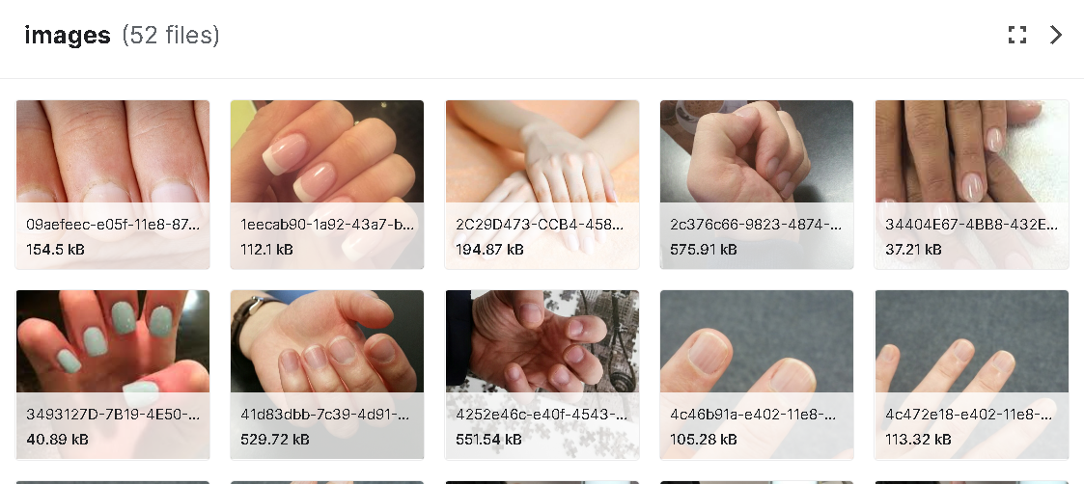
What is your solution?
“There is problem X, severity, advice, action”

Slide 8
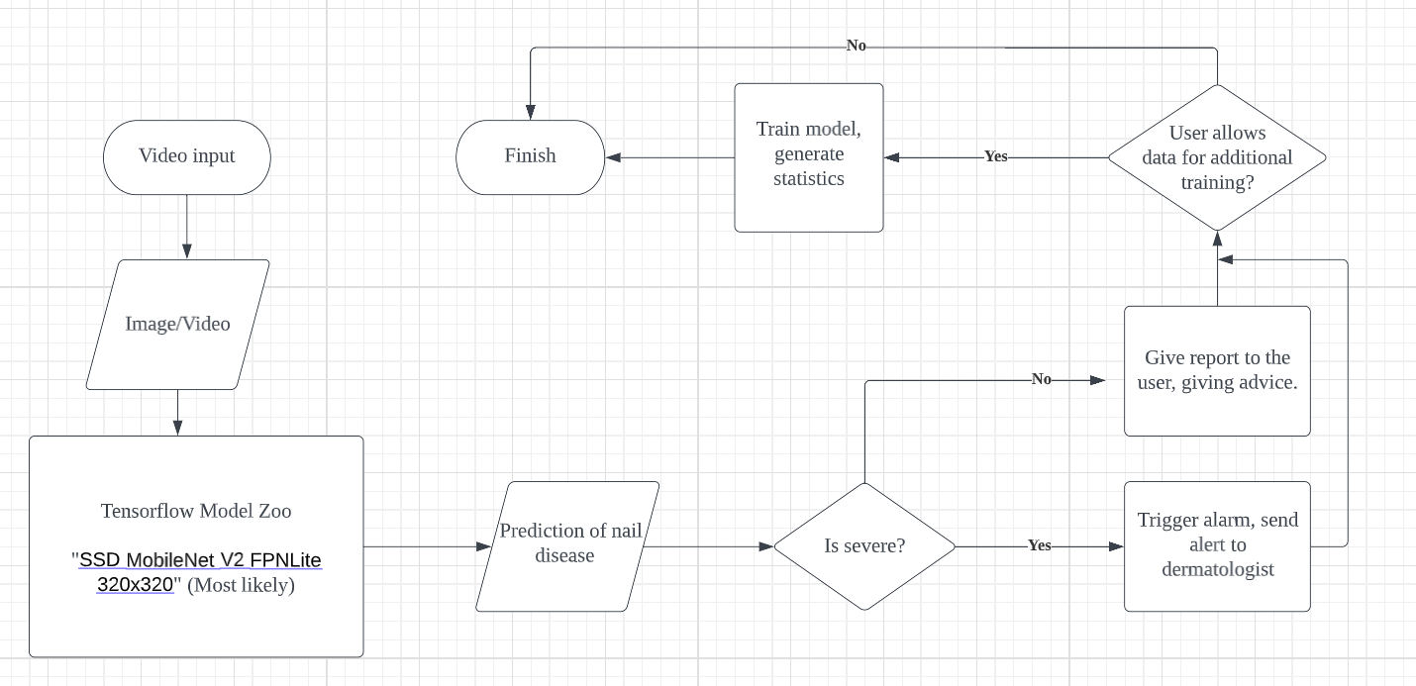
What is your solution?

Slide 9
What is your solution?
How does it work?
I use TensorFlow, where I will use computer vision, which has been trained on a CNN model. The CNN model predicts what nail condition the user has, where it will then give advice based on the nail classified.
The dataset will be labelled by me using the image labelling library, in github.
(I found images from google and youtube videos)

Slide 10
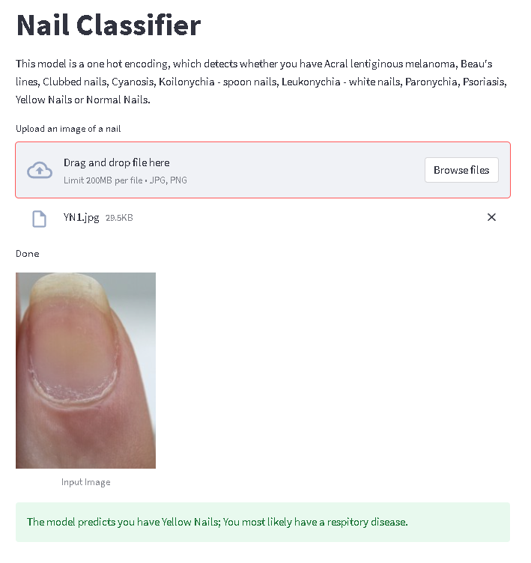
User Interface Example
On the right, there is a demonstration of the UI, which is currently incomplete.
In the future, a scale will be added, which shows how severe the user’s condition is.

Slide 11
Timeline of project
28 Jan
4 Feb
11 Feb
After 11 Feb
Labelling datasets,
Creating a dataset
Create the model, programming
Create an app, or usable software
Improve creation according to feedback.
Most of project will probably be done in January, as my mocks happen between 30th of Jan and 10th of Feb

Slide 12
Future work
I would like to talk to dermatologists to get more understanding as to what they look for when looking for nails
Get more data, preferably from dermatologists
Real life testing to test my solution’s effectiveness

Slide 13
Thanks!
Any questions?
Contact details:
Email: cheunt3@kgv.hk
Discord: Ec#8624

