Slide 1

Nails for health
CityU-EE Gifted Education Fund Programme: AIoT Coding, Engineering and Entrepreneurial Skills Education for Gifted Students
Nails predict your future, now you can read them too
Team Members (09)
09 Ethan Cheung

Slide 2
Introduction
A project that uses image detection of nail patterns to determine whether or not you have certain diseases, or have certain nutrient deficiencies.

Slide 3
Background & Motivation
Inspired by TensorFlow ‘Powered by TensorFlow: Helping doctors detect respiratory diseases using machine learning’ video
In order for countries to become more developed, I believe there needs to be better healthcare.
I would like to able to create an application that is accessible to anyone, regardless of their social status.
It should be efficient, accessible, innovative.
Diseases could be diagnosed with nail conditions; so my solution would be to check those nail patterns.

Slide 4
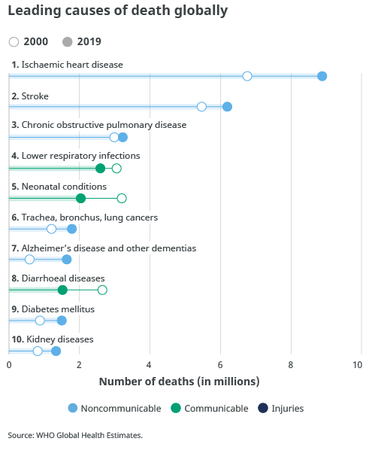
What is the target market?
As we can see, millions of people are dying globally to these problems alone.
Examples of what nails could detect would be heart diseases, respiratory infections and lung cancers, which if treated would lead to mortality rates being lower.

Slide 5
Are there existing solutions?
How the problem has been addressed by the current solution?
Currently, there is no efficient solution to this problem. There is the traditional solution of visiting the dermatologists, skin doctor. However, it can be
expensive and inefficient (time of response to a possible cancer may be too long.)

Slide 6
What is your solution?
I would like to create an application that uses machine learning, computer vision to detect the nail patterns, which can give us valuable information about what possible diseases the users may have.
Currently, I hope to keep the project simple, by having less layers of complexity that a dermatologists would analyse.

Slide 7
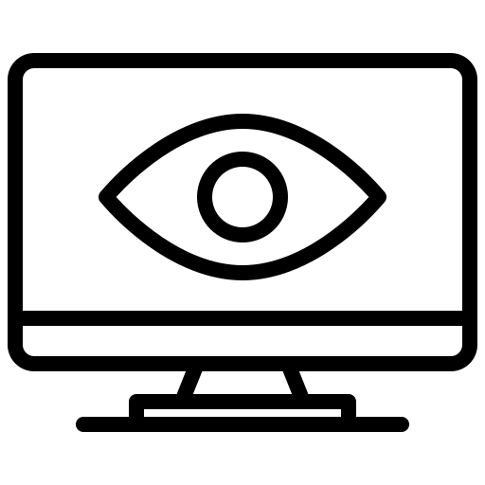
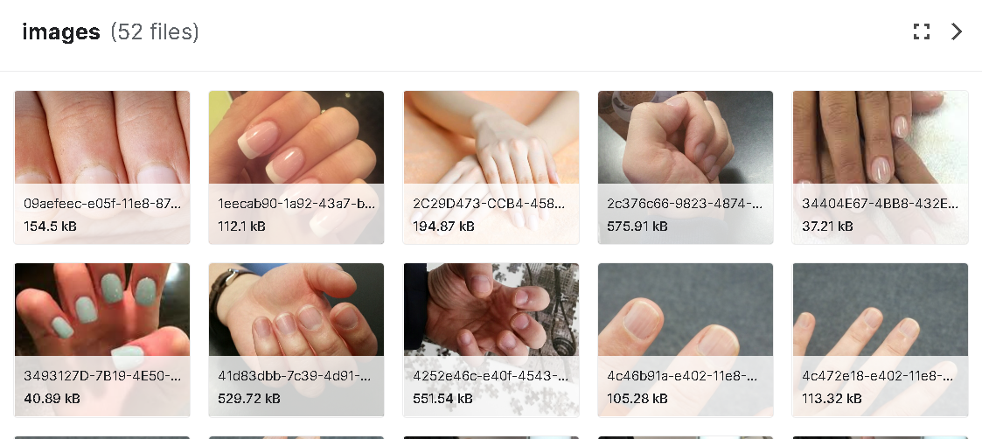
What is your solution?
“There is problem X, severity, advice, action”

Slide 8
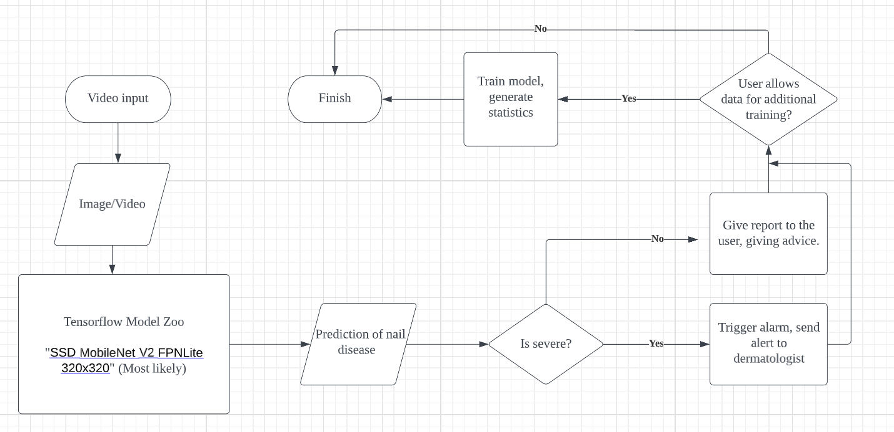
What is your solution?

Slide 9
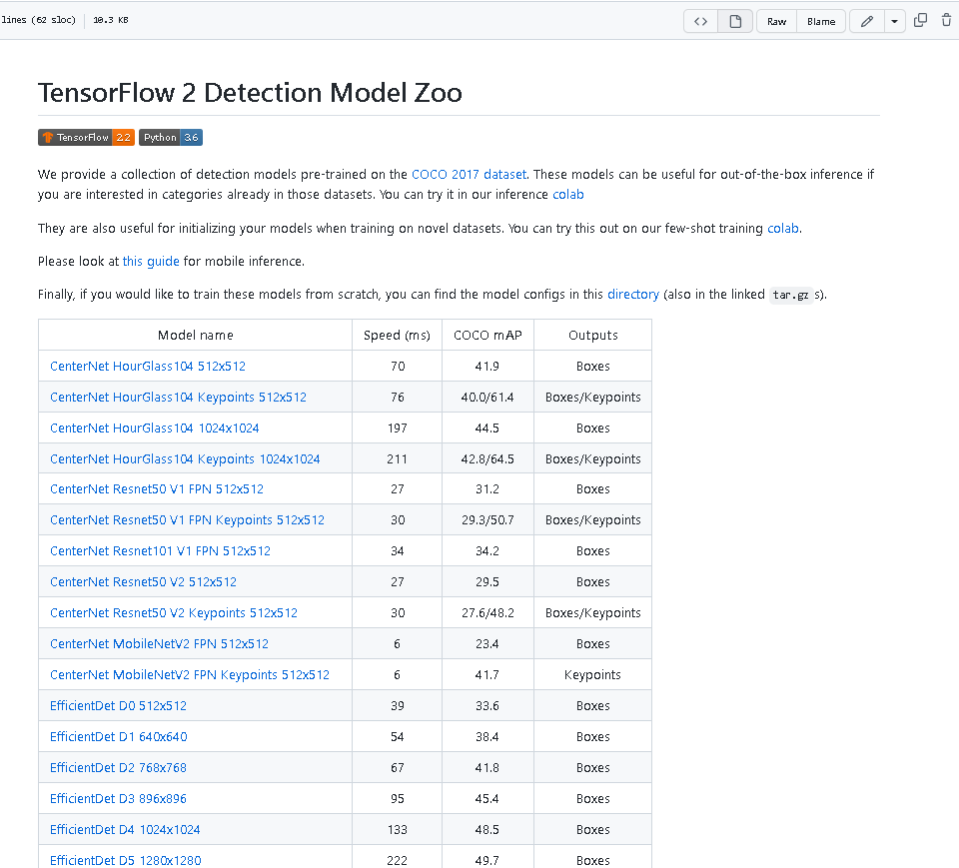
What is your solution?
How does it work?
I will use tensorflow model zoo, pre-trained model, which where I will use computer vision, to detect what nail condition the user has, where it will then take action according to those results.
The dataset will be labelled by me using the image labelling library, in github.
(I will find images from google and youtube videos)

Slide 10
Timeline
January 28
4 Feb
11 Feb
After 11 Feb
Labelling datasets,
Creating a dataset
Create the model, programming
Create an app, or usable software
Improve creation according to feedback.
Most of project will probably be done in January, as my mocks happen between 30th of Jan and 10th of Feb

Slide 11
Future work
I would like to talk to dermatologists to get more understanding as to what they look for when looking for nails
Get more data, preferably from dermatologists
Real life testing to test my solution’s effectiveness

Slide 12
Thanks!
Any questions?
Contact details:
Email: cheunt3@kgv.hk
Discord: Ec#8624

