Slide 1
計算機程式設計一: Unit 2

Slide 2
Outline
Review
Array (陣列)
Increment and Decrement Operators
Basic Data Types in C

Slide 3
Outline
Review
Array (陣列)
Increment and Decrement Operators
Basic Data Types in C

Slide 4
Review: The Structure of a C Program
#include <stdio.h>
int square(double);
int main(void)
{
int a;
a = square(1.4);
printf(“The sqr. of %f is %d\n", 1.4, a);
return 0;
}
int square(double x)
{
return x*x;
}
→ header file stdio.h for printf()
→ function declaration
→ main function: the entry point of the program
  Parameter list in ()
  Return value type
→ variable declaration: a is a variable of integer type
→ function call and value assignment
→ call a standard-library function
→ double: a C data type for floating-point numbers

Slide 5
Outline
Review
Array (陣列)
Increment and Decrement Operators
Basic Data Types in C

Slide 6
Array
#include <stdio.h>
int main(void)
{
int x[10] = {0}; //All elements are initialized as 0!
double y[5] = {2.0, 4.0, 6.0, 8.0, 10.0};
char z[3] = {'A', 'B'}; //z[2] is not initialized and will be set as '\0'!
x[0] = 3;
printf("x[0]: %d\n",x[0]);
printf("x[7]: %d\n",x[7]);
printf("y[1]: %f\n",y[1]);
printf("z[0]: %c\n",z[0]);
printf("z[2]: %c\n",z[2]);
return 0;
}
Note:
An array is a series of values of the same type, such as 10 chars or 15 ints,
  stored sequentially (in memory).
The whole array bears a single name,
  the individual items, or elements, are accessed by using an integer index.
*** Note that the numbering (or index) of array elements starts with 0, not 1.

Slide 7
Outline
Review
Array (陣列)
Increment and Decrement Operators
Basic Data Types in C

Slide 8
Arithmetic Operators in C
Assume variable A holds 10 and variable B holds 20, then:
Operator | Description | Example
+ | Adds two operands | A + B will give 30
- | Subtracts second operand from the first | A - B will give -10
* | Multiplies both operands | A * B will give 200
/ | Divides numerator by de-numerator | B / A will give 2
% | Modulus Operator and remainder of after an integer division | B % A will give 0
++ | Increments operator increases integer value by one | A++ will give 11
-- | Decrements operator decreases integer value by one | A-- will give 9

Slide 9
Increment and Decrement Operators: ++ and --
Note:
Two modes
  the prefix mode: ++a; --b;
    The variable is changed before its value is used
  the postfix mode: a++; b--;
    The variable is changed after its value is used
c=a++; is equivalent to
c=a;
a++;
c=--b; is equivalent to
--b;
c=b;
#include <stdio.h>
int main(void)
{
int a = 31;
int b = 20;
int c ;
c = a % b; // get the remainder
printf("a: %d; b: %d; c: %d\n", a, b, c);
c=a++;
printf("a: %d; b: %d; c: %d\n", a, b, c);
c=--b;
printf("a: %d; b: %d; c: %d\n", a, b, c);
return 0;
}

Slide 10
Outline
Review
Array (陣列)
Increment and Decrement Operators
Basic Data Types in C

Slide 11
Basic Data Types in C
Characters (字元)
Integers (整數)
Floating-point numbers (浮點數)
For more information, check “The GNU C Programming Tutorial (ctut.pdf) Chapter 5, pp. 19-20.”

Slide 12
Bits and Bit Patterns
Bit: Binary Digit (0 or 1)
Bit Patterns are used to represent information.
  Text characters
  Numbers
  Pictures, sounds, and others

Slide 13
Hexadecimal Notation
Hexadecimal notation: A shorthand notation for long bit patterns
  Divides a pattern into groups of four bits each
  Represents each group by a single symbol
Example: 10100011 becomes A3

Slide 14
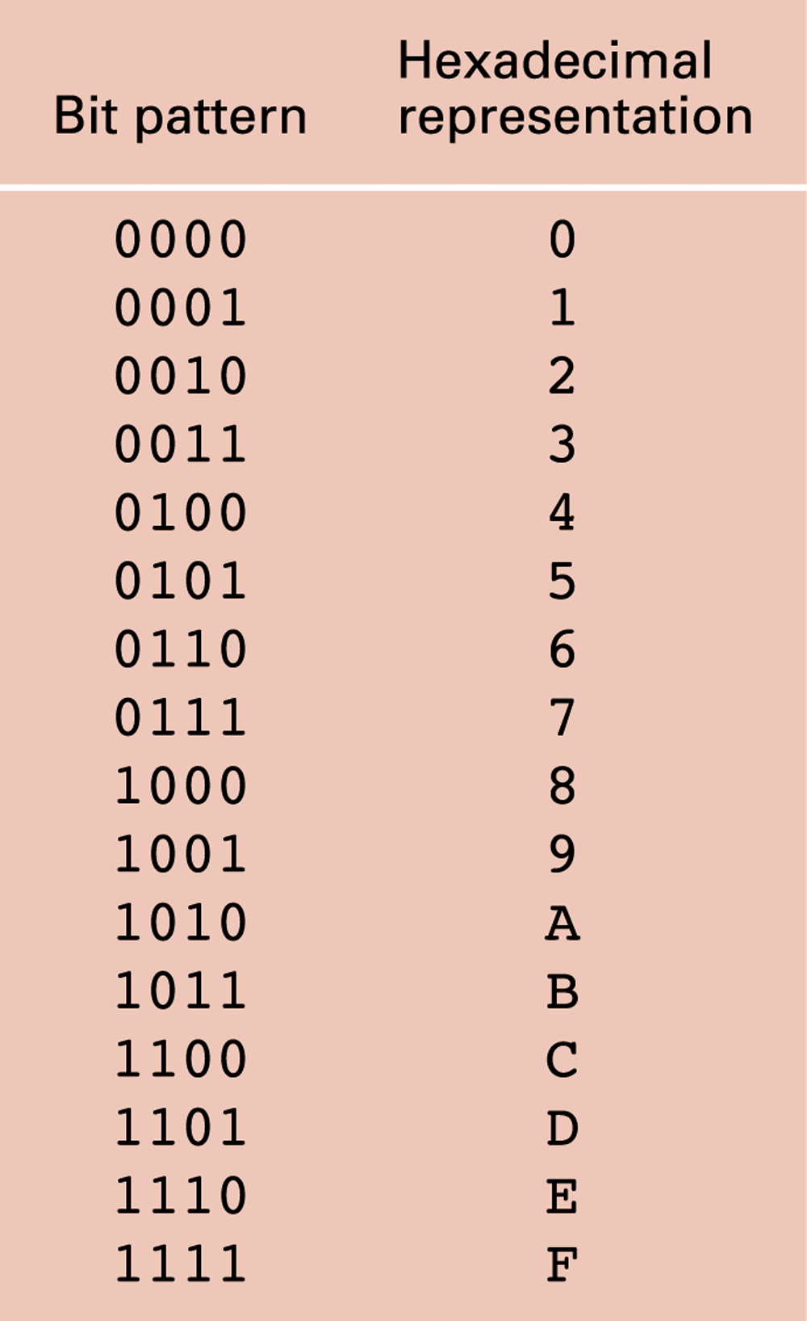
The hexadecimal coding system

Slide 15
More jargons
Kilobyte (KB): 2¹⁰ bytes = 1024 bytes ≈ 10³ bytes
  Example: 3 KB ≈ 3 × 10³ bytes
Megabyte (MB): 2²⁰ bytes ≈ 10⁶ bytes
  Example: 3 MB ≈ 3 × 10⁶ bytes
Gigabyte (GB): 2³⁰ bytes ≈ 10⁹ bytes
  Example: 3 GB ≈ 3 × 10⁹ bytes
Terabyte (TB): 2⁴⁰ bytes ≈ 10¹² bytes
  Example: 3 TB ≈ 3 × 10¹² bytes
Petabyte (PB): 2⁵⁰ bytes ≈ 10¹⁵ bytes
  Example: 3 PB ≈ 3 × 10¹⁵ bytes

Slide 16
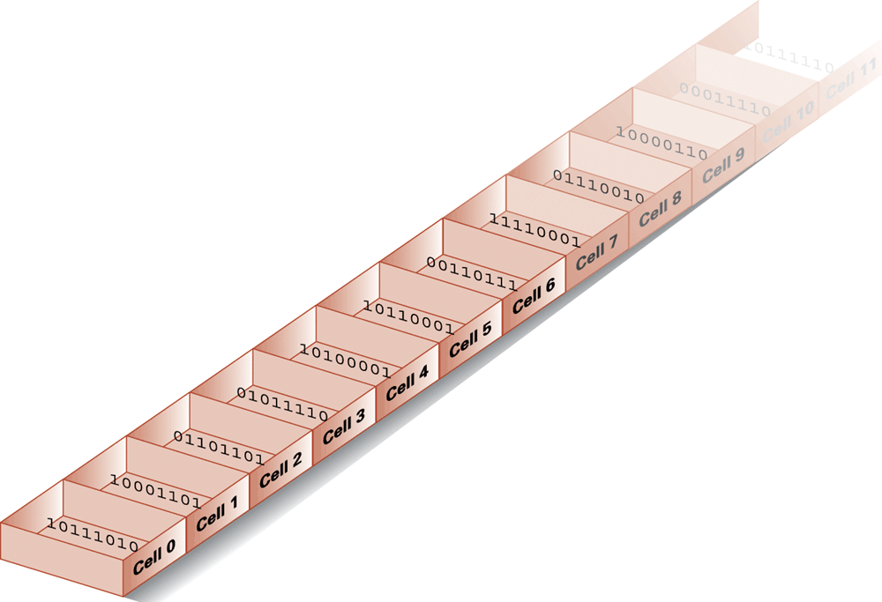
Memory cells arranged by address

Slide 17
Main Memory Cells
Cell: A unit of main memory (typically 8 bits which is one byte)
  Most significant bit: the bit at the left (high-order) end of the conceptual row of bits in a memory cell
  Least significant bit: the bit at the right (low-order) end of the conceptual row of bits in a memory cell

Slide 18
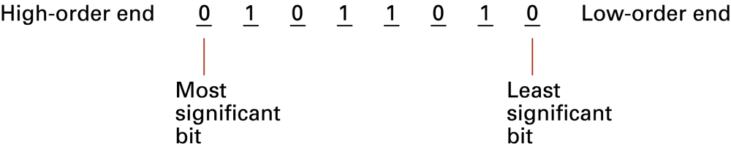
The organization of a byte-size memory cell

Slide 19
Outline
Review
Array (陣列)
Increment and Decrement Operators
Basic Data Types in C
  Characters (字元)
  Integers (整數)
  Floating-point numbers (浮點數)

Slide 20
Representing Text
Each character (letter, punctuation, etc.) is assigned a unique bit pattern.
  ASCII: Uses patterns of 7-bits to represent most symbols used in written English text
The message “Hello.” in ASCII

Slide 21

ASCII Code

Slide 22
Big5 code
For Chinese character encoding
Uses 16 bits to represent a Chinese character
Example
我 | 身 | 騎 | 白 | 馬
A7DA | A8AD | C34D | A5D5 | B0A8
1010 0111 1101 1010

Slide 23
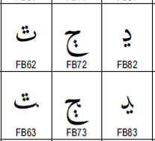
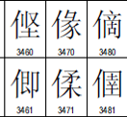
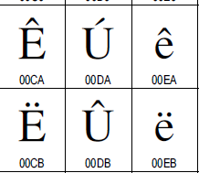
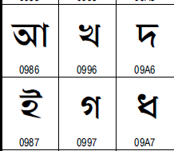
Unicode
Uses 16-bits to represent the major symbols used in languages worldwide
Arabic char
CJK char
Latin char
Indic char

Slide 24
Representing Numeric Values
Binary system/notation: Uses bits to represent a number based on powers
of two
  Instead of being based on powers of ten in the traditional decimal system

Slide 25
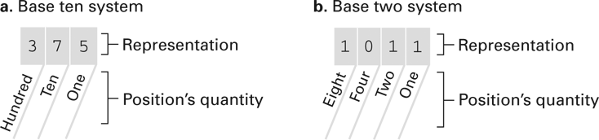
The base ten and binary systems

Slide 26
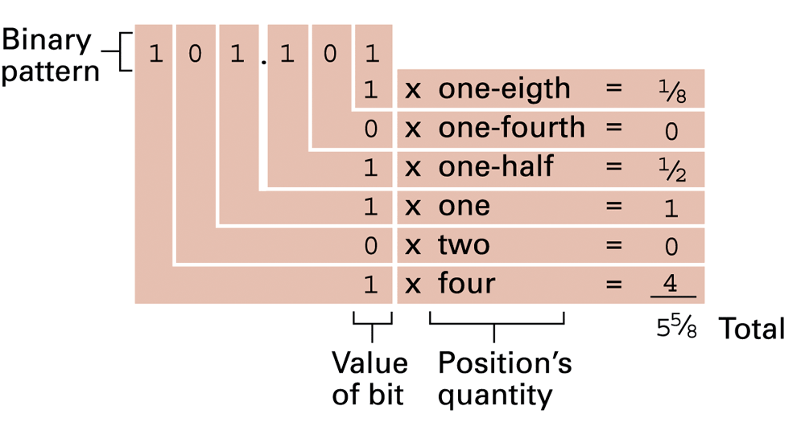
Decoding the binary representation 101.101

Slide 27
Outline
Review
Array (陣列)
Increment and Decrement Operators
Basic Data Types in C
  Characters (字元)
  Integers (整數)
  Floating-point numbers (浮點數)

Slide 28
Storing Integers
Two’s complement notation: The most popular means of representing integer values
Excess notation: Another means of representing integer values

Slide 29
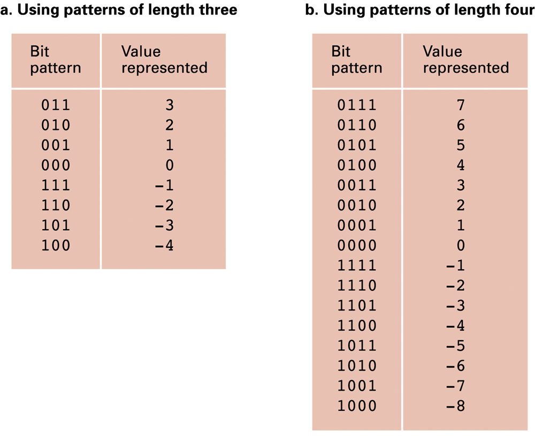
Two’s complement notation systems

Slide 30
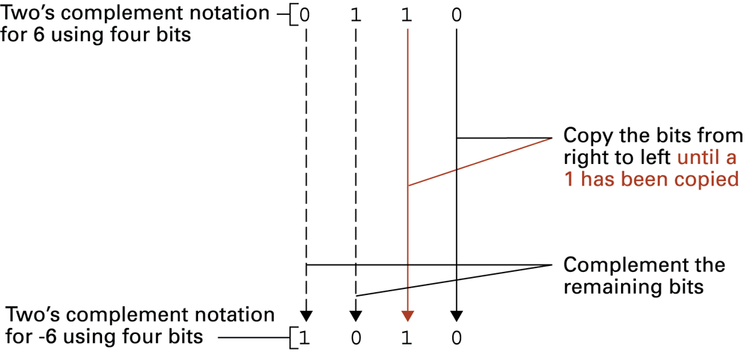
Coding the value -6 in two’s complement notation using four bits

Slide 31
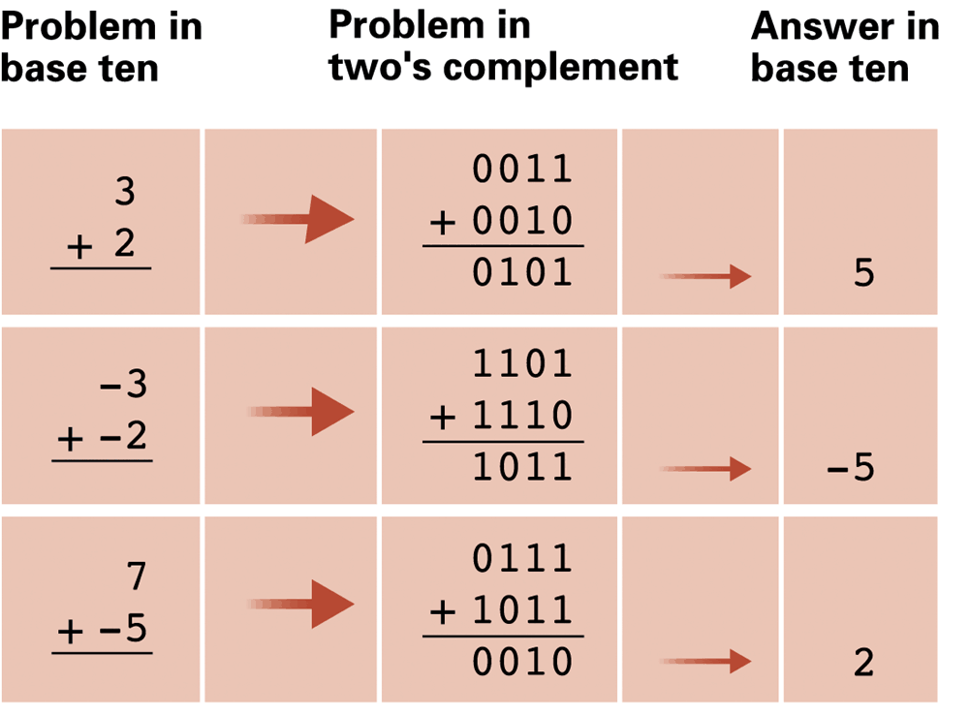
Addition problems converted to two’s complement notation

Slide 32
Computing 2’s complement
A simple algorithm to compute the 2’s complement of a number
  Change each bit 0 to 1 and bit 1 to 0
  Add 1.
1001_{b}
+ 0001_{b}
1010_{b}= －6_{d}
0110_{b} ( 6)
+ 1010_{b} (–6)
1 0000_{b} ( 0)
truncated
6_{d} = 0110_{b}
1001_{b}

Slide 33
Overflow
Bit pattern | Values
0111 | 7
0110 | 6
0101 | 5
0100 | 4
0011 | 3
0010 | 2
0001 | 1
0000 | 0
1111 | -1
1110 | -2
1101 | -3
1100 | -4
1011 | -5
1010 | -6
1001 | -7
1000 | -8
What is 5+4?
This is called overflow
  Adding two positive numbers
  results a negative number; or
  adding two negative numbers
  results a positive number.
  A 4 bits 2’s complement system
  can only represent –8~7
5_{d}+4_{d}=0101_{b} + 0100_{b}
=1001_{b}

Slide 34
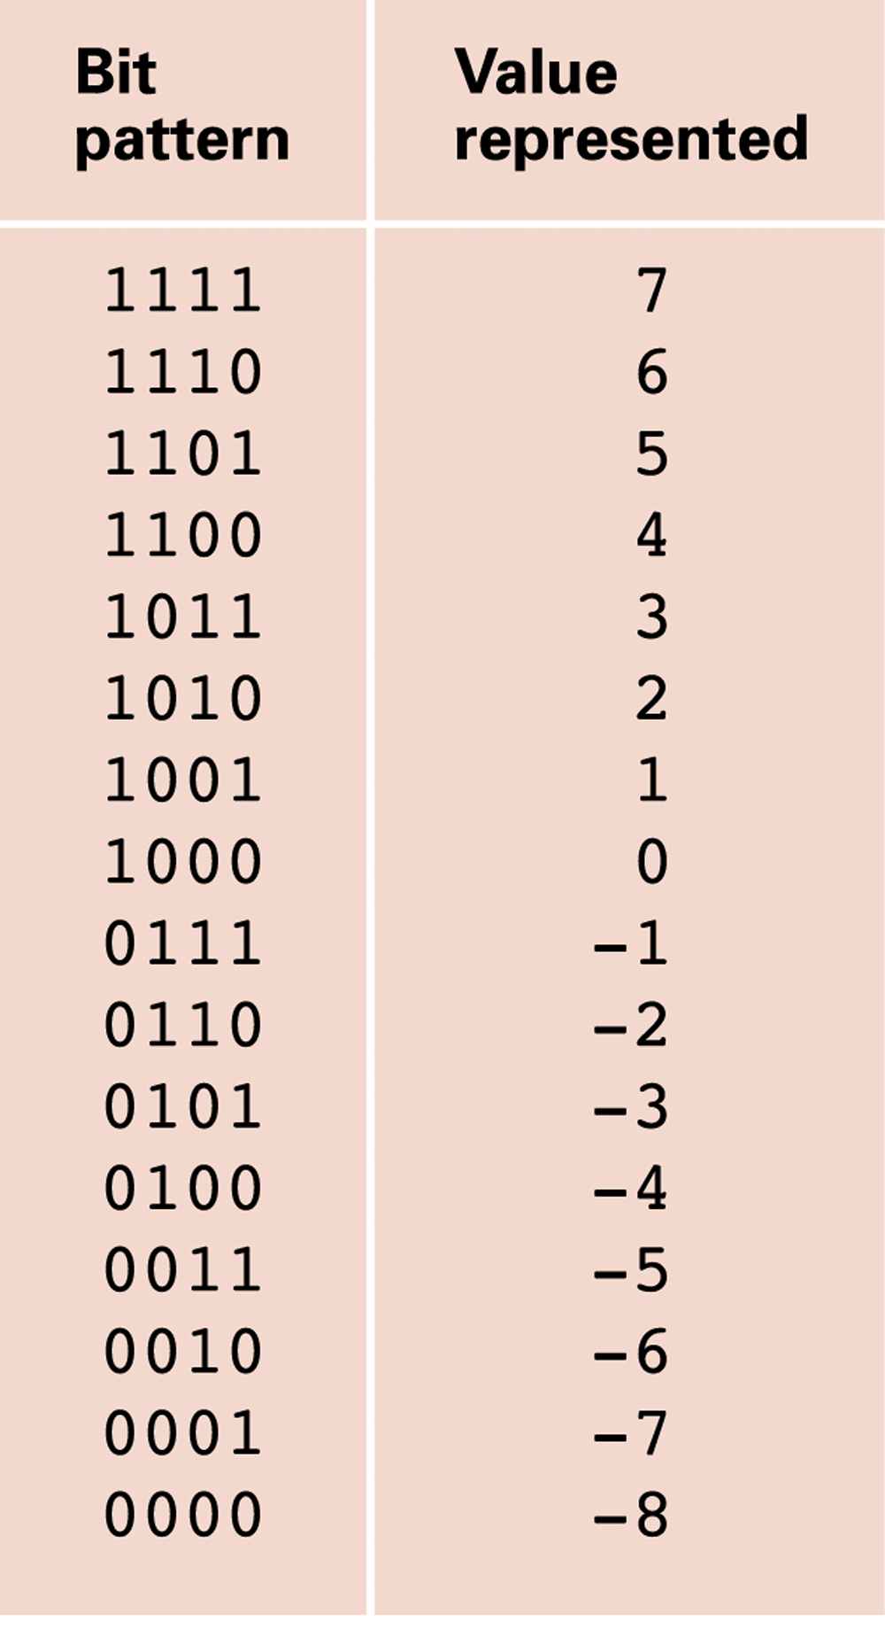
An excess eight conversion table

Slide 35
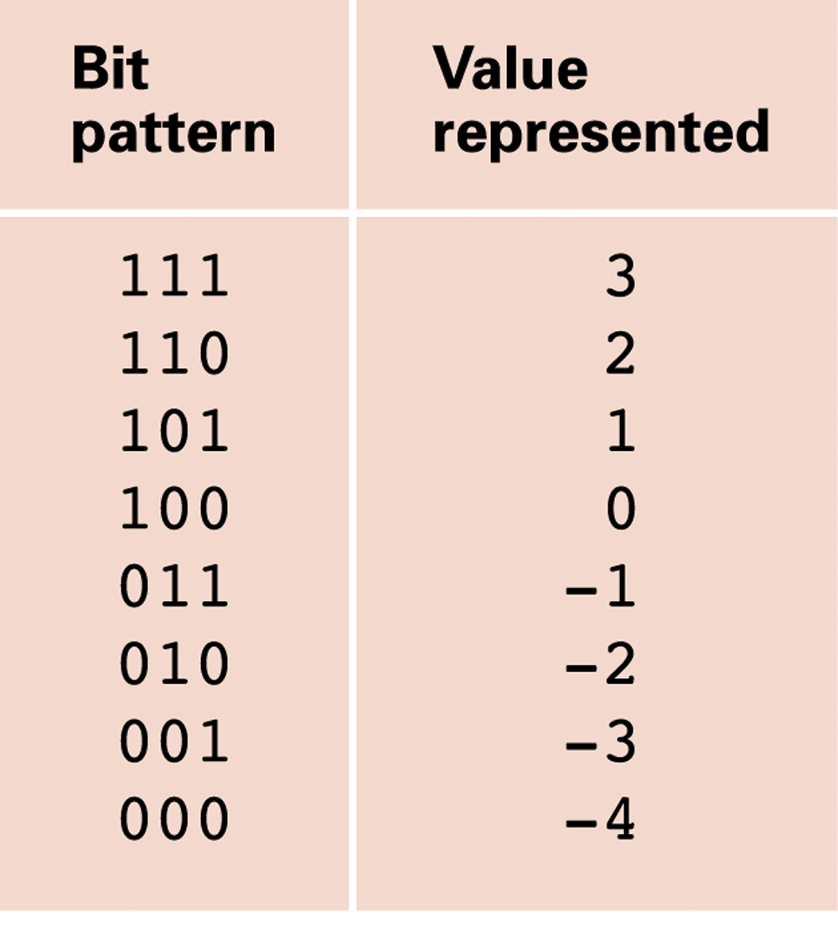
An excess notation system using bit patterns of length three

Slide 36
Outline
Review
Array (陣列)
Increment and Decrement Operators
Basic Data Types in C
  Characters (字元)
  Integers (整數)
  Floating-point numbers (浮點數)

Slide 37

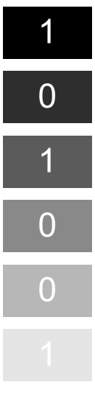
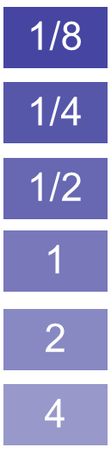
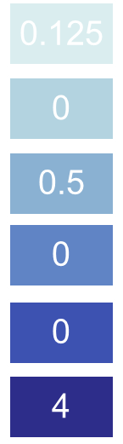
Numbers with the decimal point
Real numbers can be represented by the binary system too.
4.625_{d}

Slide 38
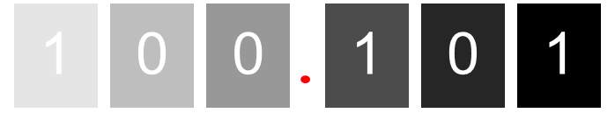
Fixed point representation
This representation is called fixed point, because the decimal point is at the fixed position.
Fixed point representation is good for calculations, but the representable range is very limited.
  Think about 1000000 or 0.0001. They will be all 0 for 6 bit fixed point representation.

Slide 39
Floating point
To represent a wide range of numbers, we allow the decimal point to “float”.
It uses the scientific notation of numbers.
  40.1_{d} = 4.01_{d}×10¹ = 401_{d}×10⁻¹ = 0.401_{d}×10²
  101.101_{b} = +1.01101_{b}×2^{2d} = +1.01101_{b}×2^{10b}.
This is called the floating
point representation of
real numbers.
sign
fraction
(or called
mantissa)
exponent

Slide 40
Ex: floating point of 2⁵/₈
Sign bit: 0 for + and 1 for –.
Exponent uses excess representation.
2⁵/₈
Binary representation
10.101
Excess notation | Bit pattern
3 | 111
2 | 110
1 | 101
0 | 100
-1 | 011
-2 | 010
-3 | 001
-4 | 000
Normalization
1.0101× 2¹
0
0 1 0 1
1 0 1
Sign
Fraction
Exponent

Slide 41
Why excess notation?
Excess notation | Bit pattern
3 | 111
2 | 110
1 | 101
0 | 100
-1 | 011
-2 | 010
-3 | 001
-4 | 000
Why excess notation?
Why moving the exponent
in front of the fraction?
Both are for the same reason:
easy to compare the numbers.
  For two normalized numbers
  x and y, if x’s exponent is larger
  than y’s exponent, x is larger
  than y.
  We can use the circuit of comparing integers to compare floating point numbers

Slide 42
Limitations of Numeric Representations
Limitations of computer representations of numeric values
  Overflow – occurs when a value is too big to be represented
  Truncation – occurs when a value cannot be represented accurately

Slide 43
Truncation error
Consider the decimal number 0.1_{d}.
  0.1 = ¹/₁₆+¹/₃₂+¹/₂₅₆+¹/₅₁₂ + ...
  So the binary representation of 0.1 is 0.000110011…
  It is an infinite sequence in the binary notation.
After normalization, it is +1.10011…× 2^{－4}. The 8 bit floating point format can only represent +1.1001× 2^{－4} = 25/256 = 0.09765625
The difference |0.1 – 0.09765625| = 0.00234375 is called truncation error.

Slide 44
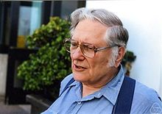
IEEE Standard 754
IEEE (Institute of Electrical and
Electronics Engineers) has made
a floating point number standard,
IEEE-754, so that different
computers can have a common ground.
Two commonly used formats of floating numbers
William Morton Kahan
 | Sign | Exponent | Fraction | Total
Single | 1 bit | 8 bits | 23 bits | 32 bits
Double | 1 bit | 11 bits | 52 bits | 64 bits

Slide 45
Exercises
What are the fractions for the following floating number representations?
  Suppose 1 bit for sign, 3 bits for exponent (using excess notation), 4 bits for mantissa
If direct truncation is used, what are the ranges of their possible values?
01001010 (b) 01101101 (c) 11011100 (d) 10101011

Slide 46
Ex. 1: Decimal vs. Hexadecimal
#include <stdio.h>
int main(void)
{
int x = 100;
printf("decimal: %d, hexadecimal: %x\n", x, x);
printf("decimal: %d, hexadecimal: %#x\n", x, x);
return 0;
}

Slide 47
Ex. 2: Different Types for Integers
#include <stdio.h>
int main(void)
{
unsigned int un = 3000000000U;
short small = 200;
long big = 65537;
printf("un = %u and not %d\n", un, un);
printf("small = %hd and %d\n", small, small);
printf("big = %ld and not %hd\n", big, big);
return 0;
}

Slide 48
Ex. 3: Different Types for Floating-Point Numbers
#include <stdio.h>
int main(void)
{
float x = 12345.0;
double y = 2.34e12; // 2.34*10^12
printf("%f or %e\n", x, x);
printf("%f or %e\n", y, y);
return 0;
}

Slide 49
Ex. 4: ASCII Code for Characters
#include <stdio.h>
int main(void)
{
char ch;
printf("Please enter a character: ");
scanf("%c", &ch);
printf("ASCII code for '%c' is %d.\n", ch, ch);
return 0;
}

Slide 50
Ex. 5: One More Example for Character Display
#include <stdio.h>
int main(void)
{
printf("character: %c ASCII code: %d\n", 55, '7');
return 0;
}

Slide 51
Ex. 6: How to Display a Character Based on another Character
For example: How to print ‘F’ based on ‘C’?
#include <stdio.h>
int main(void)
{
printf("%c is 3 seats away from %c.\n", 'C'+3, 'C');
return 0;
}

Slide 52
Ex. 7: The sizeof Operator
#include <stdio.h>
int main(void)
{
printf("int: %u bytes, char: %u bytes,\n", sizeof(int), sizeof(char));
printf("long: %u bytes, double: %u bytes.\n", sizeof(long), sizeof(double));
return 0;
}
Note:
The sizeof operator returns the size, in bytes, of its operand.
C says that sizeof returns a value of type size_t.
  This is an unsigned integer type, but not a brand-new type.

