Slide 1
計算機程式設計一: Unit 6

Slide 2
Outline
C Control Statements: Branching (continued)
  Loop Aids: continue and break
  The Conditional Operator: ?:
  Multiple Choice: switch and break
Character Input/Output
  Buffers
  Files, Streams, and Keyboard Input
  Redirection

Slide 3
Outline
C Control Statements: Branching (continued)
  Loop Aids: continue and break
  The Conditional Operator: ?:
  Multiple Choice: switch and break
Character Input/Output
  Buffers
  Files, Streams, and Keyboard Input
  Redirection

Slide 4
continue and break
Normally, after the body of a loop has been entered,
  a program executes all the statements in the body before doing the next loop test.
The continue and break statements enable you to
  skip part of a loop or
  even terminate it,
  depending on tests made in the body of the loop.

Slide 5
The continue Statement (1/3)
  #include <stdio.h>
  int main()
  {
  int i = 'A';
  do {
  if (i == 'C')
  continue;
  putchar(i);
  } while (++i < 'F');
  return 0;
  }
Output：
ABDE

Slide 6
The continue Statement (2/3)
The continue statement can be used in the three loop forms.
When encountered,
  it causes the rest of an iteration to be skipped, and
  the next iteration to be started.
If the continue statement is inside nested structures,
  it affects only the innermost structure containing it.

Slide 7
The continue Statement (3/3)
For the while and do while loops,
  the next action taken after the continue statement is to evaluate the loop test expression.
For a for loop,
  the next actions are to evaluate the update expression and then the loop test expression.

Slide 8
The break Statement (1/2)
  #include <stdio.h>
  int main()
  {
  int i = 'A';
  do {
  if (i == 'C')
  break;
  putchar(i);
  } while (++i < 'F');
  return 0;
  }
Output：
AB

Slide 9
The break Statement (2/2)
A break statement in a loop causes
  the program to break free of the loop that encloses it, and
  to proceed to the next stage of the program.
If the break statement is inside nested loops,
  it affects only the innermost loop containing it.

Slide 10
Outline
C Control Statements: Branching (continued)
  Loop Aids: continue and break
  The Conditional Operator: ?:
  Multiple Choice: switch and break
Character Input/Output
  Buffers
  Files, Streams, and Keyboard Input
  Redirection

Slide 11
The Conditional Operator: ?: (1/3)
x = (y < 0) ? -y : y;
=> if (y < 0)
  x = -y;
  else
  x = y;

Slide 12
The Conditional Operator: ?: (2/3)
The general form
expression1 ? expression2 : expression3
  If expression1 is true, the whole conditional expression has the same value as expression2.
  If expression1 is false, the whole conditional expression has the same value as expression3.

Slide 13
The Conditional Operator: ?: (3/3)
The categories of C operators
  unary operators: one operand
  binary operators: two operands
  ternary operators: three operands
    the conditional operator “?:” is C's only example in this category

Slide 14
Outline
C Control Statements: Branching (continued)
  Loop Aids: continue and break
  The Conditional Operator: ?:
  Multiple Choice: switch and break
Character Input/Output
  Buffers
  Files, Streams, and Keyboard Input
  Redirection

Slide 15
  #include <stdio.h>
  #include <ctype.h>
  int main(void)
  {
  char ch;
  printf("Give me a letter of the alphabet, and I will give ");
  printf("an animal name \nbeginning with that letter.\n");
  ch = getchar();
  if (islower(ch)) {
  switch (ch) {
  case 'a':
  printf("argali, a wild sheep of Asia\n");
  break;
  case 'b':
  printf("babirusa, a wild pig of Malay\n");
  break;
  case 'c':
  printf("coati, racoonlike mammal\n");
  break;

Slide 16
  case 'd':
  printf("desman, aquatic, molelike critter\n");
  break;
  case 'e':
  printf("echidna, the spiny anteater\n");
  break;
  case 'f':
  printf("fisher, brownish marten\n");
  break;
  default :
  printf("That's a stumper!\n");
  }
  }
  else {
  printf("I recognize only lowercase letters.\n");
  }
  return 0;
  }

Slide 17
switch ... case ... break (1/3)
The general form
  switch (integer expression)
  {
  case constant1:
  statements optional
  case constant2:
  statements optional
  default: optional
  statements optional
  }

Slide 18
switch ... case ... break (2/3)
The “integer expression” in the parentheses following the word switch is evaluated.
Then the program scans the list of labels until it finds one matching that value.
  The program then jumps to that line.

Slide 19
switch ... case ... break (3/3)
The break statement causes the program to break out of the switch and skip to the next statement after the switch.
  Without the break statement, every statement from the matched label to the end of the switch would be processed.

Slide 20
What switch cannot do (compared with if else)?
You can't use a switch if your choice is based on evaluating a float variable or expression.
Nor can you conveniently use a switch if a variable must fall into a certain range.
  “if (integer < 1000 && integer > 2)” => setting up case labels for each integer from 3 to 999

Slide 21
Advantages of switch over if/else
Cleaner code
  Code with multiple chained if/else if looks messy and is difficult to maintain
  switch gives cleaner structure
Performance
  switch is typically faster than if/else
Test order doesn't matter
  To speed up series of if/else tests one needs to put more likely cases first.
  With switch/case programmer doesn't need to think about this.

Slide 22
Advantages of switch over if/else
Default can be anywhere
  With if/else default case must be at the very end - after last else.
  In switch, default can be anywhere,
    wherever programmer finds it more appropriate.
Common code
  If you need to execute common code for several cases, you may omit break and the execution will "fall through"
    something you cannot achieve with if/else.
      There is a good practice to place a special comment /* FALLTHROUGH */ for such cases

Slide 23
Outline
C Control Statements: Branching (continued)
  Loop Aids: continue and break
  The Conditional Operator: ?:
  Multiple Choice: switch and break
Character Input/Output
  Buffers
  Files, Streams, and Keyboard Input
  Redirection

Slide 24
Echoing the input
  Hi, there. My email address
  Hi, there. My email address
  is mac@apple.com.
  is mac
  #include <stdio.h>
  int main(void)
  {
  char ch;
  while ((ch = getchar()) != '@')
  putchar(ch);
  return 0;
  }
Why you must type a whole line before the input is echoed???

Slide 25
Buffers (1/2)
Unbuffered (or direct) input
  the characters you type are immediately made available to the waiting program
  HHeelllloo,, tthheerree.. II wwoouulldd[enter]
  lliikkee aa @

Slide 26
Buffers (2/2)
Buffered input
  the characters you type are collected and stored in an area of temporary storage called a buffer
  pressing Enter causes the block of characters you typed to be made available to your program

Slide 27
Files, Streams, and Keyboard Input (1/2)
C treats input and output devices the same as it treats regular files on storage devices.
The keyboard and the display devices are treated as files opened automatically by every C program.

Slide 28
Files, Streams, and Keyboard Input (2/2)
Keyboard input is represented by a stream (flow of data) called stdin.
Output to the screen (or teletype or other output device) is represented by a stream called stdout.
getchar(), putchar(), printf(), and scanf() functions deal with these two streams.

Slide 29
The End of File
  #include <stdio.h>
  int main(void)
  {
  int ch;
  while ((ch = getchar()) != EOF)
  putchar(ch);
  return 0;
  }
For keyboard input,
In DOS, EOF = Ctrl+Z
In Unix, EOF = Ctrl+D

Slide 30
補充: I/O from/to Files
測試階段: 可以在 main 一開始的地方加入底下的程式碼這樣每次執行時就不必手動重複輸入測試資料
freopen("testcase.txt", "r", stdin);
freopen("output.txt", "w", stdout);
  testcase.txt 是你自己編輯的測試資料文字檔
  output.txt 則會由程式自動產生，檔案裡面會是程式執行的結果
最後上傳到 Online Judge 的程式碼記得要用 /* */ 把上面兩行變成註解

Slide 31
#include <stdio.h>
int main(void)
{
freopen("testcase.txt", "r", stdin);
freopen("output.txt", "w", stdout);
int a,b,c;
printf("Enter a,b,c\n");
scanf("%d%d%d",&a,&b,&c);
printf("a=%d,b=%d,c=%d\n",a,b,c);
return 0;
}

Slide 32
Redirection
“XXX.exe < input.txt”
  reassigns the stdin stream to a file
“XXX.exe > output.txt”
  reassigns the stdout stream from the display device to a file instead.
Redirection is associated with the operating system, not C.

Slide 33
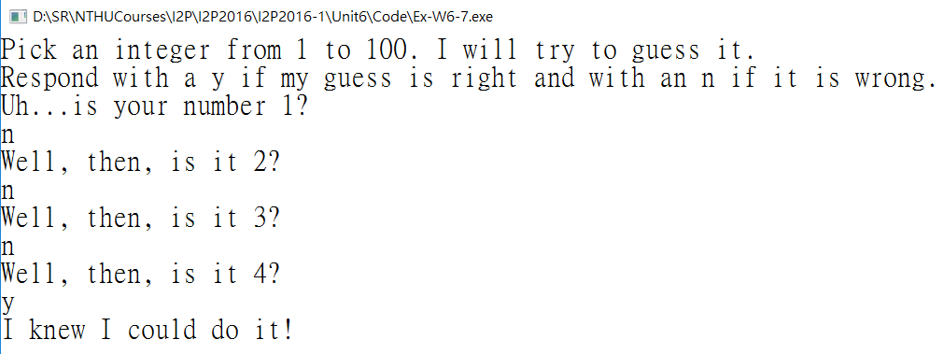
A Number-Guessing Program
An execution example

Slide 34
  #include <stdio.h>
  int main(void)
  {
  int guess = 1;
  printf("Pick an integer from 1 to 100. I will try to guess it.\n");
  printf("Respond with a y if my guess is right and with an n if it is wrong.\n");
  printf("Uh...is your number %d?\n", ???);
  while (???)
  printf("Well, then, is it %d?\n", ???);
  printf("I knew I could do it!\n");
  return 0;
  }

Slide 35
  #include <stdio.h>
  int main(void)
  {
  int guess = 1;
  printf("Pick an integer from 1 to 100. I will try to guess it.\n");
  printf("Respond with a y if my guess is right and with an n if it is wrong.\n");
  printf("Uh...is your number %d?\n", guess);
  while (getchar() != 'y') {
  printf("Well, then, is it %d?\n", ++guess);
  ???
  }
  printf("I knew I could do it!\n");
  return 0;
  }

Slide 36
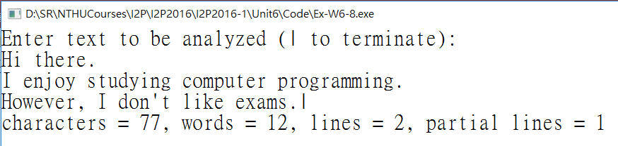
A Word-Count Program (1/6)
To make a word-counting program, which
  count characters
  count words
  count lines

Slide 37
A Word-Count Program (2/6)
Ideas
  Character and line countings are easy
    Each time getchar() is executed, #characters++
    Each time getchar() reads a ‘\n’, #lines++
      What if the program stops in the middle of a line
        count it as a partial line—that is, a line with characters but no newline
        if the last character read before the STOP character isn't a newline ‘\n’, you have a partial line.

Slide 38
A Word-Count Program (3/6)
  How to count words?
    Is a character in a word?
      You can set a flag to 1 when the first character in a word is read.
      At the next whitespace character, you must reset the flag to 0
  Pseudocode:
    if c is not whitespace and inword is false
    set inword to true and #words++
    if c is whitespace and inword is true
    set inword to false

Slide 39
A Word-Count Program (4/6)
  #include <stdio.h>
  #include <ctype.h>
  #define STOP '|'
  int main(void)
  {
  char c;
  char prev;
  long n_chars = 0L;
  int n_lines = 0;
  int n_words = 0;
  int p_lines = 0;
  int inword = 0;

Slide 40
A Word-Count Program (5/6)
  printf("Enter text to be analyzed (| to terminate): \n");
  prev = '\n';
  while ((c = getchar()) != STOP) {
  //a character
  n_chars++;
  //a line
  if (c == '\n')
  n_lines++;
  //a word
  if (!isspace(c) && !inword) {
  inword = 1;
  n_words++;
  }
  if (isspace(c) && inword)
  inword = 0;
  prev = c;
  }

Slide 41
A Word-Count Program (6/6)
  if (prev != '\n')
  p_lines = 1;
  printf("characters = %ld, words = %d, lines = %d, ", n_chars, n_words, n_lines);
  printf("partial lines = %d\n", p_lines);
  return 0;
  }

