Slide 1
計算機程式設計一: Unit 4

Slide 2
Outline
Expressions and Statements
Relational Expressions and Operators
Type Conversions

Slide 3
Outline
Expressions and Statements
Relational Expressions and Operators
Type Conversions

Slide 4
Expressions and Statements
Statements form the basic program steps of C.
  A statement is a complete instruction to the computer.
Most statements are constructed from expressions.
  An expression consists of a combination of operators and operands.

Slide 5
Expressions
Here are some expressions:
  4
  -6
  4+21
  a*(b + c/d)/20
  q = 5*2
  x = ++q % 3
  q > 3
Every C expression has a value.
Expression Value
-4 + 6 2
c = 3 + 8 11
6 + (c = 3 + 8) 17

Slide 6
Statements
In C, statements are indicated by a semicolon at the end.
  Expression: legs = 4
  Statement: legs = 4;
Four kinds of statements so far
  declaration statement
  assignment statement
  while statement
  function statement

Slide 7
/* Four kinds of statements */
#include <stdio.h>
int main(void) /* finds sum of first 20 integers */
{
int count, sum; /* declaration statement */
count = 0; /* assignment statement */
sum = 0; /* ditto */
while (count++ < 20) /* while */
sum = sum + count;/* statement */
printf("sum = %d\n", sum);/* function statement */
return 0;
}

Slide 8
Outline
Expressions and Statements
Relational Expressions and Operators
Type Conversions

Slide 9
Relational Expressions
While-loops often rely on test expressions that make comparisons.
  Such expressions are termed relational expressions.
    The operators that appear in them are called relational operators.
  These statements check to see whether the expression is true or false.

Slide 10
Relational Operators
Operator Meaning
< Is less than
<= Is less than or equal to
== Is equal to
>= Is greater than or equal to
> Is greater than
!= Is not equal to

Slide 11
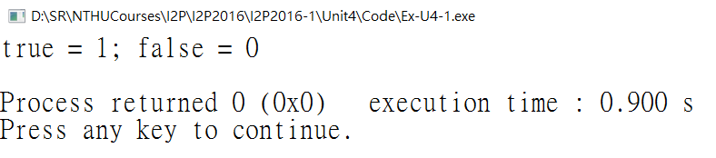
What Is Truth in C?
#include <stdio.h>
int main(void)
{
int true_val, false_val;
true_val = (10 > 2);
false_val = (10 == 2);
printf("true = %d; false = %d \n", true_val, false_val);
return 0;
}

Slide 12
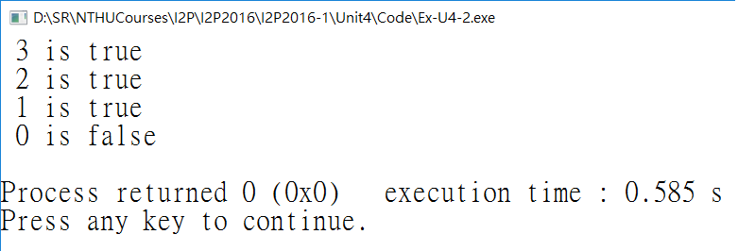
What Else Is True?
Note:
In C, all nonzero values are regarded as true, and only 0 is recognized as false.
  You can say that a while loop executes as long as its test condition evaluates to nonzero.
This puts test conditions on a numeric basis instead of a true/false basis.
while (goats != 0) is the same as while (goats)
#include <stdio.h>
int main(void)
{
int n = 3;
while (n) {
printf("%2d is true\n", n--);
}
printf("%2d is false\n", n);
return 0;
}

Slide 13
Operator Precedence
Operators (From High to Low Precedence)
1: ( )
2: - + ++ -- sizeof (type) (all unary)
3: * / %
4: + -
5: < > <= >=
6: == !=
7: =
Note that the two
  relational operator ==
  assignment operator =
are different!!!

Slide 14
Precedence of Relational Operators
The precedence of the relational operators is less than that of the arithmetic operators, and greater than that of assignment operators.
  x > y + 2 means x > (y + 2)
  x = y > 2 means x = (y > 2)
If you are not sure about the precedence rules, use ( )!!!

Slide 15
Outline
Expressions and Statements
Relational Expressions and Operators
Type Conversions

Slide 16
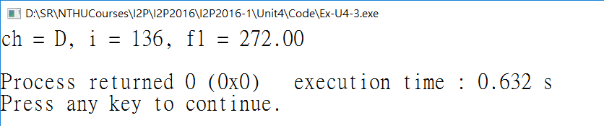
Type Conversions
#include <stdio.h>
int main(void)
{
char ch;
int i;
float fl=0;
ch = 'C';
ch = ch + 1;
i = fl + 2 * ch;
fl = 2.0 * ch + i;
printf("ch = %c, i = %d, fl = %2.2f\n", ch, i, fl);
return 0;
}

Slide 17
Automatic Type Conversion Rules (1/2)
Rule 1: In an expression, char and short, both signed and unsigned, are automatically converted to int.
Rule 2: In any operation involving two types, both values are converted to the higher ranking of the two types.
  highest to lowest: long double, double, float, unsigned long long, long long, unsigned long, long, unsigned int, and int.

Slide 18
Automatic Type Conversion Rules (2/2)
Rule 3: In an assignment statement, the final result of the calculations is converted to the type of the variable being assigned a value.
Rule 4: When passed as function arguments, char and short are converted to int, and float is converted to double.

Slide 19
Type Conversions
Line 9:
  The value of ch is converted to the 4-byte integer 67, which is then added to the 1.
  The resulting 4-byte integer 68 is truncated to 1 byte and stored in ch.
Line 10:
  The value of ch is converted to a 4-byte integer (68) for the multiplication by 2.
  The resulting integer (136) is converted to floating point in order to be added to fl.
  The result (136.00) is converted to int and stored in i.
Line 12: in argument passing,
  The value of ch is promoted to be int
  The value of fl is promoted to be double
#include <stdio.h>
int main(void)
{
char ch;
int i;
float fl=0;
ch = 'C';
ch = ch + 1;
i = fl + 2 * ch;
fl = 2.0 * ch + i;
printf("ch = %c, i = %d, fl = %2.2f\n", ch, i, fl);
return 0;
}

Slide 20
The Cast Operator: (type)
int mice;
mice = 1.6 + 1.7; /* automatic conversion */
mice = (int) 1.6 + (int) 1.7; /* cast conversion */

