Slide 1
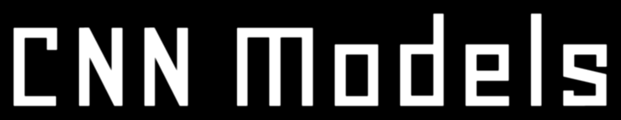

Slide 2
VGG16

Slide 3
VGG16 is a convolution neural net architecture used for image recognition. It utilizes 16 layers with weights and is considered one of the best vision model architectures
VGG16 uses convolution layers with a 3x3 filter and a stride 1 that are in the same padding and max pool layer of a 2x2 filter of stride 2
It follows this convolution and max pool layer arrangement consistently throughout the architecture
In the end, it has two fully connected layers, followed by a SoftMax for output

Slide 4
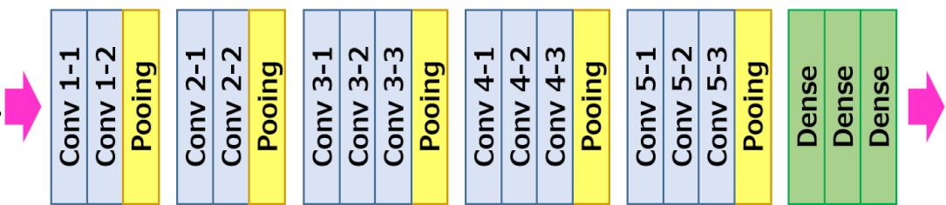
The 16 in VGG16 refers to it has 16 layers that have weights. This network is a pretty large network, and it has about 138 million (approx.) parameters

Slide 5
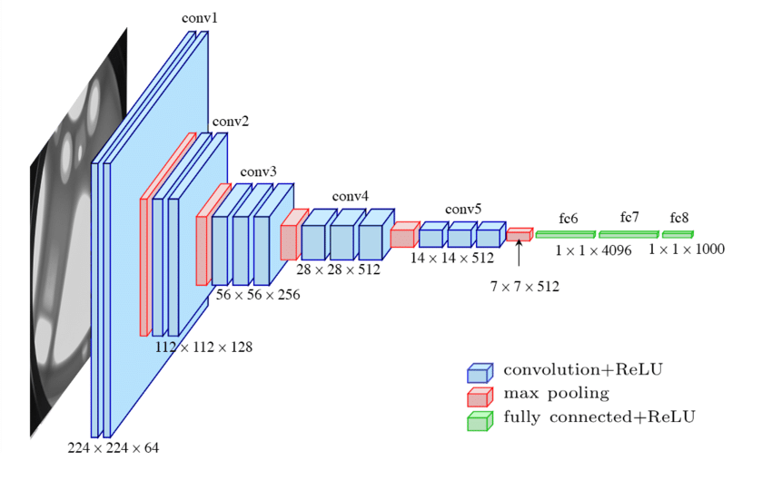

Slide 6
ImageNet Large Scale Visual Recognition Challenge (ILSVRC) is an annual computer vision competition. Each year, teams compete on two tasks
The first is to detect objects within an image coming from 200 classes, which is called object localization. The second is to classify images, each labeled with one of 1000 categories, called image classification
VGG 16 was proposed by Karen Simonyan and Andrew Zisserman of the Visual Geometry Group Lab of Oxford University in 2014 in the paper “VERY DEEP CONVOLUTIONAL NETWORKS FOR LARGE-SCALE IMAGE RECOGNITION”. This model won 1st and 2nd place in the above categories in the 2014 ILSVRC challenge

Slide 7
LSTM

Slide 8
LSTM stands for long short-term memory networks, used in the field of Deep Learning. Various recurrent neural networks (RNNs) are capable of learning long-term dependencies, especially in sequence prediction problems
LSTM has feedback connections, i.e., it can process the entire sequence of data, apart from single data points such as images
LSTM is a special kind of RNN, which shows outstanding performance on a large variety of problems

Slide 9
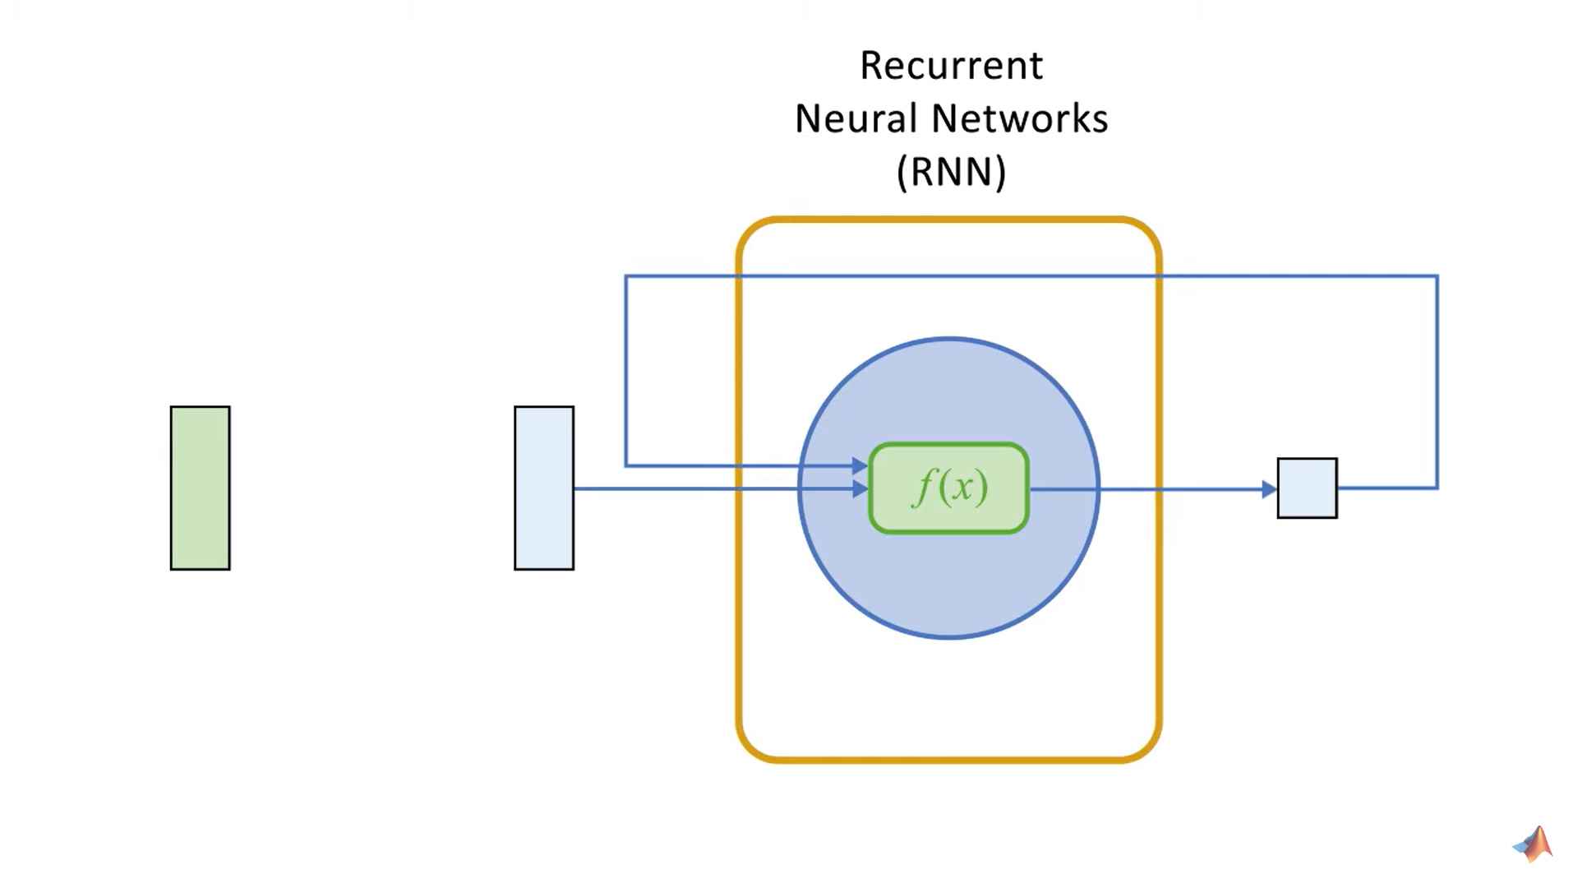

Slide 10
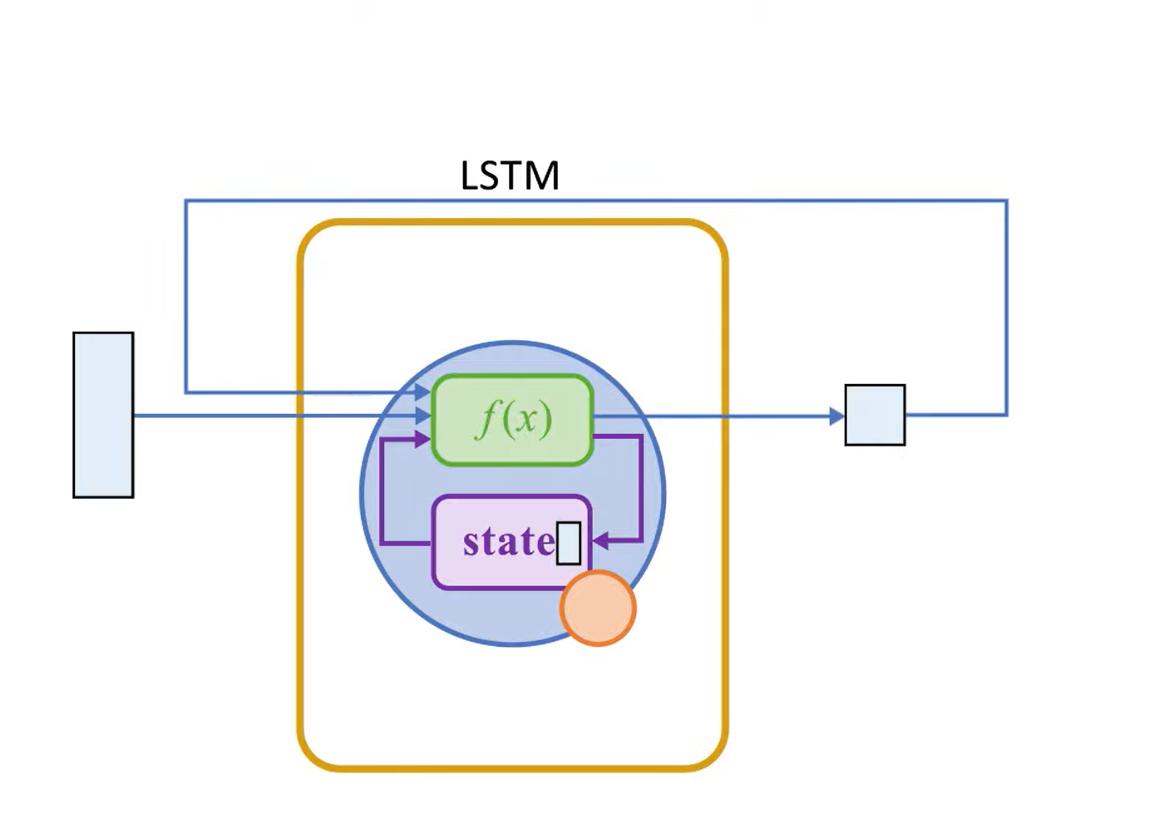

Slide 11
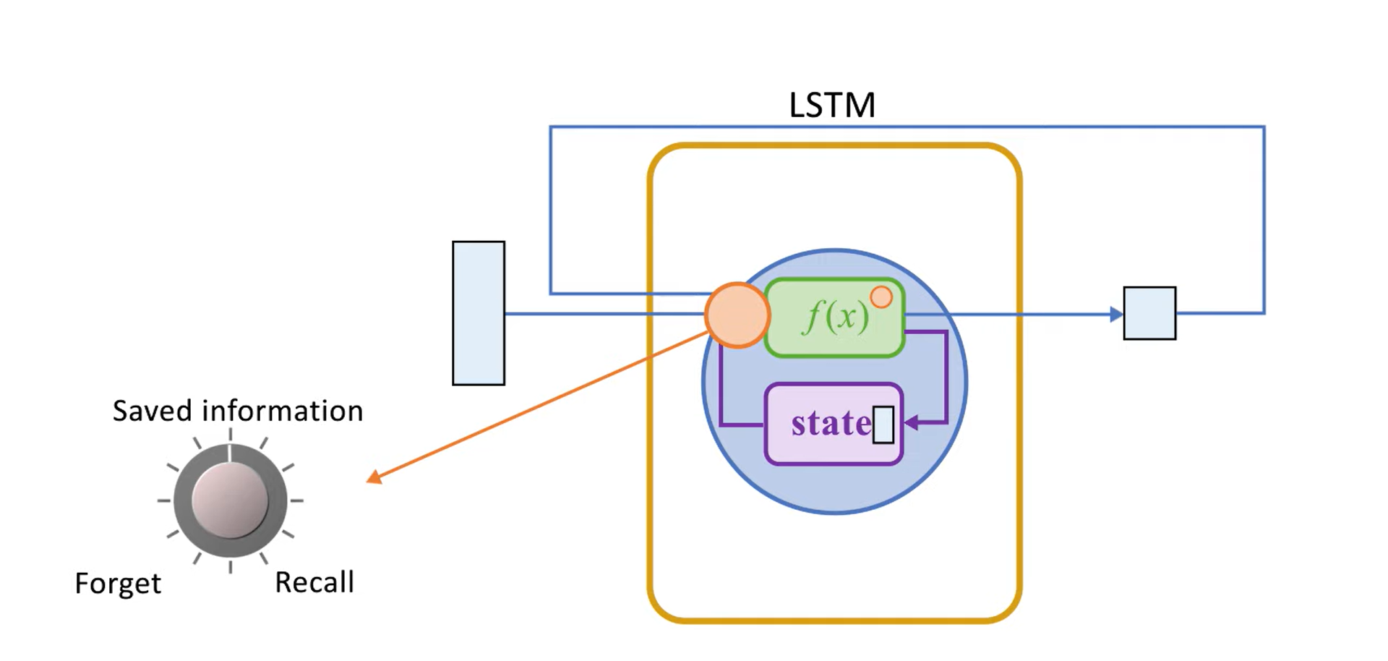

Slide 12
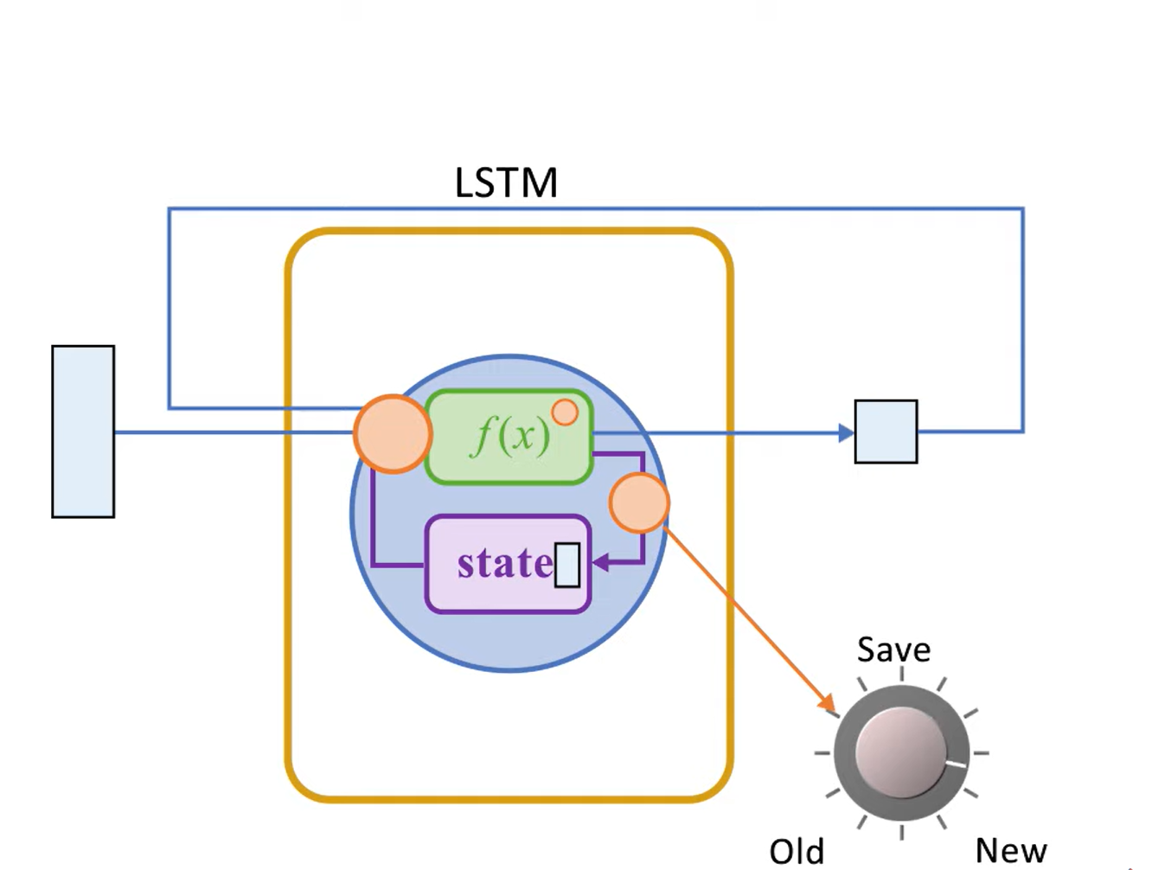

Slide 13
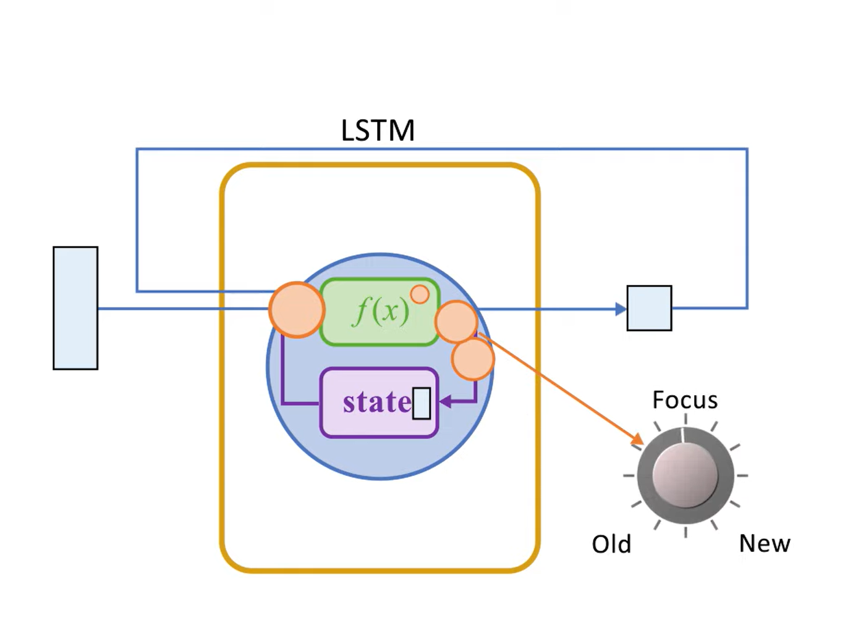

Slide 14
RNN vs LSTM
Consider, you have the task of modifying certain information in a calendar. An RNN changes the existing data by applying a function to do this
Whereas, LSTM makes small modifications to the data by simple addition or multiplication that flow through cell states. This is how LSTM forgets and remembers things selectively, which makes it an improvement over RNNs

Slide 15
Ultimate Model

Slide 16
The task of image captioning can be divided into two modules logically – one is an image-based model – which extracts the features and nuances out of our image, and the other is a language-based model – which translates the features and objects given by our image-based model to a natural sentence
For our image-based model (viz encoder) – we usually rely on a Convolutional Neural Network model. And for our language-based model (viz decoder) – we rely on a Recurrent Neural Network. The image below summarizes the approach given above.

Slide 17
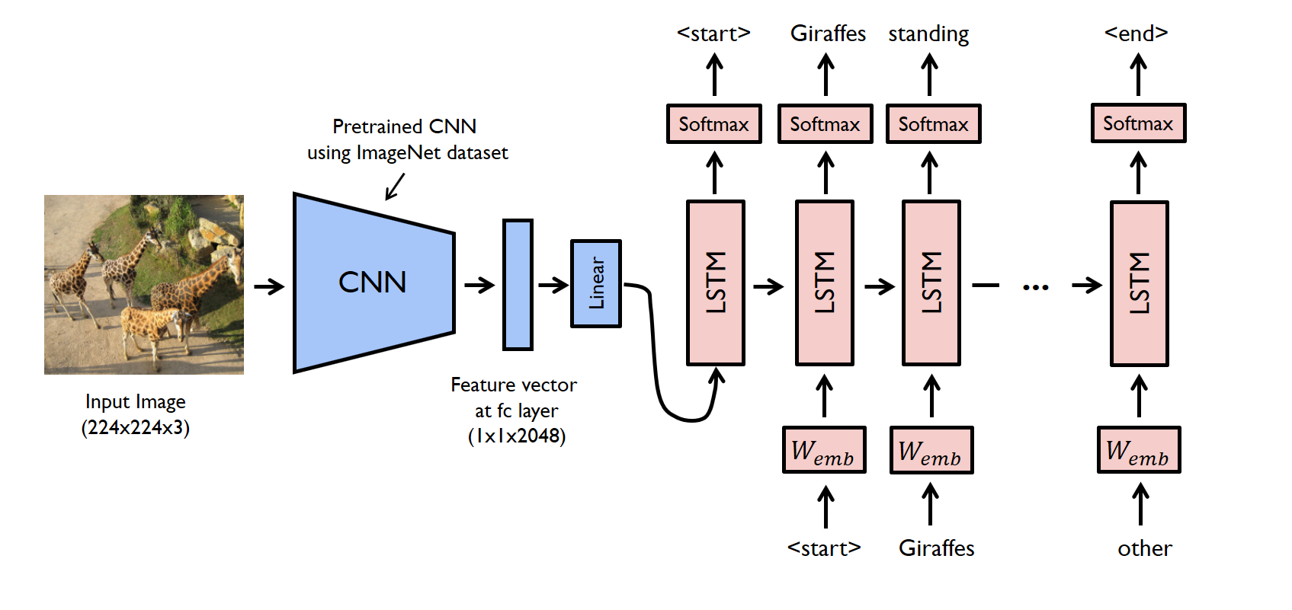
Here I'm using a pre-trained VGG16 model with weights as my CNN, which will act as an input to my RNN (LSTM)

Slide 18
