Slide 1
Renewable Energy Output Prediction
Using Artificial Neural Networks
CCS 229 Intelligent Systems
Dallas A. Aquino, Frederick Jibril L. Buñag, Ethan Jed V. Carbonell, Vincent L. Corpes Jr.
Presented to: Mr. Cyreneo S. Dofitas
April 2026

Slide 2
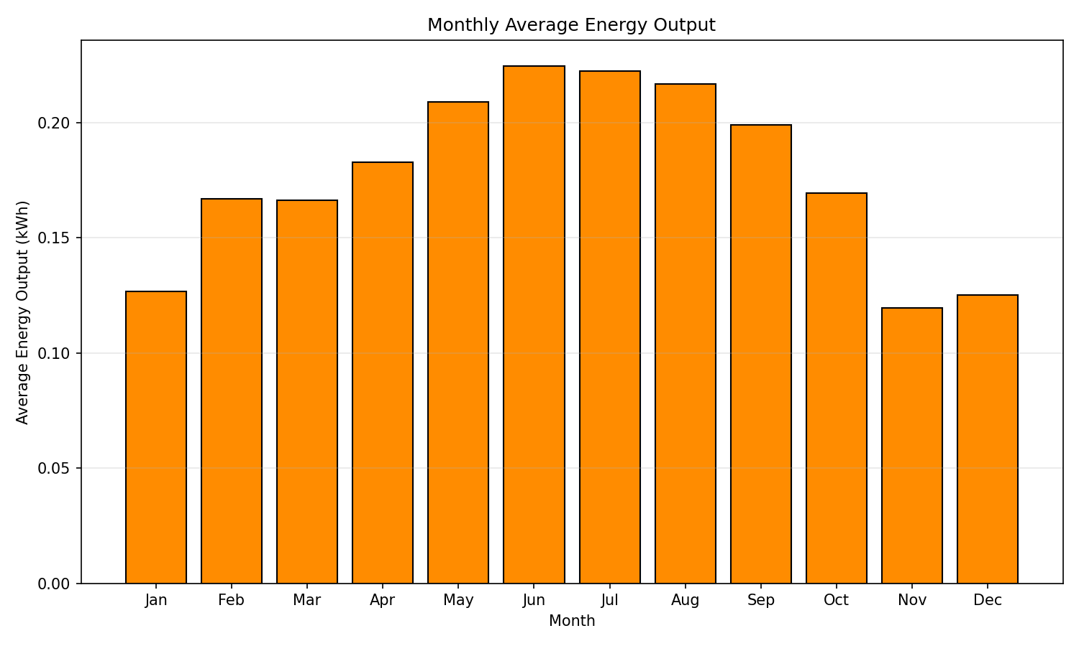
PROBLEM & MOTIVATION
Solar energy output is highly variable — driven by cloud cover, temperature, wind speed, humidity, and time of day.
Traditional linear regression cannot capture these complex nonlinear relationships.
Research Question: Can an ANN accurately predict hourly solar energy output from weather data?
Location: Madrid, Spain (40.4°N, 3.7°W) — a high-solar-potential Mediterranean site with ~1,700 kWh/m² annual GHI.
Monthly average solar energy output (kWh) — strong summer peak pattern
Accurate short-term forecasting enables better reserve scheduling, reduces curtailment, and lowers grid integration costs. Improving forecast accuracy by 10% can reduce integration costs by up to 30% (IEA).
2 / 7

Slide 3
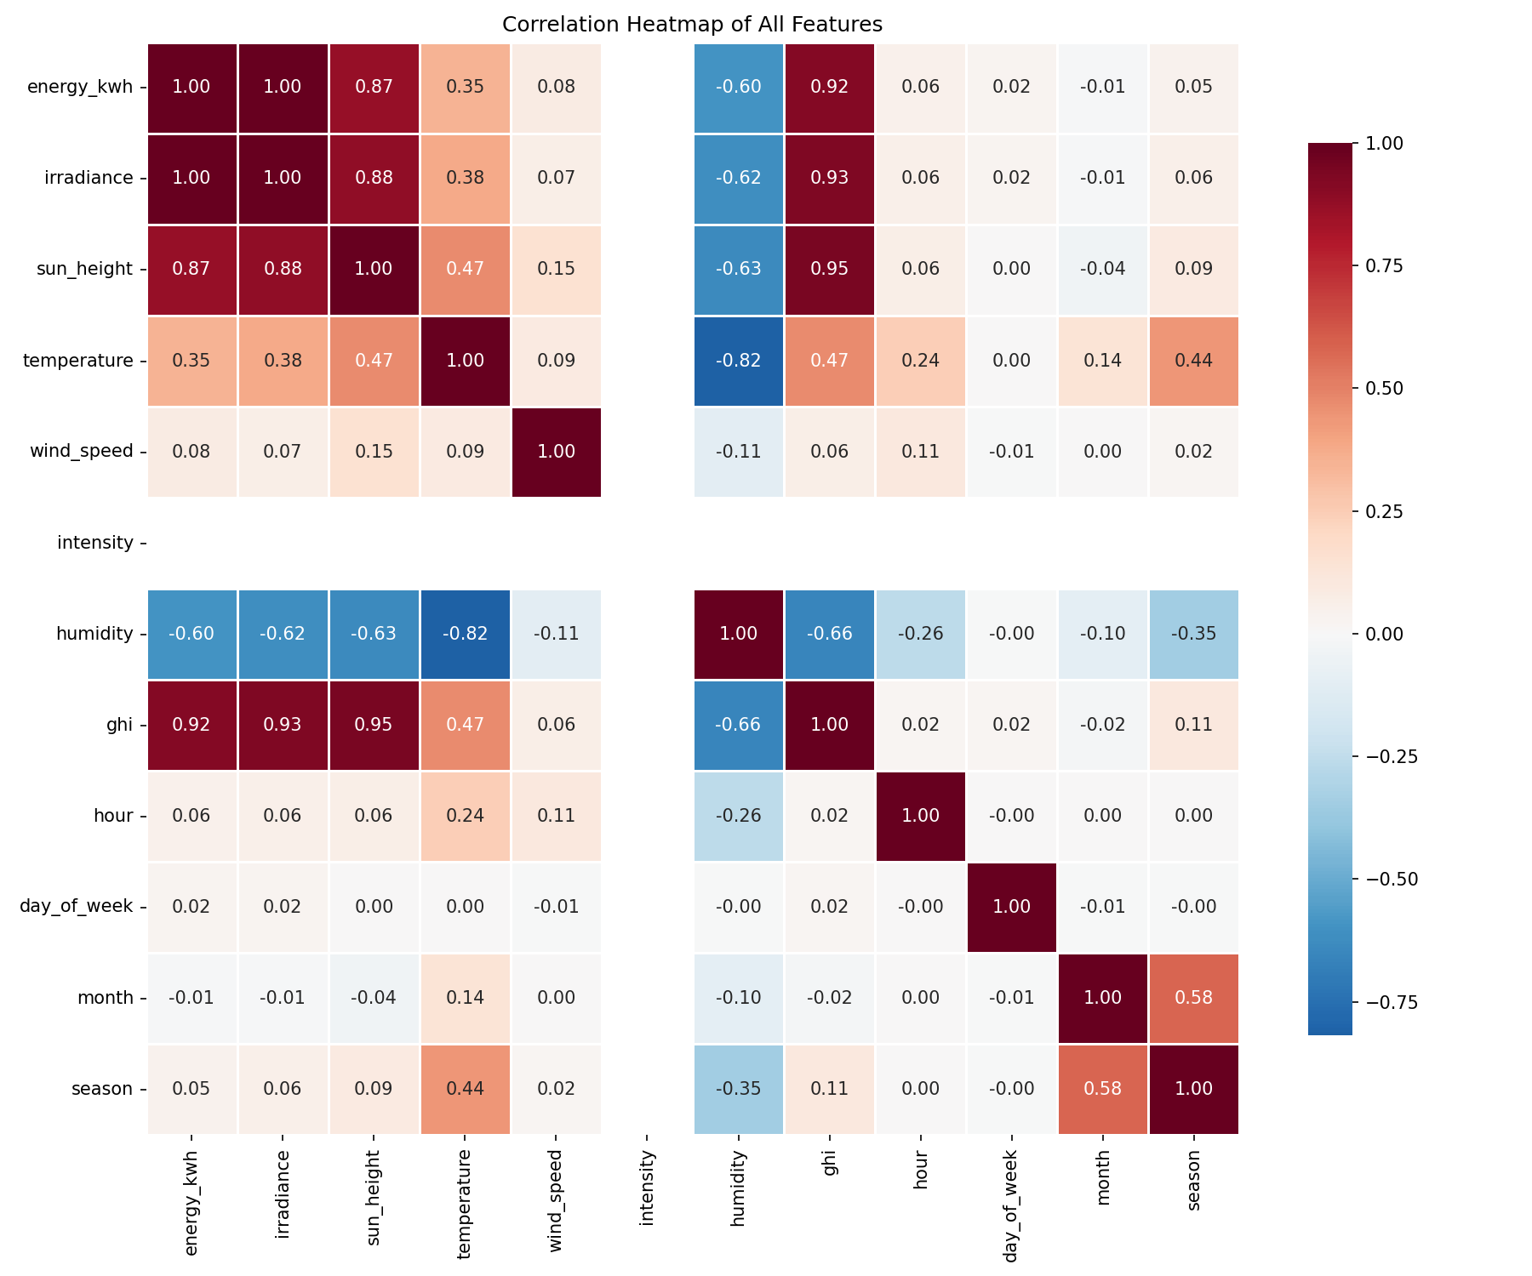
DATASET & METHODOLOGY
Data Sources
Input Features & Target
PVGIS API (European Commission JRC): PV output, irradiance, temperature, wind speed
NASA POWER API: Humidity, Global Horizontal Irradiance (GHI)
Period: Full leap year 2020 — 8,784 hourly observations
Location: Madrid, Spain (40.4°N, 3.7°W)
Inputs (X): irradiance, temperature, wind_speed, humidity, hour
Target (y): energy_kwh (hourly PV output)
Normalization: MinMaxScaler [0, 1]
Time features: hour, day_of_week, month, season
Chronological Split
Partition | Date Range | Samples | Fraction
Training | Jan — Sep 4 | 6,148 | 70%
Validation | Sep 5 — Nov 15 | 1,318 | 15%
Test | Nov 16 — Dec 31 | 1,318 | 15%
Feature correlation heatmap — irradiance dominates (r ≈ 0.998)
3 / 7

Slide 4
ANN ARCHITECTURE & TRAINING
INPUT (5)
HIDDEN 1 (10)
HIDDEN 2 (8)
OUTPUT (1)
irradiance
ReLU
ReLU
temp
ReLU
Linear → kWh
ReLU
wind
ReLU
humidity
... (7 more)
... (6 more)
hour
Training Configuration
Backpropagation Steps
Loss: Mean Squared Error (MSE)
Optimizer: Adam (lr = 0.001)
Epochs: 150 (early stopping)
Batch size: 32
Patience: 10 epochs
Best epoch: 25
Total params: 157
1. Forward pass: compute prediction ŷ through layers
2. Loss: MSE = (1/N) Σ(yᵢ − ŷᵢ)²
3. Backward pass: propagate error gradients via chain rule
4. Update: w_new = w_old − η · ∂L/∂w
Reference: Negnevitsky (2005), §6.4 — Backpropagation Learning
4 / 7

Slide 5
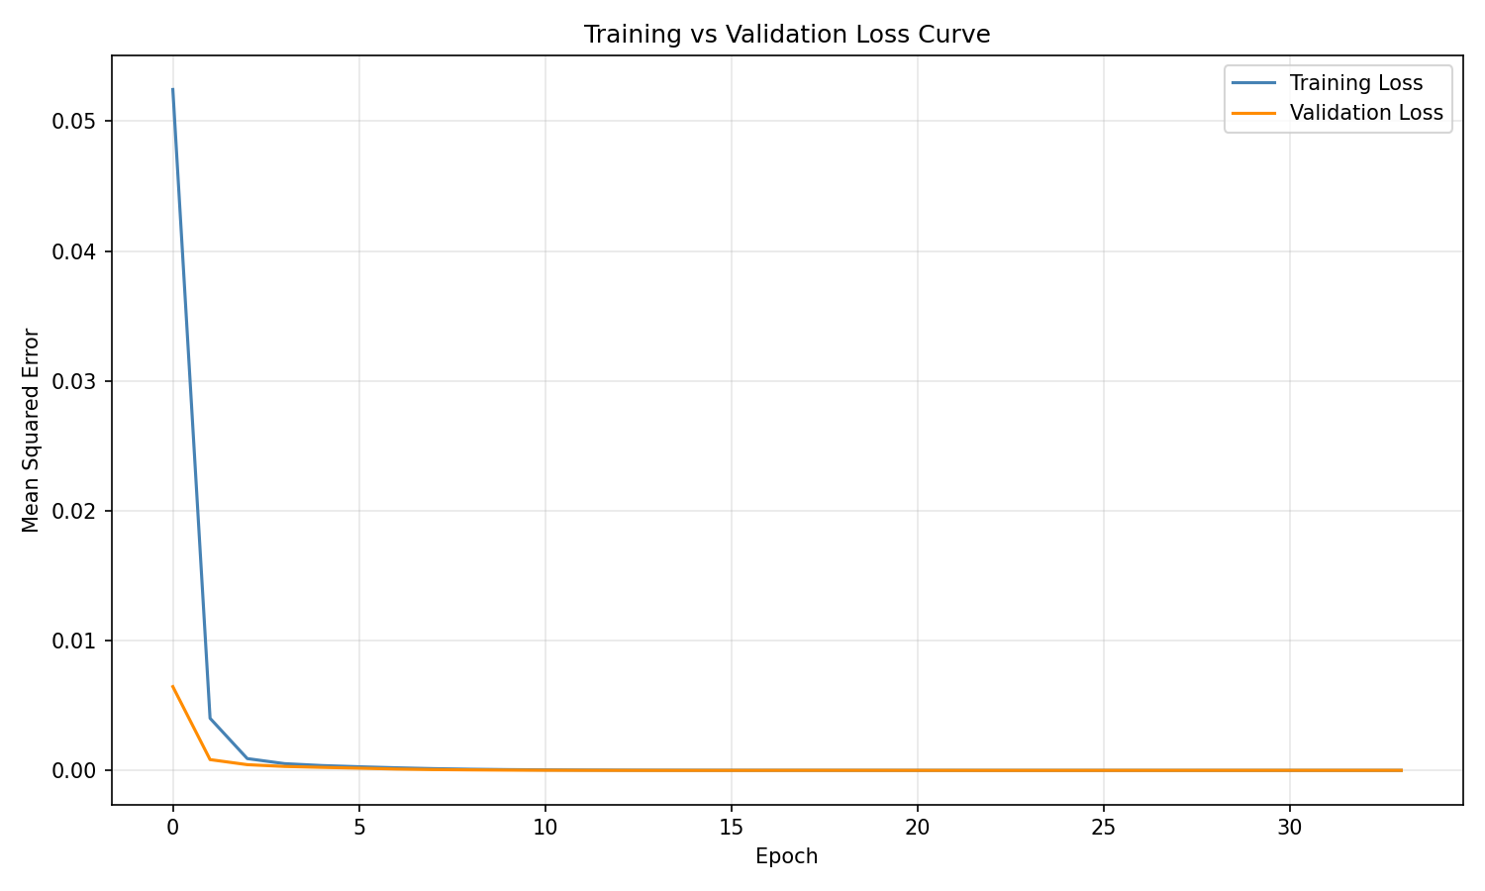
TRAINING RESULTS
Key Observations
Rapid convergence in first 10 epochs — loss drops from 0.052 to below 0.001
Best validation loss achieved at epoch 25, after which early stopping halts training
Small train-val gap indicates good generalization with minimal overfitting
No sign of divergence — validation loss plateaus rather than rises, confirming appropriate model capacity
5 / 7

Slide 6
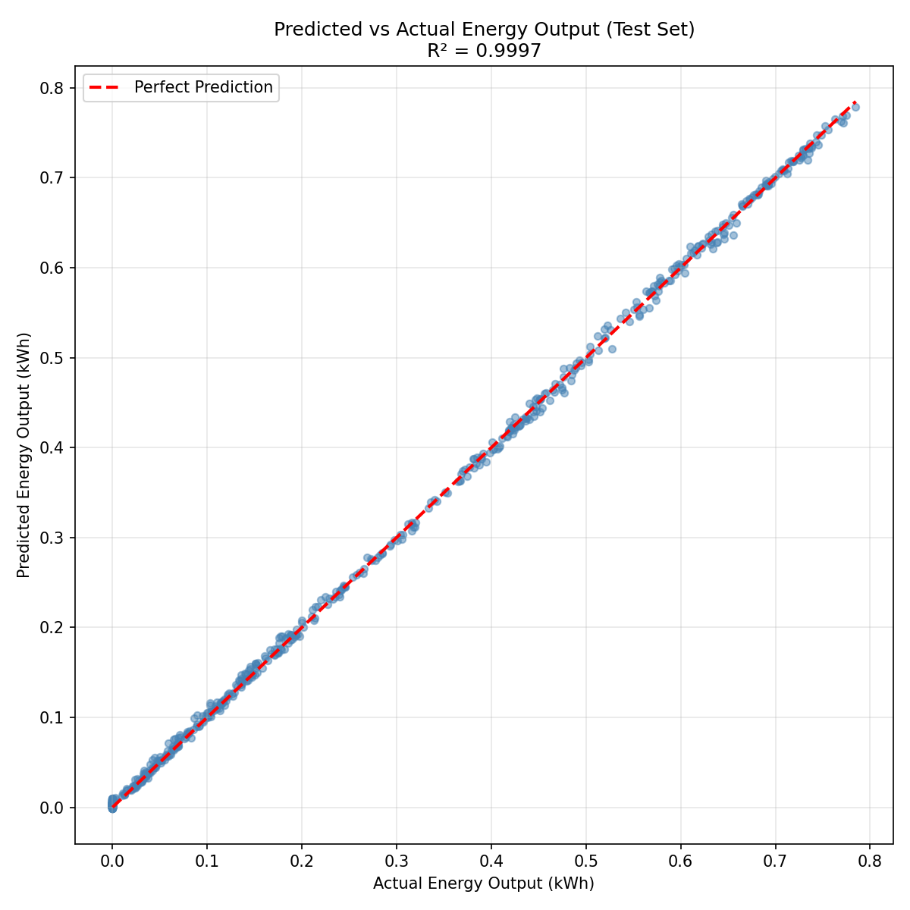
EVALUATION & PERFORMANCE COMPARISON
Model | RMSE (kWh) | MAE (kWh) | R²
ANN (MLP) | 0.00386 | 0.00295 | 0.99969
Linear Regression | 0.01642 | 0.01174 | 0.99442
RMSE Reduction
MAE Reduction
R² (ANN)
76.5%
74.8%
0.9997
Error Analysis
Best: Clear-sky conditions — residuals < 0.001 kWh
Worst: Partial cloud cover — rapid irradiance fluctuations at sub-hourly scales
Night hours: Near-zero error — model correctly learns zero-output regime
Dominant error source: cloud dynamics not resolvable with hourly features
Predicted vs. Actual — tight clustering confirms near-perfect prediction accuracy
6 / 7

Slide 7
Conclusion & Future Work
Conclusion
• A 5-10-8-1 MLP achieves R² = 0.9997 on hourly solar prediction
• ANN reduces prediction error by 76.5% vs. linear regression
• ReLU activations successfully capture nonlinear irradiance-temperature interactions
• Chronological train-test split is essential for time-series evaluation
Future Directions
• LSTM networks for temporal sequence modeling
• Satellite cloud motion vectors for nowcasting
• Ensemble methods and probabilistic forecasting with uncertainty intervals
• Multi-location transfer learning to reduce data requirements

