Slide 1


Life Dots
Configure
Instructions
World Builder
Dot Builder

Slide 2


Instructions
Life dots is about…

Slide 3
Configuration
Import
Export Config
Main Menu
Begin

Slide 4
Grid Size:
World Builder
750
Obstacles
Wall
Life dots is about…
Trap
Brush Size:
11
Food
Rain
Uniform Gaussian
Ticks / Rain:
19
Import
Drops / Rain:
107
Food / Drop:
33
Brush Size:
Export
15
Hot Spot
Food / Cell:
45
Main Menu
Brush Size:
8
Eraser
Configure
Brush Size:
12

Slide 5
Dot Builder
Import
Export
Main Menu
Configure

Slide 6
Dot Builder
Import
Export
Main Menu
Configure

Slide 7
Dot Builder
Import
Export
Main Menu
Configure

Slide 8
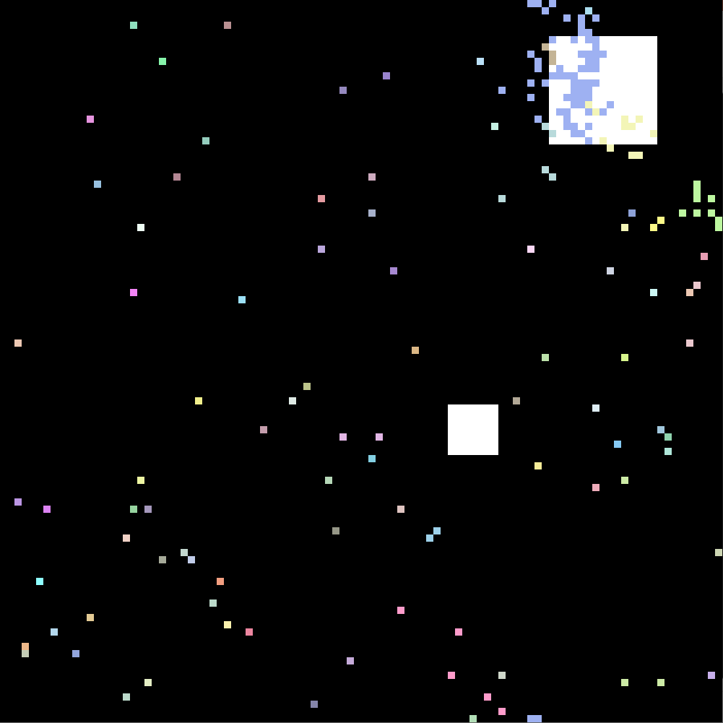
Simulation
Pause / Resume
Export
Configure
Main Menu

