Slide 1
COMP4026 Computer Vision and Pattern Recognition Group Project: Anonymised Facial Expression Recognition
P C Yuen
Department of Computer Science
Hong Kong Baptist University
2nd Semester, 2025-26

Slide 2
Group Project: Goal
Goal: To build a prototype of an anonymised facial expression recognition application.
The key challenge is to maintain facial expression recognition accuracy while the face images are privacy-protected (anonymised), that is, the original identity of the privacy-protected images should not be authenticated by a machine.

Slide 3
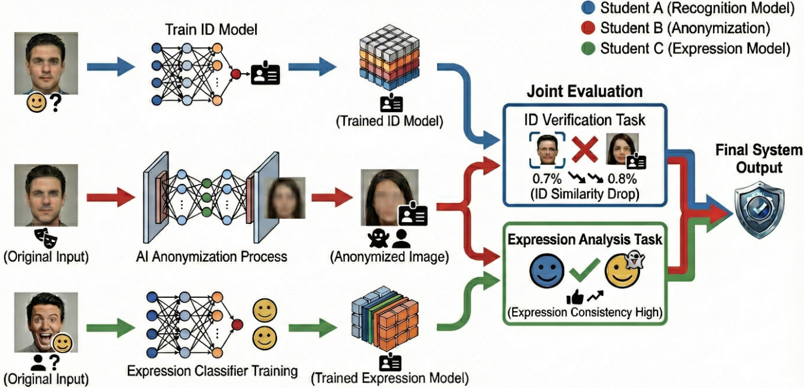
Requirement

Slide 4
Evaluation Metrics
Face Recognition Metrics (Privacy)
Accuracy on original test set — validates the reliability of the ID classifier.
Accuracy on anonymised Images — evaluate the anonymisation strength.
Expression Preservation Metrics (Utility)
Expression Consistency Rate — percentage of images with unchanged expression.

Slide 5
Group Project: Evaluation Criteria
Understanding of the Task: Clear explanation of the purpose of the project
Methodology: Justifications for the tools, methods, and models used for both real and synthetic image training.
Implementation and Comparison: Proper training, testing, and comparison of models.
Efforts and Contributions: Demonstrated effort in generating synthetic data and analysing results.
Presentation and Report Quality: Clarity and completeness of the final presentation and report.
Teamwork

Slide 6
Group Project: Assessment
Assessment*
Proposal 20%
Presentation and demonstration (including Q&A) 40%
Project report (including results) 40%
Max 15 pages (double spacing), including figures, tables and references.
You may submit supplementary materials, if needed
* Late submission policy: 10% deduction per day

Slide 7
Group Project: Timeline
24 January 2026 (5% deduction for late submission)
Submit group member list on Moodle.
10 February 2026
Project announcement.
17 March 2026(20%)
Submit a project proposal, including preliminary studies, methodology rationale, and initial design on Moodle.
20/21 April 2026 (40%)
15-min presentation and demonstration. [All group members are required to present their responsible part(s)]
30 April 2026 (40%)
Submit final report with presentation slides and programme source code on Moodle.

Slide 8
Group Project: Submission
Each group must submit the following on Moodle.
A project proposal with at most 1000 words, and 10 pages, including figures, tables and references, in pdf format. Name your document with group number and last name of group members, e.g. Group1_Proposal_Wong_Chan_Lee.pdf
A written final report in pdf format with at most 3000 words and 15 pages, including figures, tables and references. Same naming convention
Your presentation materials. Same naming convention
Your source codes. Same naming convention
*An overlength proposal/report will be subject to a penalty.

Slide 9
Group Project: Note
Declare the responsibility of each member during the presentation and in the report. Questions will be asked to a specific member who is responsible for
Each member needs to present his/her part during the project presentation. Zero marks for no show.
Include a section “GenAI Usage Disclosure” and declare the use of third-party resources.

Slide 10
Questions??

