Slide 1
CNN-Based Max Von Mises Stress Prediction for Cantilever Beam
ME504 – Deep Learning Project • Q7
Regression vs Percentile-Bin Classification
Group 3

Slide 2
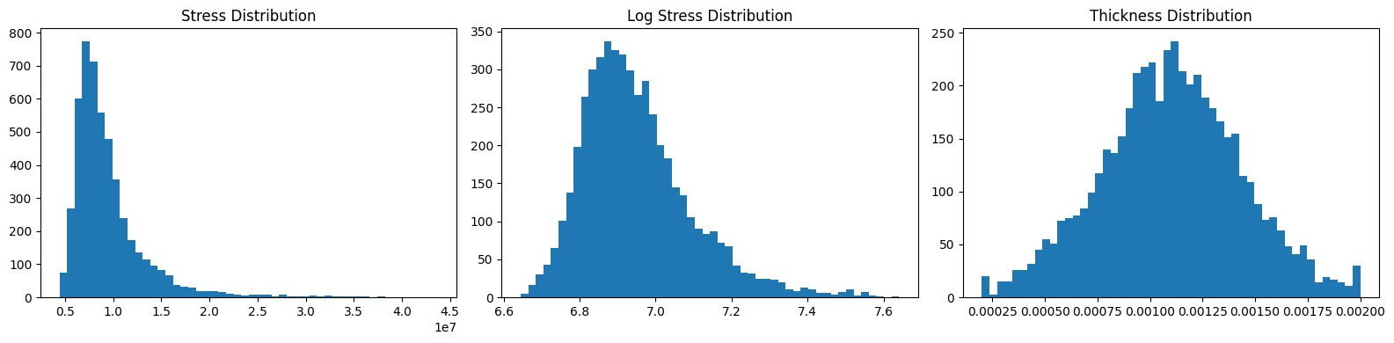
Problem Statement & Dataset Predicting structural failure risk from FE simulation data
Dataset
5 000 cantilever-beam FE simulations
Input: 226 nodal thickness values (m)
Target: max Von Mises stress (Pa)
Split: 70 % train / 15 % val / 15 % test
Feature scaling: StandardScaler (train only)
Regression target: log + z-normalised
Approach 1 – CNN Regression
• Predict exact max stress (Pa)
• MSE loss on log-scaled, z-normalised target
Approach 2 – CNN Classification
• 4 percentile bins: 0-10% / 11-25% / 26-50% / 51-100%
• Weighted cross-entropy (class-imbalance aware)
• Thresholds fixed from training set only

Slide 3
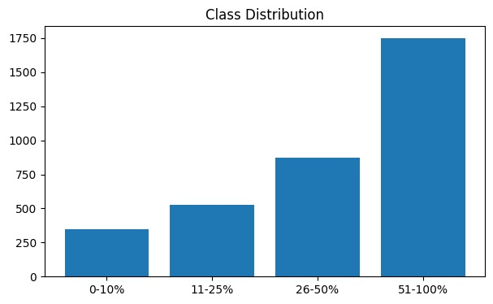
Preprocessing & Class Distribution
Percentile bins defined on training-set thresholds; weighted loss corrects imbalance
•Class 0 (0–10 th percentile) → very low stress
•Class 1 (11–25 th percentile) → low stress
•Class 2 (26–50 th percentile) → medium stress
•Class 3 (>50 th percentile) → high stress
The loss function is weighted cross-entropy

Slide 4
Shared CNN Architecture
1-D convolutions over 226-node thickness profile → shared backbone, two task heads
Hyperparameters
Conv1D Block 1
64 filters k=5 BN ReLU MaxPool/2
Regression CNN: ~250 k parameters
Classification CNN: ~251 k parameters
Optimiser: Adam lr=1e-3
Scheduler: ReduceLROnPlateau
(factor=0.5,
patience=7, min_lr=1e-6)
Batch size: 64
Max epochs: 100 | Early stop: patience=15
Conv1D Block 2
128 filters k=3 BN ReLU MaxPool/2
Conv1D Block 3
256 filters k=3 BN ReLU AdaptAvgPool→1
FC Layers (Backbone)
256→256 ReLU Drop(0.3) →128 ReLU Drop(0.3)
↑ Shared backbone output (128-D)
Regression Head
Classification Head
Linear(128 → 1)
Linear(128 → 4)

Slide 5
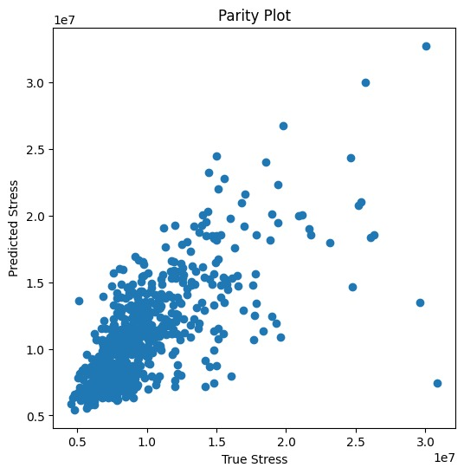
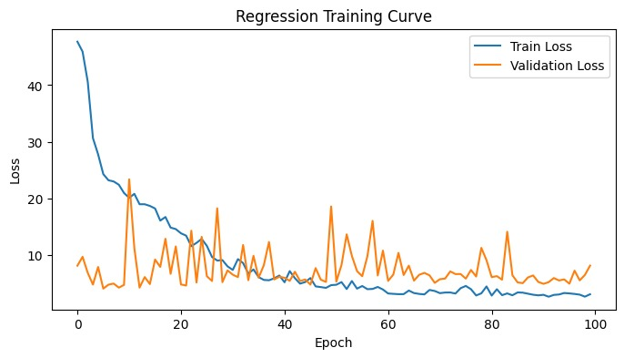
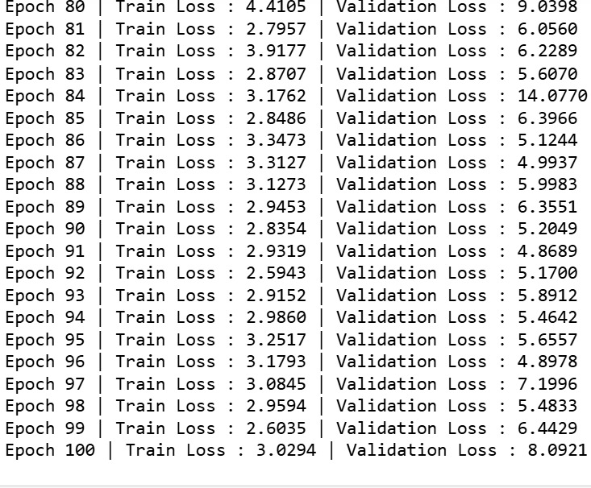
Approach 1 – CNN Regression: Training and test resluts
Train loss drops sharply from ~47 to ~3 over 100 epochs, showing the model successfully learns the stress-thickness relationship.
Validation loss is noisy and unstable, spiking repeatedly between 5–20 throughout training because there is no learning rate scheduler or early stopping — the fixed learning rate keeps overshooting the optimal weights.

Slide 6
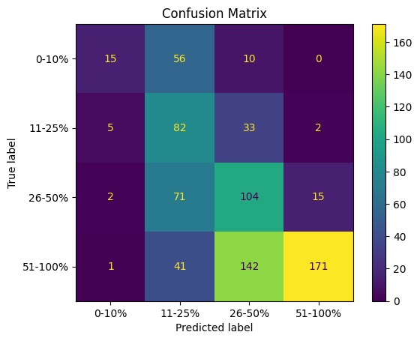
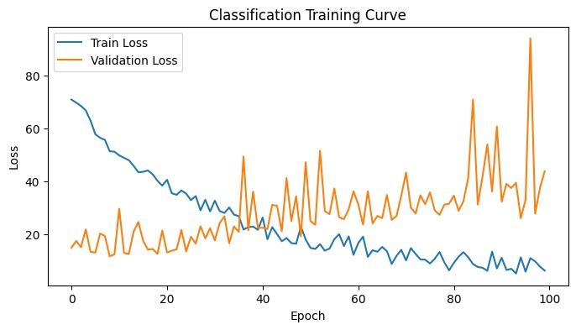
Approach 2 – CNN Classification: Training & Evaluation
Weighted cross-entropy loss; value accuracy and confusion matrices on test set
Class 0–10% is predicted worst (18.5% accuracy) because it has the fewest training samples.
Class 51–100% is predicted best since it contains most of the data, creating model bias toward this class.
Most misclassifications occur between adjacent bins because stress values near boundaries are very similar.
Overall accuracy (~57%) is low because percentile bins are artificial divisions with overlapping boundary values.
Train loss (blue) starts high at ~72 and decreases steadily to ~8 over 100 epochs, showing the model is continuously learning to classify the four stress percentile bins from the volume fraction distribution.
Validation loss (orange) starts low at ~17 but rises and becomes increasingly unstable after epoch 40, spiking as high as ~93 at epoch 97 — this is a clear sign of overfitting where the model memorises training data but fails on unseen data.

Slide 7
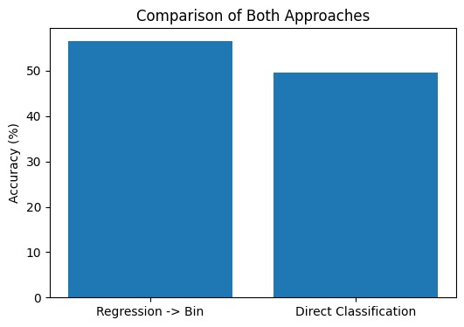
Comparison: Regression vs Classification
When to choose Approach 1 (Regression)?
•When you need the exact stress value in Pa (e.g., safety factor calculations).
•When downstream optimisation algorithms need a differentiable output to compute gradients.
•When you have a large labelled dataset (>2000 samples).
When to choose Approach 2 (Classification)?
•When you only need to rank or screen designs (e.g., discard the worst 50 %).
•When labelled data is scarce — classification converges faster.
•When extreme stress values would otherwise distort the MSE loss.

