Slide 1
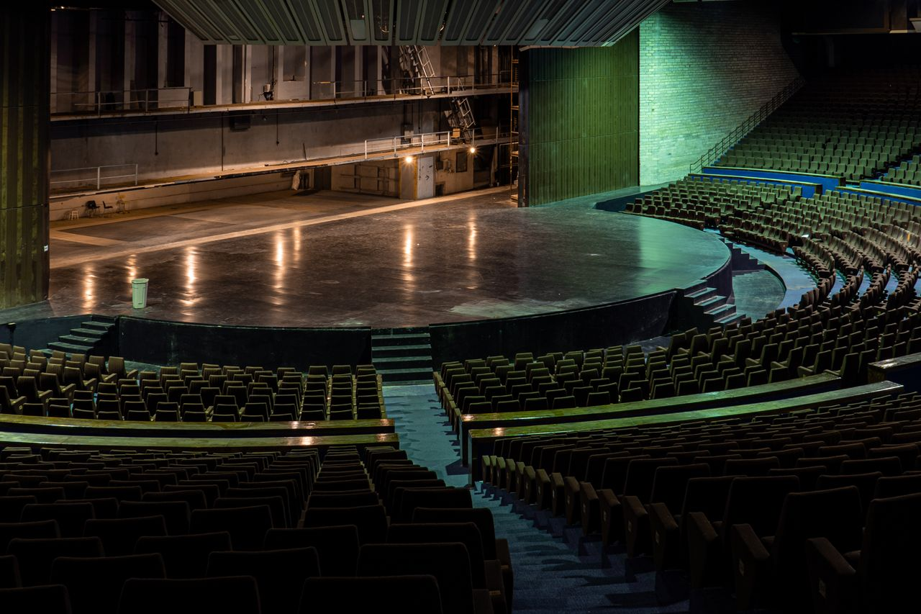
GULF COAST BALLET
An Evening
of Dance
Spring Gala results and the case for support, prepared for the development committee.

Slide 2
THE EVENING AT A GLANCE
One Night, Built for the Company
TOTAL RAISED
NET TO THE COMPANY
TABLES SOLD
INDIVIDUAL GUESTS
452,000
355,500
22
168
Against a goal of 450,000
After event costs
At the 6,000 and 10,000 levels
Seated at 500 each
The evening met its goal for the third year running. Leadership and benefactor tables anchored the room, the silent auction outperformed projection, and the paddle raise closed the gap. Every dollar above cost goes straight to the season.

Slide 3
WHERE THE GIFT COMES FROM
Revenue by Source
Total raised
452,000 dollars
Tables of ten were offered at the 6,000 and 10,000 levels. Individual seats were 500 dollars. The auction and paddle raise together brought in 204,000.

Slide 4
WHERE YOUR SUPPORT GOES
The 355,500 at Work
Restraint on cost,
ambition on stage.
The gala underwrites the parts of a season that ticket sales never quite reach. It is the extra week that turns a good performance into one people remember.

Slide 5
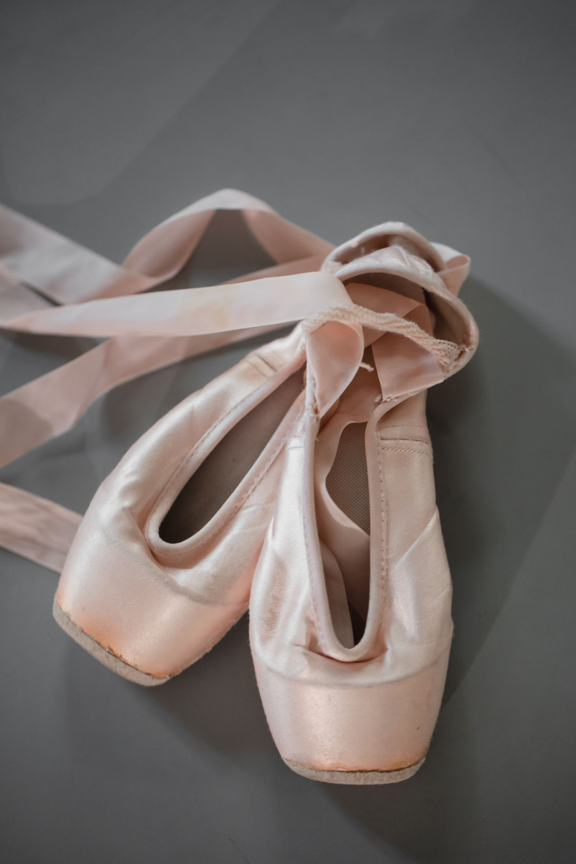
WHAT IT MAKES POSSIBLE
The Apprentice Who Stays
A gala table is the apprentice who can afford to stay another year. It is the pointe shoes that carry a principal through a run of eight. It is the original pas de deux built for one spring night.
Your support is the footing under all of it.

Slide 6
THE CASE FOR THIS SPRING
An Invitation to Lead
Renew at your current level
Tables of ten at 6,000 and 10,000, individual seats at 500.
Consider the leadership circle
A small group whose early gifts set the pace for the room.
Name a season element
Underwrite a production, an apprentice, or the new work.
Reply by February 20
So the committee can finalize seating and the program.

