Slide 1
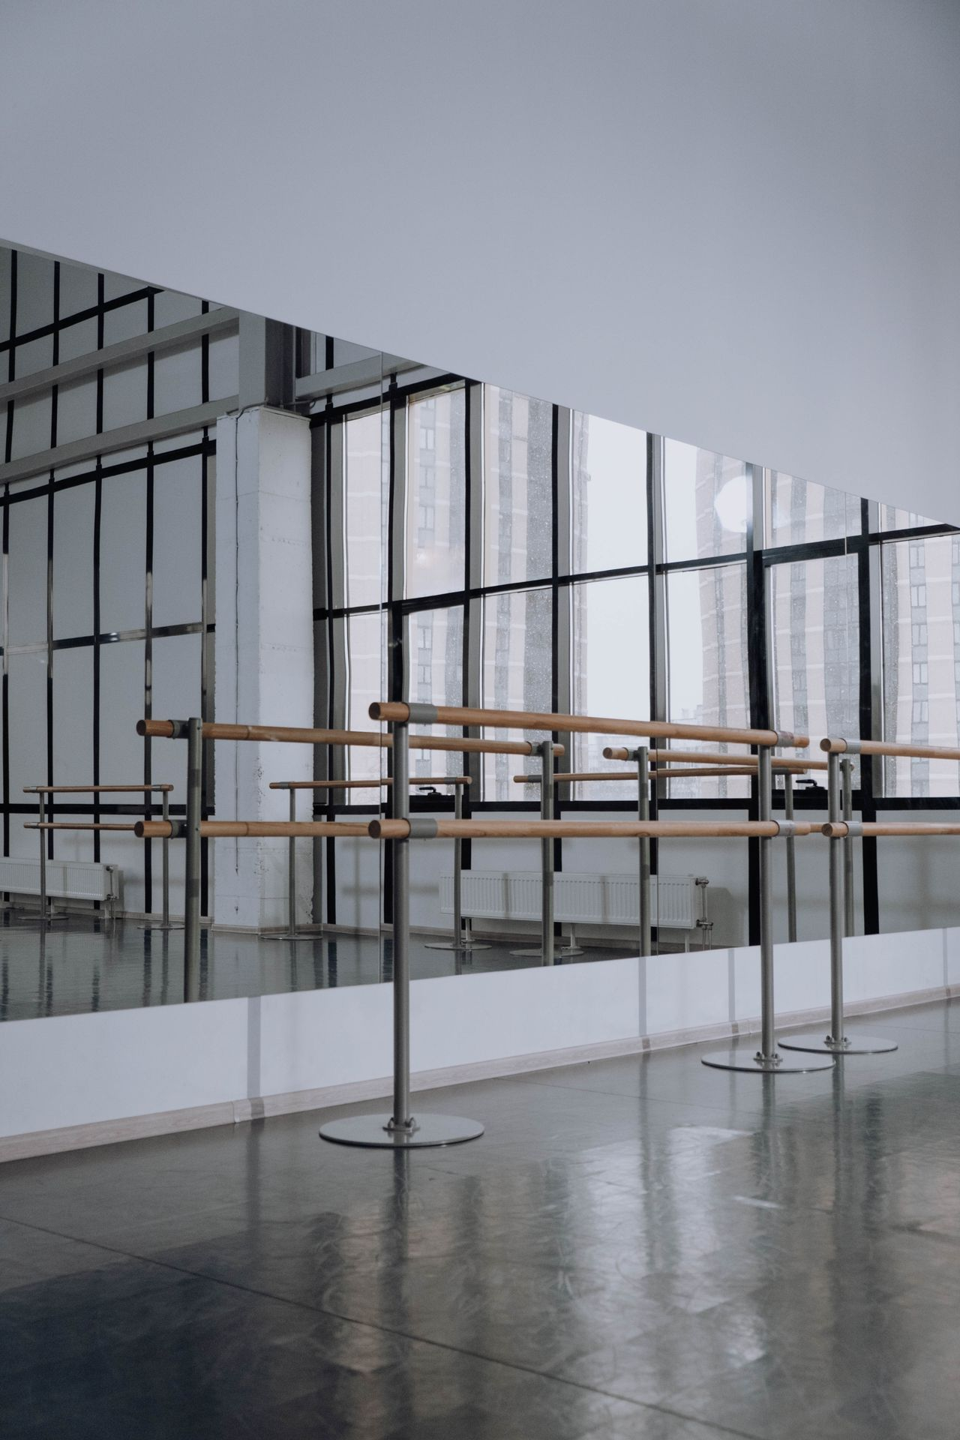
GULF COAST BALLET
2026 to 2027
Season
Artistic vision and company plan. Daniel Brooks, Artistic Director.

Slide 2
THE YEAR AHEAD
Six Productions
OCTOBER 14 TO 25, 2026
DECEMBER 11 TO 23, 2026
JANUARY 22 TO FEBRUARY 1, 2027
Swan Lake
The Nutcracker
Coppelia
Tchaikovsky
Tchaikovsky
Delibes
FEBRUARY 19 TO 28, 2027
APRIL 16 TO 25, 2027
MAY 14 TO 23, 2027
Contemporary Triple Bill
Don Quixote
Spring Program
Mixed program, new work
Minkus
Mixed program

Slide 3
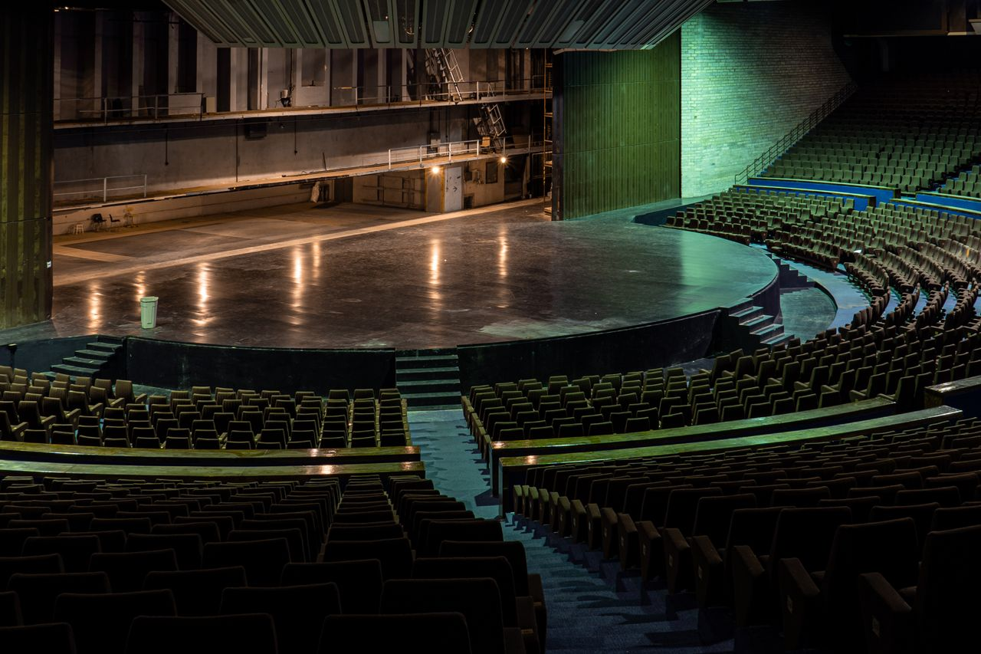
SEASON OPENER
Swan Lake
The company returns to the Gulf Coast Performing Arts Center for eight performances of Tchaikovsky's masterwork. Opening night is October 14, 2026.
PERFORMANCES
MINUTES
DANCERS
8
140
38

Slide 4
THE COMPANY
Thirty Eight Dancers
A company built to grow
Twelve principals and soloists lead the repertoire, fourteen dancers fill the corps, and twelve apprentices train toward contracts. Three principal contracts renew for the new season.

Slide 5
THE ACADEMY
Summer Intensive Enrollment
PLACES FILLED
26 of 40
TUITION PER PLACE
2,800
Ages fourteen to eighteen, with a limited number of merit scholarships.

Slide 6
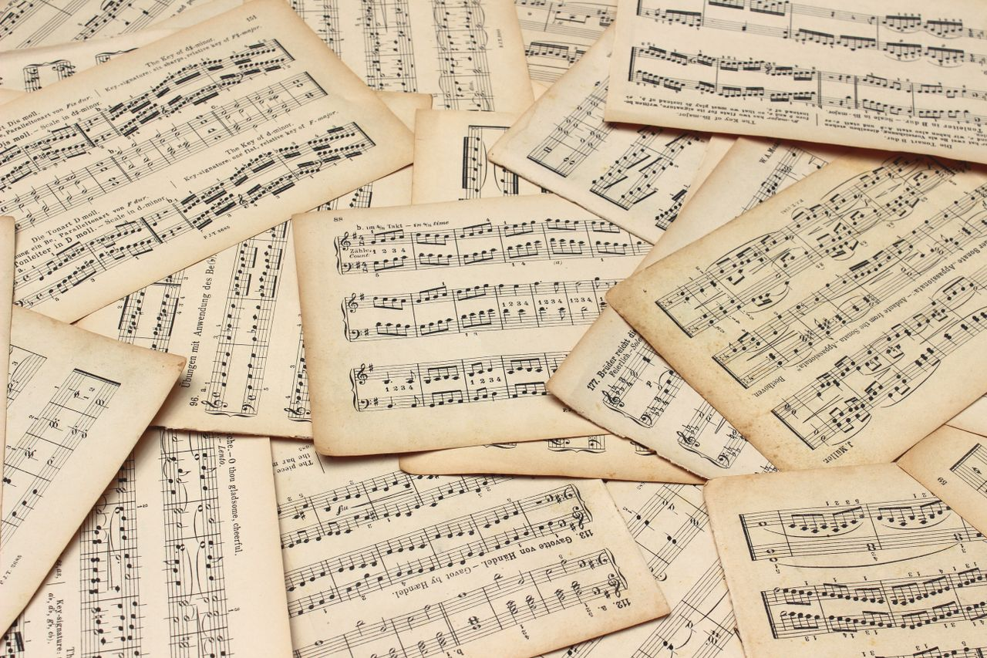
NEW WORK
An Original Pas de Deux
Set to a Ravel slow movement, roughly six minutes. It opens with the woman alone in stillness and ends on a held breath, the lights fading before the final note. Set first in company class with Tatiana Sokolov, then carried to the spring program and, in part, to the gala courtyard.

