Slide 1
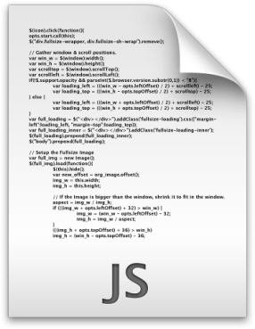
transform
target code
invoke
transformed code
invoke
override
API
analysis.js
third-party Plugin

