Slide 1
Whose 15-Minute City?
Walkable access to everyday services in Singapore's residential subzones
TBA4220 Geospatial Analysis · Group 3 (Metropolitans)
Qu Haotian · Hew Xing Yi · Zachary Chng Yao Wei · Coltrane Yao Zhiming
Notes:
Walkable access to everyday services in Singapore, and whether it differs between towns planned in different eras.

Slide 2
One target question, built from three analyses
Target question
1
Q1 Spatial structure
How is each category of service structured in space?
What kinds of neighbourhood exist in Singapore by walkable access to everyday services, and does the same set appear in towns planned in different eras?
Sets how Q3 must resample: whole blocks, not single subzones.
2
Q2 Drivers
What explains access, and how much is just density?
Decides whether Q3 removes density first, and supplies residuals.
Eras: HDB's mature and non-mature towns, a classification retired in 2024 and used here as a fixed historical grouping.
3
Q3 Types
Which kinds exist, and do old and new towns share them?
Answers the target question.
Notes:
Singapore's LTMP aims for 20-minute towns. We ask what kinds of neighbourhood exist by walkable access, and whether old and new HDB towns have the same ones. Q1 and Q2 each set a rule that Q3 follows.

Slide 3
The pipeline runs in a fixed sequence
1
2
3
4
5
6
Prep data
Access score
Coverage check
Q1 Spatial
Q2 Drivers
Q3 Types
Subzones, census, OSM facilities and buildings, all in SVY21
Services within 1 km of where residents live, weighted by spending
How much of a complete register does OSM hold?
Moran's I and LISA per category
OLS, then a spatial lag model
k-means, tested against chance
What each stage hands on
Score → all three questions: one score per category and a composite for 201 residential subzones
Coverage → Q1: a per-subzone mapping-quality flag. Q1 → Q2, Q3: the neighbour network and 31 planning-area blocks
Q2 → Q3: the density share (cluster raw or adjusted scores?) and residuals for the under-service test
Notes:
Each stage reads only what the stages before it wrote. Rscript R/run_all.R rebuilds every output from the raw data in about 75 seconds.

Slide 4
How access is measured
1
Four steps from open data to one score per residential subzone
Notes:
Four steps turn raw layers into one score per residential subzone.

Slide 5
Six open datasets feed the analysis
Unit
People
Facilities
URA Master Plan 2019 subzones
Census of Population 2020
OpenStreetMap, 2 Nov 2026
332 polygons; the unit of every analysis
Residents by subzone, age and dwelling type
21,284 scored facilities and the residential buildings
Weights
Benchmark
Control
Household Expenditure Survey 2023
ECDA preschool register
URA rail station layer
Monthly spending by category, which sets the weights
A near-complete list to test how much OSM misses
Distance from each subzone to rail, used in Q2
Notes:
All layers are projected to SVY21 (EPSG:3414), so distances are in metres. Every raw file is logged with its URL, download date, md5 and licence in docs/data_log.md.

Slide 6
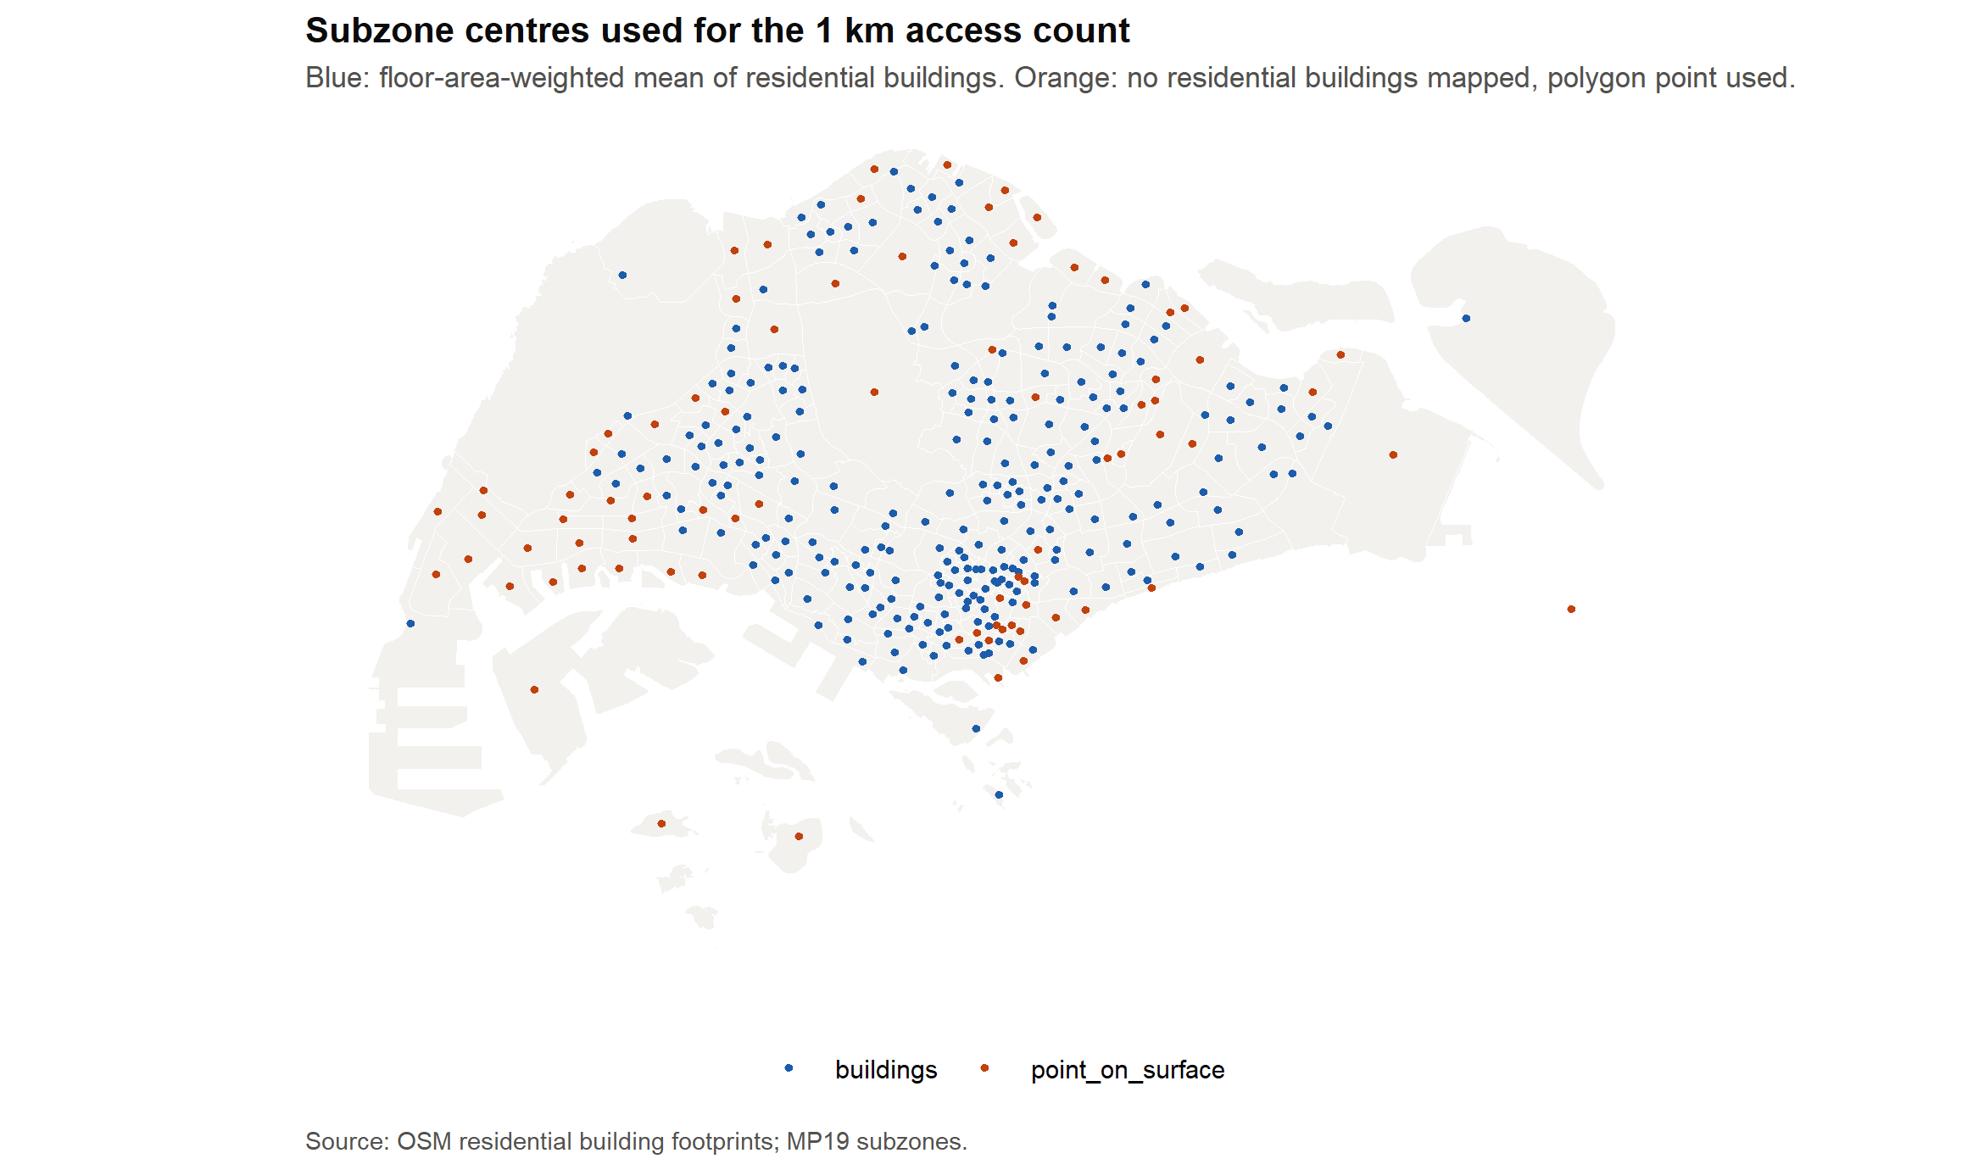
Steps 1–2: residential subzones and their centres
1
Keep subzones with at least 1,000 residents
201
99.65%
of 332 subzones kept
of all residents
Airports, reservoirs, ports and industrial estates drop out.
2
Centre on where residents live
Each subzone's centre is the floor-area-weighted mean of its OSM residential buildings (footprint × storeys). Worker dormitories are excluded, since the census counts only residents.
Notes:
A polygon centroid can fall in a reservoir or outside an L-shaped subzone, so the centre is weighted by where the residential floor area actually is.

Slide 7
Step 3: count services within 1 km, on one scale
3
Count every OSM facility within 1 km (straight line) of the centre, by category
Category score
100 × log(1 + count) / max
max = the highest log count over the 201 residential subzones, so every category runs 0–100.
Six categories from a published OSM tag lookup, which also writes the download queries
21,284 scored facilities; hospitals, private facilities and alcohol outlets are not scored
A median of 56 food outlets against 9 health facilities, so each category gets its own 0–100 scale
Notes:
Counts differ hugely in scale between categories, so each is log-scaled and divided by its maximum before they are combined. 1 km is a straight line: a known caveat, measured in Appendix A.

Slide 8
Step 4: weight each category by household spending
4
Composite = Σ weight × category score
Three caveats
Spending share is not trip frequency
Spending says nothing about variety within a category, so variety is counted separately
National averages: every subzone is scored on the same basket
Does the basket matter?
0.994
Equal weights rank the subzones almost identically. The basket barely moves the ranking.
Spearman ρ with equal weights
Notes:
Weights are each category's share of 2023 household spending. Composite = sum of weight × category score.

Slide 9
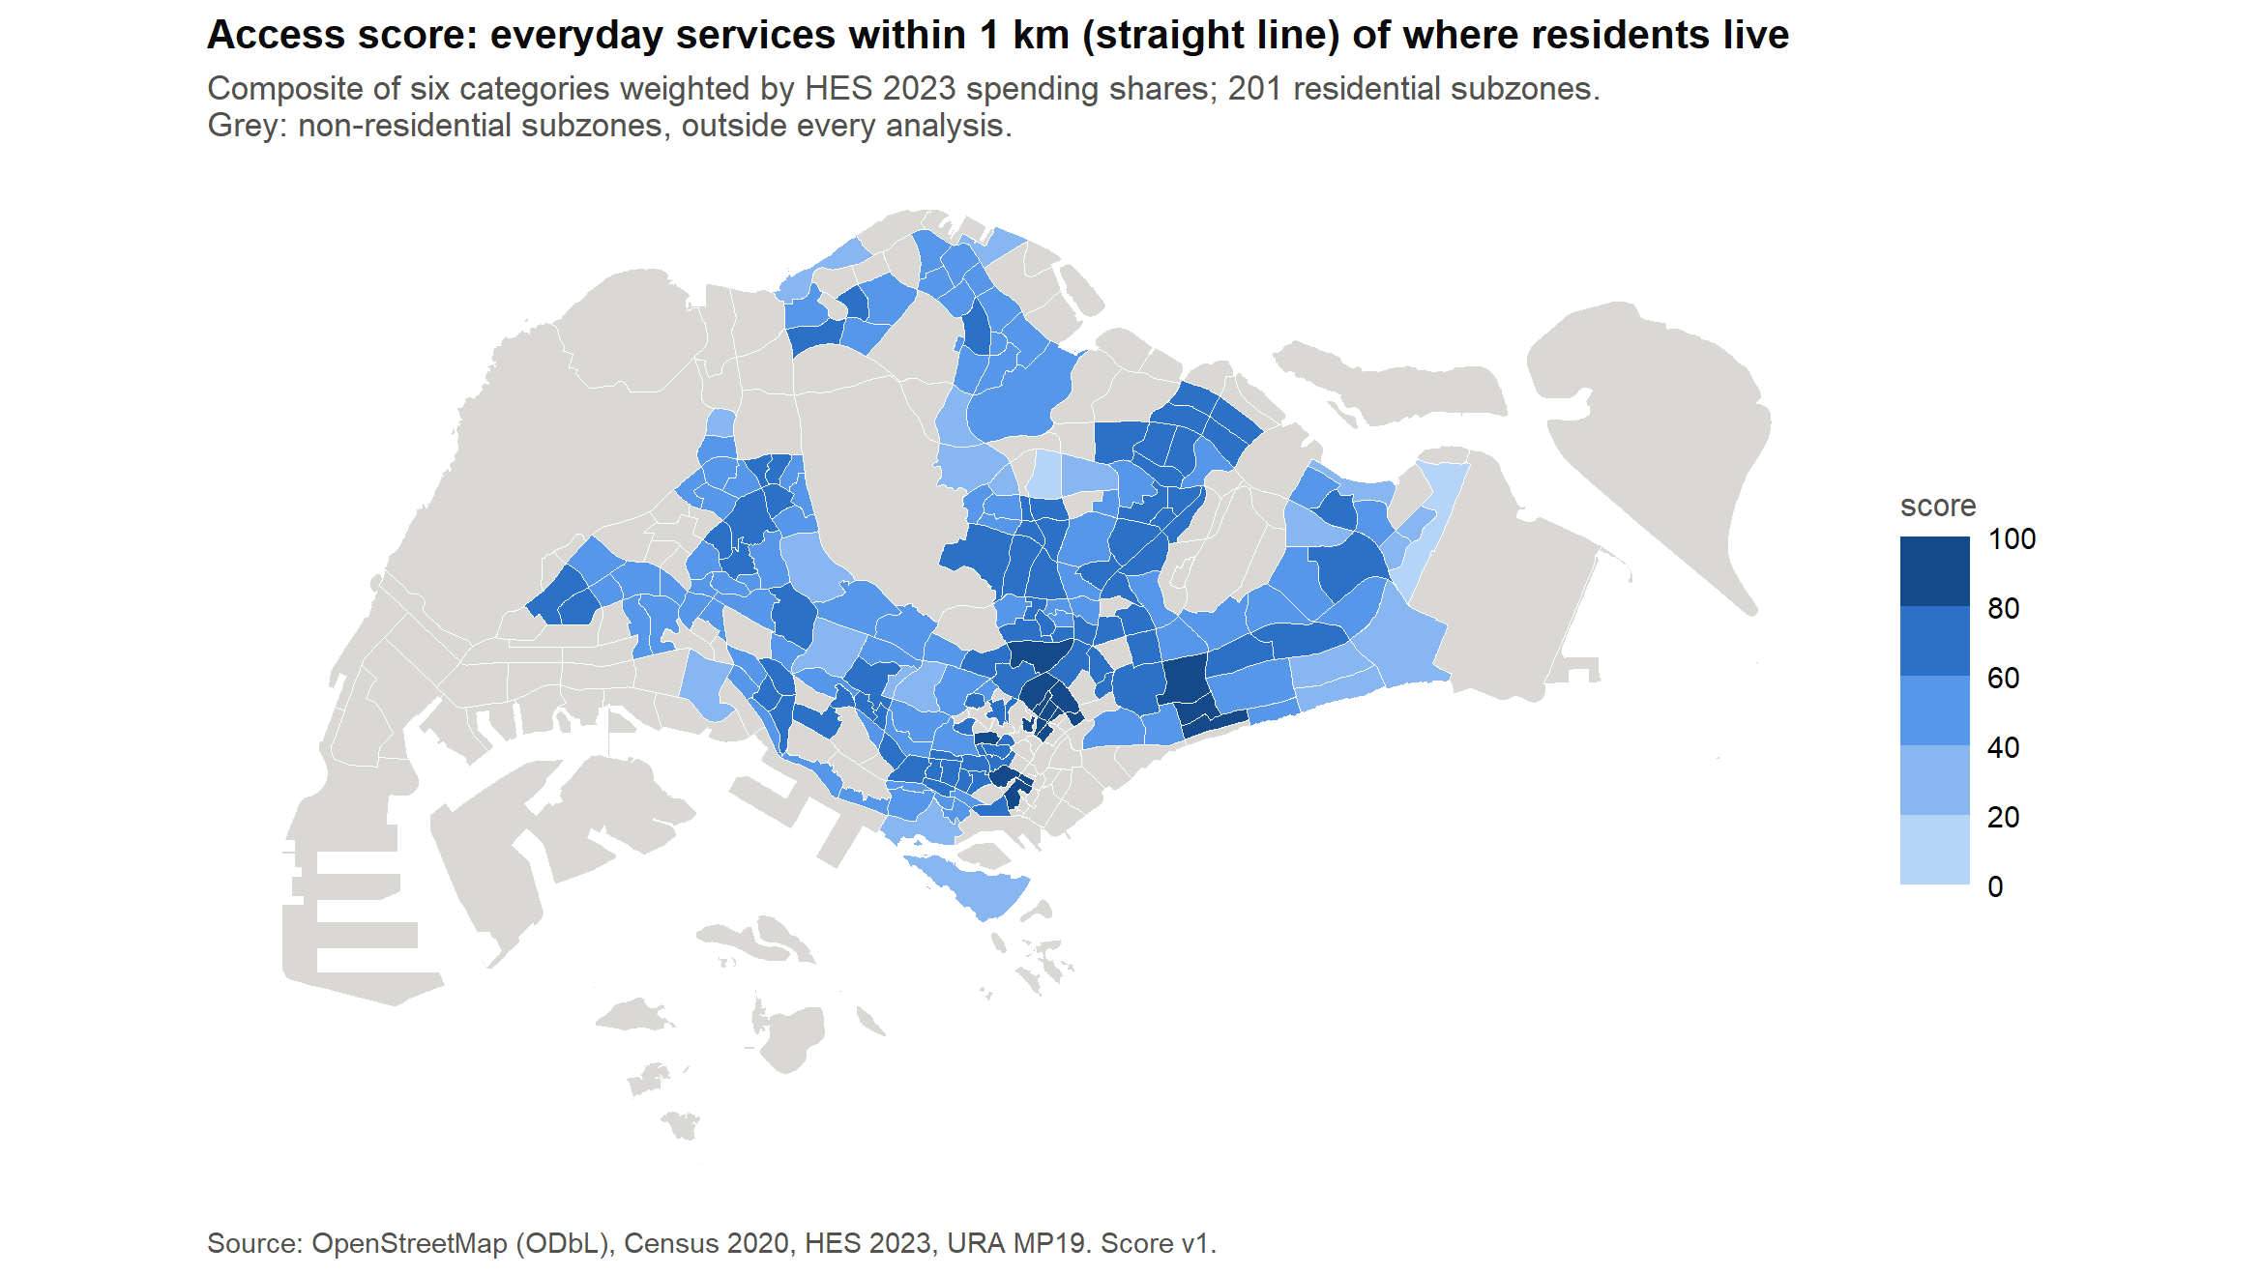
The result: one access score per residential subzone
14 – 97
composite range; median 58.9
Rank agreement with the main score
Equal weights
0.994
800 m radius
0.95
1.2 km radius
0.91
Single subzones move by up to 100 places when the radius changes, so read the map as a relative ranking.
Notes:
Composite ranges 14 to 97, median 58.9. Robust to weights, less so to the radius.

Slide 10
Can we trust OpenStreetMap?
2
A completeness check against ECDA's register of licensed preschools, before any analysis
Notes:
OSM is volunteer-built, so its gaps could bias every later result.

Slide 11
Matching ECDA preschools to OSM, one to one
1
2
3
4
5
ECDA register
Find candidates
Pair one to one
Check by hand
Correct recall
Every licensed preschool, with its address and postcode
OSM preschool within 50 m with a similar name (Jaro-Winkler) or the same postcode; unnamed within 30 m
Hungarian algorithm picks the pairs with the best total score
Stratified sample of 160 matched and unmatched pairs, checked against OSM and operators' pages
Adjust for false matches and false misses, with Wilson intervals
Provisional: 29 of the 160 rows still await a Google Maps check, so the matcher error rates may still move.
Notes:
Preschools are the one category with a near-complete official register. CHAS clinics are a supplementary benchmark only.

Slide 12
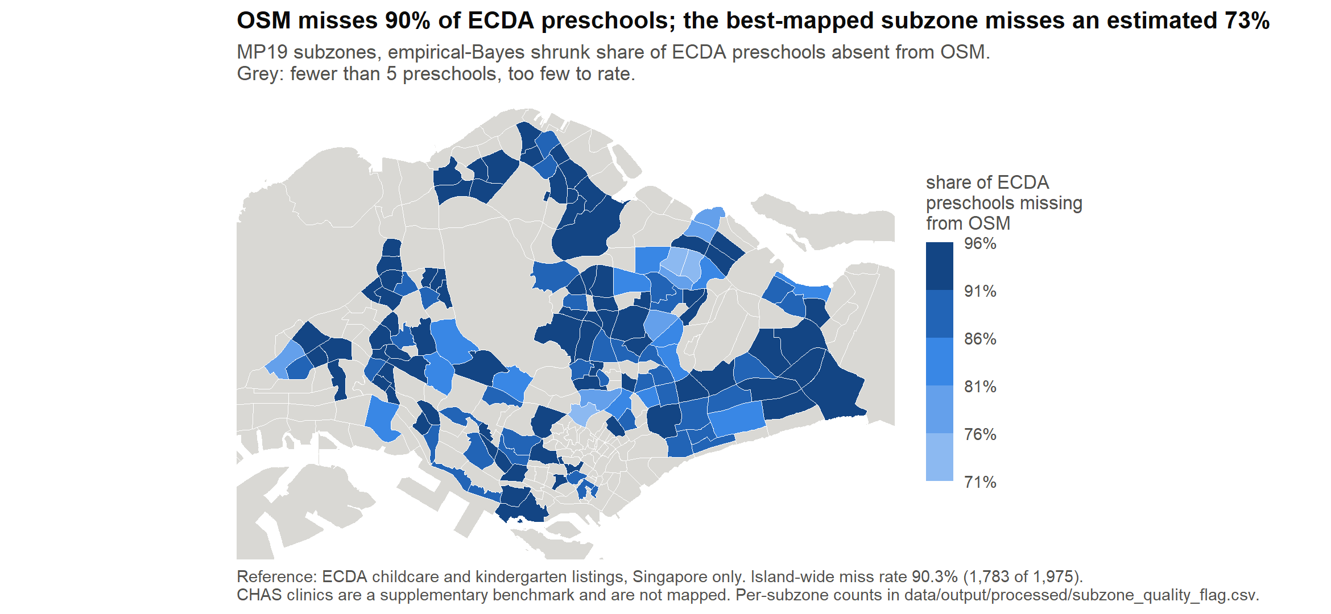
OSM holds 1 in 8 preschools, evenly across town groups
9.7%
12.1%
≈ 17%
CHAS clinics (supplementary): missed clinics do cluster, p = 0.001, so read the health category with care.
of ECDA preschools matched (95% CI 8.5–11.1%)
after matcher correction (9.3–21.9%)
counting buildings tagged kindergarten
No gap between town groups: 90.9% vs 90.1% missed, p = 0.606; a 3.8-point gap was detectable at 80% power
Misses are not clustered: random labelling with cross-K, p = 0.318
Logistic odds ratio 0.36 for non-mature towns rests on Sengkang and Hougang; without them 0.83 (p = 0.56)
Uneven within groups: 9 subzones mapped clearly better, 8 clearly worse (empirical-Bayes flag)
Notes:
Low recall, but no detectable gap between mature and non-mature towns. The score is therefore a relative measure: comparisons between subzones hold approximately, absolute counts do not.

Slide 13
Q1: How is access structured in space?
3
H₀: Moran's I = 0, for each category score and for the composite
Notes:
H₀: Moran's I = 0, for each category score and the composite.

Slide 14
Q1 method: neighbours first, then global and local tests
1
2
3
4
Neighbour network
Global Moran's I
Local Moran's I (LISA)
Correct for 201 tests
Queen contiguity on 201 subzones; one island linked to its nearest; 4.8 links on average; row-standardised. k = 6 nearest neighbours as a check
Does each category cluster across the island? 999 permutations per test, so p cannot fall below 0.001
Where are the hot spots, cold spots and outliers? 9,999 conditional permutations
About 10 subzones would look significant by chance, so Benjamini-Hochberg false discovery rate, q < 0.05
31 planning-area blocks (3–16 subzones each) are fixed here and reused for resampling in Q2 and Q3.
Notes:
The network is built after dropping non-residential subzones, so a reservoir never counts as a neighbour. Q2 and Q3 reuse the same network and blocks.

Slide 15
Every category clusters in space
0.47 – 0.57
Moran's I, queen weights (composite 0.55)
H₀ rejected for all seven: every p sits at the 0.001 permutation floor
Well-served subzones sit next to other well-served subzones
The kNN check gives the same answer (0.36–0.51)
Notes:
Moran's I 0.47–0.57 with queen weights, every p at the 0.001 floor. H0 rejected for all seven. kNN agrees at 0.36–0.51.

Slide 16
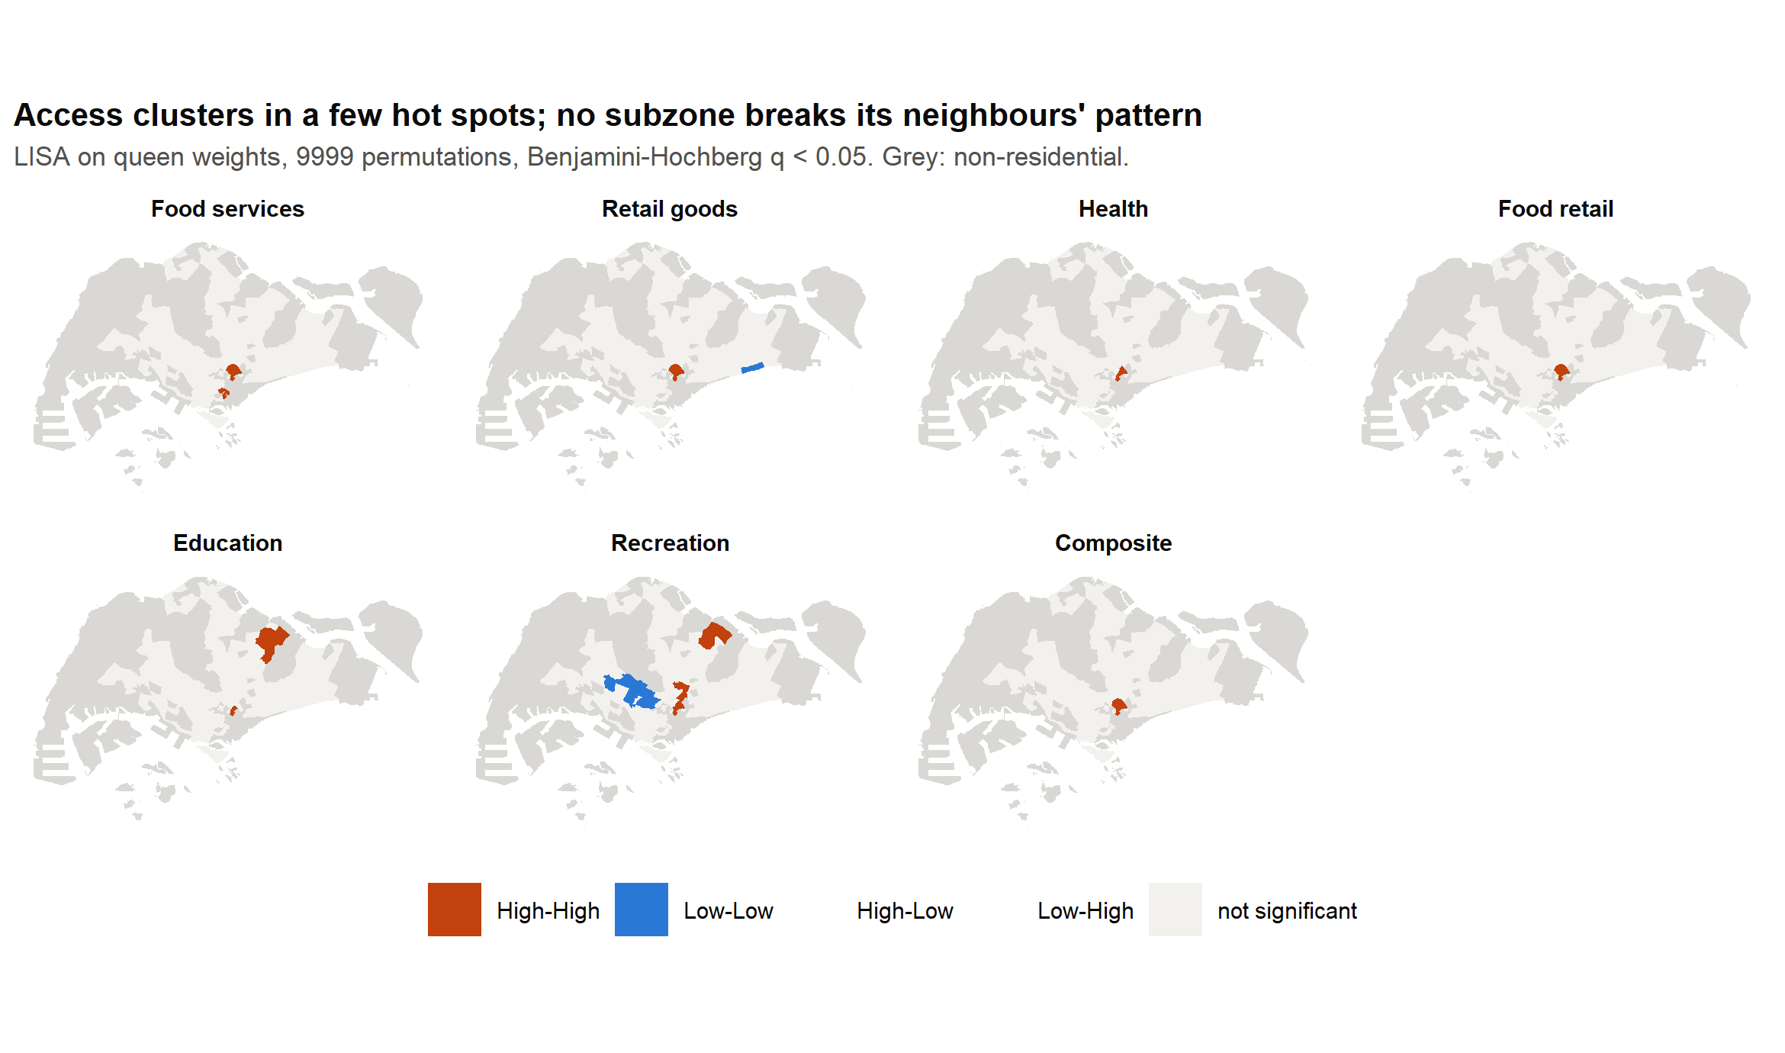
Hot spots sit in the centre, with no isolated outliers
Centre: every map has a hot spot in Kallang, Outram and Rochor (7 subzones for the composite)
North-east: education and recreation hot spots in Punggol, Sengkang (and Hougang), where OSM maps best: 79% of preschools missed against 90% island-wide
Cold spots: only recreation has some (8 Low-Low)
For Q3: all six categories are contiguous, so stability must be judged by resampling whole blocks
Notes:
After FDR correction almost every significant subzone is High-High. No High-Low or Low-High outlier in any category.

Slide 17
Q2: What explains access?
4
H₀: elderly share and housing mix do not lower the composite score (one-sided, coefficient ≥ 0)
Notes:
H0: elderly share and housing mix do not lower the composite score.

Slide 18
Q2 method: from OLS to a spatial lag model
Tested (one-sided)
1
2
3
4
Elderly share (65+)
Housing mix: share in HDB 1–3 room flats, an income proxy
OLS
Residuals cluster
Robust LM tests
Spatial lag model
201 subzones, 5 predictors. R² = 0.53; largest VIF 2.2
Moran's I 0.28, p < 0.001: errors are not independent
Favour lag (p < 0.001) over error (p = 0.417)
Lowest AIC: 1,468 vs 1,485 (error) and 1,525 (OLS); ρ = 0.54
Controls
Log population density
Distance to the nearest rail station
OSM mapping effort (mappers per km²)
The planned spatial error model gives the same conclusion (one-sided p = 0.87 and 0.51).
Notes:
Predictors are standardised, so coefficients are score points per SD. In a lag model a coefficient is not a marginal effect, so total impacts (coefficient times about 2.2) are reported.

Slide 19
No equity effect; rail and density drive access
Predictor | OLS b | OLS p | Lag total impact | Lag p
Elderly share (65+) | 0.25 | 0.595 | 1.41 | 0.771
Housing mix (HDB 1–3 room) | 0.12 | 0.542 | -1.12 | 0.284
Log population density | 2.29 | 0.012 | 5.71 | 0.003
Distance to rail | -4.09 | < 0.001 | -7.13 | < 0.001
OSM mapping effort | 7.58 | < 0.001 | 8.75 | < 0.001
How much is just density?
0.32
density's share of the model's R² (0.17 of 0.53)
Below the 0.5 threshold fixed in advance, so Q3 clusters on the raw category scores: a typology built on them is not just density under another name.
p is one-sided for the two tested variables (bold) and two-sided for the controls.
H₀ not rejected for either tested variable, in OLS, lag and error models. Across the six categories the smallest p is 0.031, or 0.37 after Holm
Mapping effort is partly mechanical: without it the elderly coefficient grows from 0.25 to 2.52, the opposite of the tested sign
Residuals go to Q3 for the under-service test.
Notes:
Neither tested variable lowers access in any model. Distance to rail and density matter. Density explains about a third of the model, below the 0.5 threshold fixed in advance.

Slide 20
Q3: What kinds of neighbourhood exist?
5
H₀(a): the type mix is the same in mature and non-mature towns
H₀(b): type membership is unrelated to Q2's residuals
Notes:
H0(a) type mix same in mature and non-mature towns; H0(b) type unrelated to Q2 residuals.

Slide 21
Q3 method: cluster, then test the clusters against chance
1
2
3
4
5
Standardise
k-means
No-cluster null
Block bootstrap
Block permutation
Six category scores as z-scores, so each weighs equally
k chosen by the highest mean silhouette; recovers 3 planted groups in a test
Same rule on 200 simulated datasets with the real correlations but no groups
Resample the 31 blocks 200 times; a group is stable if Jaccard ≥ 0.75
H₀(a): swap town labels between blocks. H₀(b): permute residuals within blocks
Q2 decided the input: raw scores, since density explains less than half the model.
Notes:
Silhouette always picks some k of at least 2, even in data with no groups, so the chosen k is compared with structureless data. Q1's clustering means resampling and permutation work on whole blocks.

Slide 22
One gradient, not distinct kinds of neighbourhood
p = 0.47
70%
silhouette 0.356 vs null mean 0.355
of variation on one principal component
0.92–0.93
92 | 109
mean Jaccard: both halves are stable
subzones at the low | high end
A cut through a continuum is also stable, so stability confirms a repeatable split, not distinct types.
Notes:
k = 2 wins the silhouette, but the real data separate no better than data with no groups. Every category is 0.5 to 0.8 SD below average at the low end: the groups differ in level, not mix.

Slide 23
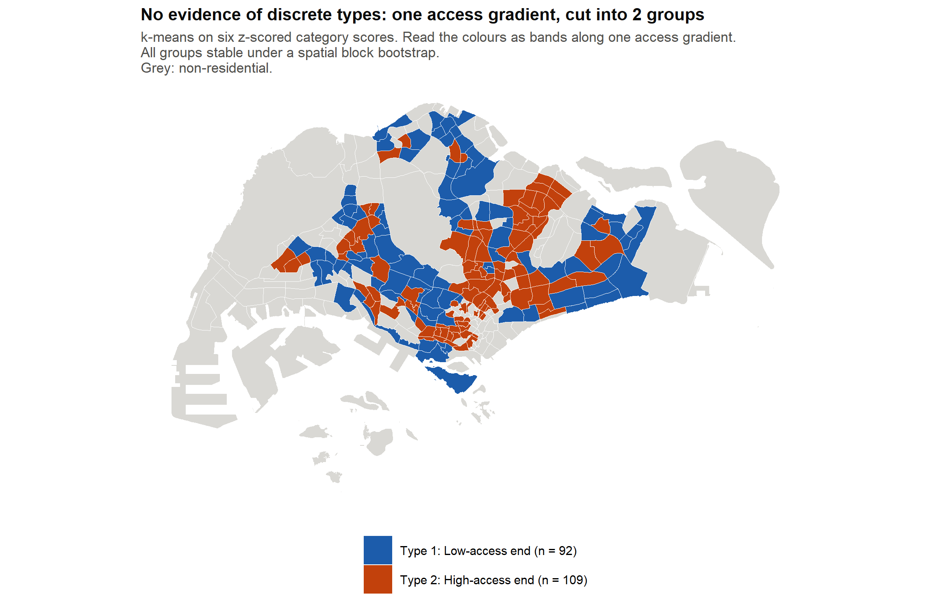
Old and new towns sit alike on the gradient
H₀(a): not rejected
The low-access end holds 42.5% of mature-town and 55.7% of non-mature subzones, a 13.2-point gap. Block permutation: χ² = 2.97, p = 0.27. Only 26 blocks, so this is no evidence of a difference, not evidence of equal mixes.
H₀(b): rejected by construction
Low end 6.0 points below the Q2 prediction, high end 6.3 above (F = 132.8). Groups cut by score always split the residuals.
Notes:
H0(a) not rejected, though with only 26 exchangeable blocks the test has little power. H0(b) rejects by construction, so it is reported descriptively.

Slide 24
Whose 15-minute city? One gradient, shared by all towns
Singapore's residential subzones spread along one gradient of walkable access, on which every category rises and falls together. Older and newer towns sit alike on it.
Q1
The gradient is spatial
Q2
It is not just density
Q3
It has no natural break
Every category clusters (Moran's I 0.47–0.57); hot spots in the centre; no isolated outliers
Density is a third of the model (0.32); rail matters; no elderly or housing-mix effect
k = 2 separates no better than no groups (p = 0.47); town mixes do not differ (p = 0.27)
For planning: the useful unit is the low-access end of the gradient, which spans both town groups. Town age alone is not a reliable guide to it.
Notes:
Neighbourhoods differ in how much lies within walking distance, more than in what kind. For planning, target the low-access end, which spans both town groups.

Slide 25
Limitations
OpenStreetMap is incomplete
Straight-line distance
Mapping effort is mechanical
The features the score reads hold about 12% of licensed preschools. Comparisons between subzones hold only approximately; absolute counts do not.
Known caveat: 1 km as the crow flies, not along streets. Kept for simplicity; see Appendix A.
Q2's control is counted from the same OSM features; we report the model with and without it.
Dates do not align
H₀(b) cannot discriminate
National spending weights
Residents counted in 2020, facilities mapped in 2026; ECDA records carry a 2021 timestamp.
Groups cut by score level always split the residuals, so it rejects by construction.
No income-specific baskets, though equal weights give near-identical ranks (ρ 0.99).
Notes:
Each limitation is stated in the report's Discussion. The straight-line caveat is examined in the appendix bonus track.

Slide 26
Appendix: bonus track
A
Outside the project scope. Answered after the project with GenAI assistance; kept on its own branch, never merged into master, and not part of the report.
Notes:
Outside the project scope. Answered after the project with GenAI assistance on branch claude/score-a6-calibration-3fcbb3, never merged into master and not part of the report.

Slide 27
A. How far do people really walk for 1 km?
1
2
3
Sample walks
Route on foot
Detour
198 centre-to-facility pairs
OSRM foot server; 194 kept
Walk ÷ straight line
1.51
≈ 661 m
median detour (IQR 1.39–1.79)
straight line reached by a 1 km walk
Notes:
198 walks from subzone centres to scored facilities were routed on the public OSRM foot server; 194 kept (4 snapped more than 100 m off the network). Detour = walking distance / straight-line distance.

Slide 28
A. What the detour means for the results
Absolute counts overstate a 1 km walk: a circle of about 660 m would match one
Rankings should hold: the 800 m variant keeps rank order at Spearman 0.95 with the main score
Town groups barely differ (1.50–1.53), so the mature vs non-mature comparison is not biased by detours
1.51 is likely an upper estimate: OSM misses many through-block links (void decks, mall interiors), and OSRM routes on the live graph
Not checked: a rerun of the score at 660 m
Notes:
The 1 km circle is closer to a 1.5 km walk. Rankings should hold; absolute within-a-walk claims should be read as straight-line reach.

