Slide 1
QR Code Implement
Zxing Code on Raspberry Pi4
Speaker : Yi Tse Wu

Slide 2
Program Resource Usage
Use Linux Command, “time”
Use Memory Analysis Tool, “Valgrind”
Notes:
sudo g++ "%f" -o %e `pkg-config --cflags --libs zxing`

Slide 3
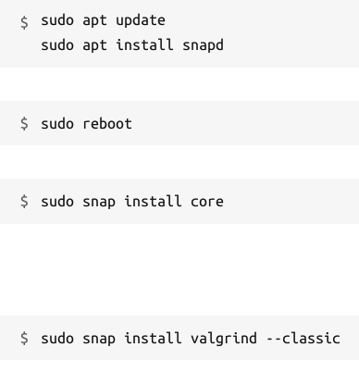
Valgrind
Valgrind is an instrumentation framework for building dynamic analysis tools. There are Valgrind tools that can automatically detect many memory management and threading bugs, and profile your programs in detail. You can also use Valgrind to build new tools.
Introduction
Installation
Command
valgrind --tool = SelectTool ./ReadQrcode_V1
Tool :
memcheck : Memory Error and Memory Leak
massif : Stack + Heap
Notes:
sudo g++ "%f" -o %e `pkg-config --cflags --libs zxing`

Slide 4
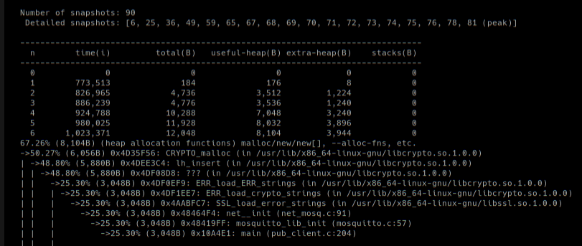
Valgrind
Notes:
sudo g++ "%f" -o %e `pkg-config --cflags --libs zxing`

Slide 5
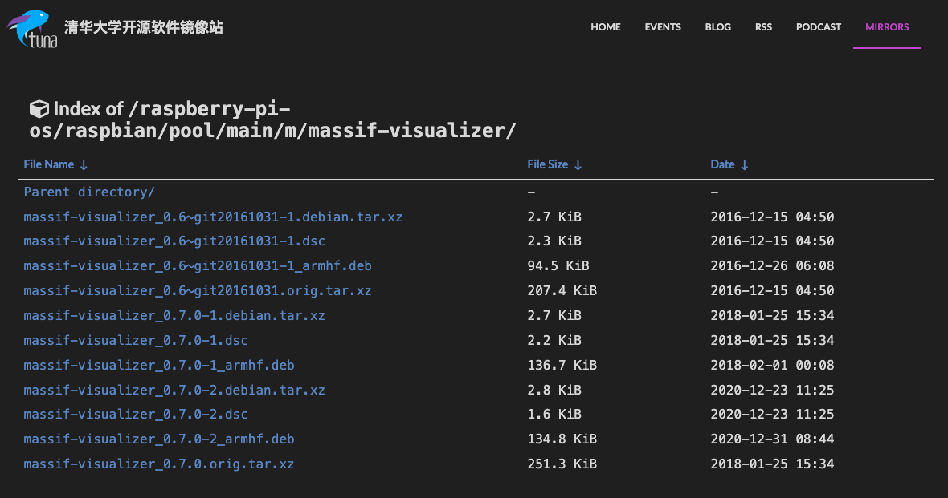
massif-visualizer
Notes:
sudo g++ "%f" -o %e `pkg-config --cflags --libs zxing`

Slide 6
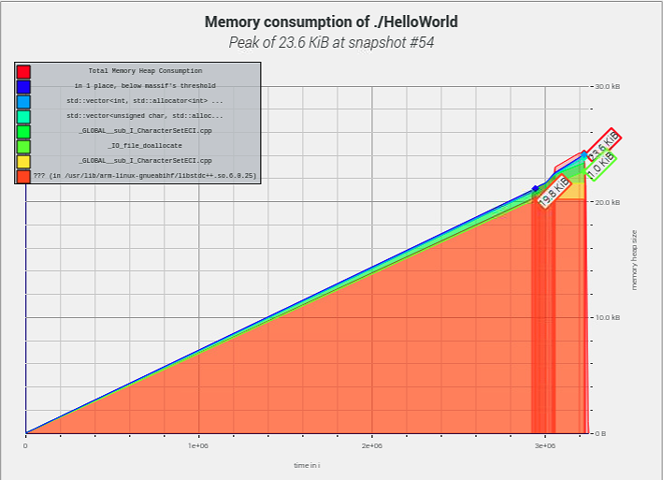
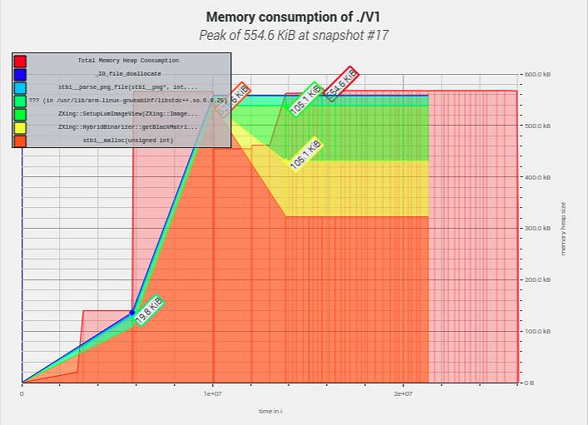
Comparison Figure 1
Notes:
sudo g++ "%f" -o %e `pkg-config --cflags --libs zxing`

Slide 7
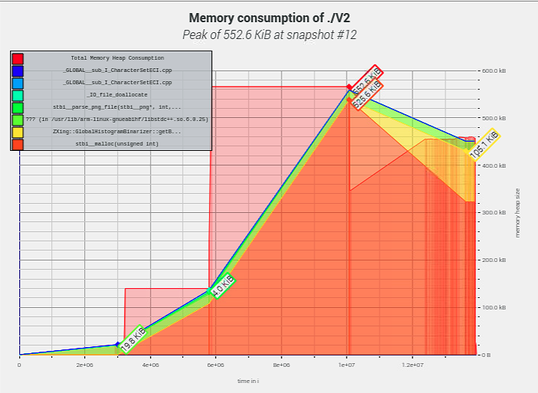
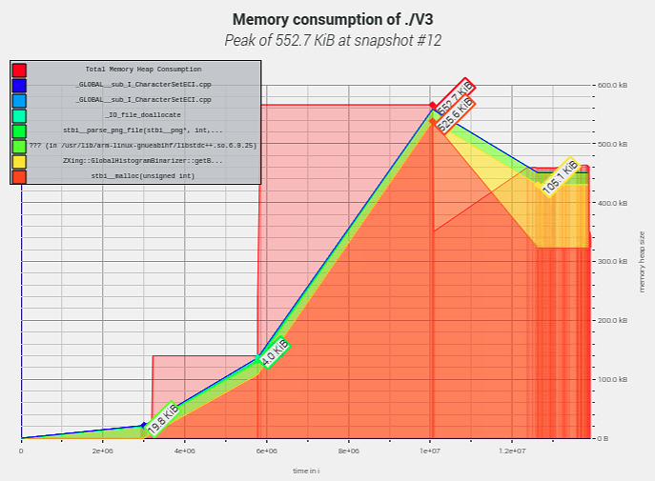
Comparison Figure 2
Notes:
sudo g++ "%f" -o %e `pkg-config --cflags --libs zxing`

Slide 8
Comparison Table, Read a 328 * 328 QR Code
Code | Memory Usage | Time | EXE File Size
V1 : General | 554.6 KB | 0.039 s | 150.6 KB
V2 : Just QR Code | 552.6 KB | 0.037 s | 168.1 KB
V3 : Optimize | 552.7 KB | 0.033 s | 164.3 KB
Hello World | 23.6 KB | 0.015 s | 8.7 KB
Notes:
sudo g++ "%f" -o %e `pkg-config --cflags --libs zxing`

