Slide 1
QR Code Implement
Zxing Code on Raspberry Pi4
Speaker : Yi Tse Wu

Slide 2
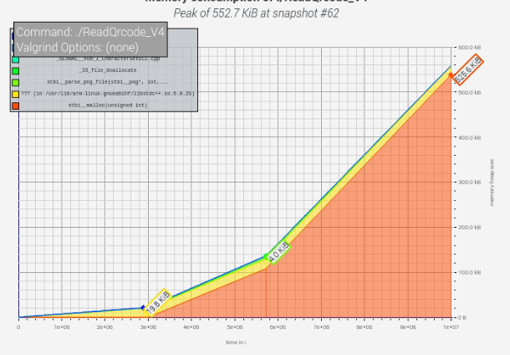
Loading image consumes huge memory
Just Stb_load
Memory usage peak is 525.6 KB
All memory is 552.7 KB
Notes:
sudo g++ "%f" -o %e `pkg-config --cflags --libs zxing`

Slide 3
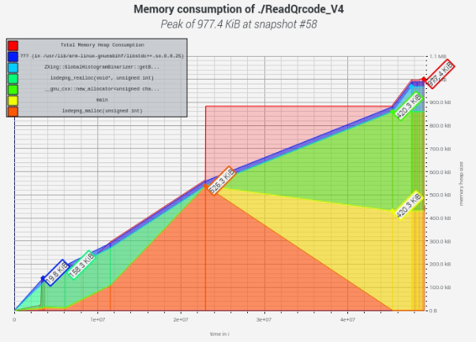
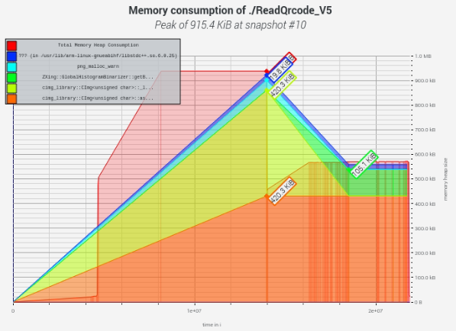
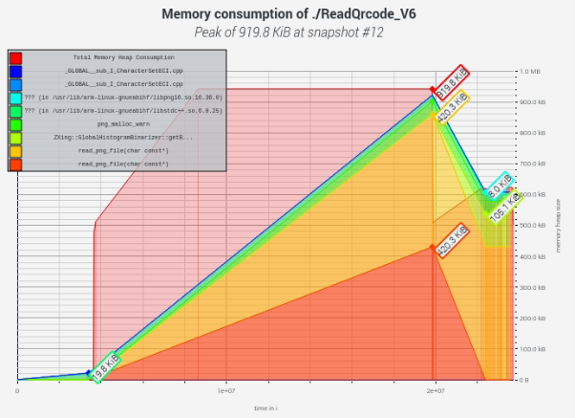
Other image reading library
lodepng CImg libpng
977.4 KB
915.4 KB
919.8 KB
Notes:
sudo g++ "%f" -o %e `pkg-config --cflags --libs zxing`

Slide 4


RGB to grayscale image
Notes:
sudo g++ "%f" -o %e `pkg-config --cflags --libs zxing`

Slide 5
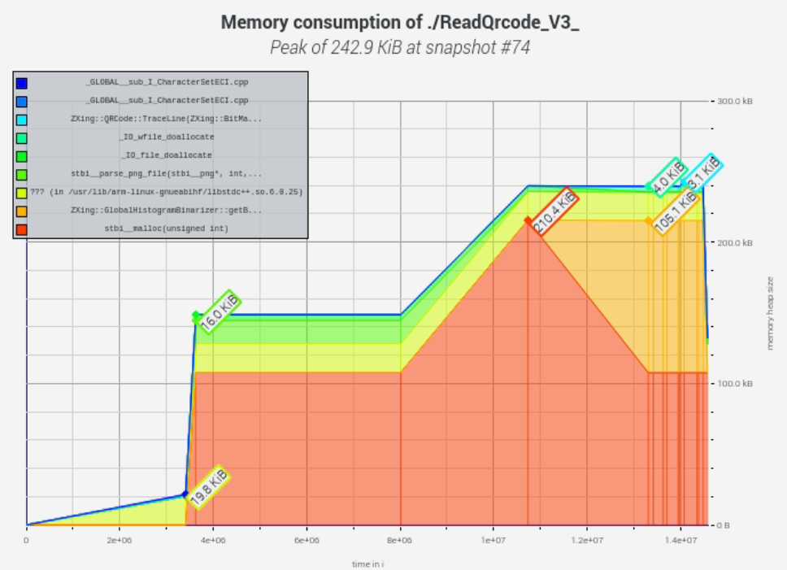
Grayscale image make memory lower
Use Stb_load to load gray img
Memory usage peak is 242.9 KB
Notes:
sudo g++ "%f" -o %e `pkg-config --cflags --libs zxing`

Slide 6
Lower memory usage ?
Notes:
sudo g++ "%f" -o %e `pkg-config --cflags --libs zxing`

