Slide 1
QR Code Implement
Zxing Code on Raspberry Pi4
Speaker : Yi Tse Wu

Slide 2
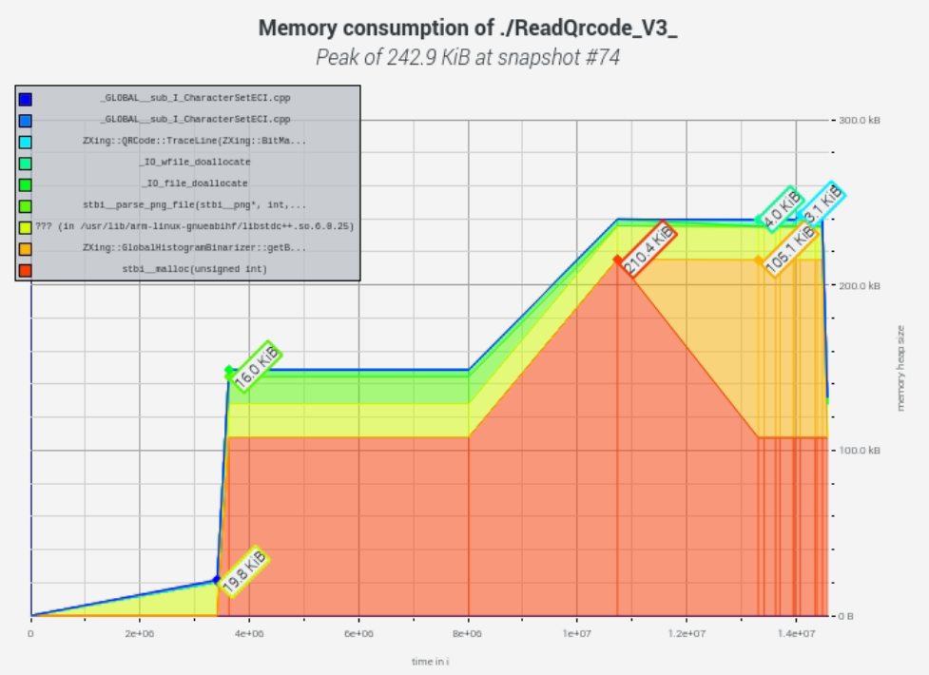
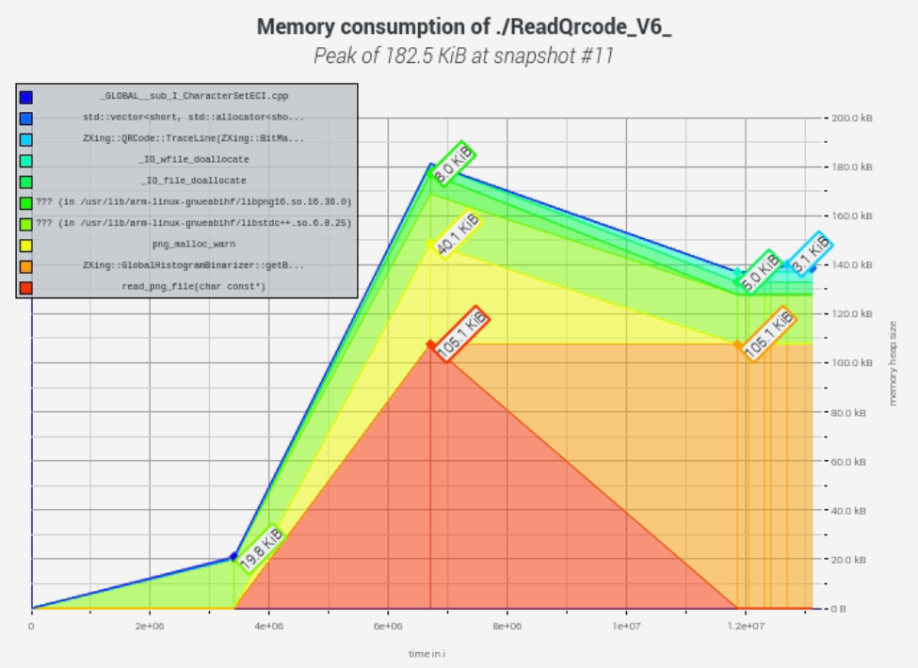
Lower Memory Usage
242.9 KB
182.5 KB
Notes:
sudo g++ "%f" -o %e `pkg-config --cflags --libs zxing`

Slide 3
ZXing Read Image Usage Resource
Notes:
sudo g++ "%f" -o %e `pkg-config --cflags --libs zxing`

