Slide 1
QR Code Implement
Zxing Code on Raspberry Pi4
Speaker : Yi Tse Wu

Slide 2
Lower Memory Usage
Notes:
sudo g++ "%f" -o %e `pkg-config --cflags --libs zxing`

Slide 3
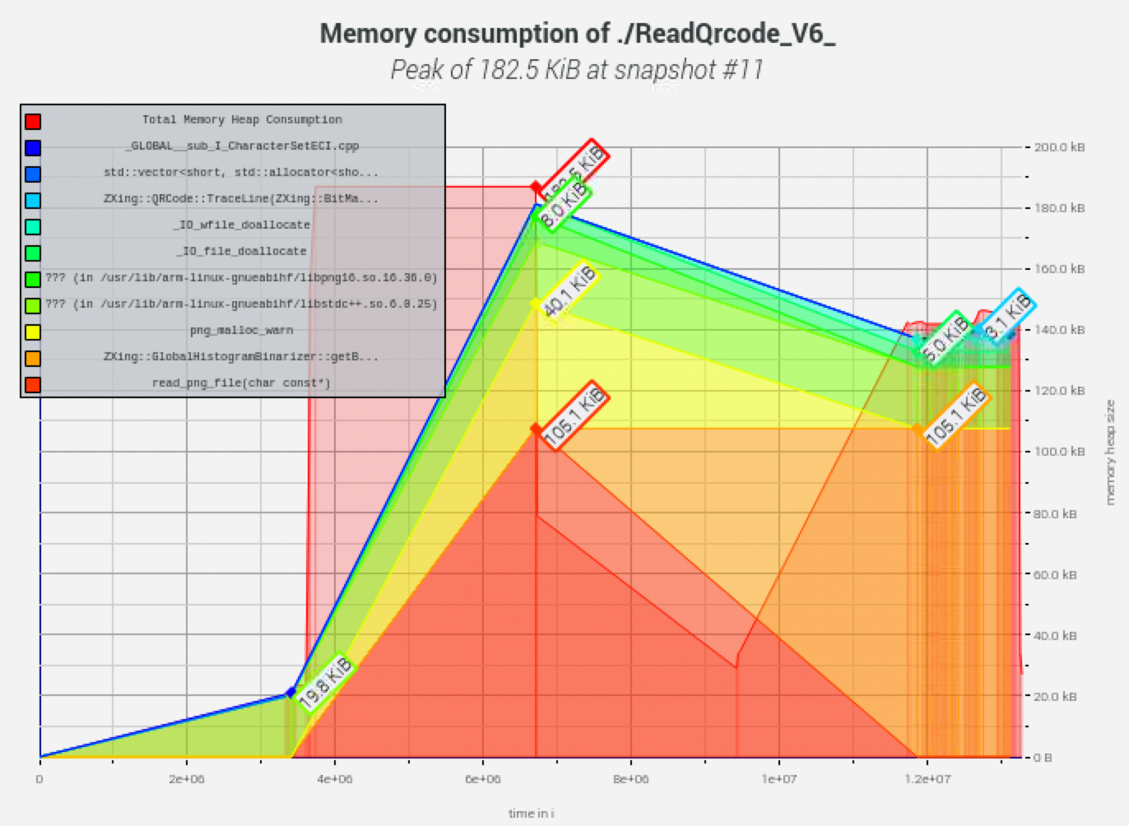
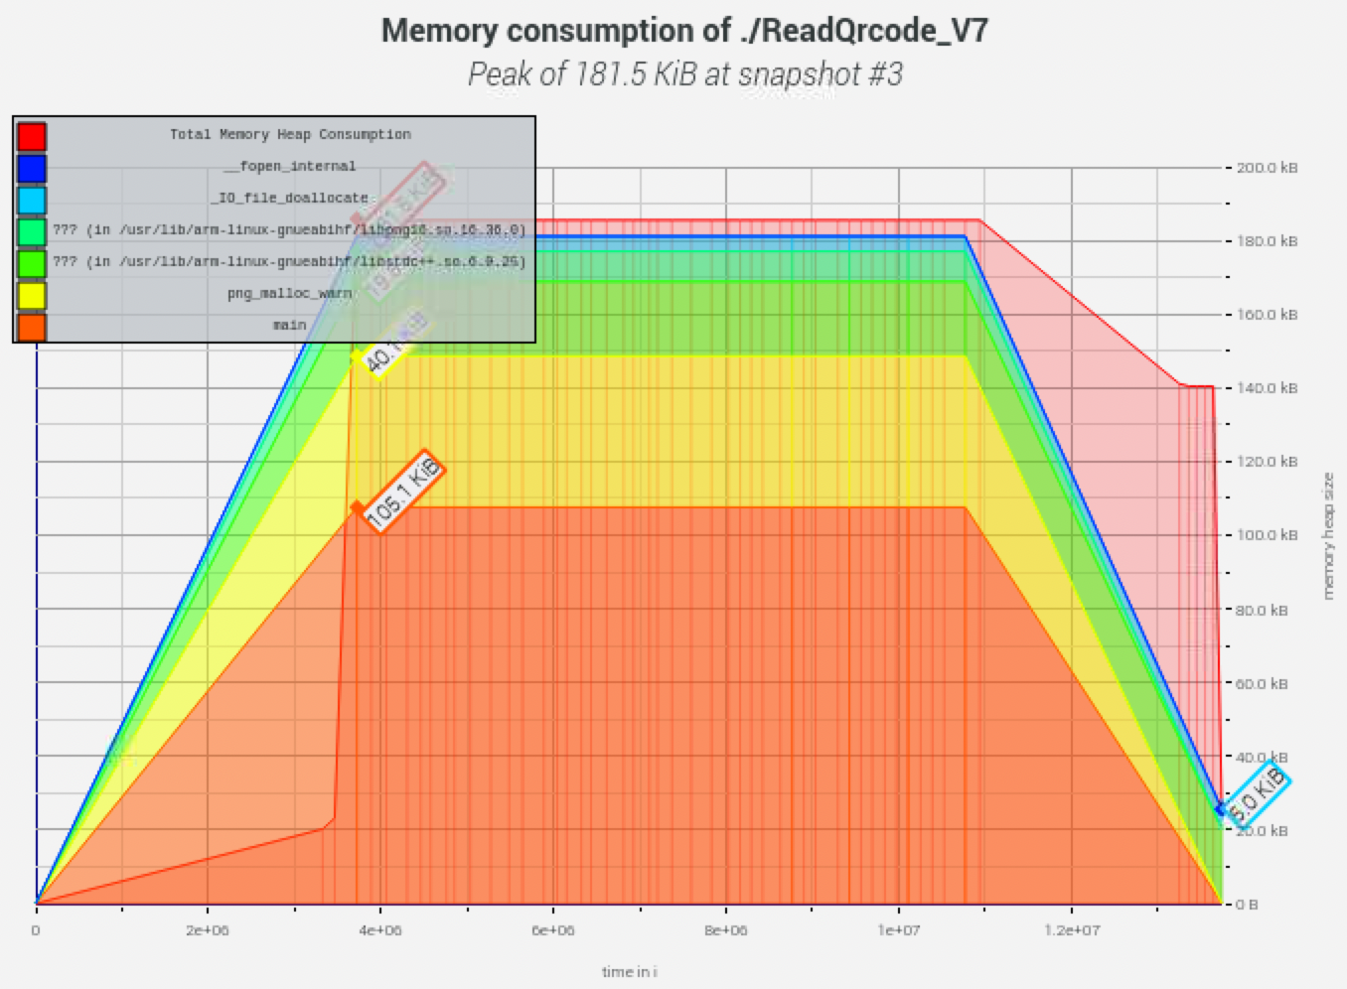
Lower than the Old Version 1 KB
182.5 KB
181.5 KB
Notes:
sudo g++ "%f" -o %e `pkg-config --cflags --libs zxing`

Slide 4
Table Size
Notes:
sudo g++ "%f" -o %e `pkg-config --cflags --libs zxing`

Slide 5
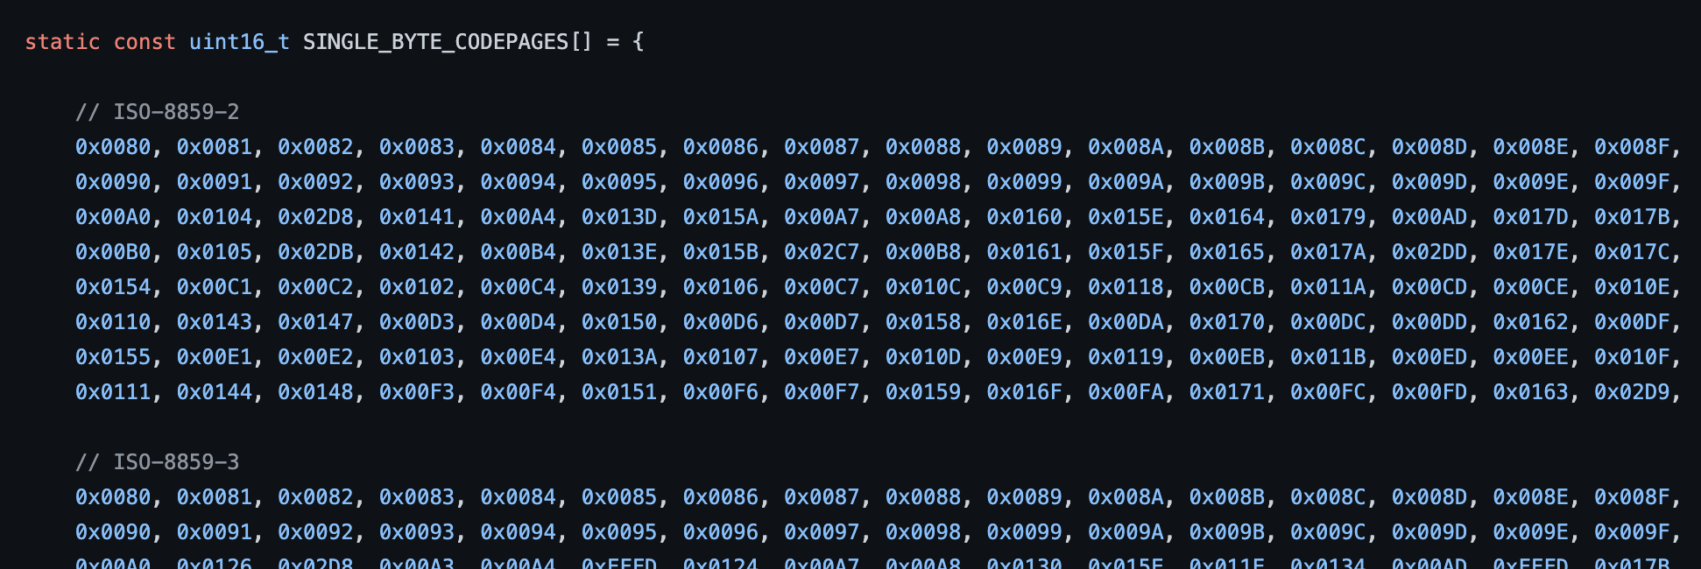
TextDecoder.cpp
https://github.com/nu-book/zxing-cpp/blob/master/core/src/TextDecoder.cpp
ISO-8859-2
ISO-8859-3
……
16*8*19*2 = 4864 bytes
Notes:
sudo g++ "%f" -o %e `pkg-config --cflags --libs zxing`

Slide 6
RTOS Research
Notes:
sudo g++ "%f" -o %e `pkg-config --cflags --libs zxing`

Slide 7
ThreadX and Zephyer
ThreadX
Zephyer
Notes:
sudo g++ "%f" -o %e `pkg-config --cflags --libs zxing`

