Slide 1
QR Code Survey
Speaker : Yi Tse Wu

Slide 2
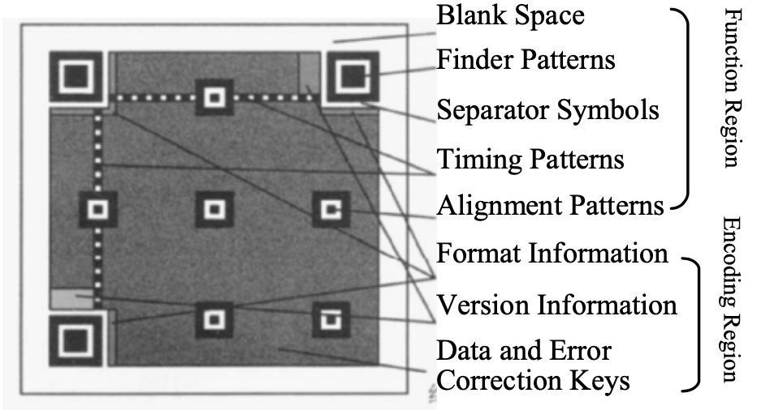
Finder & Alignment & Timing Pattern
For Localization :
Finder pattern
Alignment Pattern
Timing Pattern :
Determine density and version of QR Code symbol, and providing the reference position

Slide 3
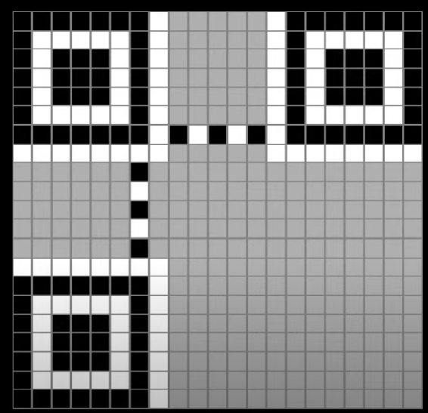
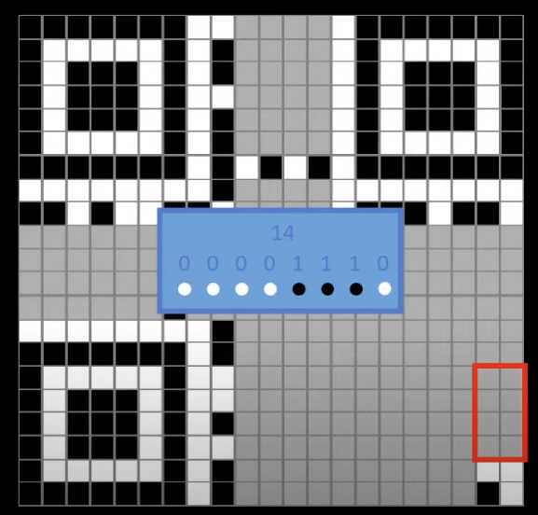
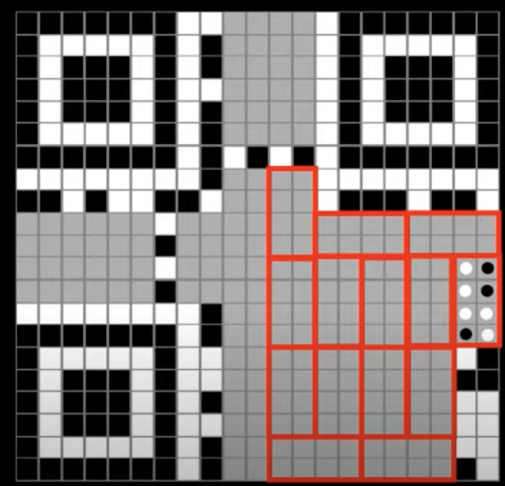
QR Code Formation
(A)
(B)
(C)

Slide 4
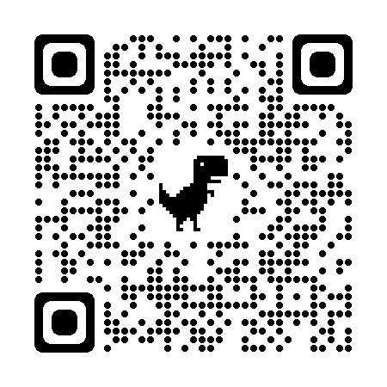
QR Code Formation

Slide 5

The Process of QR Code Recognition
Binarization
Extraction
Perspective
Transformation
Reed-Solomon Error Correction
Decoded Text
Binarization
Location
Affine
Transformation
Obtain Version Number
Version
Decode
Search Alignment Pattern
Calculate Information of region alignment
Sample
Get Bits Stream
Format
Decode
Input Code
Stream

Slide 6

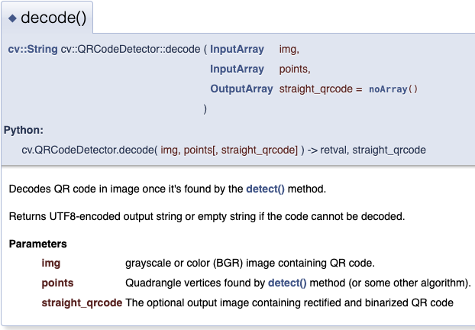

Open Source (Python、C++) for QR Code
Python Code
C++ Code(OpenCV)

