Slide 1
QR Code Survey
Computer Resource Usage Comparison of QR Code Algorithm
Speaker : Yi Tse Wu

Slide 2
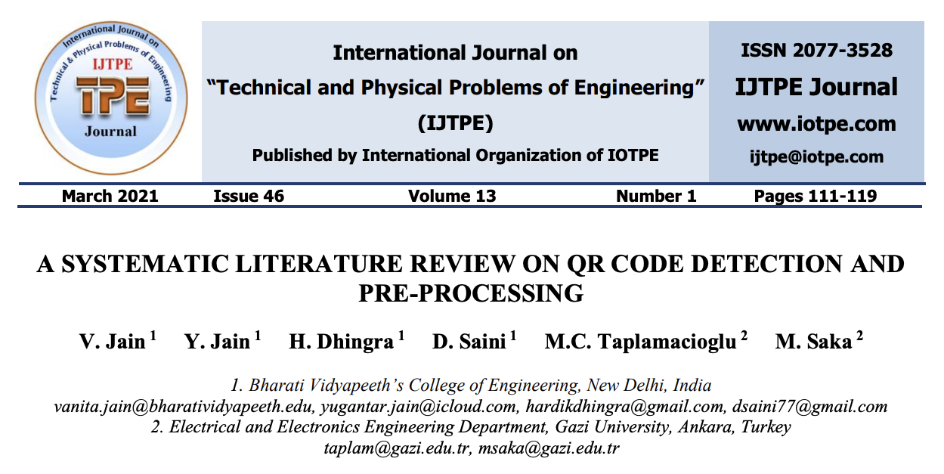

Slide 3
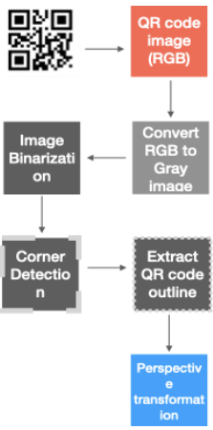
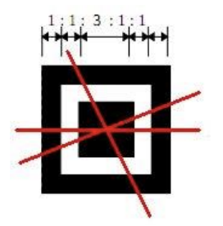

Localization, Pre-processing, and Decoding
Localization
Pre-processing
After detection of a QR code, its image is processed to make it suitable for optimal and accurate decoding. This step is commonly called pre-processing. Due to the real world applications of the QR code, pre-processing becomes vital to not only enhance the accuracy of decoding but also to make it faster and simpler.
Detection and localization of a QR code are essential and the first-step in the workflow of using them and retrieving information.
Notes:
Decoding is the final step where the information/data is retrieved and relies on the main standard architecture of the QR code [2]. The maximum work and innovation has been done for the former two steps, hence, the review shall focus on them with greater focus.

Slide 4
Localization, Pre-processing, and Decoding
Decoding is the final step where the information/data is retrieved and relies on the main standard architecture of the QR code. The maximum work and innovation has been done for the former two steps, hence, the review shall focus on them with greater focus.
Decoding ?
Notes:
Decoding is the final step where the information/data is retrieved and relies on the main standard architecture of the QR code [2]. The maximum work and innovation has been done for the former two steps, hence, the review shall focus on them with greater focus.

Slide 5
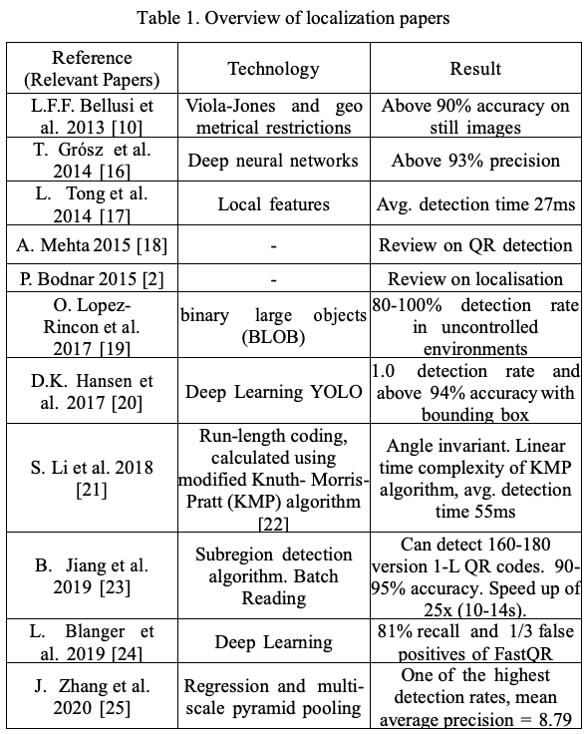
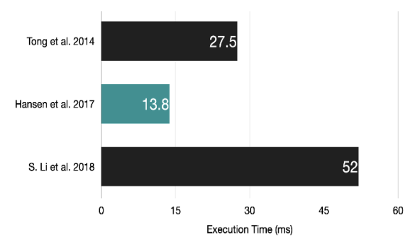

Localization
The figure shows the comparison in execution time of the best performing algorithms for QR code detection
While they give a good estimate, it is observed that they are prone to significantly vary with the dataset and with the computing machine too.

Slide 6
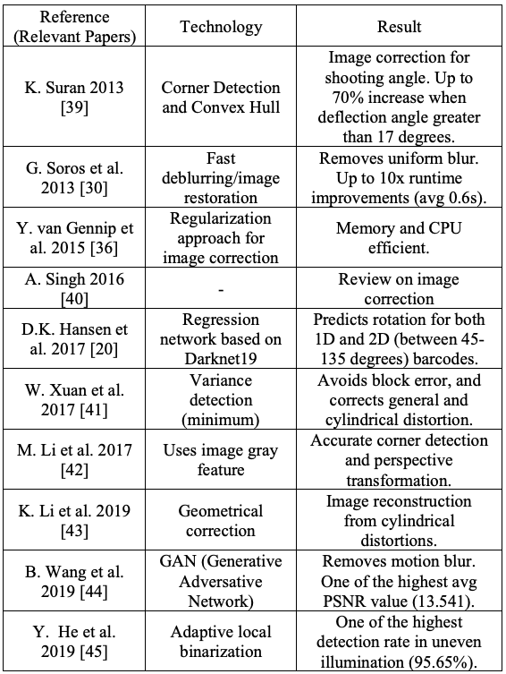
Pre-processing
The results of the algorithm were very promising with up to 10x speedups seen in the process when compared to among more than 8 other algorithms.
The author notes that the algorithm is specially designed for wearables and mobile devices and hence focuses on speed instead of high quality deblurring.

Slide 7
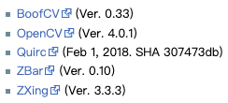
Open Source for QR Code
Open Source for QR code
BoofCV : JAVA
OpenCV : C++
Quirc : C++
Zbar : C++
Zxing : C++

Slide 8
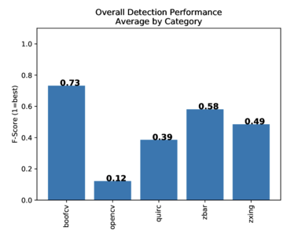
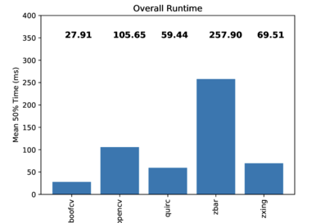
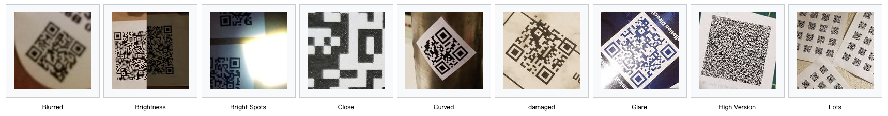
Open Source Performance Comparison

