Slide 1
QR Code Implement
Zxing / OpenCV on Rpi
Speaker : Yi Tse Wu

Slide 2
ZXing

Slide 3

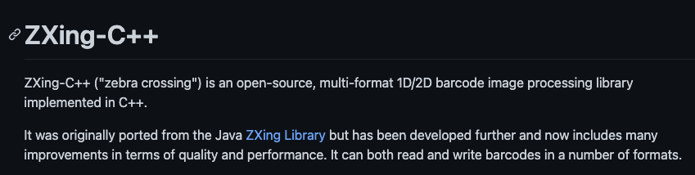
ZXing Installation
https://github.com/nu-book/zxing-cpp

Slide 4
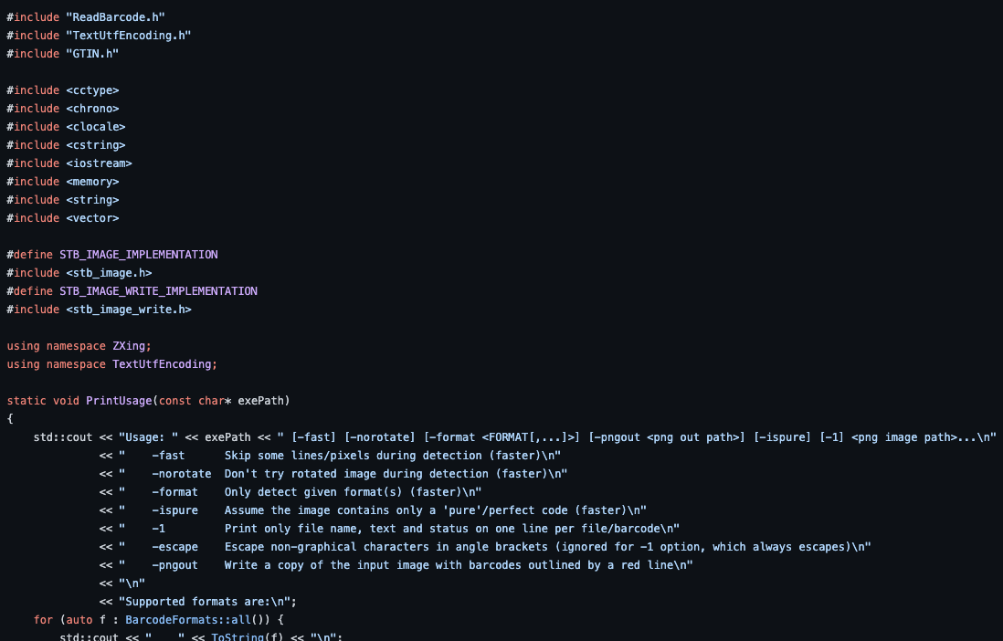
Recognize Three QR Code Images on Pi3
Pixels | Seconds
328*328 | 0.031
1822*1822 | 0.321
2138*2138 | 1.496
https://github.com/nu-book/zxing-cpp/blob/master/example/ZXingReader.cpp

Slide 5
OpenCV

Slide 6
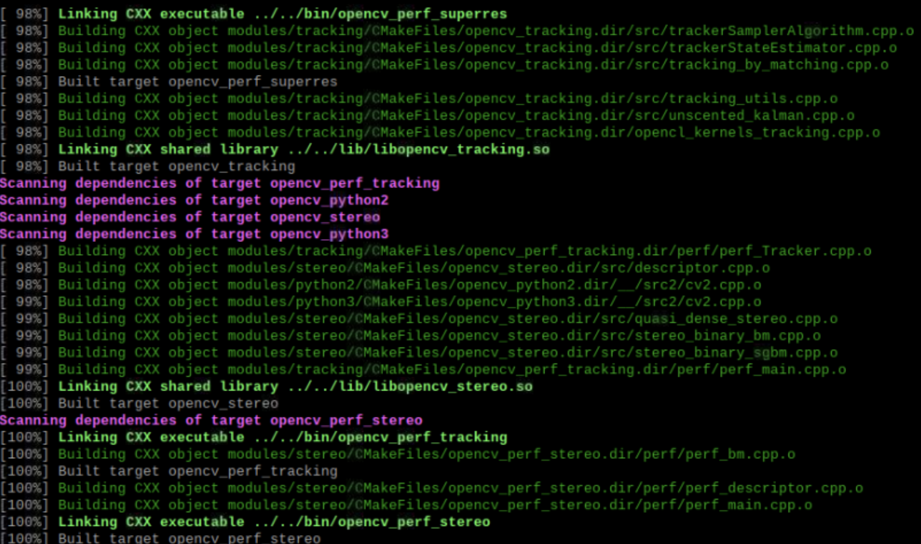
OpenCV Installation
https://www.notion.so/wesleych3n/RPI-Lesson-1-OpenCV-Qt-Creator-dbd22e36e905452b8366f4e3302b3632

Slide 7
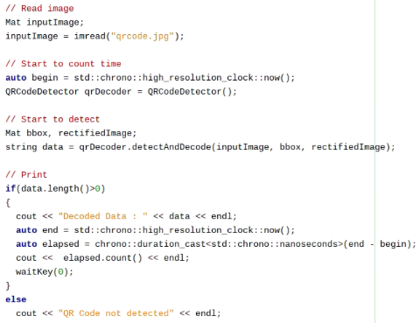
Recognize Three QR Code Images on Pi3
Pixels | Seconds
328*328 | 0.75
1822*1822 | 4.2
2138*2138 | 9.38

Slide 8
Comparasion : OpenCV and ZXing
Pixels | Seconds
328*328 | 0.75
1822*1822 | 4.2
2138*2138 | 9.38
Pixels | Seconds
328*328 | 0.031
1822*1822 | 0.321
2138*2138 | 1.496
OpenCV
ZXing

