Slide 1
QR Code Implement
Zxing Evaluation on Rpi4
Speaker : Yi Tse Wu

Slide 2

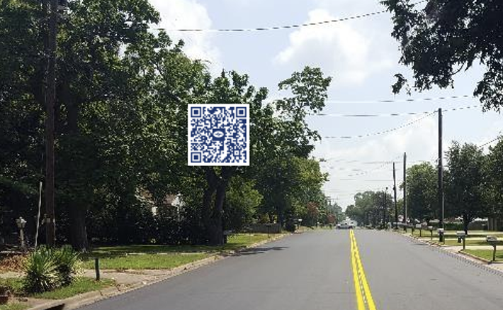

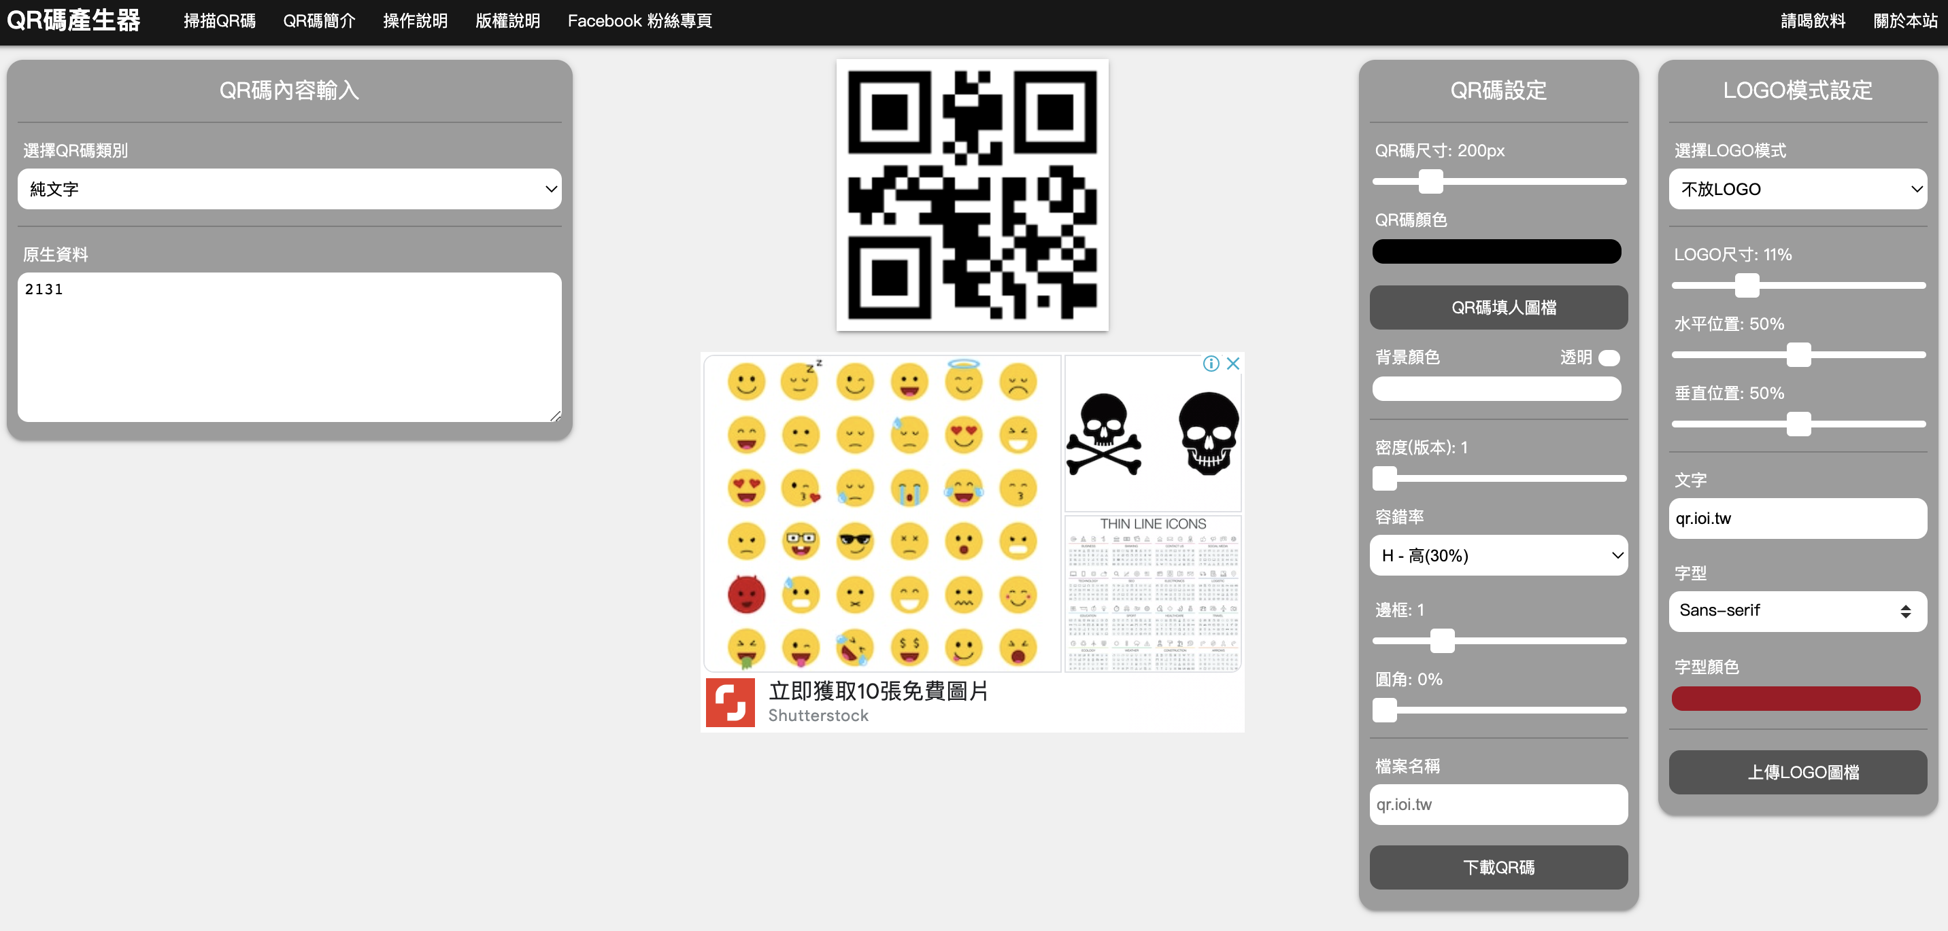
Use Python for Automatic Experiments
Combine_QRCode.py
ZXingReader.cpp
Shrink_QRCode.py
975*549 image combined with a 60*60 QR Code
https://www.kaggle.com/datasets/coledie/qr-codes?resource=download
https://qr.ioi.tw/zh/

Slide 3
Combine

Slide 4
The Combine Test Meets the Shrink Test
Pixels | Successful Recognition Rate | 60*60 | 55*55 | 50*50
328*328 | 84% Not found <= 16% Img Size is 52*52 | Success | Success | Fail
1822*1822 | 97% Not found <= 3% Img Size is 55*55 | Success | Success | Fail
2138*2138 | 99% Not found <= 1% Img Size is 21*21 | Success | Success | Success

Slide 5
Shrink & Version

Slide 6
Sheet
QR Code Version | Version 1 | Version 2 | Version 3 | Version 4
Modules | 21*21 | 25*25 | 29*29 | 33*33
Test 1_Min Resolution | 57*57 | 65*65 | 59*59 | 80*80
Test 2_Min Resolution | 33*33 | 42*42 | 44*44 | 60*60
Test 3_Min Resolution | 36*36 | 42*42 | 40*40 | 60*60

Slide 7
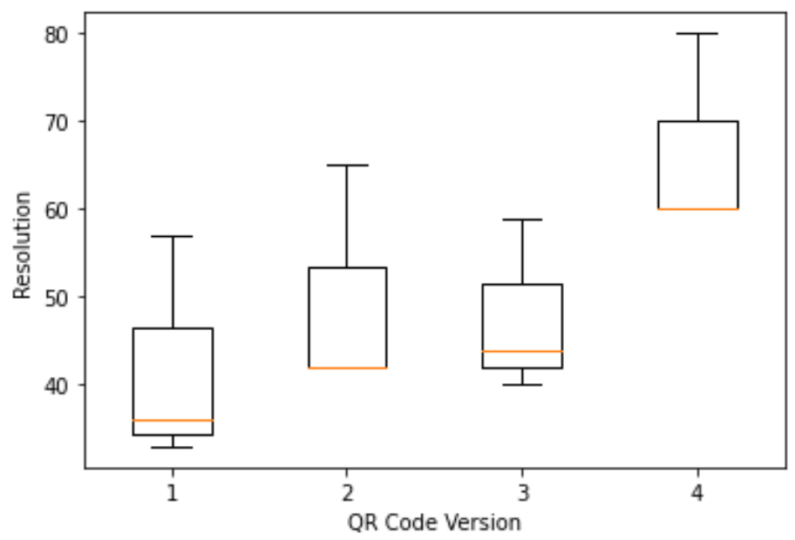
Chart
V1 | V2 | V3 | V4
21*21 | 25*25 | 29*29 | 33*33
57*57 | 65*65 | 59*59 | 80*80
33*33 | 42*42 | 44*44 | 60*60
36*36 | 42*42 | 40*40 | 60*60

