Slide 1
QR Code Implement
Zxing Evaluation on Rpi4
Speaker : Yi Tse Wu

Slide 2
Shrink

Slide 3

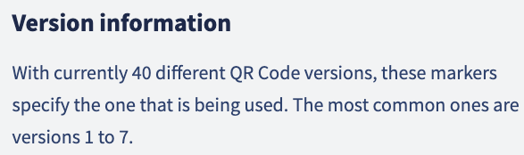
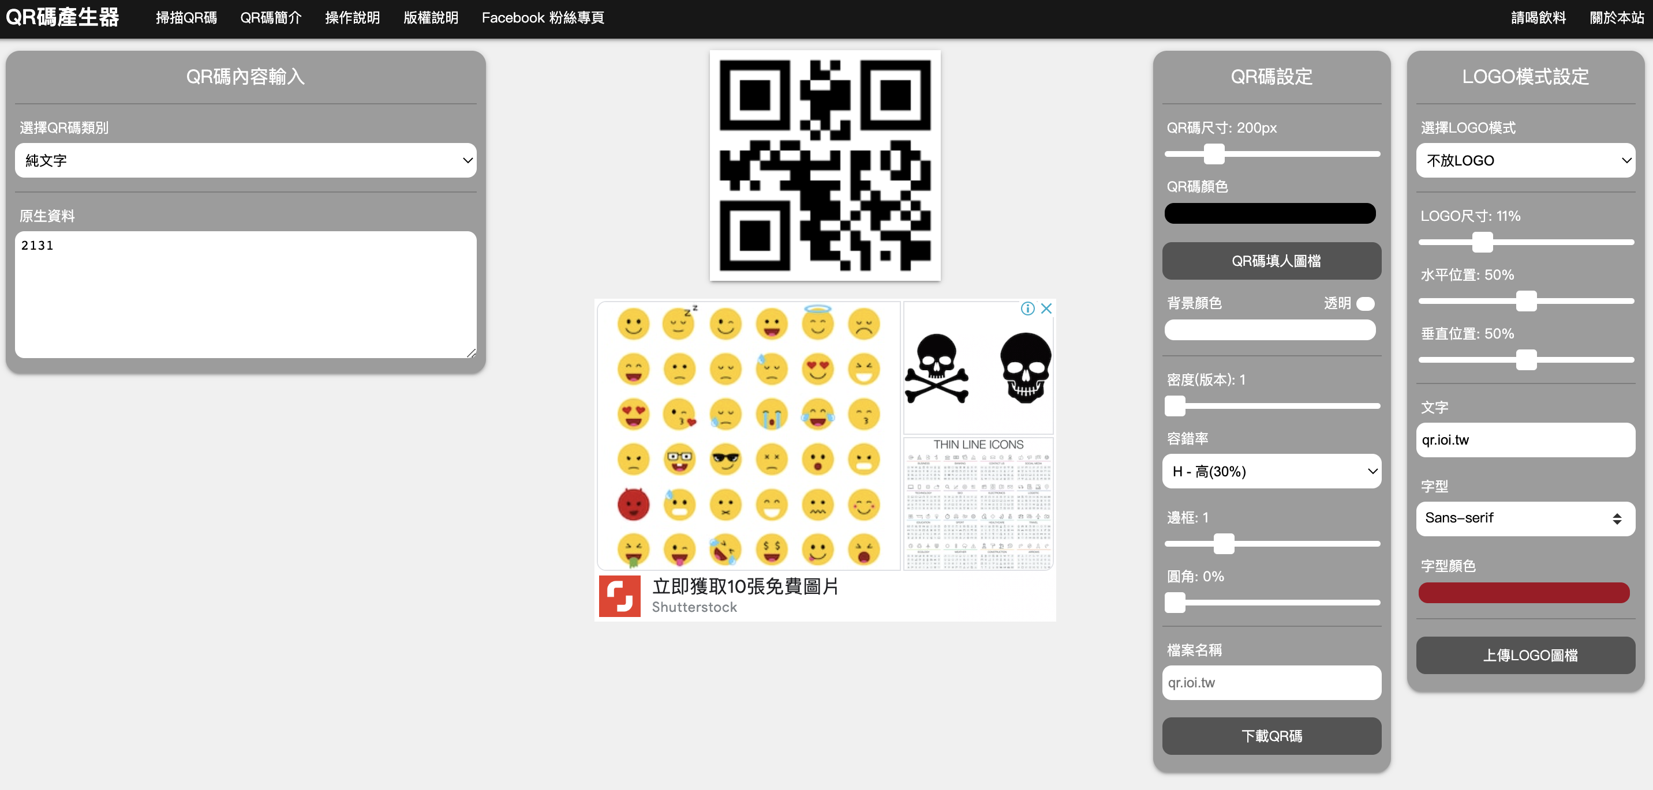
Use Python for Automatic Experiments
Shrink_QRCode.py
ZXingReader.cpp
https://www.qr-code-generator.com/qr-code-marketing/qr-codes-basics/
https://qr.ioi.tw/zh/

Slide 4
Version & Min resolution Table
QR Code Version | Version 1 | Version 2 | Version 3 | Version 4
Modules | 21*21 | 25*25 | 29*29 | 33*33
Min Resolution | 57*57 | 65*65 | 59*59 | 80*80
Min Resolution | 33*33 | 42*42 | 44*44 | 60*60
Min Resolution | 36*36 | 42*42 | 40*40 | 60*60

Slide 5
Version & Min resolution Table
QR Code Version | Version 5 | Version 6 | Version 7
Modules | 37*37 | 41*41 | 45*45
3 Times Resolution | 111*111 | 123*123 | 135*135
Min Resolution (L) | 87*87 | 95*95 | 104*104
Min Resolution (M) | 87*87 | 95*95 | 104*104
Min Resolution (H) | 87*87 | 95*95 | 104*104

Slide 6
ZXingReader.cpp

Slide 7

stb : A Simple and Easy-to-use Image Library
Stb 這個名字取自 Sean T. Barrett
https://github.com/nothings/stb
Github的檔案裡全部都是 .h 類型的檔案，因此安裝十分方便，只要download 以後，在 code 裡面 include .h header 的檔案即可
https://developpaper.com/introduction-of-simple-and-easy-to-use-image-decoding-library-stb_image/

