Slide 1
QR Code Implement
Zxing Code on Raspberry Pi4
Speaker : Yi Tse Wu

Slide 2
Write a Simple QR Code Recognition Program
Notes:
sudo g++ "%f" -o %e `pkg-config --cflags --libs zxing`

Slide 3
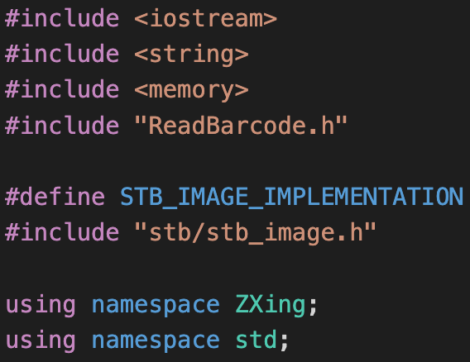
Compiler Setting and Library Included
pkg-config is a helper tool used when compiling applications and libraries. It helps you insert the correct compiler options on the command line so an application can use gcc -o test test.c `pkg-config --libs --cflags glib-2.0` for instance, rather than hard-coding values on where to find glib (or other libraries).
sudo g++ "%f" -o %e `pkg-config --cflags --libs zxing`
Notes:
sudo g++ "%f" -o %e `pkg-config --cflags --libs zxing`

Slide 4
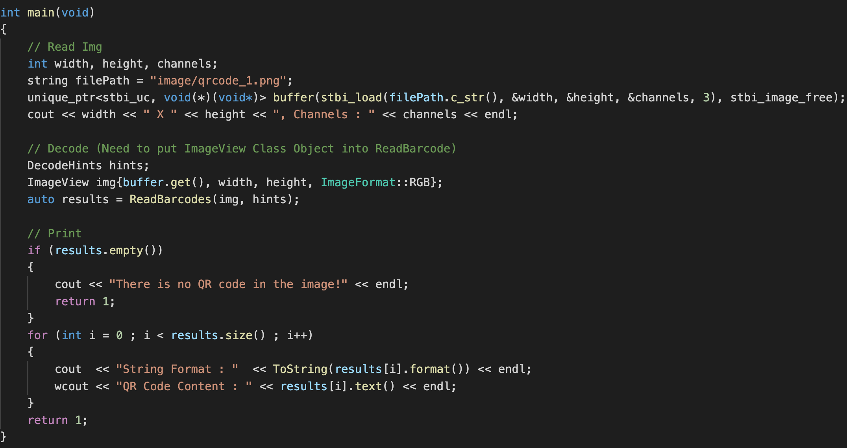
The Main Source Code
226 line -> 37 line (refer to ZXingReader)

Slide 5
Trace Code
Notes:
sudo g++ "%f" -o %e `pkg-config --cflags --libs zxing`

Slide 6
Trace the function, ReadBarcodes()
zxing-cpp/core/src/ReadBarcode.cpp
zxing-cpp/core/src/MultiFormatReader.cpp
BitMatrix.getPatternRow
zxing-cpp/core/src/qrcode/QRDetector.cpp
{
FindLeftGuard
Function : FindFinderPatterns()
LocateConcentricPattern

