Slide 1
QR Code Implement
Zxing Code on Raspberry Pi4
Speaker : Yi Tse Wu

Slide 2
Just QR Code Recognition
Notes:
sudo g++ "%f" -o %e `pkg-config --cflags --libs zxing`

Slide 3
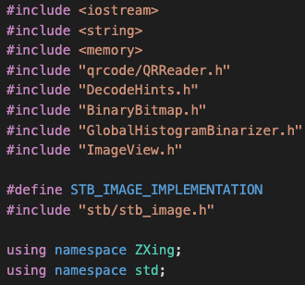
Source Code
stbi_load
ImageView
GlobalHistogramBinarizer
BinaryBitmap
Reader
Notes:
sudo g++ "%f" -o %e `pkg-config --cflags --libs zxing`

Slide 4
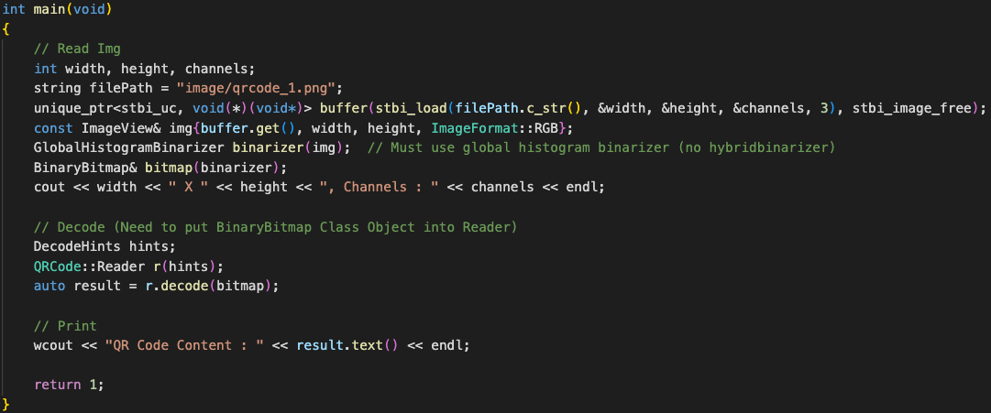
Source Code
Notes:
sudo g++ "%f" -o %e `pkg-config --cflags --libs zxing`

Slide 5
Program Resource Usage
Use Python Library, “tracemalloc” and “time”
Notes:
sudo g++ "%f" -o %e `pkg-config --cflags --libs zxing`

Slide 6
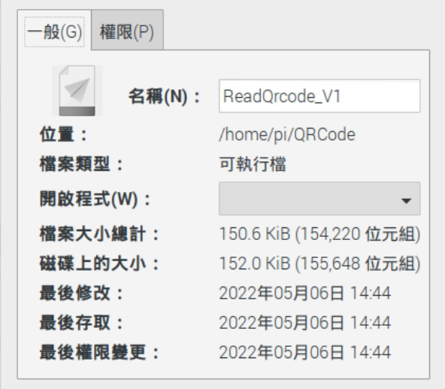
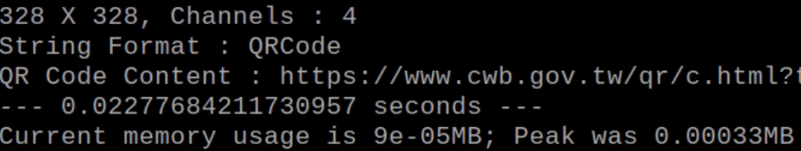
ReadQRCode_V1 Resource Usage
Read a 328*328 QR Code Image,
Consume 0.0228 seconds
Peak Memory Usage is 0.00033MB
Notes:
sudo g++ "%f" -o %e `pkg-config --cflags --libs zxing`

Slide 7
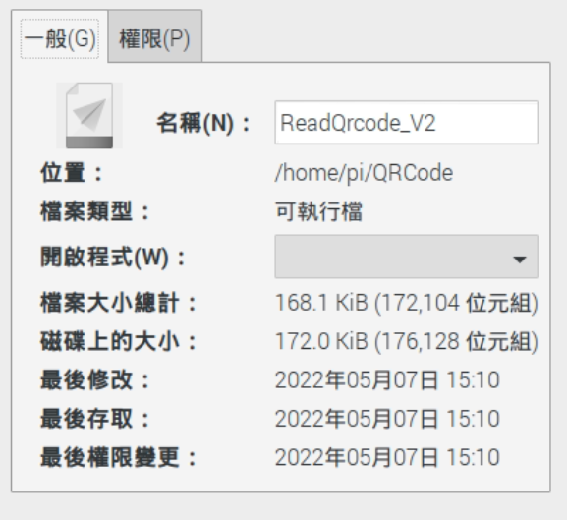

ReadQRCode_V2 Resource Usage
Read a 328*328 QR Code Image,
Consume 0.0179 seconds
Peak Memory Usage is 0.00033MB
Notes:
sudo g++ "%f" -o %e `pkg-config --cflags --libs zxing`

